Slide 1
Project: IEEE P802.15 Working Group for Wireless Personal Area Networks (WPANs)
Submission Title: Affordable OFDM for SUN Networks
Date Submitted: 1 May 2009
Source: Steve Shearer, self
Address: Pleasanton, CA, USA
Voice: (408) 417 1137 , FAX: [], E-Mail: Shearer_inc @ yahoo.com
Re: [802.15.4g] TG4g Call for Proposals, 2 February, 2009
Abstract: This presentation demonstrates that an OFDM system that is properly configured to the application at hand, can lead to a highly efficient, low complexity PHY suitable for Smart Utility Networks. It gives some insight to the simple methods that have been used to create the SUN OFDM PHY proposal that could be implemented on a low cost off-the-shelf microcontroller.
Purpose: Technical Proposal to be discussed by IEEE 802.15 TG4g
Notice: This document has been prepared to assist the IEEE P802.15. It is offered as a basis for discussion and is not binding on the contributing individual(s) or organization(s). The material in this document is subject to change in form and content after further study. The contributor(s) reserve(s) the right to add, amend or withdraw material contained herein.
Release: The contributor acknowledges and accepts that this contribution becomes the property of IEEE and may be made publicly available by P802.15.

Slide 2
Affordable OFDM a low cost multi carrier system for Smart Utility Networks
Steve Shearer
May 2009

Slide 3
Introduction
There are many concerns about the inherent complexity of OFDM systems
  These concerns often arise from analysis of particular OFDM systems that are highly inappropriate for this application
The purpose of this presentation is to demonstrate that an OFDM system, that is properly configured to the application at hand, can lead to a highly efficient, low complexity PHY
  We believe that this proposal can be implemented on an off-the-shelf microcontroller at very low cost
This presentation gives some insight to the simple methods that have been used to create the SUN OFDM PHY proposal
  And shows how this proposal is compatible with the existing standard and some new proposals
We believe that this proposal is elegant in its simplicity, and is worthy of consideration as an option for the new Smart Utility Networks PHY, which will likely become a universally adopted standard

Slide 4
Contents
Proposal meets the requirements of the PAR
Multicarrier systems
  Modulation methods
  Channel coding
  Reference transmitter diagram
Data structure
  Preamble
  PHY Header
  Data payload
Low cost Hardware implementation

Slide 5
Requirements of the PAR
Operation in any of the regionally available license exempt frequency bands, such as 700MHz to 1GHz, and the 2.4 GHz band.
Data rate of at least 40 kbits per second but not more than 1000 kbits per second
Achieve the optimal energy efficient link margin given the environmental conditions encountered in Smart Metering deployments.
Principally outdoor communications
  highly obstructed, high multipath locations with inflexible antenna orientation
  Applications for Wireless Smart Metering Utility Network further intensify the need for maximum range
  Wireless Smart Metering Utility Network requirement of 100% coverage
  ability to provide long-range point-to-point circuits available for meshing
PHY frame sizes up to a minimum of 1500 octets
Simultaneous operation for at least 3 co-located orthogonal networks
Connectivity to at least one thousand direct neighbors characteristic of dense urban deployment

Slide 6
This Proposal meets the PAR
It is applicable to the 700, 800, 900 MHz and 2.4Ghz bands
Supports data rates from 22.5 kbps to 360 kbps
Achieves very good energy efficient link margin
Designed for outdoor environments because it addresses
  Multipath by using long symbol times and a cyclic prefix
  Spatial nulls by using slow frequency hopping
  Fading by employing channel coding for improved packet error performance
  Provides long range where necessary
Supports packet sizes up to 2047 octets with low PER in outdoor environments
Is adjacent channel friendly to allow co-located orthogonal networks
Supports connectivity to multiple neighbors
Complexity is low enough that it could be implemented as a software modem on a number of cheap microcontrollers

Slide 7
Basic Parameters
16 pt FFT
  12 active carriers giving 24 or 12 bits per symbol using DBPSK or pi/4 DQPSK per carrier
  Carrier spacing = 18.75kHz
  Signaling b/w = 243.75kHz
  Channel spacing = 300kHz
FFT rate is 15 k transforms/s
  OFDM Symbol time = 66.66us
  Maximum data rate = 360kbps
  Multipath tolerance > 20us
Slow packet-by-packet frequency hopping to mitigate spatial nulls
Complexity is three orders of magnitude lower than WLAN
Channel Coding derived from ½ rate K=5 convolutional mother code
  Puncturing and frequency diversity
  coding rates from 2/3 through to 1/8
  Soft decision decoding for higher performance
  Minimum data rate is 22.5 kbps
Data Rate (kbps) | Modulation | Code Rate
360 | pi/4 DQPSK | uncoded
240 | pi/4 DQPSK | 2/3
180 | pi/4 DQPSK | 1/2
120 | DBPSK | 2/3
90 | DBPSK | 1/2
45 | DBPSK | 1/4
22.5 | DBPSK | 1/8

Slide 8
Multicarrier Systems
The available bandwidth is split into multiple carriers
  Each carrier is separately modulated
Lengthens the symbol time without reducing the data rate
  Mitigates multipath
  Offers inherent frequency diversity
Many systems use multicarrier methods configured to the application requirements
  UWB 1.5GHz b/w, WLAN 20MHz b/w, … TETRA PMR 25kHz b/w
  Many of these are designed for long battery life
An FFT is a computationally efficient way to generate a multicarrier signal
  Added advantage that the carriers are orthogonal (OFDM)
  Complexity is (O) nlog₂(n)
This proposal uses a 16 point FFT in a b/w of ~250kHz
  So complexity is very low – (O) 64
  Many simple FIR filters require more
  computation than this FFT
  3000 times less complex than UWB
System | # FFT Points | Complexity (O) | Symbol rate | Complexity x Rate | Ratio
UWB | 128 | 896 | 3333333.33 | 2986.67 | 1
SUN | 16 | 64 | 15000 | 0.96 | 3111

Slide 9
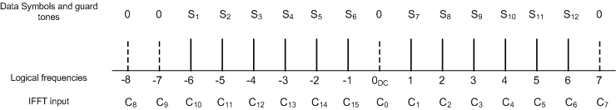
Multicarrier Modulation
This proposal modulates each carrier using differential PSK
The PSK symbols are mapped onto the frequency domain as follows:-
Several frequencies are nulled out
  The nulled DC component helps in the implementation of cheap, zero-IF receivers
  The nulled frequencies at the band edges significantly ease filtering complexity for adjacent channel performance
A 16 point Inverse FFT produces the time domain samples

Slide 10
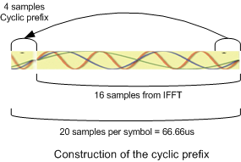
Cyclic Prefix
A cyclic prefix is added by copying some of the last samples of the symbol to the front
  Protects against multipath by making the received signal look like it underwent a circular convolution with the channel impulse response

Slide 11
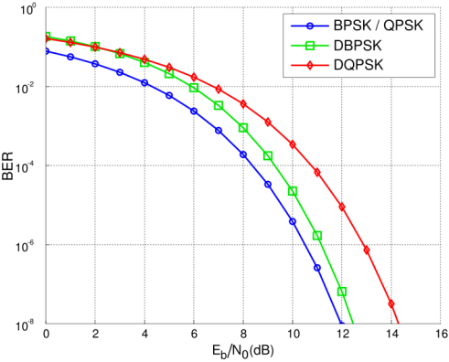
Why Differential PSK?
Packets can be as long as 2047 octets
  Time on the channel at lowest data rate > 0.7 seconds
  Highly probable that the fading rate is higher than 1/0.7 = 1.5Hz – which means that the channel has changed phase by the end of the burst
  Coherent demodulation requires channel tracking and this adds unwanted complexity
No equalizer is required
  Differential PSK is immune to channel phase changes
There is some performance loss when compared to coherent demodulation
  This loss is small – a few dB in AWGN BER
But complexity is very low
  One complex multiply per PSK symbol at 15kHz rate
And there is a subtle advantage...
  The demodulated symbol is weighted by the previous symbol which is effectively a channel estimate
  This means that the result makes an optimal soft decision
  And soft decision Viterbi decoding gains back many dB in Packet Error Rate performance

Slide 12
Channel coding
Packet Error Rate degrades as packet length increases
  In a pseudo static, non dispersive channel, this degradation can be minimal even for uncoded systems
However, any multipath, fading, or interference can have devastating effects on the uncoded PER
Channel coding offers vast improvement, especially for long packets
Paging systems have used BCH or Golay
codes since the 1980’s
  But they have limited performance
Convolutional codes offer significantly
better performance
  And with modern hardware, they are
  easy to implement

Slide 13
Choice of Convolutional Code
Coding Gain generally increases with code constraint length K
  Unfortunately, decoder complexity increases exponentially with constraint length
The SUN application must balance performance with cost
Choose a ½ rate, K=5 code as a
good balance between gain
and complexity
  16 states
  G_{1,2} = [35, 23], D_{free}=7
  Hard decision gain = 2.4dB
  Soft decision gain ~ 4.4dB
Decoder complexity is
4000x lower than WLAN

Slide 14
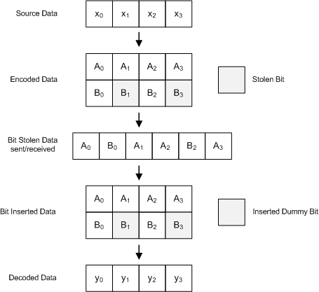
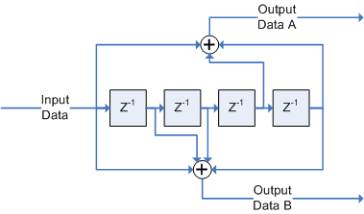
Puncturing for Flexible data rates
Puncturing is a process of removing redundancy to increase the coding rate
  Bits are removed before transmission
  And replaced with dummy bits on reception
This is a well researched area (Hagenauer et al.)
  Used in many systems
Easy to implement using array indexing
operations

Slide 15

Frequency Spreading
Frequency spreading is a method of replicating DPSK symbols on different carriers
  It protects against frequency selective fading
  Enhances SNR performance in AWGN channels
The diagram indicates how the left half of the spectrum is replicated using conjugated versions of the PSK symbols
The subtle advantage of this method is that it enforces Hermitian symmetry and results in a time domain signal that contains only real components
  This can be an advantage in reducing radio complexity for systems that implement only the lower data rates
DPSK symbols can be optimally recombined at the receiver with little computational overhead
  One complex addition per carrier

Slide 16
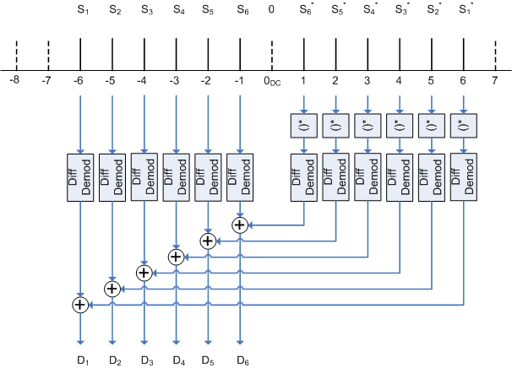
Frequency De-spreading
Frequency de-spreading at the receiver can be accomplished as follows
This method is elegant because
  It achieves channel weighted (maximal ratio) combining
  And is extremely simple

Slide 17
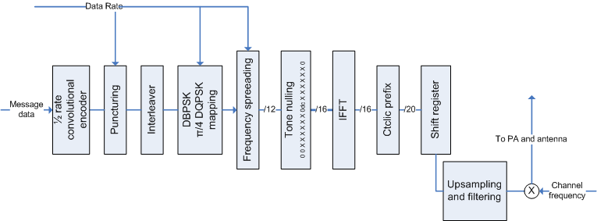
Reference Transmitter Diagram
Summary of transmitter signal processing

Slide 18
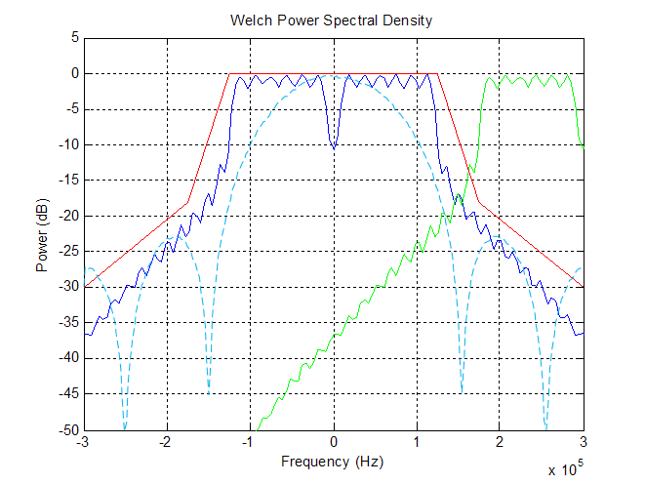
Spectral Properties
Comparison with adjacent channel and 100kbps MSK as references

Slide 19
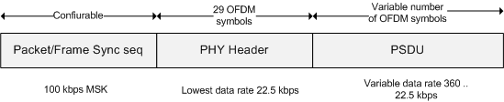
Data Structure
Packets are made up of:-
  Synchronization sequence using 100 kbps MSK
  PHY header coded for robustness
  Variable length data payload coded according to data rate

Slide 20

Frame Synchronization
Preamble uses a 1 0 1 0… sequence
  Used for bit timing and coarse frequency correction
Followed by two inverted Barker words and a non-inverted Barker word
  The first Barker word can be used to wake up the processor
  The second and third are used for fine frequency estimation
Modulation method is 100 kbps PSK

Slide 21

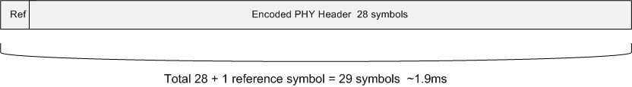
PHY Header
The PHY header contains 6 fields
  Rate field specifies the data rate of the payload frame
  Length specifies the length of the payload
  Scrambling seed
  Message type
  Header Check sequence
    16 bit CRC taken over the data fields only
    Avoids erroneous decoding of payloads and saves power consumption
  Tail bits for Viterbi decoder flushing
Encoded at the lowest data rate for robustness
  One reference symbol pre-pended for DPSK
  Total of 29 symbols

Slide 22

Data Unit (PSDU)
Frame Payload
  8 to 2047 octets
CRC
  32 bit IEEE CRC for error detection
Tail and Pad bits
  Used to clear encoder memory

Slide 23
Implementation
Computation requirements of this proposal are well suited to implementation on a cheap 30MIPS microcontroller
Published data indicates that the 16 pt FFT could complete in 21us
  Approximately 1/3 of the necessary 66us between FFT’s
  The remaining 2/3 of the processor cycles can be used for the remaining modem functions
Many of these microcontrollers also contain ADC’s, DAC’s, and other hardware suitable for this application
  This would enable a single chip baseband/protocol stack implementation
 | Complex FFT points | Processor cycles | Time (us) | Complexity (O) using nlog2n | Ratio of cycles to (O)
Published data | 256 | 19055 | 635 | 2048 | 0.31
 | 128 | 8485 | 282 | 896 | 0.31
 | 64 | 3739 | 124 | 384 | 0.32
estimated for SUN | 16 | 623 | 21 | 64 | 0.33

Slide 24
Conclusions
We have shown how several signal processing concepts can be appropriately scaled to provide a low complexity SUN PHY layer
  Robust differential modulation schemes offering soft decision outputs with low complexity
  Efficient multicarrier generation
  A lightweight channel coding scheme providing high performance and flexible data rates
This proposal offers the following advantages:-
  PAR compliant and cost effective
  Ample ability to overcome multipath, fading , spatial nulls and co-channel interference
  High spectral efficiency, low adjacent channel interference
  Well suited to software modem implementation for fast time-to-market
  Dimensioned to cover both short and long range links
This proposal offers robust performance to the higher layers of the protocol stack and we believe it will offer 100% coverage in a well planned system

