Slide 1
Project: IEEE P802.15 Working Group for Wireless Personal Area Networks (WPANs)
Submission Title: Application Requirements from Asset Tracking and Monitoring
Date Submitted: 29 August, 2008
Source: Wei Hong, Company: Arch Rock Corporation
Address: 501 2nd Street, Suite 410, San Francisco, CA 94707, USA
Voice: 415-692-0828, FAX: 415-278-0441, E-Mail: whong@archrock.com
Re: Application Requirements for 802.15.4e
Abstract: This talk covers the requirements for 802.15.4e from Asset Tracking and Monitoring applications.
Purpose: Application Requirements for 802.15.4e
Notice: This document has been prepared to assist the IEEE P802.15. It is offered as a basis for discussion and is not binding on the contributing individual(s) or organization(s). The material in this document is subject to change in form and content after further study. The contributor(s) reserve(s) the right to add, amend or withdraw material contained herein.
Release: The contributor acknowledges and accepts that this contribution becomes the property of IEEE and may be made publicly available by P802.15.

Slide 2
Requirements from Asset Tracking and Monitoring Applications
Wei Hong, Ph.D.
Arch Rock Corp.

Slide 3
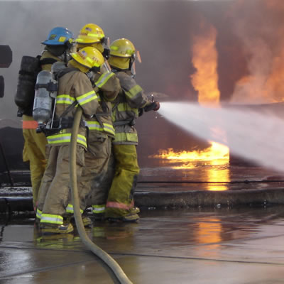
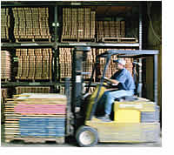
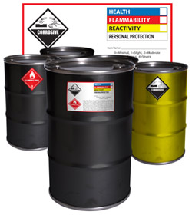
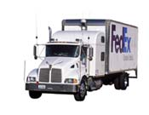
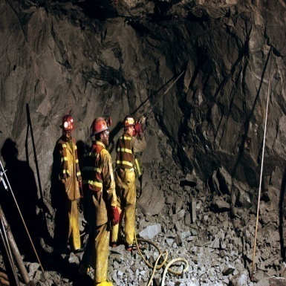
Asset Tracking and Monitoring Examples

Slide 4
Location Tracking v.s. Condition Monitoring
Many location technologies exist
passive/active RFIDs, WiFi tags, UWB, ultra-sound
GPS, AGPS
➔ Out of scope of 15.4e
15.4-based location tracking
15.4 for coarse location by proximity
15.4a for more acurate localization
Condition monitoring
Sensing and logging while asset is in transit
Environmental: temperature, humidity, light, etc.
Shock, tempering, etc.
Location or proximity sensing by GPS or 15.4(a)
Offload data when near infrastructure

Slide 5
Requirements from Asset Tracking and Monitoring
Low-power operations while disconnected from network
Vigilant for network/neighbor discovery
Quick network discovery and join
Rapid offload of bulk data
Congestion control
15.4 as proximity sensor
Node and network mobility

Slide 6
Thanks You
These requirements can be supported by coordinated sampled listening over 15.4 (see proposal).
Questions?

