Slide 1
User Selection for Co-BF/Co-SR based on OBSS RSSI Measurements
Date: 2025-03-13
Authors:

Slide 2
Abstract
Coordinated Spatial Reuse (Co-SR) and Coordinated Beamforming (Co-BF) are defined in 11bn D0.1 to improve medium usage in multi-BSS scenarios.
Not all STAs are suitable for Co-BF/Co-SR transmissions.
Each AP should select the suitable STAs to participate in Co-BF/Co-SR.
The AP does not know which in-BSS/cross-BSS non-AP STA is suitable for Co-BF/Co-SR with another AP.
It is not easy for the AP to measure OBSS RSSI between the AP and cross-BSS STAs, and between its in-BSS STAs and the other Co-BF/Co-SR AP.
Proposal: non-AP STA measures OBSS RSSI from OBSS AP (passive/active)
  Option 1: STA sends OBSS RSSI report to AP, AP selects candidate Co-BF/Co-SR STAs
  Option 2: STA makes decision as candidate Co-BF/Co-SR STA and sends indication to AP

Slide 3
Background
Co-BF and Co-SR are two multi-AP coordination schemes defined in P802.11bn D0.1 to improve medium usage in multi-BSS scenarios [1]
Co-BF: enable concurrent transmissions of two APs with multiple antennas to each AP’s associated STAs while minimizing interference to OBSS STAs by using the CSI of the channels between each AP and the recipient STAs of the other AP of the Co-BF transmission.
Co-SR: enable concurrent transmissions of multiple APs using transmit power control. The Co-SR transmission is initiated by an AP that obtains a TXOP and becomes the sharing AP.
Co-BF and Co-SR need to select the suitable non-AP STAs to maximize performance gains and to minimize interference/overhead/complexity.

Slide 4
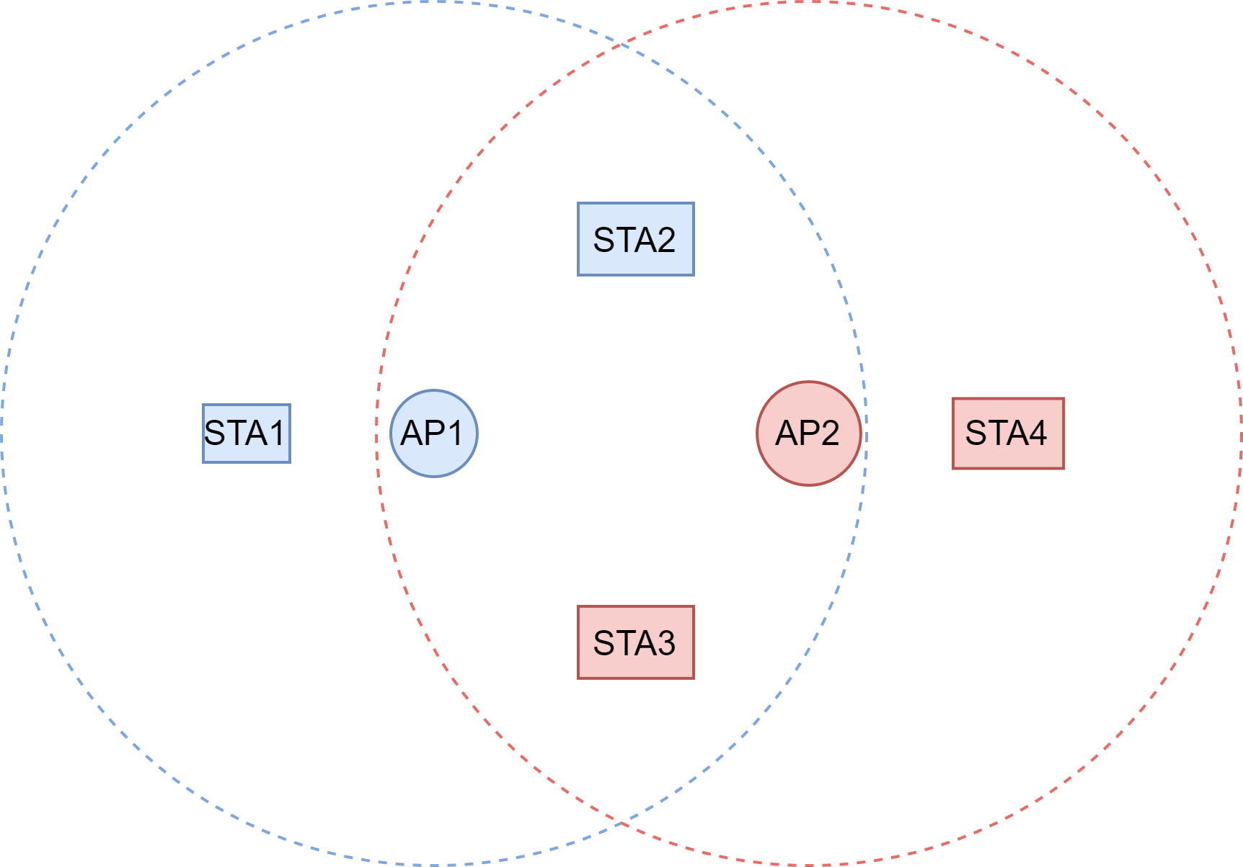
Problem Statement (1/3)
Not all STAs are suitable for Co-BF/Co-SR transmissions.
  AP1 cannot detect/decode the frames from STA4; AP2 cannot detect/decode the frames from STA1
  AP1 may have interference to STA3; AP2 may have interference to STA2
  STA1 cannot hear AP2; STA4 cannot hear AP1
  STA1/STA4: good for Co-SR, bad for Co-BF (if frame detection/decoding between AP and unassociated STAs is needed); STA2/STA3: good for Co-BF, bad for Co-SR

Slide 5
Problem Statement (2/3)
Each AP should select the suitable STAs to participate in Co-BF/Co-SR
For Co-BF:
  Each AP needs to detect/decode OBSS transmissions, e.g., ICF/ICR/MU-BAR/BA/cross-BSS CSI, if frame detection/decoding between AP and unassociated STAs is needed
  Otherwise, OBSS detection/decoding errors, or certain AP is not aware of OBSS failures → higher overhead/complexity and lower performance [backup]
For Co-SR:
  Each AP needs to have proper TX power control/RX sensitivity control to reduce OBSS interference
  Otherwise, low in-BSS signal quality, or high OBSS interference → higher overhead/interference and lower performance

Slide 6
Problem Statement (3/3)
AP1 does not know which in-BSS STA is suitable for Co-BF/Co-SR with AP2
  AP1 does not know the RSSI between its in-BSS STAs and AP2
AP1 does not know which cross-BSS STA is suitable for Co-BF/Co-SR with AP2
  AP1 does not know the RSSI between itself and cross-BSS STAs (unassociated with AP1 but associated with AP2)
Same issues for AP2
To select the suitable STAs for Co-BF/Co-SR, OBSS RSSI measurements can be helpful
It is not easy for AP1/AP2 to measure OBSS RSSI between AP1/AP2 and unassociated STAs
  For in-BSS STAs, hard for the AP to select which in-BSS STAs to measure OBSS RSSI: the AP only knows in-BSS RSSI and no prior information about in-BSS STAs w.r.t. OBSS AP
  For cross-BSS STAs, hard for the AP to probe cross-BSS STAs: limited prior information or stale information about unassociated STAs, e.g., OBSS RSSI from the PASN phase

Slide 7
Proposal: OBSS RSSI Measurements for Co-BF/Co-SR User Selection
Non-AP STA measures OBSS RSSI from the OBSS AP (the other Co-BF AP)
  Passive: non-AP STA measures OBSS RSSI by Beacons from the OBSS AP, low overhead
  Active: non-AP STA sends a request frame to the OBSS AP and measures OBSS RSSI by the response frame. OBSS AP may measure OBSS RSSI by the request frame. Need to avoid frequent/unintended requests. Options for the request/response frame: [backup]
    Probe Request/Probe Response
    RTS/CTS [4]
    NDPA/NDP [5, 6]
The OBSS RSSI measurements can be used for user selection for Co-BF/Co-SR
  Option 1: Non-AP STA reports the OBSS RSSI measurements to its associated AP, and the AP selects the candidate STA for Co-BF/Co-SR (or can be used for other purposes)
  Option 2: Non-AP STA determines its intention to be a candidate Co-BF/Co-SR STA based on the in-BSS/OBSS RSSI measurements and sends the indication to its associated AP.
It can coexist with other criteria/ways for selecting candidate Co-BF/Co-SR STAs.

Slide 8
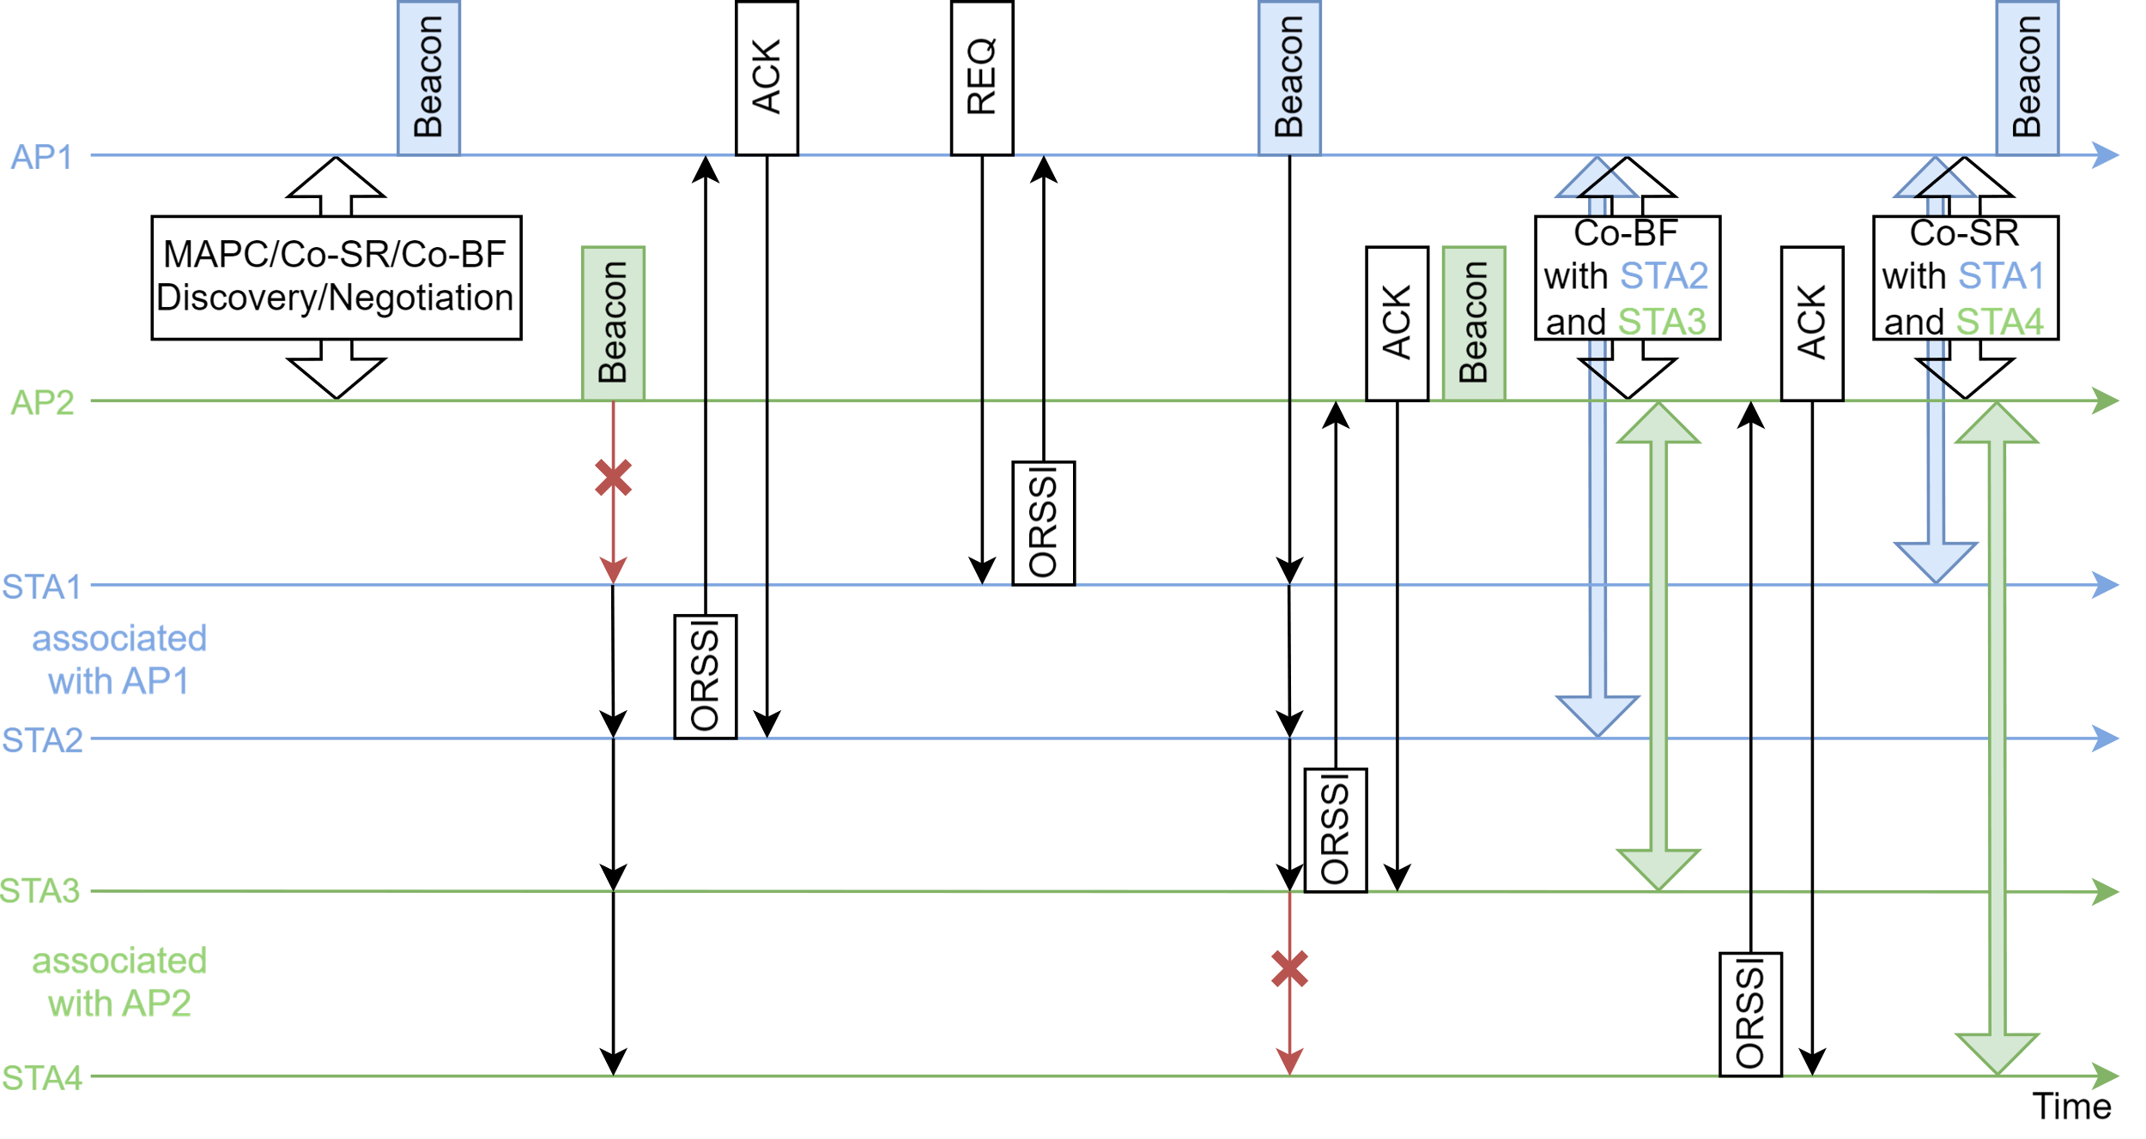
Example: Passive OBSS RSSI Measurements for Co-BF/Co-SR User Selection
AP1 and AP2 have MAPC/Co-SR/Co-BF negotiation.
STAs measure OBSS RSSI by Beacons of AP1/AP2.
STA2 sends OBSS RSSI to AP1; AP1 requests for OBSS RSSI from STA1; similar for STA3 and STA4.
AP1 and AP2 select candidate STAs by in-BSS/OBSS RSSI (and other conditions) and performs sounding and Co-SR/Co-BF transmissions with selected STAs.
STAs only monitor OBSS RSSI of selected APs.
TBD conditions/rules for OBSS RSSI measurement/ report, e.g., frequency, interval, eligible STAs, etc.
TBD signaling for when can’t hear OBSS frames.
Passive/active RSSI measurements may overlap with other phases like sounding and data transmission.

Slide 9
Conclusion
This submission presents a proposal for user selection for Co-BF/Co-SR based on OBSS RSSI measurements
  Step 1: Non-AP STA measures OBSS RSSI from OBSS AP (passive/active)
  Step 2: Option 1: STA sends OBSS RSSI report to AP; Option 2: STA makes decision as candidate Co-BF/Co-SR STA and sends indication to AP
  Step 3: AP selects candidate Co-BF/Co-SR STAs
  AP/STA may have rules for how/when OBSS RSSI can be measured, e.g., which non-AP STA, measurement frequency/interval, etc., especially for active probing with OBSS AP
It helps UHR APs select the suitable non-AP STAs to participate in Co-BF/Co-SR, reduce interference/overhead/complexity, and improve performance gains

Slide 10
References
[1] IEEE P802.11bn/D0.1, January 2025
[2] 802.11-25/0412r3, CoBF Frame Sequences and Signaling Details, Sherief Helwa (Qualcomm)
[3] 802.11-25/0247r1, M-AP CoBF Sounding Sequence, Arik Klein (Huawei)
[4] 802.11-24/1879r0, Proposals for Expeditious Discovery of APs for Initial Association and Roaming, Neel Krishnan (Apple Inc)
[5] 802.11-24/2122r0, Fast RSSI Measurement Follow-up, Guogang Huang (Huawei)
[6] 802.11-24/1414r2, Channel Measurement Based on Control Frame Exchange, Guogang Huang (Huawei)

Slide 11
Straw Polls
SP1: Do you agree to include the following into the TGbn SFD?
A non-AP UHR STA may perform cross-BSS RSSI measurements with unassociated UHR Co-BF AP(s) in TBD conditions by Beacons, Probe Response or other TBD frames. The non-AP STA may report the OBSS RSSI measurements to its associated AP to help the AP select candidate Co-BF/Co-SR STAs.
Results: Y, N, A

Slide 12
Backup

Slide 13
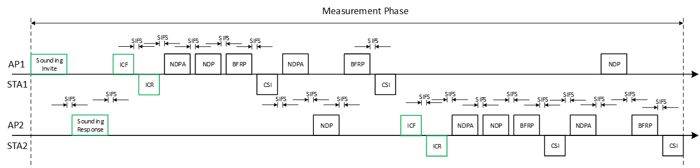
Recap: Co-BF Sounding and Transmission Sequence
AP2 needs to detect/decode the frames, e.g., ICR, CSI, BA, from STA1
STA1 needs to detect/decode the frames, e.g., NDP, from AP2
AP1 needs to detect/decode the frames, e.g., ICR, CSI, from STA2
STA2 needs to detect/decode the frames, e.g., NDP, from AP1
Co-BF APs/STAs need to avoid frame failures or add extra frames to address potential issues, e.g., MU-RTS and TXOP return [3]
Co-BF Measurement Phase and Transmission Phase [2] 802.11-25/0412r3
[back]

Slide 14
Recap: RSSI Measurement of Neighboring APs
There are proposals for link measurement of neighbor APs for seamless roaming [4, 5, 6]
  Use Control frame to reduce delay, compared to Beacon/Probe Response
RTS/CTS: [24/1879r2, 24/2118r1]
  Low overhead (~100 microseconds), similar RSSI accuracy as beacon/probe response
  24/2118 proposes to let AP advertise the transmit power used to transmit beacon and probe response
NDPA/NDP: [24/2122r0, 24/1414r2]
  Can include timestamp and TX power information
  Can add more LTF
  Similar procedure defined in 11bf
  More frame exchanges and higher overhead than RTS/CTS; need security/privacy setup
Both options need to avoid frequent/unintended requests from unassociated STAs
[back]

Slide 15
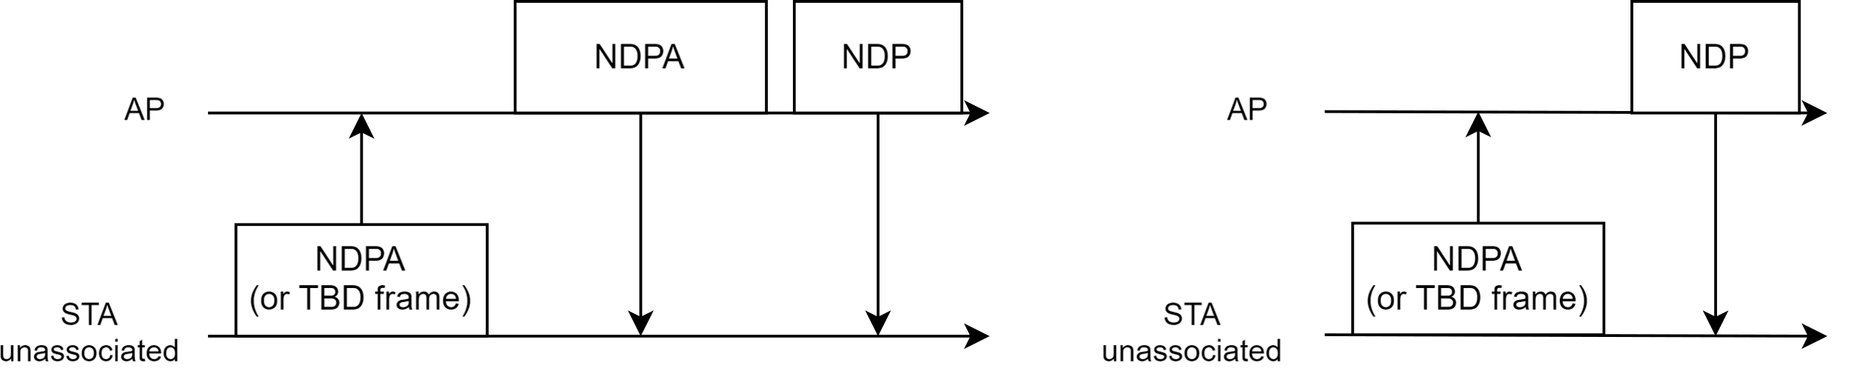
Non-TB Sounding Initiated from Non-AP STA
Non-TB sounding (designed for DL OBSS RSSI measurement for seamless roaming [5, 6]) can be reused for Co-SR/Co-BF purposes, e.g.,
Non-AP STA (unassociated) sends NDPA (or TBD frame) to the OBSS AP
The OBSS AP sends NDP to the non-AP STA (OBSS AP may also send NDPA before NDP)
Non-AP STA measures DL OBSS RSSI by the NDP from the OBSS AP
Some other options:
  Non-AP STA estimates CSI by the NDP from AP
  Non-AP STA sends cross-BSS CSI feedback to AP
  Non-AP STA estimates UL OBSS RSSI; OBSS AP measures UL OBSS RSSI
[back]

Slide 16
Non-TB Sounding Initiated from Non-AP STA
It can be used in different scenarios/phases for Co-BF/Co-SR
During the preparation phase
  Any OBSS interference between AP and unassociated STAs would introduce lower performance for Co-BF/Co-SR
  Any failure, especially between AP and unassociated STAs, would introduce extra overhead/complexity for Co-BF
  It is necessary to have a preparation phase to select the suitable STAs to avoid potential failure/interference
  The preparation phase, with initial RSSI measurement or lightweight sounding between AP and unassociated STAs, can help select the suitable STAs and avoid extra overhead/complexity/interference
  It is hard for AP to initiate/request in-BSS STAs (associated) or cross-BSS STAs (unassociated) for OBSS RSSI
During the sounding phase for Co-BF
  In-BSS sounding and cross-BSS sounding can be in different TXOPs
  In-BSS/cross-BSS CSI can be valid across multiple TXOPs, for example ~20ms
  Non-AP STA may obtain the TXOP before the AP. In this case, the non-AP STA may initiate non-TB sounding
  If CSI feedback during the preparation phase is still valid, non-AP STA may send it to AP during sounding phase
  Need to avoid frequent/unintended requests from unassociated STAs; need to address duplicated sounding for active probing (both AP and non-AP STA may initiate the sounding procedure)
[back]

