Slide 1
R-TWT operation with NPCA
May 2025
Date: 2025-04-11
Authors:

Slide 2
Background
In TGbn, there were discussions for non-primary channel access(NPCA) operation
In current NPCA operation, an ongoing R-TWT SP in an NPCA primary channel is not considered
For proper R-TWT SP operation, the R-TWT SP operation should be considered in the NPCA Primary channel
This contribution discusses how to manage R-TWT SP in the NPCA Primary Channel

Slide 3
Background: NPCA Operation
When Primary channel is known to be busy due to an OBSS’s TXOP, an AP and STAs associated with the AP can switch its operating channel to NPCA primary channel
In NPCA Primary channel, the AP and the STAs can perform communication during the OBSS’s TXOP.

Slide 4
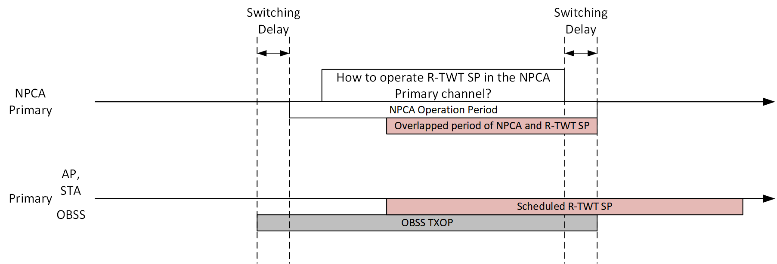
R-TWT SP in the NPCA Primary Channel
While an R-TWT SP is scheduled, an OBSS may occupy primary channel.
The current 11bn draft does not cover this case
In other words, How the R-TWT operation is performed in the NPCA Primary channel is not defined

Slide 5
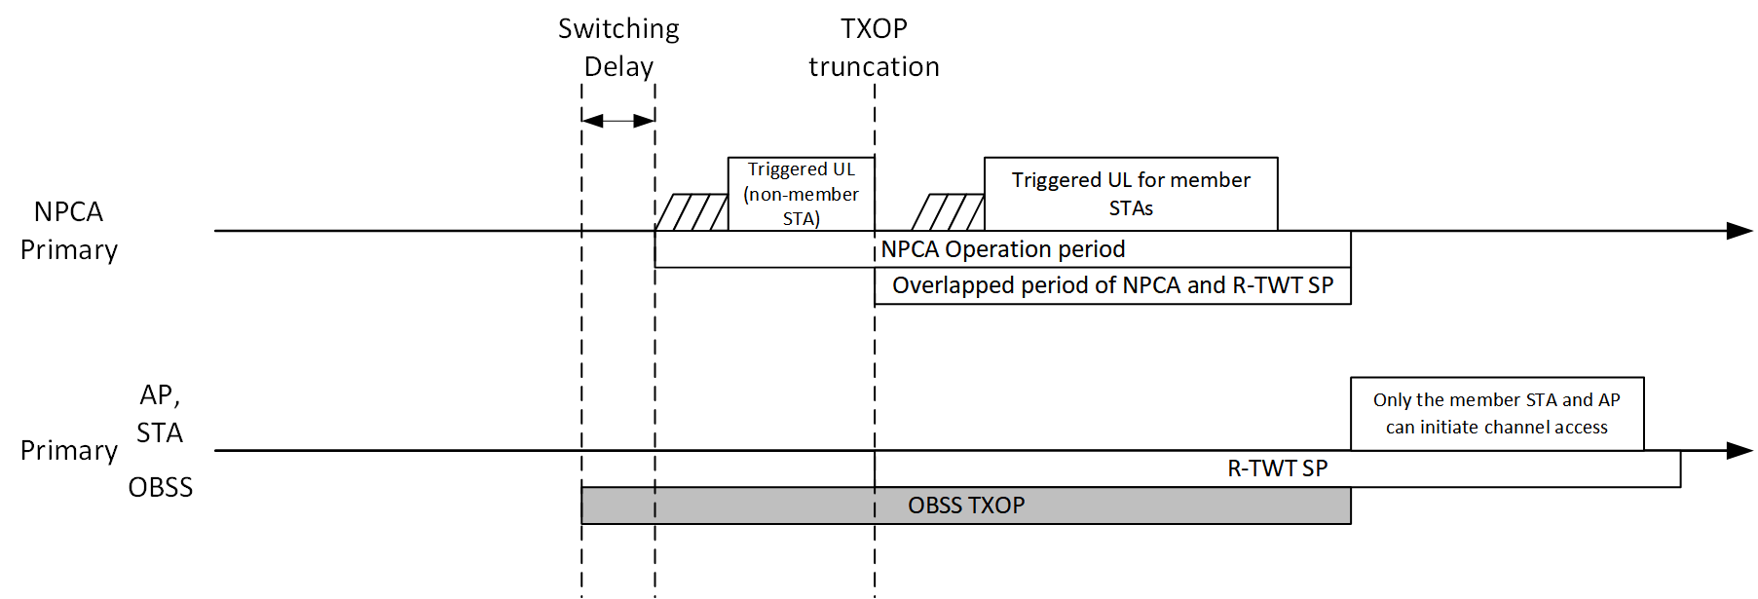
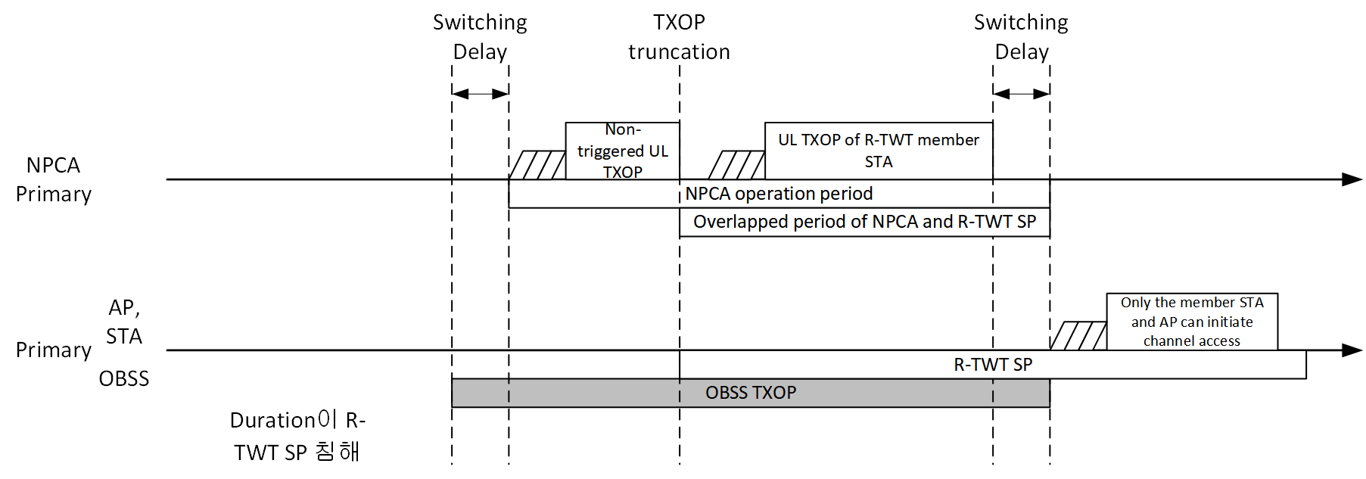
Two Possible approaches: Respect ongoing R-TWT SP or Delay R-TWT SP
1. If the R-TWT SP is respected in the NPCA Primary channel, TXOP of STAs shall be truncated in the NPCA Primary channel before the start time of R-TWT SP.
When the R-TWT SP is remaining in the primary channel when the NPCA operation ends, only the R-TWT SP member STAs and AP can initiate channel access
When untriggered UL is disallowed in the NPCA Primary channel, the AP can exchange UL frame with the R-TWT member STAs after the R-TWT SP is started.

Slide 6
Two Possible approaches: Respect ongoing R-TWT SP or Delay R-TWT SP
2. If the R-TWT SP is delayed, the R-TWT SP can be started in the primary channel when the NPCA operation ends
In this case, only the R-TWT SP member STAs and AP can initiate channel access

Slide 7
Conclusion
This submission explained R-TWT operation with NPCA
This submission proposes two approaches for R-TWT operation in the NPCA Primary channel
1. Respect R-TWT SP in the NPCA Primary channel
2. Delay R-TWT SP after the NPCA operation
With this submission, the low latency operation can be performed without problems

