Slide 1
802.15 Liaison Report – March 2025
Date: 2025-03-13
Authors:

Slide 2
Abstract
Overview of current activities in WG15.

Slide 3
Working Group 15 November Agenda
Agenda:
https://mentor.ieee.org/802.15/dcn/25/15-25-0077-04-0000-march-2025-802-15-agenda.xlsx
WG opening report:
https://mentor.ieee.org/802.15/dcn/25/15-25-0078-04-0000-march-2025-802-15-opening-report.pptx

Slide 4
Subgroup Closing Reports
Title | URL
TG15.6ma Closing Report for March 2025 | https://mentor.ieee.org/802.15/dcn/25/15-25-0151-01-006a-tg15-6ma-closing-report-for-march-2025.pptx
SCM Agenda, Opening and Closing Report March 2025 | https://mentor.ieee.org/802.15/dcn/25/15-25-0120-01-0mag-scm-agenda-opening-and-closing-report-march-2025.pptx
TG4ab Closing Report | https://mentor.ieee.org/802.15/dcn/25/15-25-0165-00-04ab-tg4ab-closing-report.pptx
TG4ac March Opening and Closing Report | https://mentor.ieee.org/802.15/dcn/25/15-25-0118-02-04ac-march-opening-and-closing.pptx
IEEE 802.15 IG NG-OWC Closing Report (March 2025) | https://mentor.ieee.org/802.15/dcn/25/15-25-0164-00-07ma-ieee-802-15-ig-ng-owc-closing-report-march-2025.pptx
TG15.6ma Closing Report for March 2025 | https://mentor.ieee.org/802.15/dcn/25/15-25-0151-00-006a-tg15-6ma-closing-report-for-march-2025.pptx
IG agenda opening and closing report and Minutes | https://mentor.ieee.org/802.15/dcn/25/15-25-0141-00-acss-ig-agenda-opening-and-closing-report-and-minutes.pptx
SCM Agenda, Opening and Closing Report March 2025 | https://mentor.ieee.org/802.15/dcn/25/15-25-0120-00-0mag-scm-agenda-opening-and-closing-report-march-2025.pptx
TG4ad Agenda, Opening and Closing Report March 2025 | https://mentor.ieee.org/802.15/dcn/25/15-25-0116-01-04ad-tg4ad-agenda-opening-and-closing-report-march-2025.pptx

Slide 5
802.15 Overview
Wireless Specialty Networks Active standards:
802.15.3 - no active projects but a bunch of really cool stuff
802.15.4 - many current projects (see next slide)
802.15.6a Body Area Networks: WG ballot recirculations
802.15.7a Higher Rate, Longer Range Optical, in publication
802.15.9a KMP Transport, extensions to key management: Working group ballot
802.16t Extension to 802.16 for specific bands: Submitted to REVCOM (pending)
Interest Group Access: Several technical concepts to be developed into potential new projects
SC THz: discussing future THz communications with Terabit/second data rates

Slide 6
802.15.4 Projects
802.15.4ab Next Generation UWB: First WG recirculation
802.15.4ac Enhanced Privacy: Initial WG ballot
802.15.4ad Next Generation SUN PHYs: Pre-draft, technical contributions and proposals
802.15.4ae ASCON light weight encryption extension for 802.15.4: draft in progress

Slide 7
802.15.4ab Next generation UWB: Amendment to IEEE Std 802.15.4-2024 (rev E)
Recirculation ballot in progress
Closing report: https://mentor.ieee.org/802.15/dcn/25/15-25-0165-00-04ab-tg4ab-closing-report.pptx
 | Current Schedule
First recirculation | March 2025
Recirculation comment resolution | March-May 2025
Second recirculation | May 2025
Recirculation comment resolution | June-July 2025
First SA-Ballot | After July 2025…
SA-Ballot comment resolution | After that

Slide 8
802.15.4ac Enhanced Privacy
This amendment specifies modifications to the IEEE Std 802.15.4 medium access control (MAC) specification to specify mechanisms that address and improve user privacy. These mechanisms include randomized addresses, and exchanges that support session continuity. This amendment maintains backward compatibility with the base standard.
State: WG Recirculation
Opening and closing report: https://mentor.ieee.org/802.15/dcn/25/15-25-0118-02-04ac-march-opening-and-closing.pptx

Slide 9
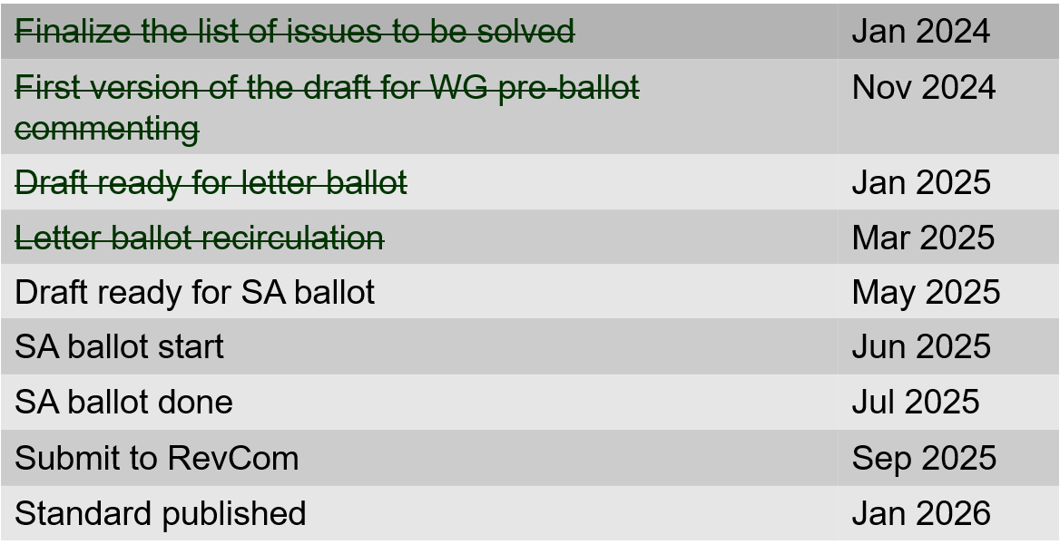
802.15.4ac Enhanced Privacy Timeline

Slide 10
802.15.4ad Next Generation SUN PHYs
Developing enhancements to the 802.15.4 SUN PHYs (FSK, OFDM)
State: pre-draft development
Meeting goals:
Considering technical contributions
Objectives completed
Closing report: https://mentor.ieee.org/802.15/dcn/25/15-25-0116-01-04ad-tg4ad-agenda-opening-and-closing-report-march-2025.pptx

Slide 11
802.15.4ad Timeline
2024
November: Approve Technical Guidance Document
Issue call for proposals (next week)
2025
January: Hear initial proposals
March: Hear updated proposals
March to May – 2 conference calls
simulation results of remaining proposals not yet provided
Prepare table of proposals for analysing against technical guidance document
May: Hear final proposals
July and beyond: Merging and start drafting the standard

Slide 12
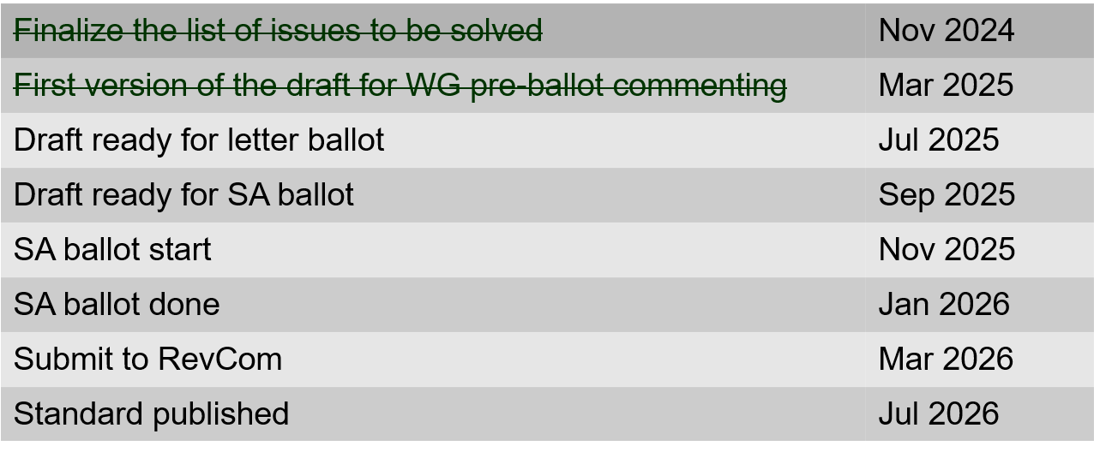
802.15.4ae (ASCON) ASCON light weight encryption extension for 802.15.4
Meeting achievements
Reviewed comments NIST received
Created draft ready for letter ballot
Created test vectors
Start pre-letter ballot comment collection after this session
Closing report: https://mentor.ieee.org/802.15/dcn/25/15-25-0119-01-04ae-march-opening-and-closing.pptx

Slide 13
802.15.6ma
Draft in WG ballot
Session objectives: Preparation for 2nd Recirculation
Closing report: https://mentor.ieee.org/802.15/dcn/25/15-25-0151-01-006a-tg15-6ma-closing-report-for-march-2025.pptx

Slide 14
TG 6ma Timeline(expected)
Tech Req Doc July 2022
Presentation of proposals
May 2023
Comment Resolutionfor LB
Nov. 2024
Comment Resolutionfor LB2
Jan. 2025
EC approval to SA, SA submission
March 2025
SA recirculation
May 2025
WG PreBallot submission for Draft2.5 August 2024
SA recirculation if required
July 2025
Revcom Approve
Sept 2025
^{Draft V1,18 Com}
May. 2024
Recirculation (LB2)
Dec. 2024
RevcomSubmission
August 2025
Comment Resolution fo Draft v2.3 on WG for PreBallot July 2024
1st Letter Ballot(LB)
Sept. 2024
Conditional approval for Standard Association Ballot (SA)
February 2025
TRD,CMD
Call Proposals Sept 2022
Std. Draf V1.9 Proposals
Nov. 2023
Notes: SASB/RevCom scheduled for 2024 a guess

Slide 15
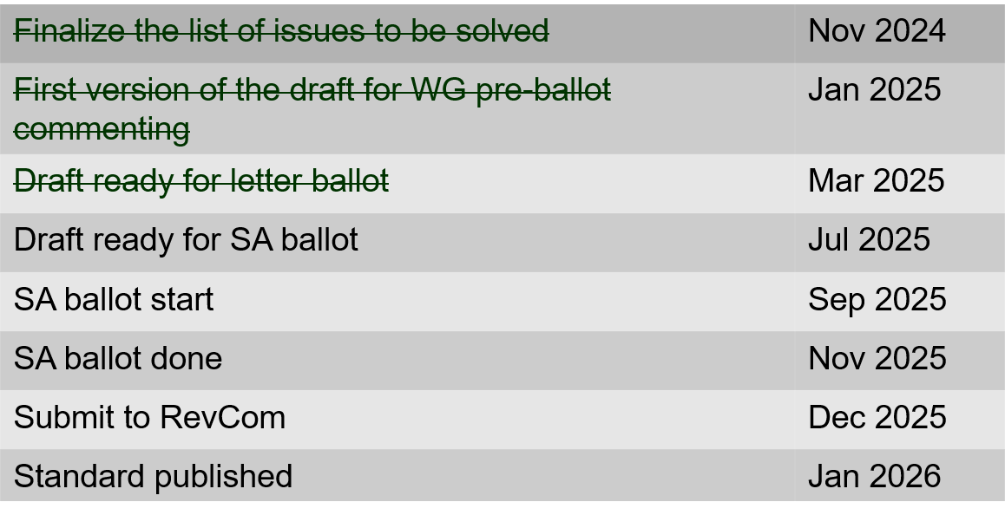
802.15.9a KMP Transport
Extensions to key management: extending to support EDHOC
State: draft development
Session objectives
Complete pre-ballot comment resolution
Initiate WG ballot
Opening and closing report: https://mentor.ieee.org/802.15/dcn/25/15-25-0117-02-009a-march-opening-and-closing.pptx

Slide 16
IG Access
Contributions on modified channel access building on suspendable CSMA-CA
Contribution on spectrum efficient group associate
Plan for May:
Move forward with possible MAC enhancement project (802.15.4)

Slide 17
Licensed Narrowband Amendment TG16t
Pre-submitted for REVCOM
Pending LMSC approval (14-March)

