Slide 1
ICF and response frame design for Co-TDMA
Date: 2025-02-28
Authors:

Slide 2
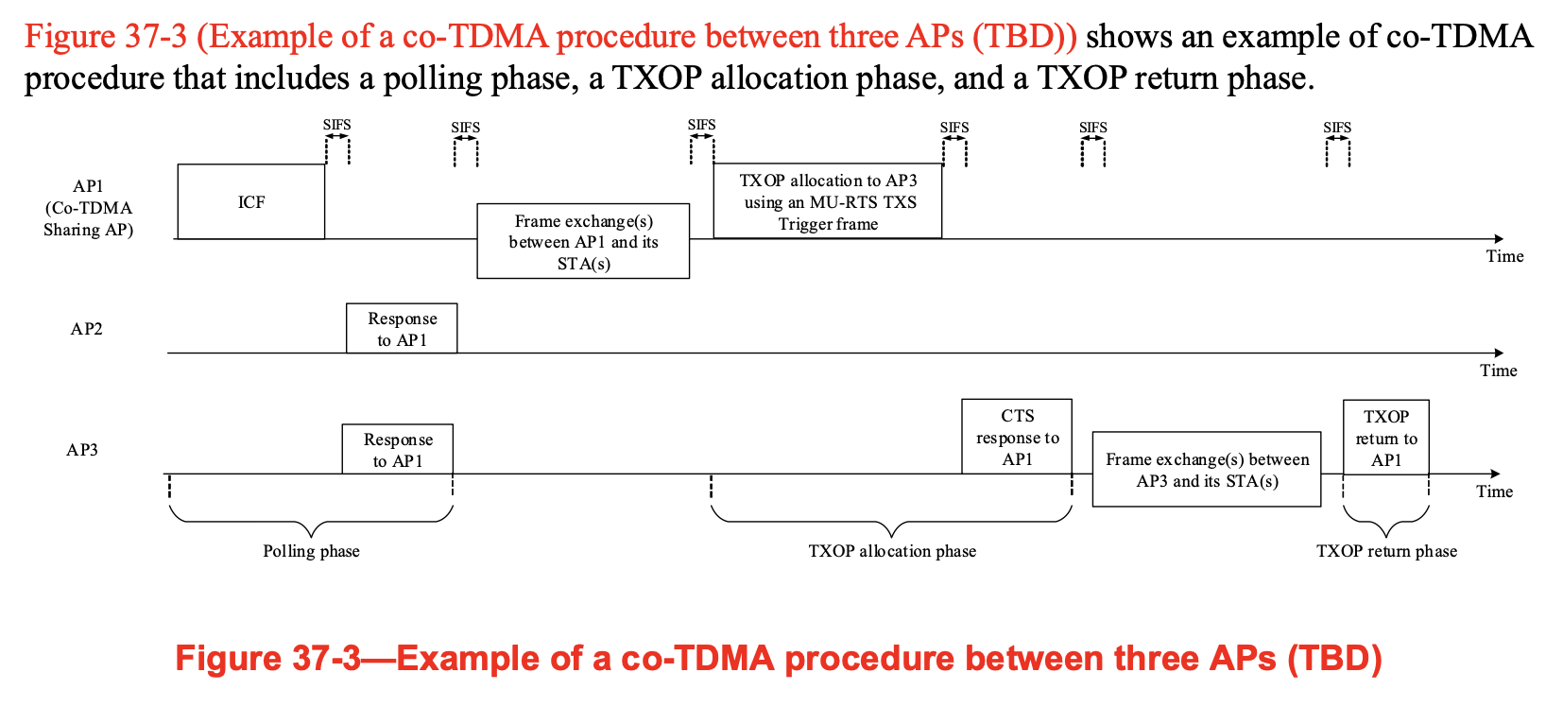
Introduction
This contribution proposes information fields for the ICF and the response frame in co-TDMA.

Slide 3
Co-TDMA ICF and response frame
Details of the Co-TDMA ICF and Response frame have not been defined
BSRP frame has been selected as ICF to poll polled AP
Current BSRP does not include a way to signal common information to the polled APs
ICF needs to indicate at least the minimum AC for which the TXOP has been obtained and the AP intends to share the TXOP (3 bits):
the shared portion of the TXOP shall be used by a Co-TDMA shared AP(s) only for traffic that belongs to the same or higher priority ACs as the AC of the obtained TXOP.
It would also be useful to indicate the duration for which the TXOP has been obtained to allow the polled AP to make a better decision how to respond to the ICF with a sharing request
TXOP period can be in steps of 16us/100us (10/7 bits)
Information can be included in a Special User Info field of the ICF, identified by a special AID value greater than 2007 (i.e., specific to C-TDMA)

Slide 4
Co-TDMA ICF and response frame
Response frame sent by polled AP is Multi-STA BA
Multi-STA BA information elements: AP ID (12 bits), Request TXOP flag (1 bit) –
if Request TXOP flag is 1: it would also be useful to indicate further information such as the requested shared TXOP duration for example in steps of 16/100us (10/7 bits)
if Request TXOP flag is 0 because polled AP does not have any traffic with eligible AC or does not request the TXOP for another reason;

Slide 5
SP 1 + 2
Do agree that the Co-CTDMA ICF shall include the TXOP duration and the AC for which a TXOP was obtained by a Co-TDMA sharing AP ?
the shared portion of the TXOP shall be used by a Co-TDMA shared AP(s) only for traffic that belongs to the same or higher priority ACs as the AC of the obtained TXOP.
Y/N/Abstain
Do you agree that the information common to the polled AP(s) is signaled in a Special User Info field of the ICF, identified by a special AID value greater than 2007 (i.e., specific to C-TDMA)
Y/N/Abstain

Slide 6
SP 3
Do you agree that 802.11bn should add the following additional feedback information which the polled AP includes in the Multi-STA BA frame as a response to the Co-TDMA ICF?
The request TXOP flag (set to 1 if shared TXOP is requested, 0 if not)
The requested TXOP duration (only relevant if TXOP flag is set to 1): If the value is set to 0, the polled AP does not request a specific duration.
Y/N/Abstain

