Slide 1
Intrinsic vulnerabilities of the MIMO channel sounding procedure
Date: 2025-03-10
Authors:

Slide 2
F. Meneghello, F. Gringoli, M. Cominelli, M. Rossi, and F. Restuccia,
“How to BREAK MU-MIMO Precoding in IEEE 802.11 Wi-Fi Networks,”
Proc. of IEEE International Conference on Computer Communications (INFOCOM), London, UK, May 2025.

Slide 3
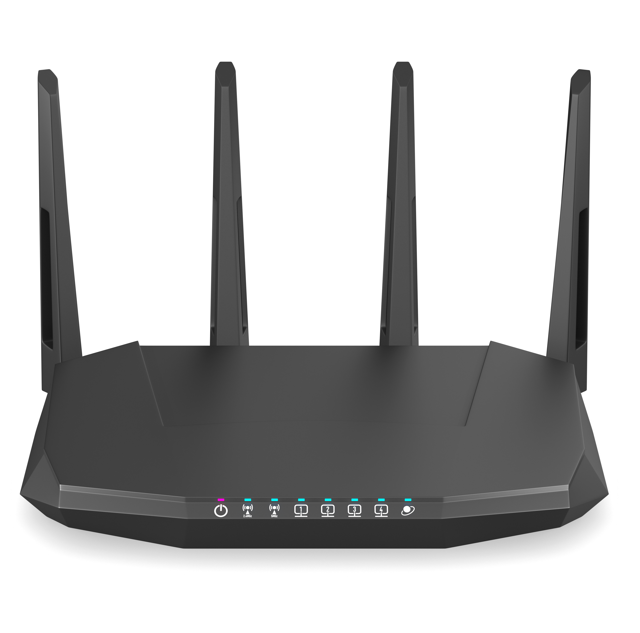

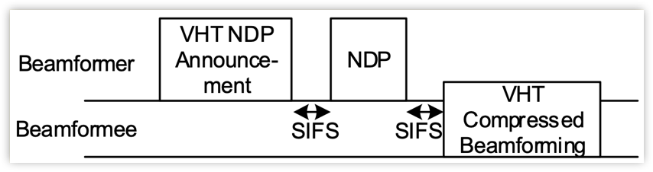
Channel sounding in IEEE 802.11
AP
STA
1
NDP
2
Estimate channel matrix
Compute compressed feedback
4
3
Precoding
Compressed channel feedback

Slide 4
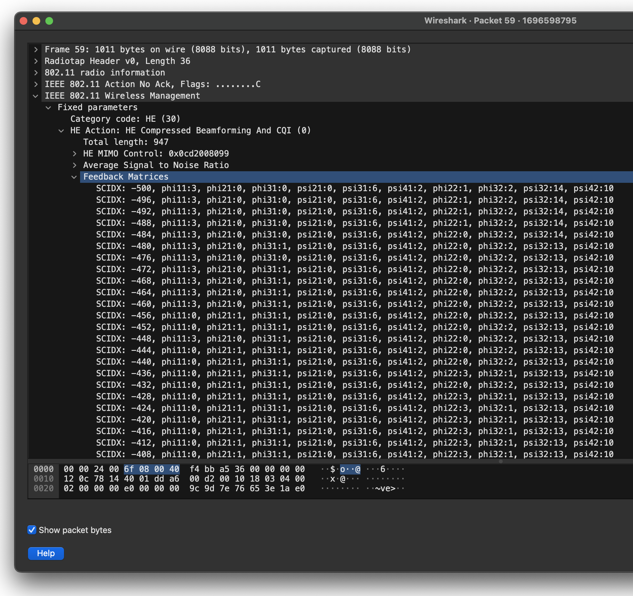

Vulnerabilities
AP
STA
NDP
Estimate channel matrix
Compute compressed feedback
Precoding
Compressed channel feedback
1
2
a) Transmitted unencrypted
b) Assumed legitimate
Procedure universally known

Slide 5


BREAK
Legitimate STA
Compressed channel feedback
AP
4
-65% Mbps
1
Eavesdropping
2
Incorrect precoding
Adversary STA
BREAK channel feedback
3
17% corrupted

Slide 6
Random attack does not work

Slide 7
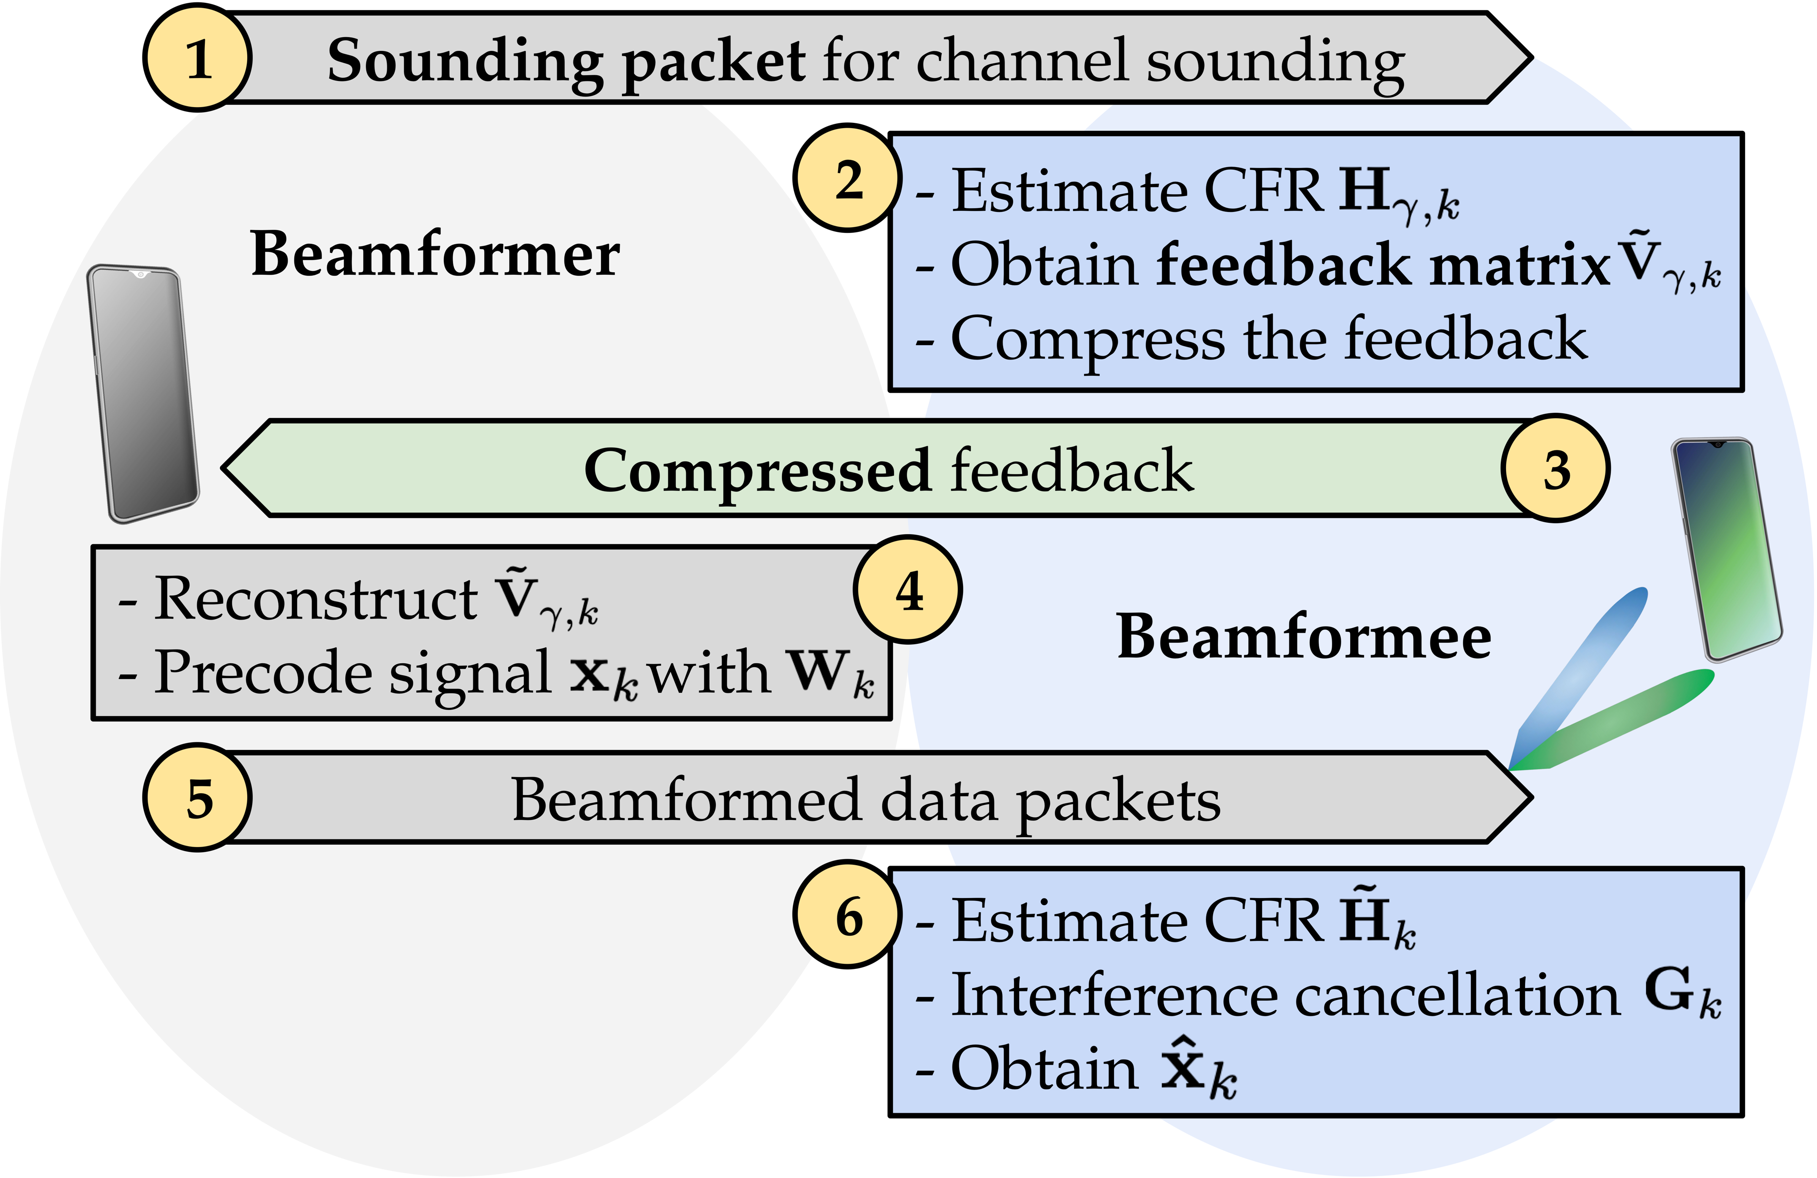
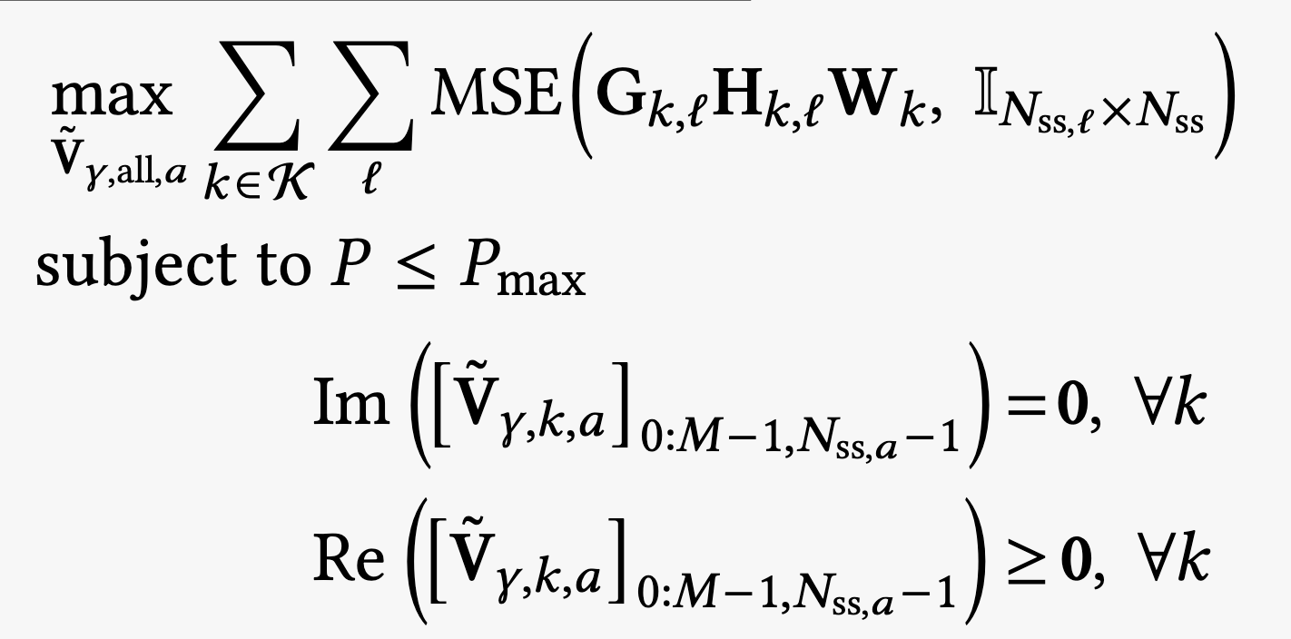
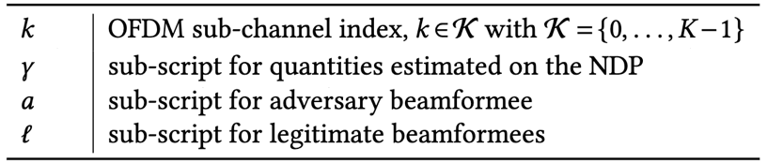
BREAK malicious feedback
Not available at the adversary

Slide 8
Experimental setup
IEEE 802.11ac channel 157
80 MHz bandwidth (256 OFDM sub-channels)
AP
  Asus RT-AC86U IEEE 802.11ac Wi-Fi router
STAs
  Asus RT-AC86U IEEE 802.11ac Wi-Fi router
  Samsung A52S smartphone

Slide 9
Two-STA evaluation
https://www.youtube.com/watch?v=SeVt0PWZZ8o

Slide 10
Four-STA evaluation

Slide 11
Countermeasures
Encryption
Machine learning
Yet all Wi-Fi devices currently in use are vulnerable to BREAK
More than 21 billion devices¹
¹ Wi-Fi Alliance, “Value of Wi-Fi.”
https://www.wi-fi.org/discover-wi-fi/value-of-wi-fi, 2024.

Slide 12
Thanks!
Questions?

