Slide 1
Follow-up on AMP DL OOK generation
March 2025
Doc.: IEEE 802.11-25/0440r0
Date: 2025-03-09
Authors:
Name | Affiliation | Address | Phone | Email
Wang Ke | OPPO |  |  | wangke6@oppo.com
Shengjing Cui
Wang Ke |  |  |  | xuweijie@oppo.com

Slide 2
Abstract
Doc.: IEEE 802.11-25/0440r0
In this contribution, the OOK generation for AMP DL will be further discussed.
The advantage of DSSS OOK will be discussed while considering requirements for AMP DL control portion and AMP excitation portion.

Slide 3
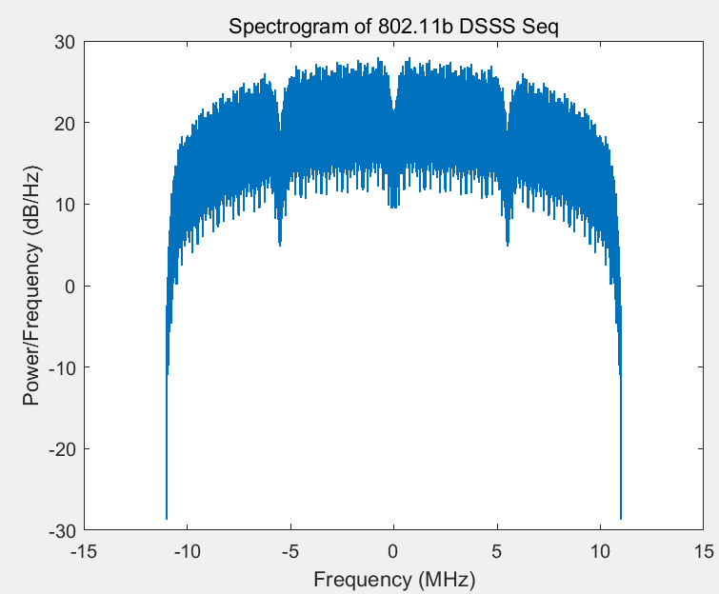
Recap:OOK generation with DSSS(1)
March 2025
Doc.: IEEE 802.11-25/0440r0
  In 802.11b, Barker code (1,-1,1,1,-1,+1,+1,+1,-1,-1,-1) is used to spread information bits to a wideband DSSS signal with 22MHz spectrum.

Slide 4
Recap: OOK generation with DSSS(2)
March 2025
Doc.: IEEE 802.11-25/0440r0
  In order to generate a narrow bandwidth DSSS signal, one way is to replace Barker code with another spreading code.
    Less randomization than Barker code, one example is [1 1 1 1 -1 -1 -1 -1 -1 -1 -1]
      about 3 times spectrum spreading via About 4 times repetition of 1 or -1
  The new output DSSS signal is OOK modulated (may has Manchester coding), as shown in the following.

Slide 5
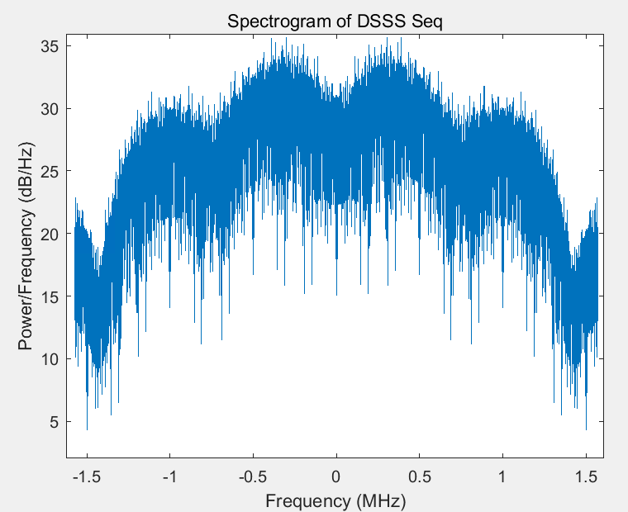
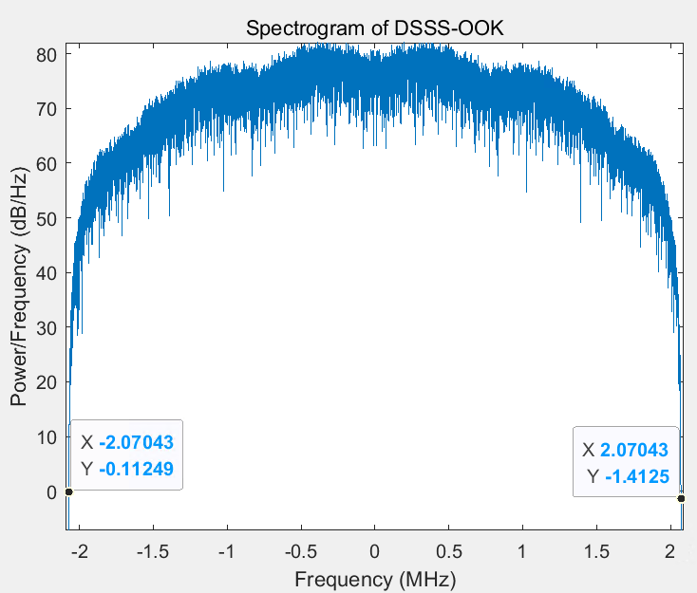
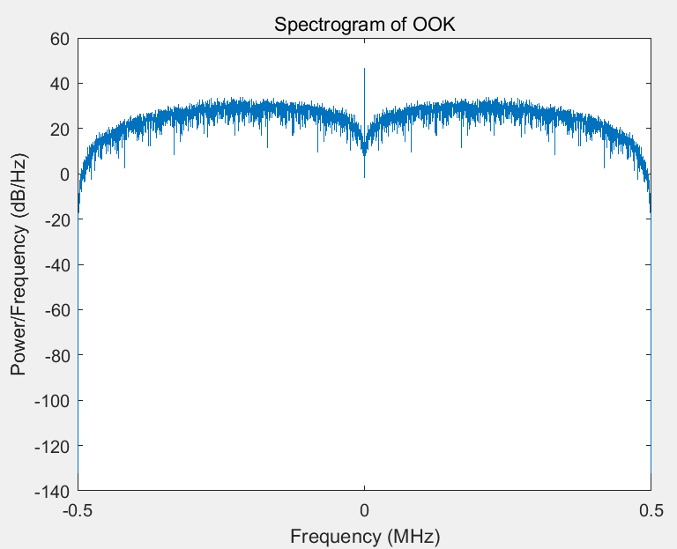
Recap: OOK generation with DSSS(3)
March 2025
Doc.: IEEE 802.11-25/0440r0
  The new DSSS signal is OOK modulated, the BW of the output DSSS OOK = BW of DSSS + BW of OOK envelope.

Slide 6
Further thoughts on OOK for AMP DL
March 2025
Doc.: IEEE 802.11-25/0440r0
  For the DL control portion, what the proper bandwidth of it?
    Considering the regulation requirement and the PSD limitation, it shall be no less than 10MHz in order to support a maximum power of 20dBm.
    On the other hand, shall it have guard band on both side in order to ease the possible filtering implementation?
      E.g. as for 11ba, the BW of WUR portion is 4MHz and it leaves guard band of 8 MHz on each side.
      For AMP, in order to support long range coverage, IF receiver may be utilized to improve the receiver sensitivity. In such case, it had better to have guard band.

Slide 7
Further thoughts on OOK for AMP DL
March 2025
Doc.: IEEE 802.11-25/0440r0
  For the excitation portion, we see similar requirement of the BW
    Considering the regulation requirement and the PSD limitation, it shall be no less than 10MHz in order to support a maximum power of 20dBm.
    On the other hand, it shall have guard band on both side in order to avoid the power leakage from the backscattering signal to adjacent channel.
      e.g. if the BW of the excitation portion is 20MHz, an AMP UL PPDU of 250kbps modulated on top of it will have a bandwidth of (20+1) MHz . It will affect the neighboring node operating on the adjacent channel.

Slide 8
Advantages of DSSS OOK
March 2025
Doc.: IEEE 802.11-25/0440r0
  We see at least the following advantage of DSSS OOK,
    Only baseband update is needed, no new hardware requirement
    Flexible to generate OOK signal with required bandwidth by using proper spreading code[1][2][3]
    Flexible to support different data rates, i.e., 250kbps and 1Mbps
    Can be applied for both AMP DL control and excitation portion
    Low PAPR, better performance than OFDM OOK

Slide 9
Summary
March 2025
Doc.: IEEE 802.11-25/0440r0
  In this submission, further thoughts on OOK for AMP DL is discussed and the advantages of DSSS OOK are analyzed. We propose DSSS based OOK is supported as one candidate waveform for AMP DL. It will be up to implementation to select which kind of waveform to use, i.e. DSSS-OOK or OFDM-OOK.

Slide 10
March 2025
Doc.: IEEE 802.11-25/0440r0
Straw Poll #1
Do you agree with the following text:
  DSSS based OOK is supported for AMP DL.
Yes
No
Abstain
Slide 10
Wang ke (OPPO)

Slide 11
Reference
March 2025
Doc.: IEEE 802.11-25/0440r0
IEEE 802.11-24/1802r0 OOK generation for AMP DL
IEEE 802.11-25/0050r0 AMP DL wideband OOK generation.
IEEE 802.11-25/0075r2 Further Thoughts on AMP DL PPDU for Mono-static Backscattering

