Slide 1
Channel Access for IMMW
Date: 2025-03-09
Authors:
Name | Affiliation | Address | Phone | Email
Dongju Cha | LG Electronics | 19, Yangjae-daero 11gil, Seocho-gu, Seoul 137-130, Korea |  | dongju.cha@lge.com
Insun Jang
 |  |  |  | insun.jang@lge.com
Hongwon Lee
 |  |  |  | hongwon.lee@lge.com
Jinsoo Choi
 |  |  |  | js.choi@lge.com
Eunsung Park |  |  |  | esung.park@lge.com
Insik Jung |  |  |  | insik0618.jung@lge.com
HanGyu Cho |  |  |  | hg.cho@lge.com
Sanggook Kim |  | 10225 Willow Creek Rd, San Diego, CA, USA |  | sanggook.kim@lge.com

Slide 2
Introduction
Several contributions considers throughput enhancement and latency reduction as main target objective for IMMW [1] ~ [4]
Also, contributions have almost identical view of including mmWave link as part of MLO along with other sub-7GHz links
  For convenience, we call STAs (or APs) operating on mmWave bands mSTA (or mAPs) and also call STAs (or APs) operating on sub-7GHz bands sSTA (or sAPs)
To achieve the target objective, efficient channel access in mmWave band should be studied
In this contribution, we share our thoughts on channel access for IMMW

Slide 3
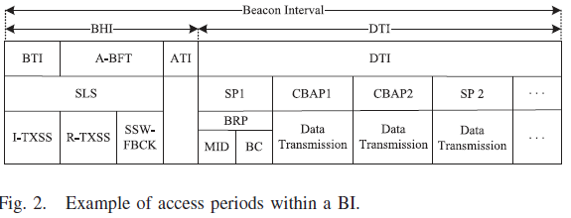
Recap: General Channel Access (ad/ay)
Access periods within a beacon interval is divided into Beacon Header Interval (BHI) and Data Transmission Interval (DTI)
DTI is access period that is mainly for data transmission
  It can be subdivided into CBAP and SP, which can appear in arbitrary combinations and it is scheduled by AP during BHI using DMG/EDMG Beacon
  CBAP follows the rules of EDCA, in which STAs compete with each other
  SP is scheduled contention free interval that are allowed only for the dedicated pair of STAs
* Contention Based Access Period (CBAP)
* Service Period (SP)

Slide 4
General: Channel Access
For mmWave link, sAP can schedule the service periods (SP) for frame exchange between mSTAs (e.g., mAP and mSTA) and within scheduled SP, how to design channel access to need to be discussed
  Dedicated SP: Service period that is dedicated only to the exclusive pair of STAs
    Ensures guaranteed access and reduced channel access delay to the medium for high-priority or latency sensitive traffic, e.g., XR, gaming
    Beamforming overhead can be reduced since STAs have dedicated access to the channel
  Non-Dedicated SP: Service period that not a dedicated SP
    E.g., SP that accessible for all associated STAs or group of multiple STAs
    It enables multiple STAs to access the channel dynamically following EDCA rules and is suitable when strict scheduling is not required, e.g., unpredicatable traffic pattern

Slide 5
Design Principles
Enable mmWave channel access with simple changes to the baseline including followings
  Assuming no management frame (e.g., Beacon) to be transmitted in mmWave bands
    Considering MLO, these can be transmitted through sub-7 GHz band to reduce management overhead and power consumption
    Scheduling service periods (e.g., dedicated SP and non-dedicated SP) between STAs in mmWave link can be setup through sub-7 GHz band
      E.g., Dedicated SP can be done through individual TWT negotiation and non-dedicated SP can be done through broadcast TWT operation

Slide 6
How to design channel access
– Within Dedicated SP
Within the SP that is dedicated for a pair of mSTAs, following baseline EDCA may cause unnecessary channel access delay
Considering the fact that only the pair of mSTAs contending for the channel and the likelihood of collisions is very low due to the nature of directional communication in mmWave band,
  While following the baseline EDCA,
    to minimize the channel access delay, adjusting value of EDCA Parameter Set (e.g., AIFSN and/or ECWmin) for mmWave link can be considered
      e.g., xIFS (e.g., PIFS) CCA may be enough in an enviroment where chance of OBSS interference is very low (e.g., this can be feasible through setting AIFSN to 1)
      However, it may be critical if collision happens since OBSS and myBSS retry TX at the same time if channel is IDLE during xIFS
      So after collision happens, follows the baseline EDCA rule which increases CW to defer transmission

Slide 7
Considerations for
– Dedicated SP
Within the Dedicated SP, following things need to be considered
  To guarantee the SP exclusive for a pair of mSTAs,
    AP can schedule each SP not to be overlapped that is interfering each other in time domain
    mSTAs are not allowed to transmit frames outside of its dedicated SP (e.g., outside of its negotiated individual TWT SP)
  Within the dedicated SP, which STA (mAP or mSTA) to be a TXOP holder need to be considered
    E.g., By setting Trigger field to 1 in TWT Parameter Set, mAP can be considered as a TXOP holder
  How to schedule the dedicated SP between mSTAs?
    TWT mechanism can be leveraged but, we assume that no management frame (e.g., TWT Setup frame) being transmitted in mmWave link
    E.g., Dedicated SP can be negotiated w/ individual TWT setup exchange

Slide 8
Considerations for
– Non-Dedicated SP
Within the Non-Dedicated SP, following things need to be considered
  Non-dedicated SP where multiple STAs perform channel access and attempt to initiate frame exchange, deafness node problem [appendix] may need to be considered
    Due to the nature of directional communication of mmWave band, in case of AP and STA1 is communicating in directional beam, AP is listening toward STA1 and the other STAs may not recognize
    These STAs may attempt to initiate frame exchange which would increase its CW value, meaninglessly
  How to schedule the non-dedicated SP between mSTAs?
    TWT mechanism can be leveraged but, we assume that no management frame (e.g., TWT Setup frame) being transmitted in mmWave link
    E.g., Non-Dedicated SP can be Broadcast TWT ID set to 0, and w/o membership setup, all associated mSTAs can access the channel following EDCA rule

Slide 9
Conclusion
In this contribution, we shared our thoughts on
  Two types of service period
    Dedicated SP and Non-Dedicated SP
  How to design channel access within each service period
  Some issues that need to be considered within each service period

Slide 10
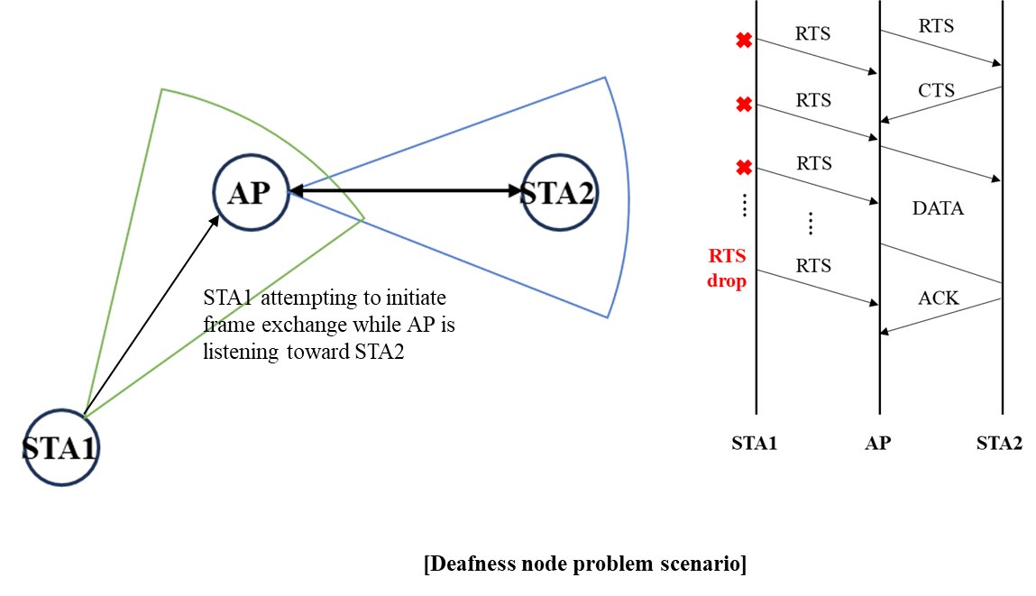
Appendix

Slide 11
Reference
[1] 11-23/0066, Discussion on Target Objectives for IMMW (Eunsung Park, LGE)
[2] 11-23/1878, High Level Design Considerations of IMMW (Jianhan Liu, Mediatek)
[3] 11-23/1968, Discussion on general direction of integrated mmWave (Ming Gan, Huawei)
[4] 11-24/0116, IMMW Draft Proposed PAR (Laurent Cariou, Intel)

Slide 12
Straw Poll #1
Do you support the following text in TGbq?
  TGbq defines a mechanism that schedules service period(s) for exchanging frame(s) between mSTAs (mSTA1 and mSTA2) operating on a link in a mmWave band through sSTAs (sSTA1 and sSTA2) operating on a link in a sub 7-GHz band
    mSTA1 is affiliated with the same MLD as sSTA1
    mSTA2 is affiliated with the same MLD as sSTA2
    How to schedule the service period(s) is TBD

Slide 13
Straw Poll #2
Do you support the following text in TGbq?
  TGbq reuses or updates existing TWT mechanism that schedules service period(s) for exchanging frame(s) between mSTAs (mSTA1 and mSTA2) operating on a link in a mmWave band through sSTAs (sSTA1 and sSTA2) operating on a link in a sub 7-GHz band
    mSTA1 is affiliated with the same MLD as sSTA1
    mSTA2 is affiliated with the same MLD as sSTA2

Slide 14
Straw Poll #3
Do you support the following text in TGbq?
  STAs operating on a link in a mmWave band are allowed to transmit frame(s) only within their scheduled service periods

Slide 15
Straw Poll #4
Do you support the following text in TGbq?
  TGbq defines a mechanism to resolve or mitigate the deafness node problem

