Slide 1
Packet Detection for ELR
Date: 06-Mar-25

Slide 2
Introduction
Detection Improvements for ELR
  Cross-correlation (CC) detection has been proposed [1] to improve detection of ELR frames in low SNR
    Otherwise range extension may be limited by L-STF detection, despite other ELR improvements in the PPDU format
  In contrast to autocorrelation (AC) detection, which is widely used now, CC requires a better clock synchronization between transmitter and receiver
This contribution
  Compares autocorrelation vs. cross-correlation detection for different CFO offsets
  Points out the need to have pre-correction requirements for all ELR PPDUs
  Provides additional context for CID 357 [2]

Slide 3
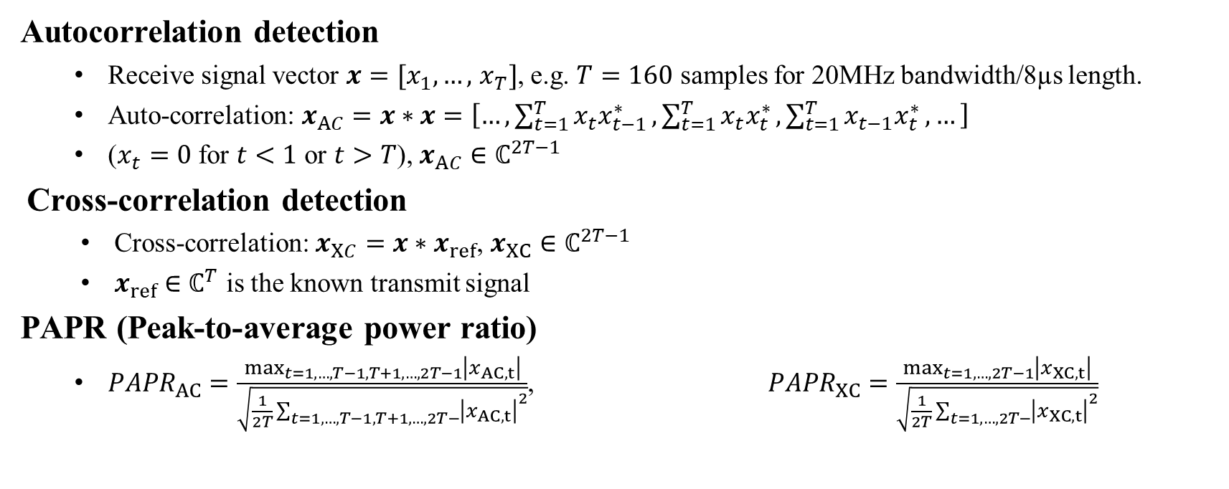
Mathematics of Detection
Autocorrelation detection
  Receive signal vector $x=[x_{1},…,$ $x_{T}]$, e.g. $T=160$ samples for 20MHz bandwidth/8µs length.
  Auto-correlation: $x_{AC}=x∗x=\left[…,\sum_{t=1}^{T}{x_{t}x_{t−1}^{∗}},\sum_{t=1}^{T}{x_{t}x_{t}^{∗}},\sum_{t=1}^{T}{x_{t−1}x_{t}^{∗}},…\right]$
  ($x_{t}=0$ for $t<1$ or $t>T$), $x_{AC}∈ℂ^{2T−1}$
Cross-correlation detection
  Cross-correlation: $x_{XC}=x∗x_{ref}$, $x_{XC}∈ℂ^{2T−1}$
  $x_{ref}$ $∈ℂ^{T}$ is the known transmit signal
PAPR (Peak-to-average power ratio)
  ${PAPR}_{AC}=\frac{\max_{t=1,…,T−1,T+1,…,2T−1}\left|x_{AC,t}\right|}{\sqrt{\frac{1}{2T}\sum_{t=1,…,T−1,T+1,…,2T−}{{\left|x_{AC,t}\right|}^{2}}}}$, ${PAPR}_{XC}=\frac{\max_{t=1,…,2T−1}\left|x_{XC,t}\right|}{\sqrt{\frac{1}{2T}\sum_{t=1,…,2T−}{{\left|x_{XC,t}\right|}^{2}}}}$

Slide 4
Example Signals
Autocorrelation detection
Cross-correlation detection
In the ACF, the center value is excluded (as it is always a peak), no frequency offset

Slide 5
Mathematics of Detection (2)
PAPR can be a good measure for signal detection
  In absence of signal PAPR will be low (top figure)
  With signal present, PAPR will be high
    15.5dB (with signal) vs. 8.5dB PAPR (without signal) in the example figures
    PAPR decreases as noise, CFO, … become stronger
Choosing a threshold for PAPR establishes a detect/no-detect criterion
  See next slides for details

Slide 6
Threshold Selection
Role of the Detection Threshold
  The threshold for determining a correct detection is subject to the trade-off between false alarms (false positives) and missed detections (false negatives)
  False alarms cause unnecessary operations at the receiver
  Missed detections cause a packet loss
Threshold Selection
  From a given false-alarm requirement (e.g., one false-alarm per second), the PAPR threshold can be derived
  The threshold also depends on the number of antennas
 | 1 antenna | 2 antenna | 4 antenna
Autocorrelation | 10.9 dB | 9.8 dB | 9.1 dB
Crosscorrelation | 12.2 dB | 10.5 dB | 9.4 dB

Slide 7
Mis-Detection Probability (AWGN)
Once Threshold is established, the probability of false negatives (misdetection) can be evaluated
Conditions (AWGN)
  No channel, 1 antenna
  Detection TH = 10.9dB (acorr)/12.2dB (xcorr)
    i.e., 1 false alarm per second (see slide 6)
  5.25GHz channel
Observations
    With less than 5ppm CFO, 3dB improved sensitivity of cross-correlation vs. Autocorrleation is achieved
    With autocorrelation and cross-correlation, the miss-detection probability is sufficiently low to avoid a substantial increase of the packet error rate

Slide 8
Mis-Detection Probability (B LOS channel)
Conditions
  B LOS channel, 2 antennas
  Detection TH = 9.8dB (acorr)/10.5dB (xcorr)
    i.e., 1 false alarm per second
  5.25GHz channel
Observation
  Cross-correlation still achieves ~3dB better sensitivity, but a higher SNR is required for the same miss-detect probability (compared to AWGN)

Slide 9
Mis-Detection Probability (D NLOS channel)
Conditions
  D NLOS channel, 2 antennas
  Detection TH = 9.8dB (acorr)/10.5dB (xcorr)
    i.e., 1 false alarm per second
  5.25GHz channel
Observation
  With the D NLOS channel, the performance of cross-correlation detection is degraded
  Even at higher SNR, there are mis-detects

Slide 10
PAPR as function of CFO (AWGN)
Autocorrelation detection
Cross-correlation detection
Conditions:
5.25GHz
AWGN (no channel)
1 antenna
20MHz bandwidth
8µs LSTF
PAPR/dB
PAPR/dB
While the auto-correlation PAPR doesn‘t change with the clock offset, cross-correlation PAPR is lowered significantly with increasing clock offset

Slide 11
PAPR as function of CFO (Channel D)
Autocorrelation detection
Cross-correlation detection
Conditions:
5.25GHz
D NLOS channel
2 rx antennas
20MHz bandwidth
8µs LSTF
PAPR/dB
PAPR/dB
The channel impulse response lowers the PAPR and thus, the detection capabilities.
Cross-corrleation is more sensitive than autocorrelation

Slide 12
ELR PPDU pre-compensation
Current CFO pre-compensation requirement for ELR PPDUs is 15 kHz (See 38.3.20.2)
  I.e., 6.25 ppm at 2.4 GHz, 2.7 ppm at 5.5 GHz
  Both these values correspond to regions where CC outperforms AC (see previous slides)
Per 802.11bn D0.1, pre-compensation is only required for “ELR PPDU carrying immediate response frame in response to a preceding soliciting frame”
Degradation of CFO pre-compensation over time may result in CC losing its advantage

Slide 13
Conclusions
Clock Synchronization Requirement
  Cross-correlation detection only gives a benefit with sufficiently low CFO
  Multiple antennas help improve detection
  802.11bn D0.1 only imposes a precompensation requirements for UL packets sent as responses the AP packets
    This is not sufficient for general operation
    If some CFO precompensation is not ensured, the detection sensitivity of CC will decrease and extended-range property of ELR will be lost due to detection errors
Receiver complexity and Power Consumption
  Without guaranteed precompensation, the receiver can not rely on CC exclusively
  Sophisticated detection schemes (e.g., a combination of cross-correlation and autocorrelation), may have a significant impact on the APs power consumption, as this is the hardware component which remains active all time, even without traffic

Slide 14
References
[1] Wook Bong Lee et.al., “An ELR PPDU Follow-Up” IEEE 802.11-24/1573r0, September 2024
[2] “IEEE 802.11bn CC50 comments on D0.1”, IEEE 802.11-25/0296r0

