Slide 1
802.11 VLAN Support
Date: 2025-03-08
Authors:
Slide 1
Notes:
doc.: IEEE 802.11-07/xxx2r0
July 2007
Donald Eastlake 3rd, Motorola

Slide 2
Abstract
802.11 networks frequently handle different categories of traffic and different communities that need to be isolated from each other. This is commonly done by VLANs (802.1Q) in wired networks. While there are some provisions for the support of VLANs in 802.11, there is room for extension and addition of VLAN support. This presentation explores current VLAN support in IEEE Std 802.11 and suggests some areas where further support could be provided.
Slide 2
Notes:
doc.: IEEE 802.11-07/xxx2r0
July 2007
Donald Eastlake 3rd, Motorola

Slide 3
Simple Example Scenario
(unified infrastructure, single interface end stations)
Other Services
End Point Assesment and Remediation
MAP 2
MAP 1
AP 2
Healthy Station
Healthy Station
Healthy Station
Infected Station
Healthy Station
Normal VLAN
Assessment and Remediation VLAN
Wired Connection
New Station

Slide 4
Contents
Existing 802.11-2020 VLAN Support
Amendments With No Mention of VLANs
Additional VLAN Support Possibilities
Previous WNG Results
Straw Poll
References

Slide 5
Existing 802.11-2020 VLAN Support
Clause 11.22 WLAN interworking with external networks procedures (Annex R: Interworking with external networks)
  Also Clause 4.3.20. See later slides.
Clause 9.4.2.30: TCLAS element
  See later slide
Clauses 4.3.28.3.2, 4.3.28.3.3: GLK (802.11ak)
  One aspect of General Link (GLK) supports direct connection of a STA to an 802.1Q VLAN bridge.
Annex M: EPD and LPD headers and the integration function
  Illustrate formats for including a VLAN tag in a frame
Annex C: MAC and PHY MIB
  dot11NonAPStationVLANId, dot11NonAPStationVLANName

Slide 6
Existing 802.11-2020 VLAN Support
Annex R: Interworking with external networks
    R.4.1: the interworking service model generally assumes infrastructure mode
  R.3.2: Multiple SSPNs
    See next slide
  R.5.3: System aspects for emergency call support
    Suggest the AP can separate backhaul emergency services traffic from other traffic with a dedicated VLAN
  R.5.5: Access to emergency services in an RSN
    The AP can look up the VLAN ID to use with a AAA Server, or it can have an emergency services VLAN configured.

Slide 7
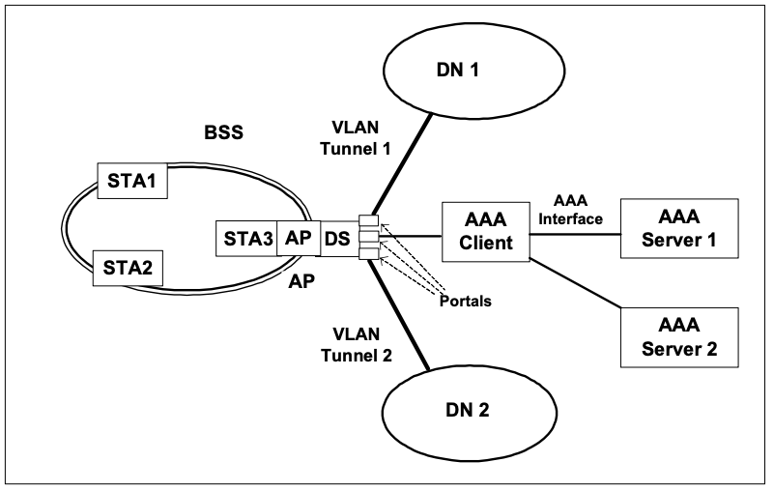
Clause R.3.2, Multiple SSPNs
VLAN Tunnel 1
VLAN Tunnel 2
802.11-2020 Figure R-1 plus highlighting

Slide 8
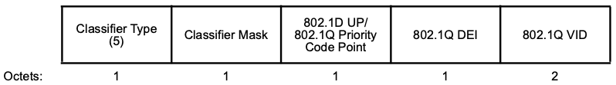

Existing 802.11-2020 VLAN Support
Clause 9.4.2.30: TCLAS element (traffic classification)
  Includes a Frame Classifier
  Frame Classifier Type 5 includes a VLAN ID
  However, Clause 9.4.2.30 specified that both the DEI and the VID subfields are ignored.
802.11-2020 Figure 9-311
802.1Q-2022 Figure 9-1– VLAN Tag Control Information

Slide 9
Amendments/Corrigendum
With No Mention of VLANs
11ax
11ay
11az
11bb
11bd
11-2020-cor1-2022
11be_D7.0
11bf_D7.0
11bh_D6.0
11bk_D4.0
11bi_D1.0
11bn_D0.1

Slide 10
Additional VLAN Support Possibilities
Here are some high-level areas where additional support may be possible. No doubt there are others I have missed.
Extension of TCLAS with a new frame classifier type that tests VLAN ID.
Further specification of the AP / AAA / SSPN communication protocol (the “SSPN Interface”).
Extension of Generic Advertisement Service (GAS) and Pre-Association Discover (PAD) to include VLAN information.

Slide 11
Additional VLAN Support Possibilities
(continued)
Extension so a STA associated with an AP could conveniently use multiple VLANs, for example for different services? (I.E. VLAN aware Non-AP STA.)
Possible VLAN extensions for Multiple SSID.
Extension of Mesh to provide VLAN restrictions on links / nodes. Effectively multi-topology.
Improved Mesh internetworking service discovery, i.e. SSPN support.

Slide 12
Results At November 2024 Plenary
After the presentation of
https://mentor.ieee.org/802.11/dcn/24/11-24-1904-03-0wng-vlan-segregated-data-services.pptx
Straw Poll: Do you favour the formation of a TIG to explore additional uses of and management of VLANs inside WLANs?
Straw Poll Result:
  47 Yes / 41 No / 71 Abstain
See also earlier results in reported in 11-08/114r0
Slide 12
Notes:
doc.: IEEE 802.11-07/xxx2r0
July 2007
Donald Eastlake 3rd, Motorola
Page 12

Slide 13
Straw Poll For March 2025 Plenary
Straw Poll: Do you favour the formation of a TIG to explore uses and management of VLANs with WLANs?
Straw Poll Result:
  Yes / No / Abstain
Slide 13
Notes:
doc.: IEEE 802.11-07/xxx2r0
July 2007
Donald Eastlake 3rd, Motorola
Page 13

Slide 14
References
IEEE Std 802.11-2020 – WLANs
IEEE Std 802.1Q-2022 – VLANs
Slide 14
Notes:
doc.: IEEE 802.11-07/xxx2r0
July 2007
Donald Eastlake 3rd, Motorola

Slide 15
Example Scenario II
(diverse mesh, multi-interface mesh points)
Internet
Organization 1 Infrastructure
Local Mesh Service
Organization 1 Service
Organization 2 Service
Org 2
MPP
Organization 2 Infrastructure
Org 1
MPP
Org 1
MP
Org 2
MP
Org 2
MP
Org 1
MP
Org 3
MP
Org 2
MP
Org 1
MP

Slide 16
Scenario II without segregated data services
Internet
Organization 1 Infrastructure
Organization 1 Service
Organization 2 Service
Org 2
MPP
Organization 2 Infrastructure
Org 1
MPP
Org 1
MP
Org 2
MP
Org 2
MP
Org 1
MP
Org 3
MP
Org 2
MP
Org 1
MP

