Slide 1
Spatial Reuse for NPCA Capable STAs
Date: 2025-03-08
Authors:
Name | Affiliations | Address | Phone | Email
Salvatore Talarico | Nokia |  |  | salvatore.talarico@nokia.com
Klaus Doppler
Mika Kasslin
Okan Mutgan
Prabodh Varshney
Behnam Dezfouli
Behnam Dezfouli
Mikhail Liubogoshchev
Mika Kasslin
Eda Genc
Juhyung Lee
Juhyung Lee
Kerstin Johnsson
Oleg Chistyakov
Mario Costa
Enrico Rantala

Slide 2
Introduction
During the past IEEE 802.11 Interim and Ad-Hoc meetings, NPCA has been agreed ([1-10]) and the following motion was approved:
This motion does not indicate any restrictions about the received power of the OBSS: the received power must be higher than -82 dBm for PD. However, this value may change if Spatial Reuse (SR) is used.
Move to add to the TGbn SFD the following:
The event that triggers switching to the NPCA primary channel shall be
OBSS Control frame exchange (e.g., (MU-)RTS/CTS) or
OBSS HE/EHT/UHR PPDU
Note: Other conditions TBD
Move: Laurent Cariou Second: Gaurang Naik
Discussion: None.
Result: Approved with unanimous consent.
Reference documents:[24/0495r0, 11-24/1218r1]. SP result: No objections.

Slide 3
Reference to Comment Resolution
This contributions proposes a resolution for the following comment [11]:
CID | Commenter | Clause | Page, Line | Comment | Proposed Change | Ad-hoc
2697 | Salvatore Talarico | 26.1 | X | Behaviour of how STAs should operate when spatial reuse is used by NPCA capable STAs | Backwards compatibility of spatial reuse should be properly handled for NPCA capable STAs | MAC

Slide 4
Recap: 802.11ax Spatial Reuse
In 802.11ax,
The concept of BSS coloring was introduced which assigns a unique label to each BSS
AP randomly selects a color (1-63) and mentions it in the HE Operation element in the beacon or probe responses, which is indicated in the SIG-A field of the PHY header for any frames sent in the BSS.
If collision is detected (STAs belonging to an OBSS are using same color), a collision is reported through an Event Report Frame where an AP disables its own color (BSS Color Disabled bit in the HE Operation element) and then sends a BSS Color Change Announcement or a specific HE BSS Color Change announcement action frame.
Some interference mitigation techniques are introduced with two flavors:
OBSS Packet Detection (PD)-based SR: used mainly for untriggered transmissions and to allow to ignore the transmissions of the OBSS system thereby by choosing properly an OBSS PD thresholds, and consequently reducing the transmit power to minimize the disruptions to the neighboring OBSS when transmitting concurrently
Parametrized SR (PSR): used for trigger-based transmissions and aims to inform STAs in the neighboring OBSSs how much they can transmit without affecting the reference AP’s ability to properly decode the uplink frames from its own associated STAs

Slide 5
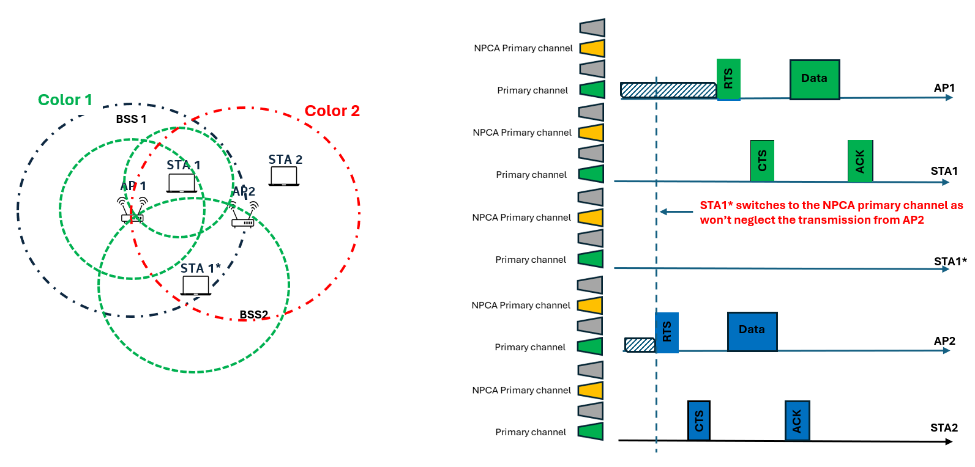
Problem Statement
When NPCA is jointly enabled with SR, based on the OBSS PD thresholds that STAs may select the ambiguity that NPCA creates when it comes to determining when to switch to the NPCA primary channel is exacerbated.
In the example below, SR with non-SRG OBSS PD is jointly enabled with NPCA, and within BSS1 all the STAs will accordingly select their OBSS PD values so that to reduce footprint and impact on BSS2. However, while AP1 and STA1 select their non-SRG OBSS PD so that they can ignore transmissions from AP2, STA1* cannot. So this would lead AP1 and STA1 to continue to stay on the primary channel, while STA1* will switch to NPCA primary channel.

Slide 6
Proposal
In order to mitigate the issue highlighted in prior slide:
Option 1: NPCA is never used jointly with SR
Since these two features address the same issue (i.e., overlapping of OBSS transmissions), these are used orthogonally based on TBD conditions
Either SR is superseded when NPCA is enabled or they are never enabled together
Option 2: NPCA can be jointly used with OBSS PD-based SR
A common OBSS PD threshold could be defined to mitigate the ambiguity in switching among devices belonging to the same BSS
NPCA primary channel is triggered by the detection of OBSS Control frame exchange (e.g., (MU-)RTS/CTS) or OBSS HE/EHT/UHR PPDU with a power level higher than the common OBSS PD threshold
SR transmit power constraints are applied regardless of whether a STA operate on primary or NPCA primary channel

Slide 7
Summary
In this contributions, we discussed the negative impact of SR on NPCA, when these two features are used together.
To address this issue two options are provided:
Option 1: NPCA is never used jointly with SR
Option 2: NPCA can be jointly used with OBSS PD-based SR
A common OBSS PD threshold could be defined to mitigate the ambiguity in switching among devices belonging to the same BSS
NPCA primary channel is triggered by the detection of OBSS Control frame exchange (e.g., (MU-)RTS/CTS) or OBSS HE/EHT/UHR PPDU with a power level higher than the common OBSS PD threshold
SR transmit power constraints are applied regardless of whether a STA operate on primary or NPCA primary channel

Slide 8
Straw Poll #1
Do you agree that when NPCA and SR are operated jointly, the ambiguity that NPCA creates when it comes to determining when to switch to the NPCA primary channel is exacerbated and this issue shall be addressed?
Yes
No
Abstain

Slide 9
Straw Poll #2
Do you agree that HE spatial reuse operation shall be superseded by the NPCA operation?
Yes
No
Abstain

Slide 10
References
[1] IEEE 802.11-23/34, “Non-primary channel utilization”, Sindhu Verma
[2] IEEE 802.11-23/631, “Secondary channel usage and secondary 20MHz channel backoff”, Liwen Chu
[3] IEEE 802.11-23/797, “Non-primary channel access”, Yongho Seok
[4] IEEE 802.11-23/961, “UHR secondary channel access”, Minyoung Park
[5] IEEE 802.11-23/1112, “Thoughts on secondary channel access”, Insun Jang
[6] IEEE 802.11-23/1365, “Discussions on non-primary channel access”, Sanghyun Kim
[7] IEEE 802.11-23/1891, “Nonprimary Channel Access Follow-Up”, Gaurang Naik
[8] IEEE 802.11-23/1911, “Secondary channel access and frame transmission”, Dongju Cha
[9] IEEE 802.11-23/1951, “Concurrent CCA for non-primary channel access”, Leonardo Lanante
[10] IEEE 802.11-24/1762, “PDT-MAC-NPCA”, Matthew Fischer
[11] IEEE 802.11bn CC50 comments on D0.1, IEEE 802.11-25/0296r17

