Slide 1
Further Design Details for CoBF Operation
Date: 2024-03-10
Authors:
Name | Affiliation | Address | Phone | Email
Sherief Helwa | Qualcomm Inc. |  |  | shelwa@qti.qualcomm.com
George Cherian
Alfred Asterjadhi
Abhishek Patil
Gaurang Naik
Duncan Ho
Sanket Kalamkar
Giovanni Chisci

Slide 2
    Introduction
The Coordinated BeamForming (CoBF) topic has been of great interest to the TGbn group for a long time.
In July 2024 meeting, a motion passed defining the CSR and CoBF CAP schemes.
  Motion 29 (MAC):
    Define a multi-AP Coordinated Spatial Reuse at TxOP-level with power control
    Define multi-AP Coordinated Beamforming
    Other multi-AP coordination modes are YBD
The PHY group has been actively contributing on the topic and multiple Motions got agreed on defining several CoBF-related aspects such as:
  Including in CoBF operation channel sounding and transmission procedures
  Different variants of the sounding sequence
  Including 2 APs in CoBF sounding and handling frequency synchronization between them
  Etc.
However, many MAC-related aspects stay open. Therefore, the goal of this contribution is to discuss CoBF from a MAC perspective and to close on some of the open items related to both the CoBF sounding and transmission phases.

Slide 3
    Sounding Sequence
The CoBF operation mainly relies on the concept of beam nulling where the APs participating in CoBF need to null their Tx signals at the STA(s) associated to the other AP to limit interference levels.
To achieve that goal, Channel State Information (CSI) must be available at the OBSS AP.
This necessitates doing a channel sounding sequence procedure where each of the two APs collects CSI between itself and the OBSS STAs expected to be scheduled during CoBF transmission (In-BSS STA CSI can be collected as well).
It was agreed in PHY to build upon the legacy sounding sequence based on NDP/NDP Announcement frames.
Two channel sounding sequences were introduced: Sequential and Joint Sounding.
eMLSR/DPS clients can be handled in a similar way to that of the legacy sounding sequence.
  ICF/ICR frame exchanges are included in the sequence prior to the NDPA frames.
Another essential addition we propose is initiating the sequence with a Sounding Request/Response frame exchange between the two APs involved in sounding.
  This ensures the availability of the second AP and its willingness to participate.
  Also indicating whether ICF/ICR frames are included in the sequence or not.
  Which type of sounding sequences is being initiated, i.e., sequential or joint sounding.

Slide 4
    Sounding Sequence
Note that for STAs operating in modes that do not require the inclusion of ICF/ICR exchanges prior to further frame exchanges, the sequence can proceed without those ICF/ICRs, e.g., non-eMLSR/non-DPS STAs.
Sequential sounding sequence:
Joint sounding sequence:

Slide 5
    Transmission Phase
The transmission phase consists of an initial 3-way handshaking between the two APs participating in CoBF followed by the actual data transmission and BA info collection.
During the initial handshaking steps, the APs:
  Share information about their scheduled clients so that the other AP can pick the correct CSI and perform the signal nulling effectively.
  Agree on all the needed parameters for joint CoBF transmission.
  Provide the needed means for time and frequency synchronization.
CoBF Invite: Sharing AP invites shared AP to the CoBF TXOP and shares scheduled STA(s) information.
CoBF Response: Shared AP accepts/rejects CoBF invitation and shares scheduled STA(s) information.
CoBF Trigger: Acts as a synchronization reference and provide needed parameters for joint Tx.
Similar to the sounding sequence, ICF/ICR exchanges are needed to support eMLSR/DPS STAs.

Slide 6
    Transmission Phase
To address the pressing issue of high CoBF sequences complexity, we propose to proceed with staggered ICF/ICR frame exchanges across the two BSSs.
  By doing so, the CoBF Invite/Response frames are drastically simplified, and the exchange is now a pure AP2AP communication with no involvement of STAs.
    However, one alternative is to combine the ICF frame(s) with the CoBF Invite/Response frames which will add more complexity but reduce the number of frames.
  So, CoBF operation agreements and all Tx preparation can be done between the two APs then follows the STAs preparation for data frame exchanges.
    Link activation for eMLSR or LCM to HCM switching for DPS STAs.
  A final frame (CoBF Trigger/Sync) is added for synchronization purposes and possibly for sharing more info needed to construct the DL PPDUs.

Slide 7
    Transmission Phase
This sequence requires the introduction of the concept of extended time-out periods for eMLSR/DPS clients before switching back.
  The idea is to prevent those clients from switching back during inactivity periods that overlaps with frame exchanges in the other BSS within the sequence.
  The duration of this extended time-out period must be sufficient to cover the longest silent period in the sequence.
For this sequence, it is also essential for the 2 APs to indicate to each other whether they will include ICF/ICR frame exchanges in the sequence or not.
  Invite: Sharing AP can indicate if it is scheduling eMLSR/DPS clients and ICF/ICR are included.
  Response: Shared AP can indicate if it is scheduling eMLSR/DPS clients and ICF/ICR are included.

Slide 8
    Summary
The CoBF Sounding and Transmission sequences are discussed and proposals for the following signaling details were provided:
  Needed frames within both sequences and indication on their presence.
  STAs’ operation modes that need to be supported within CoBF sequences.
  How these operation modes will be supported.

Slide 9
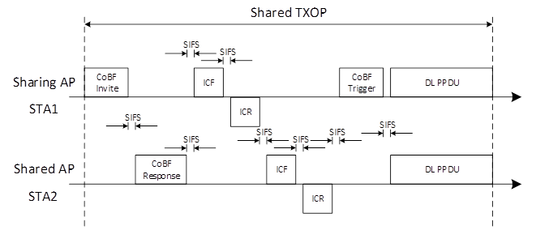
    SP1
Do you agree to use the following CoBF transmission sequence to support STAs requiring ICF/ICR before data frame exchanges?
  The frame sequence consists of:
    A CoBF Invite/CoBF Response frame exchange between the sharing and shared APs.
    Follows ICF/ICR frame exchanges between the APs and their associated STAs happening sequentially across the two APs; sharing AP then shared AP.
      The presence of the ICF/ICR frame exchange from each AP is conditional on the CoBF PPDU being addressed to one or more STAs.
      The presence of the ICF/ICR frame exchange from each AP is indicated in the CoBF Invite/Response frames.
      ICF1-ICR1 are exchanged between the sharing AP and its STAs
      ICF2-ICR2 are exchanged between the shared AP and its STAs
    Finally, a CoBF Trigger/Sync frame preceding the data PPDUs sent by the two APs simultaneously.
    Frame sequence for Ack information polling is TBD.
    Whether the CoBF-invite and ICF1 can be merged and CoBF-response and ICF2 can be merged is TBD.

Slide 10
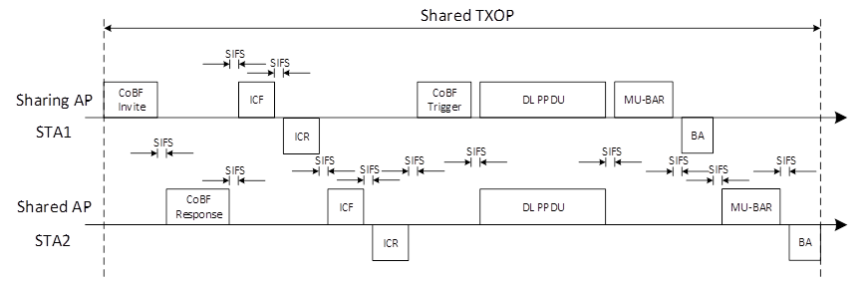
    SP2
Do you agree to use the following sequence for acknowledgement information polling from STAs scheduled in a CoBF transmission sequence
  MU-BAR/BA frame exchanges are used by each AP separately, i.e., sequentially.
  NOTE1: The first MU-BAR frame (transmitted by the sharing AP) can be embedded in the preceding DL PPDU as in baseline.
  NOTE2: The frame sequence for eliciting simultaneous ACKs from clients of both sharing and shared APs if agreed in PHY is TBD.

Slide 11
    SP3
Do you agree that:
  For DPS non-AP STA(s) scheduled with CoBF in high capability mode, the same switch-back behavior as for eMLSR with extended time-out period is used.

Slide 12
    SP4
Do you support that any CoBF sounding sequence that includes Cross-BSS CSI collection shall be initiated by a two-way handshake between the two APs participating in the sequence
  The two-way handshake exchange consists of a Sounding Invite frame and a Sounding Response frame.
  The Sounding Invite/Response frame exchange is used to:
    Confirm the availability of both APs for CSI collection.
    TBD for indication whether each AP will include ICF/ICR exchanges with its client or not.
    Further information to be exchanged is TBD.

