Slide 1
COBF/COSR Design Follow-up
Date: 2025-03-10
Authors:
Name | Affiliations | Address | Phone | Email
You-Wei Chen | Mediatek | 2840 Junction Ave. San Jose, CA, 95134 |  | You-Wei.Chen@mediatek.com
Eric Pc
Jianhan Liu
Kaiying Lu
Shengquan Hu
Thomas Pare

Slide 2
Introduction
COBF/COSR motions passed in IEEE [1]. There are still some open topics:
  BSS color location in U-SIG
  PE of COBF and COSR PPDU
  To perform COBF/COSR transmission with a unified preamble, some information exchange are required and discussed in [2-5].
  Detailed frame exchange and containers need to be determined in MAC.
  Contents for COBF precoder calculation and preamble preparation can be decided in PHY.
In this presentation, we will discuss aforementioned topics.

Slide 3
BSS Color locations in U-SIG
If we put first BSS color as shared AP in the COBF PPDU, it helps shared AP STAs set intra NAV. Since UHR STAs can understand two BSS color, this only helps EHT STAs.
We prefer to keep the first BSS color as sharing AP:
  It is less impact to sharing AP TX processing flow (follow the normal TX).
  If shared AP does not able to transmit COBF/COSR PPDU after trigger, it does not make sense to ask OBSS STAs set intra NAV.
 | 0 | 1 | 2 | 3 | 4 | 5 | 6 | 7 | 8 | 9 | 10 | 11 | 12 | 13 | 14 | 15 | 16 | 17 | 18 | 19 | 20 | 21 | 22 | 23 | 24 | 25
U-SIG1 | PHY version identifier |  |  | Bandwidth |  |  | UL/DL | BSS color (sharing AP) |  |  |  |  |  | TXOP |  |  |  |  |  |  | BSS color (shared AP) |  |  |  |  | Validate
U-SIG2 | PPDU Type |  | COBF/ COSR | punctured channel info |  |  |  |  | Validate | UHR-SIG MCS |  | Number Of UHR-SIG Symbols |  |  |  |  | CRC |  |  |  | Tail

Slide 4
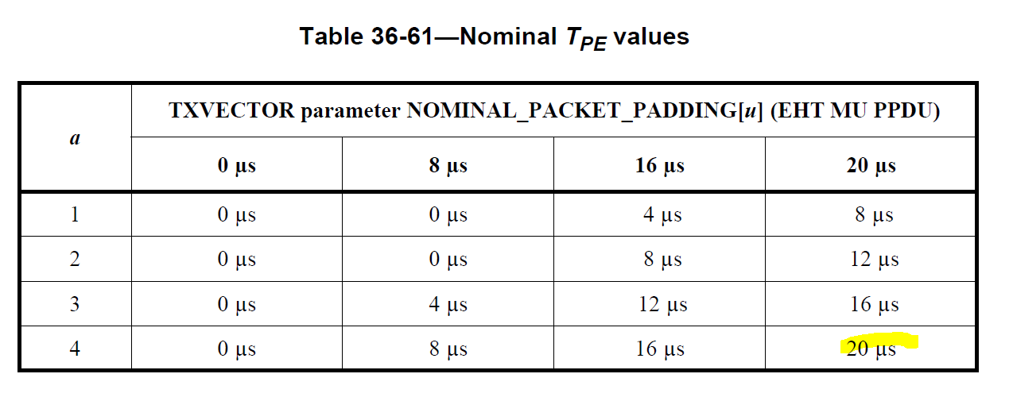
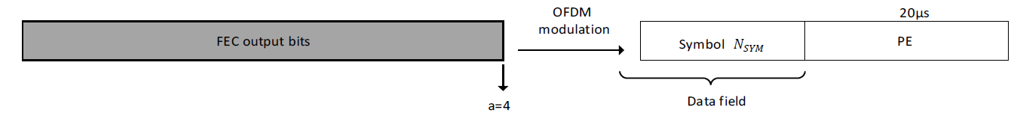
Fixed TPE
PE setting is depending on the STA capabilities, e.g., give additional time to decode the incoming PPDU or to prepare ACK.
From both BSS, the setting PE in COBF and COSR PPDU (max allowable PE) should accommodate all STA requirements.
To avoid additional info exchange, we propose to fixed TPE as 20us:
  nominal_packet_padding =20us and a factor =4
  Fixed TPE=20us

Slide 5
A common frame exchange for COBF/COSR
It is desirable to have a common framework for both COBF and COSR.
  To simply the standard design.
Prefer to exchange necessary info for calculating the COBF precoder.
  To simply the carried info
Prefer to confirm and carry self-contained info for COBF/COSR PPDU transmission.
  To simply the implementation.
  Exchange necessary Info for performing CoBF/CoSR PPDU transmission.
Sharing AP STA
AP1
Invite
Sync
COBF/COSR PPDU
Shared AP STA
AP2
Response
COBF/COSR PPDU
  Detailed frame exchange will be determined in MAC
non-AP STA1
non-AP STA2
  Confirmed COBF/COSR transmission and provided the confirmed info (self-contain).

Slide 6
Information carried in Invite/Response
To intial the TXOP, sharing AP informs the shared AP this TXOP is used for COBF or COSR.
Operating bandwidth and punctured information need to be fixed over the entire TXOP and indicated in the COBF invite.
  No dynamic punctuing.
One example:
Subfield | Invite | Response
Control | Invite | Join
Length related info | Yes | Yes
PHY version | Yes | Yes
Bandwidth | Yes
Punctured Channel Information | Yes
GI+LTF Size | Yes
Number Of UHR-LTF Symbols |  | Extra LTF Allowed
Max allowed SS for shared AP | Yes
STA ID | Sharing AP STAs | Shared AP STAs
MCS |  | Shared AP STAs
Spatial Configuration | Sharing AP STAs | Shared AP STAs
2xLDPC |  | Shared AP STAs

Slide 7
Information carried in Sync
We prefer to carry self-contained information for COBF/COSR transmission.
  If use trigger frame for CBF Sync, some information is already in common and special user info field.
  Same ordering of per STA info in the Sync frame and the MU PPDU for COBF transmission.
One example:
Subfield | Trigger/ Sync
Length | Already in the common field
PHY Version Identifier | Already in the special user info field
Bandwidth | Already in the common and special user info field
BSS Color | Both BSS color 1 and 2
TXOP | Yes
Punctured Channel Information | Yes
Number of UHR-SIG Symbols | Yes
GI+LTF Size | Already in the common field
Number Of UHR-LTF Symbols | Already in the common field
LDPC Extra Symbol Segment | Already in the common field
Pre-FEC Padding Factor | Already in the common field
PE Disambiguity | Already in the common field
Number of CoBF Users | Yes
STA ID | Yes
MCS | Yes
Spatial Configuration | Yes
BSS Flag | Yes
2xLDPC | Yes

Slide 8
References
[1] TGbn Motions List - Part 2, 25/14r8
[2] COBF Design for UHR, 24/1822r4
[3] Information Exchange in the COBF Transmission Phase, 25/389r0
[4] Co-Triggering Frame Design for CoBF, 25/87r0
[5] Some Open Issues on COBF,25/381r0

Slide 9
Straw Poll #1
Do you support to include the following text to the 11bn SFD?
The first BSS color in U-SIG indicates the sharing AP and the second BSS color in U-SIG indicates the shared AP in UHR MU PPDU for COBF and COSR transmission.

Slide 10
Straw Poll #2
Do you support to include the following text to the 11bn SFD?
For Co-BF and Co-SR transmissions using UHR MU PPDU, TPE is fixed as 20us.
  nominal_packet_padding =20us and a factor =4.
  Supporting doc: 11-25/399r1, 11-25/401r0

