Slide 1
Open Issues for 60 MHz DBW
Date: 2025-03-09
Authors:
Name | Affiliation | Address | Phone | Email
Eunsung Park | LG Electronics | 19, Yangjae-daero 11gil, Seocho-gu, Seoul 137-130, Korea |  | esung.park@lge.com
Dongguk Lim |  |  |  | dongguk.lim@lge.com
Jinyoung Chun |  |  |  | jiny.chun@lge.com
Insik Jung |  |  |  | insik0618.jung@lge.com
Jinsoo Choi |  |  |  | js.choi@lge.com
HanGyu Cho |  |  |  | hg.cho@lge.com

Slide 2
Introduction
We discuss open issues for DBW60
CSD starting index for UHR-STF
PS160 and RU Allocation subfields in a UHR variant User Info field
Constant shift value for DRU on a frequency subblock of wide bandwidth
For all of the proposals, we try to reuse the existing designs for DBW80 as much as possible

Slide 3
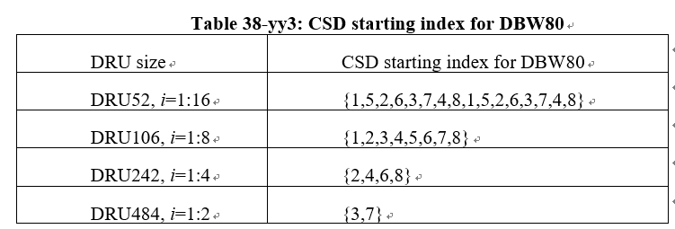
CSD Starting Index for DBW60 (1/3)
We agreed CSD starting index for DBW80 as follows
We can simply reuse the above table for DBW60 (Option 1)
The same CSD starting index can be used for the same DRU index
Note that CSD is used for DRU UHR-STF transmission to solve unintentional beamforming issue
DRU size | CSD starting index for DBW60
DRU52, i=1:12 | {1,5,2,6,3,7,4,8,1,5,2,6}
DRU106, i=1:6 | { 1, 2, 3, 4, 5, 6}
DRU242, i=1:3 | { 2, 4, 6}
Underlined indices have collision with other DRUs

Slide 4
CSD Starting Index for DBW60 (2/3)
To further reduce the collision of the CSD starting index between DRUs, we can modify CSD starting indices for some 52 DRUs (Option 2)
In this approach, we reuse the CSD starting indices for DBW80 as much as possible and minimize the collision
The maximum number of DRUs which have the same CSD index is 2 and 4 for Nss=1 and Nss=2, respectively
DRU size | CSD starting index for DBW60
DRU52, i=1:12 | {1,5,2,6,3,7,4,8,7,5,8,6}
DRU106, i=1:6 | { 1, 2, 3, 4, 5, 6}
DRU242, i=1:3 | { 2, 4, 6}
CSD indices in red are modified values
Underlined indices have collision with other DRUs for Nss=1

Slide 5
CSD Starting Index for DBW60 (3/3)
To further reduce the collision of the CSD index between DRUs for Nss=2, we can modify CSD starting indices for some 52 DRUs (Option 3)
In this approach, we still reuse the CSD starting indices for DBW80 as much as possible and minimize the collision
The maximum number of DRUs which have the same CSD index is 2 and 3 for Nss=1 and Nss=2, respectively
This approach also has no collision for 242 DRUs
Option 1 is sufficient for AGC as shown in [1] and it is preferable in terms of implementation
DRU size | CSD starting index for DBW60
DRU52, i=1:12 | {1,5,2,7,3,7,4,8,1,5,3,6}
DRU106, i=1:6 | { 1, 2, 3, 4, 5, 6}
DRU242, i=1:3 | { 2, 4, 6}
CSD indices in red are modified values
Underlined indices have collision with other DRUs for Nss=1

Slide 6
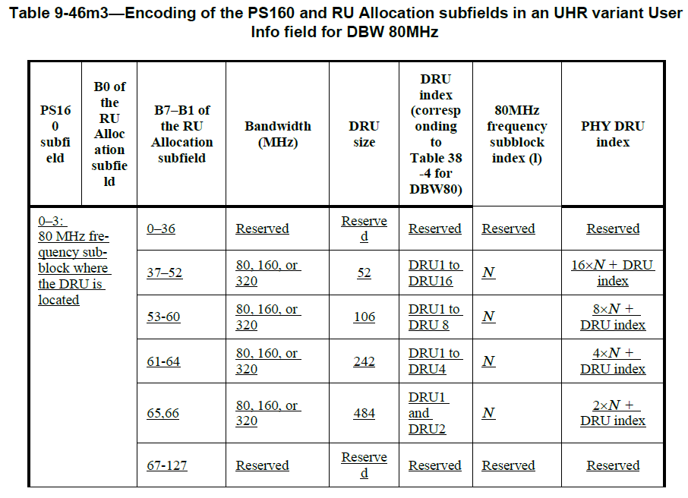
PS160 and RU Allocation Subfields for DBW60 (1/2)
The following table describes encoding of the PS160 and RU allocation subfields in a UHR variant User Info field for DBW80

Slide 7
PS160 and RU Allocation Subfields for DBW60 (2/2)
We can modify the table in the previous slide for DBW60
While we can also consider modifying the PHY DRU index based on the number of DRUs for DBW60 in each 80 MHz frequency subblock, we prefer to keep the values as in the DBW80 design for consistency and simple implementation
PS160 subfield | B0 of the RU Allocation subfield | B7-B1 of the RU Allocation subfield | Bandwidth (MHz) | DRU Size | DRU index | 80MHz frequency subblock index (l) | PHY DRU index
0-3: 80 MHz frequency subblock where the DRU is located |  | 0-36 | Reserved | Reserved | Reserved | Reserved | Reserved
 |  | 37-48 | 80, 160, or 320 | 52 | DRU1 to DRU12 | N | 16xN + DRU index
 |  | 49-52 | Reserved | Reserved | Reserved | Reserved | Reserved
 |  | 53-58 | 80, 160, or 320 | 106 | DRU1 to DRU6 | N | 8xN + DRU index
 |  | 59-60 | Reserved | Reserved | Reserved | Reserved | Reserved
 |  | 61-63 | 80, 160, or 320 | 242 | DRU1 to DRU3 | N | 4xN + DRU index
 |  | 64-127 | Reserved | Reserved | Reserved | Reserved | Reserved

Slide 8
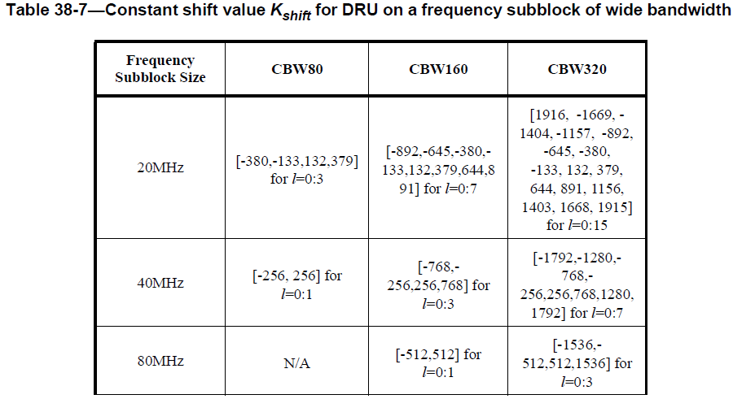
Constant Shift Value in Wide Bandwidth for DBW60
The following table describes constant shift value for DRU on a frequency subblock of wide bandwidth
For DBW60, we can just use the constant shift value defined in the 80 MHz frequency subblock
DBW60 is defined in an 80 MHz frequency subblock where the last 20 MHz is punctured
Constant shift values defined in 20 / 40 / 80 MHz frequency subblocks are used for DBW20 / DBW40 / DBW80, respectively

Slide 9
Straw Poll #1
Do you support to add the following table for encoding of the PS160 and RU allocation subfields in a UHR variant User Info field for DBW60 to the 11bn SFD?
PS160 subfield | B0 of the RU Allocation subfield | B7-B1 of the RU Allocation subfield | Bandwidth (MHz) | DRU Size | DRU index | 80MHz frequency subblock index (l) | PHY DRU index
0-3: 80 MHz frequency subblock where the DRU is located |  | 0-36 | Reserved | Reserved | Reserved | Reserved | Reserved
 |  | 37-48 | 80, 160, or 320 | 52 | DRU1 to DRU12 | N | 16xN + DRU index
 |  | 49-52 | Reserved | Reserved | Reserved | Reserved | Reserved
 |  | 53-58 | 80, 160, or 320 | 106 | DRU1 to DRU6 | N | 8xN + DRU index
 |  | 59-60 | Reserved | Reserved | Reserved | Reserved | Reserved
 |  | 61-63 | 80, 160, or 320 | 242 | DRU1 to DRU3 | N | 4xN + DRU index
 |  | 64-127 | Reserved | Reserved | Reserved | Reserved | Reserved

Slide 10
Straw Poll #2
Do you support to add the following to the 11bn SFD?
The constant shift value defined in the 80 MHz frequency subblock is used for DBW60

Slide 11
References
[1] 11-25-0358-00-00bn-open-topics-for-dru-on-60mhz

