Slide 1
TSF for trigger based AMP communication
Mar 2025
Doc.: IEEE 802.11-25/0342r0
Date: 2025-03-06
Authors:
Name | Affiliation | Address | Phone | Email
Chuanfeng He | OPPO |  |  | hechuanfeng@oppo.com
Weijie Xu |  |  |  | xuweijie@oppo.com
Yinan Qi |  |  |  | v-qiyinan@oppo.com

Slide 2
Background
Doc.: IEEE 802.11-25/0342r0
The motion about the support of AMP TSF, duty cycle operation and the trigger based AMP uplink PPDU transmission were agreed.[1]
MM-1: If AMP device is able to support AMP TSF, the maximum timing offset is ±10⁴ ppm.
MM-2: 11bp defines a mechanism to allow an AP to solicit AMP uplink PPDU(s) from one or more 802.11bp clients.
MM-4: If an AMP device is able to support TSF, it can monitor AMP DL Frame in a duty-cycle manner.
PM-2: 11bp defines at least one mode of MAC/PHY that allows an AMP-only device with active uplink communication in 2.4GHz subject to the following requirements:
clock accuracy requirement is relaxed compared to legacy 802.11 devices;
the active uplink communication can only be sent in response to being polled by the AP.
It has not been discussed on how to support TSF for the trigger based AMP uplink PPDU transmission mechanism.
Chuanfeng He (OPPO)

Slide 3
Mar 2025
Doc.: IEEE 802.11-25/0342r0
Recap: Timestamp
Timestamp in legacy 802.11 standards
Timestamp is used to synchronize the TSF timer of non-AP STAs in BSS.
TSF timer is used for STAs to derive the time of TBTT, TWT, SP, and so on.
Each STA shall maintain a TSF timer which is able to span 2⁶⁴ microseconds.
The size of timestamp is 8 Octets, which is carried in Beacon or Probe Response frame.
Slide 3
Chuanfeng He (OPPO)

Slide 4
Mar 2025
Doc.: IEEE 802.11-25/0342r0
Recap: Duty cycle and Multiple access operation
Duty cycle operation [1][2]
It is challenging for AMP STA to perform consistent monitoring for potential AMP trigger for uplink transmission due to limited power storage.
Duty-cycle operation can reduce the time duration of AMP STAs Rx, which are the main contributors of power consumption during awake time.
The motion about duty cycle operation for AMP DL frame monitoring was agreed.
Trigger based multiple access for AMP [1] [3]
Burst uplink traffic from large number of AMP device is typical for AMP communication, e.g. in logistics and warehouse scenarios.
Sequential polling/trigger is inefficient for the access of large number of AMP device.
Multiple access mechanism can address the burst type uplink traffic from large number of AMP device, including TDM, FDM and CDM.
The motion about trigger based AMP uplink PPDU(s) from one or more 802.11bp clients was agreed.
Slide 4
Chuanfeng He (OPPO)

Slide 5
Mar 2025
Doc.: IEEE 802.11-25/0342r0
Timestamp for AMP TSF
Awake duration of AMP STA evaluation:
For the power consumption of AMP STA during service period
SP power consumption: 10uW[4]
A fully charged capacitor of 24µF(27µJ with 1.5V) can only cover the power consumption for 2.7 seconds, which can contain 540 SPs with 5ms for each SP.
For the power consumption of AMP STA during idle
Clock power consumption: 510pW [4]
Idle Power consumption: 0.1uW [4]
A fully charged capacitor of 24µF can only cover the power consumption of AMP STA in idle for 268 seconds.
For the power consumption of AMP STA with duty cycle
Assuming on/off ratio is 20%, e.g. 5ms SP every 100ms(SP=5ms, duty cycle period=100ms), a fully charged capacitor of 24µF can cover the power consumption of AMP STA for 45 seconds, which covers 450 duty cycle periods.
If AMP STA performs energy harvesting during idle state, it can keep online for longer time. This depends on WPT from energizer controlled by AP. Typically, AP decides to provide WPT when necessary. WPT is not always available for energy harvesting.
Slide 5
Chuanfeng He (OPPO)

Slide 6
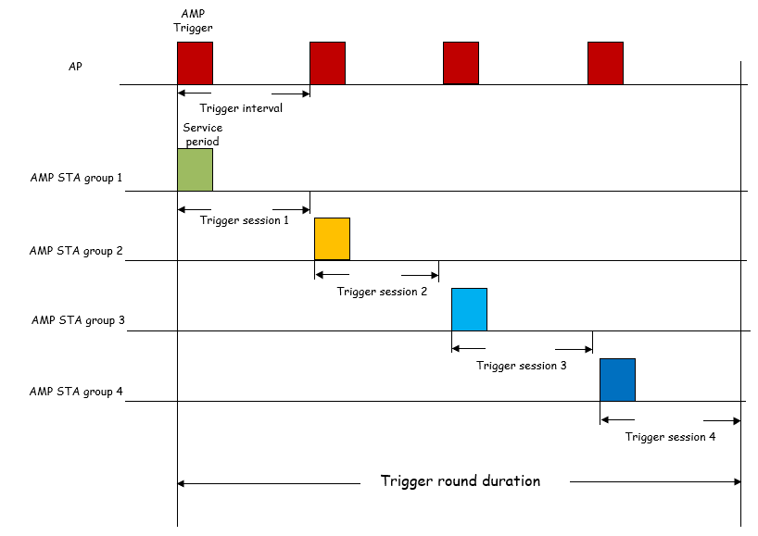
Mar 2025
Doc.: IEEE 802.11-25/0342r0
Timestamp for AMP TSF
Timestamp length to address a clock drift of 1%.[5]
We can assume 268 seconds as the longest duty cycle. To correct 1% clock drift, the length of TSF timer should be $\log_{2}{(268∗1e6∗1\%)}=$21-22 bits. Consider the use of the timing granularity in the order of 32us as 11ba, we can drop the first 5 LSB of TSF to support 17bits AMP timestamp.
Actually, duty cycle period up to 268 seconds is not reasonable for many use cases, such as inventory and real time sensor. Typical duty cycle period for these use cases may be from several tens of milliseconds to 1000ms, which results in maximum 14-5=9bits AMP timestamp.
Trigger round duration
A trigger round includes several trigger sessions initiated by AMP trigger.
For use case such as inventory, AP may try to traverse all the AMP STAs within a trigger round duration, based on random access mechanism.
A trigger round duration should not be too long because of latency and limited energy storage.
Slide 6
Chuanfeng He (OPPO)

Slide 7
Mar 2025
Doc.: IEEE 802.11-25/0342r0
Timestamp for AMP TSF
Observations:
The total awake duration of AMP STA may be short due to limited power storage.
The maximum duty cycle period can not be too long for several use cases, which require low latency.
The clock drift is limited within the maximum duty cycle period, which only requires short timestamp. The TSF timer can only span the maximum duty cycle period to make AMP STA timing synchronized before the next AMP trigger reception.
The trigger round duration ,which is equivalent to operation duration of AMP STA for success UL PPDU transmission, should be short. The TSF timer can only need to cover trigger round duration to make AMP STA timing synchronized before success UL PPDU transmission.
Proposals:
Introduce short timestamp for AMP TSF.
Slide 7
Chuanfeng He (OPPO)

Slide 8
Mar 2025
Doc.: IEEE 802.11-25/0342r0
Timestamp delivery
Observations:
The main contribution of timestamp is to allow Duty-cycle operation for trigger monitoring.
The duty cycle period of AMP STA should be short in most use cases, which are latency sensitive. It means AMP trigger is transmitted more frequently. Even for some inactive traffic like sensor, AMP trigger should be transmitted frequently for potential UL transmission from sensor with different SPs.
The main behavior of AMP STAs is the monitoring of AMP trigger. It is easier for AMP STA to obtain timestamp self contained in AMP trigger.
Beacon is a parallel frame for AMP STA. It may have functionalities other than AMP trigger, if it remains exit for AMP operation. Timestamp reception through beacon brings additional complexity and power consumption.
Proposal:
AMP STA can obtain a short timestamp through AMP trigger.
Slide 8
Chuanfeng He (OPPO)

Slide 9
Mar 2025
Doc.: IEEE 802.11-25/0342r0
Timestamp delivery in AMP Trigger
TSF timer start or alignment based on timestamp in AMP trigger.
Service period starting determination based on TSF timer.
TSF timer spanning at least one duty cycle period.
Slide 9
Chuanfeng He (OPPO)

Slide 10
Mar 2025
Doc.: IEEE 802.11-25/0342r0
Proposal
Introduce short timestamp for AMP TSF. The length of timestamp is TBD.
AMP STA can obtain a short timestamp through AMP DL Frame sent by AP for soliciting AMP uplink PPDU(s) from one or more 802.11bp clients.
Slide 10
Chuanfeng He (OPPO)

Slide 11
Mar 2025
Doc.: IEEE 802.11-25/0342r0
Straw Poll #1
Do you agree with the following text:
Short timestamp is defined to support AMP TSF. The length of timestamp is TBD.
Yes
No
Abstain
Slide 11
Chuanfeng He (OPPO)

Slide 12
Mar 2025
Doc.: IEEE 802.11-25/0342r0
Straw Poll #2
Do you agree with the following text:
If an AMP device is able to support TSF, it can obtain timestamp through AMP DL Frame sent by AP for soliciting AMP uplink PPDU(s) from one or more 802.11bp clients.
Yes
No
Abstain
Slide 12
Chuanfeng He (OPPO)

Slide 13
Reference
Mar 2025
Doc.: IEEE 802.11-25/0342r0
IEEE 802.11-24/1613r4, Specification framework for tgbp
IEEE 802.11-25/0032r0, Duty cycle AMP operation
IEEE 802.11-25/0031r0, Trigger based multiple access for AMP
IEEE 802.11-25/0039r0, AMP Open Service Period
IEEE 802.11-25/0285r0, SP Timing Synchronization with AMP Beacon

