Slide 1
Channel access for Active Tx non-AP AMP STAs – follow up
Date: 7 March 2025
Name | Affiliation | Address | Phone | Email
Rojan Chitrakar | Huawei | Singapore |  | rojan.chitrakar@huawei.com
Lei Huang
Ian Bajaj
Notes:
Jul 12, 2010
Page 1

Slide 2
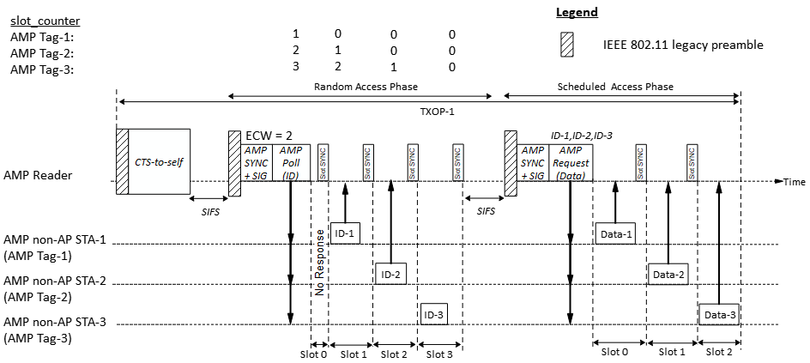
Recap: Time-slot based channel accessActive Tx non-AP AMP STAs [1]
A time-slot based channel access may be based on random access or scheduled access. An AMP AP initiates a random access when it is not aware of the identities of the non-AP AMP STAs in its coverage, while it uses the scheduled access to communicate with AMP STAs that are known to it. The random access phase can be omitted if the AMP AP is already aware of the AMP tag’s IDs.
Slots Sync may be transmitted at slot boundaries to help the non-AP AMP STAs to align with the slots.
Notes:
Some concerns were received in the past meeting about the overhead of Slot SYNC during the random access phase.

Slide 3
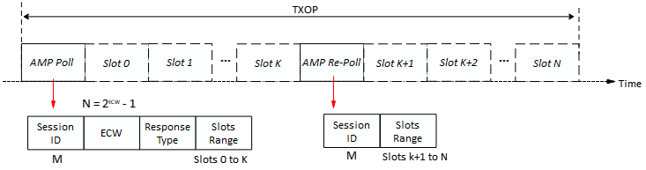
Recap: Time-slot based random access (1/3) [6], [7]
Random access procedure:
1. The AMP AP gains access to wireless medium and transmits a first AMP frame (e.g., an AMP Poll frame) to start a random access session. The frame indicates:
Session ID: Identifies the random access session
The total number of random access slots = 2^{ECW}
2. Upon receiving an AMP Poll frame, a non-AP AMP STA randomly choose a slot_counter in the range [0, 2^{ECW} - 1]. If slot_counter is 0, the AMP STA transmits the requested response in slot 0, else it decrements the slot_counter at each subsequent slot boundary and transmits the requested response in the slot in which the slot_counter reaches 0.
3. The AMP AP may transmit a second AMP frame (e.g., an AMP Re-Poll) to continue the random access session and indicates:
Session ID: Identifies the random access session
4. Upon receiving an AMP Re-Poll frame (with a matching Session ID), the non-AP AMP STA decrements the slot_counter. If slot_counter is 0, the AMP STA transmits the requested response in the following slot, else it decrements the slot_counter at each subsequent slot boundary and transmits the requested response in the slot in which the slot_counter reaches 0.
The range of slots allocated by the frame
Solicited Response Type(s) (e.g., ID, Sensor Data etc.)
The range of slots allocated by the frame

Slide 4
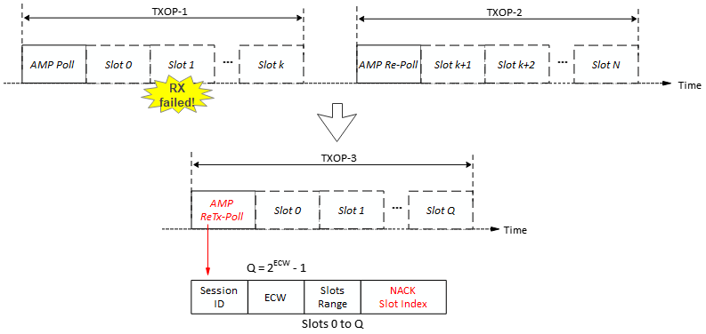
Recap: Time-slot based random access (2/3) [6], [7]
Random access procedure:
5. Upon detecting failed reception in a slot (e.g., due to collisions, or other interference), the AMP AP initiates a selective random access retransmission procedure by transmitting a third AMP frame (e.g, AMP ReTx-Poll frame):
Session ID: Identifies the random access session
  NACK Slot Index: Index of slot or slots for which retransmission is solicited.
Only the AMP non-AP STAs that had transmitted in the slot indicated by the NACK Slot index will participate in the retransmission random access session.
The total number of random access slots = 2^{ECW}
The range of slots allocated by the frame
= Slot 1

Slide 5
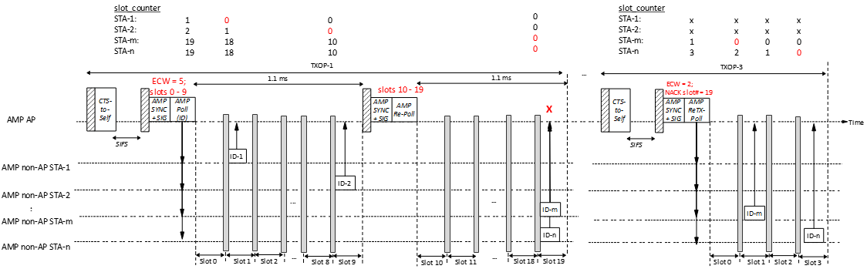
Recap: Time-slot based random access (3/3) [6], [7]
Random access procedure (An example):
If the solicited response type is short (~100 uS), random access may be used on its own (i.e., scheduled transmission is not required).
If the number of slots per Poll frame is limited (e.g., 10 slots), guard intervals (e.g., 10 uS) between slots is sufficient to prevent inter-slot collisions.
Due to the low DL data rate, explicit ACKs cause very high overhead, at times being larger than the solicited UL response! Selective retransmission random access session can be used to resolve collisions, if any.

Slide 6
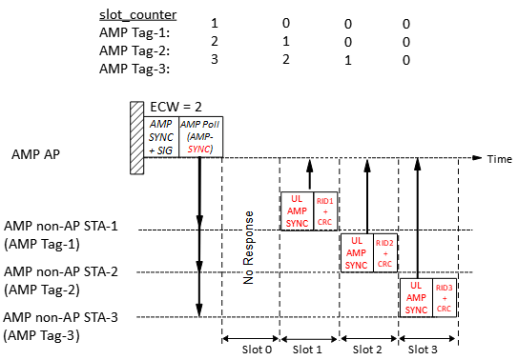
Compact Time-slot based random access
If the solicited response is long (say > 200 uS), using random access alone may not be the best option due to the increased risk of collision/interference during the UL transmission. Two step process, with a compact random access phase, followed by selective scheduled transmission will be more efficient.
Compact random access procedure:
1. The AMP frame (e.g., an AMP Poll frame) that starts a random access session indicates:
Solicited Response Type = AMP-SYNC
2. Upon receiving an AMP Poll frame, a non-AP AMP STA randomly choose a slot_counter in the range [0, 2^{ECW} - 1], and a short Random ID (RID) and transmits a compact response (UL AMP-SYNC + RID + CRC) in the slot in which the slot_counter reaches 0.
3. The AMP AP records the indices of the random access slots in which it successfully receives the short response. Failure to correctly receive a RID indicates collision in a slot.
4. Since the Slots are not large, guard intervals of a few µS between the slots may be sufficient to prevent inter-slot collisions.
Assuming UL AMP-SYNC with 16 bits, 2 bits RID and 2 bits CRC and ~10% guard interval, the slot duration required:
@250 kbps = ~88 µS; @1 Mbps = ~22 µS; @ 4 Mbps = ~5.5 µS
Even at @250 kbps and random access with 16 slots, the worst drift (@10K ppm) at the start of the 16th slot is @13 µS.
Notes:
@250 kbps, with 70 uS slots, the 16th slot starts at 1050 uS.

Slide 7
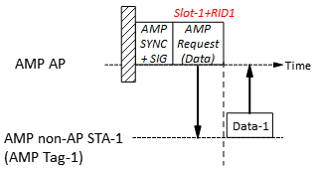
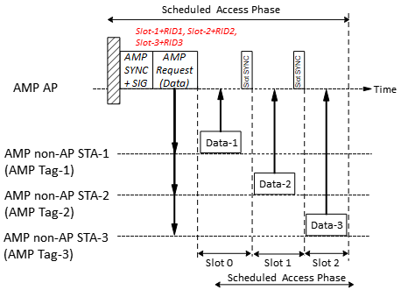
Time-slot based scheduled access
Scheduled access procedure:
The AMP AP transmits a control frame (e.g., an AMP Request frame) assigning transmission time-slots to one or more non-AP AMP STAs based on the RID and the slot index of the Random Access phase in which it successfully received the RID. Random access slots in which RID is not received (due to no response, or collision etc.), is not assigned a time-slot in the Scheduled Access phase. The AMP Request frame may also specify the solicited response (e.g., MAC Address, Buffer Date etc.).
If an AMP STA receives an AMP Request frame and finds the index of the slot in which it transmitted an RID in the Random Access Phase assigned a time-slot in the AMP Request frame and the RID matches, it transmits its response in the assigned time-slot.
If the slot duration is large (e.g., > 1 ms), the AMP AP may transmit a Slot Sync at slot-boundaries to indicate start of a time-slot but if the slot duration is small, guard interval may be sufficient.

Slide 8
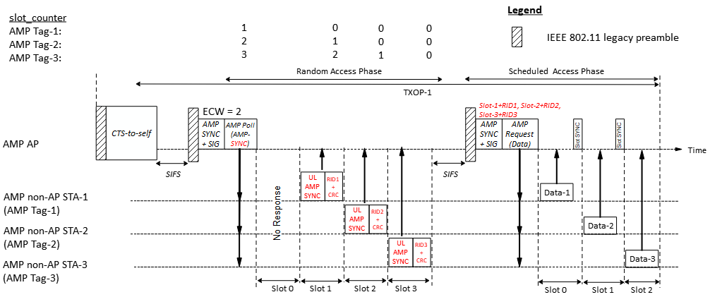
Time-slot based channel access
Example:
During random access session, Tag 1, 2 and 3 successfully transmits UL AMP-SYNC+RID in slot 1, 2 and 3 respectively.
Subsequently, the AMP AP schedules the tag that transmitted RID in Slot 1 (Tag 1) to transmit in Slot 0, the tag that transmitted RID in Slot 2 (Tag 2) to transmit in Slot 1 and the tag that transmitted RID in Slot 3 (Tag 3) to transmit in Slot 2 of the scheduled transmission session.

Slide 9
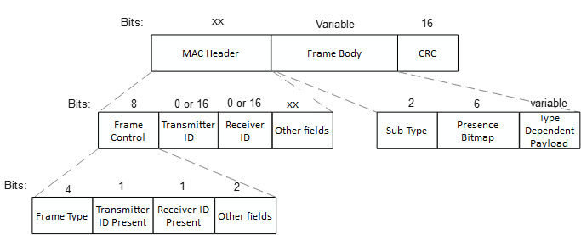
AMP frame
Similar to the views expressed in [3], [4], we propose that AMP frame be designed similar to WUR frames, only carrying the absolutely essential fields.
One AMP Frame Type (AMP Trigger) may be used to initiate time-slot based channel access
Frame Type | Name | Description
0 | AMP Trigger | AMP frame to solicit a response from non-AP AMP STAs either during random access or scheduled access.
… | …
X | AMP UHF | AMP frames used to encapsulate UHF commands
X+1 ~ 15 | - | Reserved

Slide 10
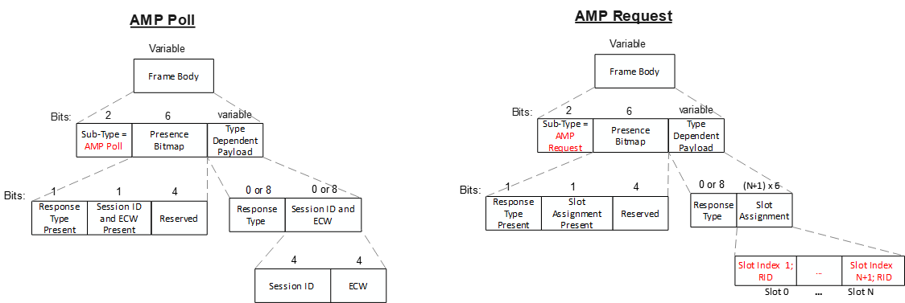
AMP Trigger frames
The parameters to be carried in the AMP Trigger frame will be different for random access and scheduled access. In order to keep the frames compact, we propose to define different sub-types of the AMP Trigger frame, e.g., AMP Poll, AMP Re-Poll, AMP ReTx-Poll for random access and AMP Request for scheduled access.
Slot index of the Random Access phase & RID
Indicates that AMP-SYNC is solicited.

Slide 11
Summary
We discussed the details of the time-slot based channel access for active TX AMP STAs and propose:
  The time-slot based channel access may be based on random access or scheduled access.
  If the solicited response type is short, random access may be used on its own.
  If the solicited response is long, two step process, with a compact random access phase, followed by selective scheduled transmission may be used.
    During random access, AMP tags transmits the UL AMP-SYNC and a Random ID to keep the slots short.
    During scheduled access, AMP AP may assign time-slots to one or more AMP tags based on the slot index of the Random Access phase
  We propose to define different sub-types of the AMP Trigger frame, e.g., AMP Poll for random access and AMP Request for scheduled access.

Slide 12
SP 1
Do you agree to add to 11bp SFD:
802.11bp supports a channel access mechanism for Active Tx non-AP AMP STAs that may continue over two or more TXOPs.
  An AMP AP initiates the channel access by transmitting an AMP frame in a first TXOP.
  The AMP AP may continue the channel access in a second TXOP by transmitting another AMP frame in the second TXOP.
  An Active Tx non-AP AMP STA may transmit the solicited response in one of the TXOPs.
  Further details (e.g., frame formats etc.) are TBD.

Slide 13
SP 2
Do you agree to add to 11bp SFD:
802.11bp supports a time-slot based channel access mechanism for Active Tx non-AP AMP STAs.

Slide 14
SP 3
Do you agree to add to 11bp SFD:
802.11bp supports a time-slot based random access mechanism for Active Tx non-AP AMP STAs:
  AMP AP transmits an AMP frame to start a random access session with two or more random access time-slots.
  An Active Tx non-AP AMP STA that receives the AMP frame, may randomly choose one of the random access time-slots and transmit its response in the time-slot.
  Further details (e.g., frame formats, how a STA choses a random access time-slot etc.) are TBD.

Slide 15
SP 4
Do you agree to add to 11bp SFD:
802.11bp supports a time-slot based scheduled access mechanism for Active Tx non-AP AMP STAs:
  AMP AP transmits an AMP frame to assign one or more transmission time-slots.
  An Active Tx non-AP AMP STA that receives the AMP frame, transmit its response in an assigned time-slot.
  Further details (e.g., frame formats, how the time-slots are assigned etc.) are TBD.

Slide 16
References
[1] 25/0046r0, Channel access for Active Tx non-AP AMP STAs (Rojan Chitrakar et. al.)
[2] 24/1776r1, Multiple access mechanisms for AMP (Chuanfeng He et. al.)
[3] 24/1811r0, Frame format discussion (Liwen Chu et. al.)
[4] 11-24/1537r2, Wireless connectivity challenges for AMP only IoT devices under 802.11 specification (Solomon Trainin)
[5] 11-25/252r0, Slotted vs Pure Aloha for Active Transmitter AMP Use Cases (Amichai et. al.)
[6] 11-24/1212r0, Discussions on AMP Channel access (Rojan Chitrakar et. al.)
[7] 11-24/1549r0, Follow-up on AMP Channel access (Rojan Chitrakar et. al.)

