Slide 1
Challenges in Downlink Bandwidth Control in 1 Mb/s PPDU
Date: 2025-03-10
Authors:
Name | Affiliations | email
Steve Shellhammer | Qualcomm | shellhammer@ieee.org
Bin Tian |  | btian@qti.qualcomm.com
Pooria Pakrooh |  | ppakrooh@qti.qualcomm.com
Manideep Dunna |  | mdunna@qti.qualcomm.com
Alice Chen |  | alicel@qti.qualcomm.com

Slide 2
Background
The Downlink supports two data rates
1 Mb/s
250 kb/s
The Downlink uses OOK
The Downlink Data field uses Manchester encoding
Hence the OOK symbol duration in the Data field is 0.5 µs
Based on ETSI and China regulations it is beneficial to have wider bandwidth in the Downlink to allow for higher transmit power in those regulatory domains

Slide 3
ETSI and China Regulations
From [1] we see the ETSI and China 2.4 GHz regulations
Region | Power Limit (dBm) | PSD Limit (dBm/MHz)
ETSI | 20 | 10
China | 20 | 10
The PSD limit is measured in 1 MHz bandwidth
So, the highest power in any 1 MHz bandwidth controls the total allowed transmit power

Slide 4
Challenges in using OFDM Symbol for Bandwidth Control
Several previous presentations have looked at some of the challenges in generation a wideband Downlink 1 Mb/s PPDU
In [2, 3, 4] it was pointed out that for a 20 MHz OFDM symbol with duration of 0.5 µs, only a few (e.g., 8) subcarriers can be used
In [3] it was pointed out that “Because of the small IFFT size, the variations in PSD will reduce the total allowed power in case of PSD limited transmission, as the PSD is measured over 1 MHz”
They suggested that “To reduce these variations, “randomization in frequency may be used”

Slide 5
Challenges with using a Barker Code for Bandwidth Control
In [4] they showed the use of a Barker code (like in DSSS) for the 250 kb/s Downlink
However, if we want to use a Barker code for 0.5 us OOK symbols, there are some challenges
First, if we were to use an 11-bit Barker code, like in DSSS, the bandwidth would be 44 MHz, and not 22 MHz
This is because the 0.5 µs symbol is half the duration of the 1 µs symbol used in DSSS
Another approach is to use a shorter Barker code, but that does not reuse the DSSS design

Slide 6
Challenges with using a Barker Code for Bandwidth Control
One possibility is to use a 5-bit Barker code for spreading the 0.5 µs OOK symbols
The 5-bit Barker code is $[1, 1, 1, −1, 1]$
We try that code and apply it to a zero-mean OOK sequence
We plot the PSD of the unfiltered and filtered spread sequence
We also show the DSSS Spectral mask

Slide 7
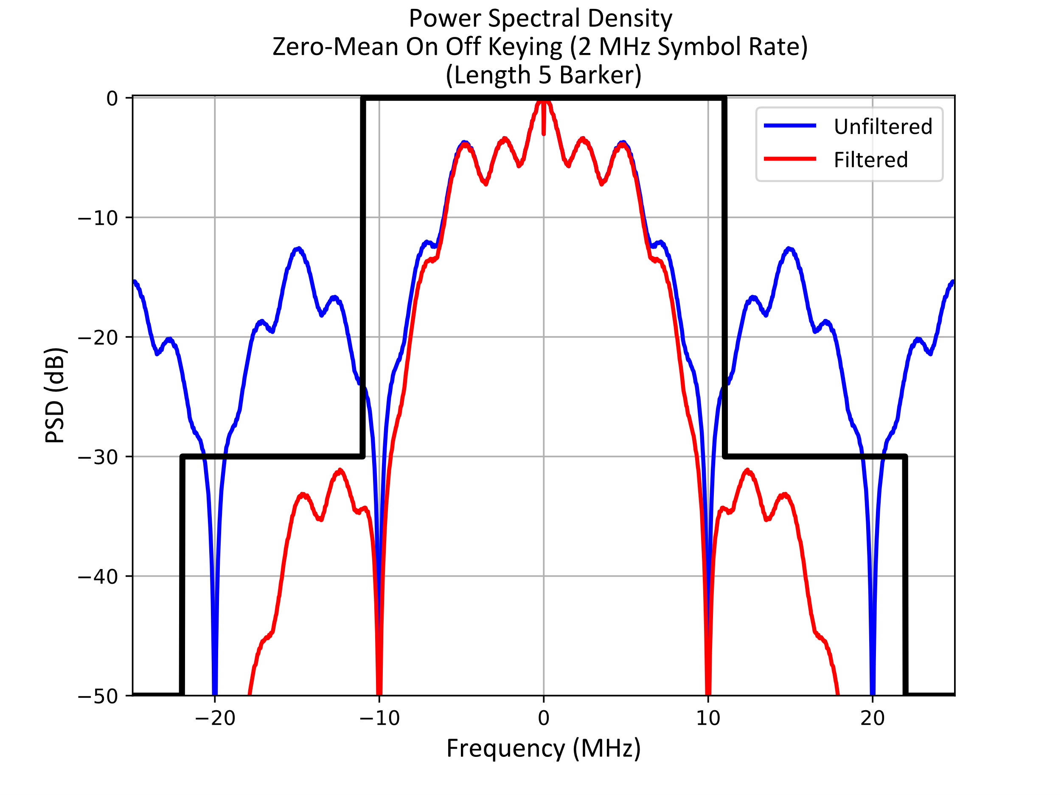
Challenges with using a Barker Code for Bandwidth Control
We see with some filtering the PSD fits within the DSSS spectral mask
However, the PSD is not very flat, which will lead to a loss in transmit power based on PSD regulatory limits

Slide 8
Conclusions
There are benefits in a wideband Downlink in ETSI and China regulatory domains, since it allows higher transmit power
However, widening the bandwidth using a 0.5 µs OFDM symbol has challenges, as identified in several presentations
Also, widening the bandwidth using a 5-bit Barker sequence does not provide a flat PSD, which also limits the allowed transmit power

Slide 9
References
Steve Shellhammer and Bin Tian, “Regulations and Noise Figure – Impact on SNR,” IEEE 802.11-17/365r0, March 2017
Wang Ke, Shengjing Cui, Weijie Xu, “OOK generation for AMP DL,” IEEE 802.11-24/1802r0, November 2024
Leif Wilhelmsson, Sebastian Max, and Dennis Sundman, “Signal Design for OOK,” IEEE 802.11-25/51r0, January 2025
Panpan Li, Bin Qian, and Lei Huang, “AMP DL Wideband OOK Generation,” IEEE 802.11-25/50r0, January 2025

