Slide 1
Follow-up on WPT: Protocol, Waveform and PPDU
March 2025
Doc.: IEEE 802.11-25/0320r0
Date: 2025-03-13
Authors:
Name | Affiliation | Address | Phone | Email
Yinan Qi | OPPO |  |  | v-qiyinan@oppo.com
Weijie Xu
Chuangfeng He

Slide 2
Abstract
Doc.: IEEE 802.11-25/0320r0
In this contribution, we discuss the following issues:
WPT protocol between energizer and AMP device
Co-existence of WPT signals

Slide 3
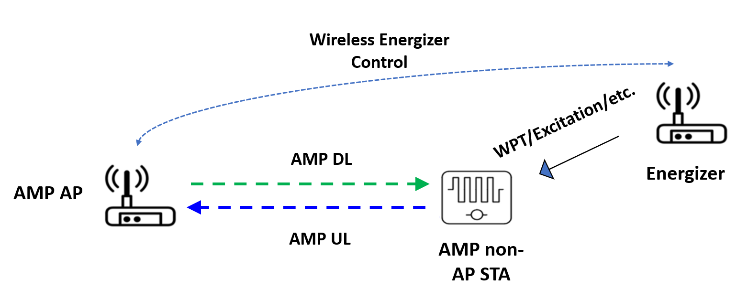
March 2025
Doc.: IEEE 802.11-25/0320r0
Recap of Progress
Agreement: IEEE 802.11bp defines a mechanism that allows an AMP non-AP STA to report its energy harvesting and power related information to AMP AP STA. The parameters that are included in the report and how to report such information is TBD.
Energizer can potentially transmit other signals, e.g., preamble, wake-up signal, etc.
Two main challenges
How does the AMP STA report to the AP?
What information should be conveyed in this report?
Slide 3
Yinan Qi (OPPO)

Slide 4
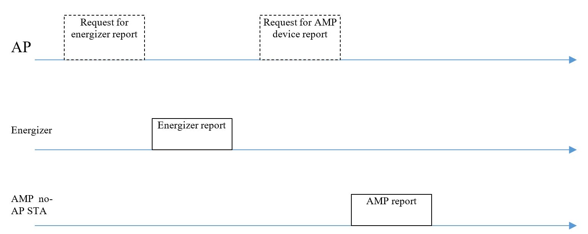
March 2025
Doc.: IEEE 802.11-25/0320r0
WPT Protocol: AMP non-AP STA Reporting
Long-term/non-periodic v.s. short-term/periodic feedback
Long-term/non-periodic feedback info
Less frequent, sometimes only once
Can be done at the beginning of communication or upon the request of the AP
Information such as EH related information, energy storage related information, etc.
Short-term/periodic feedback info
More frequent and can be real time
In formation such as power status/requirements
Slide 4
Yinan Qi (OPPO)

Slide 5
March 2025
Doc.: IEEE 802.11-25/0320r0
WPT Protocol: AMP non-AP STA Reporting
Joint reporting v.s. individual reporting
Joint reporting
Less signalling overhead and less energy consumption
Power category can jointly indicate the power status of the AMP non-AP STAs [1]
Individual reporting
High signalling overhead and high energy consumption
Joint reporting can be baseline and individual reporting can be optional and only reported when necessary.
Slide 5
Yinan Qi (OPPO)

Slide 6
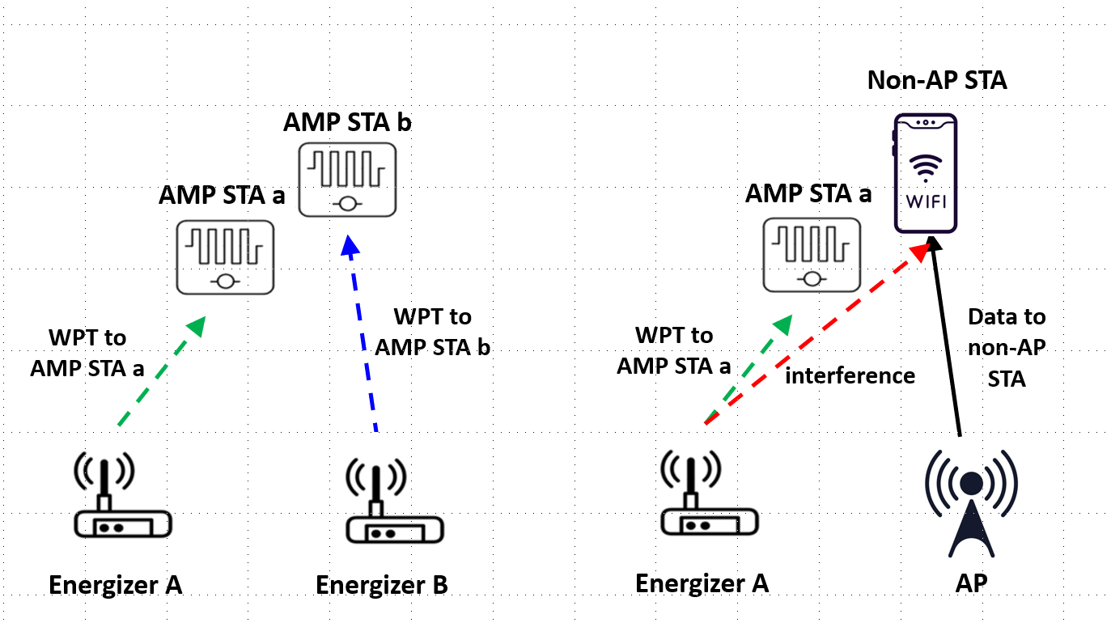
March 2025
Doc.: IEEE 802.11-25/0320r0
WPT PPDU: Co-existence Issue
Two co-existence cases
Co-existence between WPT signals should be allowed
No interference issue
Maybe even beneficial with mutual enhancement
Co-existence between WPT signals and other 802.11 systems on S1G, e.g., 802.11ah, or even non-WiFi S1G systems, e.g., Smart Utility Networks, Low Energy, Critical Infrastructure Monitoring, etc.
May cause heavy interface since the high Tx power of WPT to reach the AMP devices
Slide 6
Yinan Qi (OPPO)

Slide 7
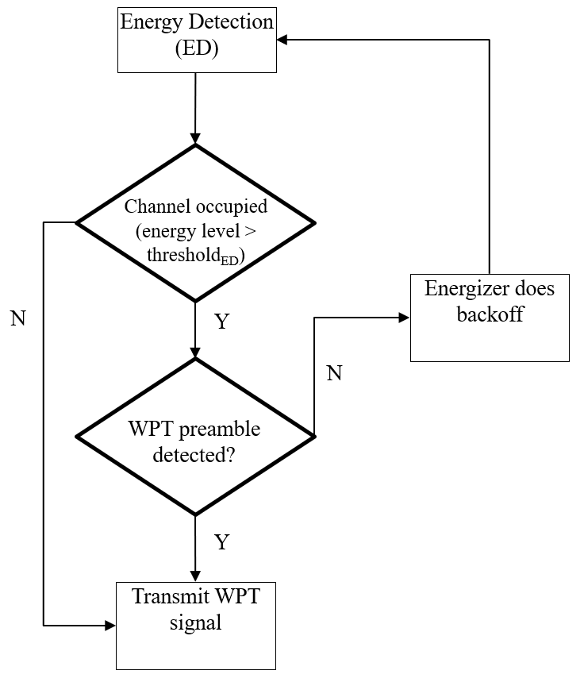
March 2025
Doc.: IEEE 802.11-25/0320r0
WPT Procedure
AP can coordinate the WPT procedure and control the Tx of WPT signal from the energizers.
Challenge: AP may not be able to reserve S1G channel for WPT
Energizer needs to do LBT by itself on S1G
The energizer can do ED first.
In the case of collision, the energizer needs to keep listening to the channel. If a preamble is detected, the energizer knows the signal is WPT signal and it can transmit its own WPT signal.
Otherwise, it no preamble is detected, the energizer assumes the signal in the air is communication signal and does backoff.
Design WPT signal that can be fully or partially understood by the energizer → WPT preamble.
Slide 7
Yinan Qi (OPPO)

Slide 8
Reference
March 2025
Doc.: IEEE 802.11-25/0320r0
[1] “AMP Device Power Status,” IEEE 802.11-24/1381r0, Aug. 2024

Slide 9
March 2025
Doc.: IEEE 802.11-25/0320r0
SP1
Do you agree to capture the following text to TGbp SFD?
AMP devices shall support joint reporting of energy and power related information, e.g., power status, to the AP during activation or upon the request of the AP?
The details on how to define power status are TBD
Slide 9
Yinan Qi (OPPO)

Slide 10
March 2025
Doc.: IEEE 802.11-25/0320r0
SP2
Do you agree to capture the following text to TGbp SFD?
WPT signals are allowed to overlap with each other.
Slide 10
Yinan Qi (OPPO)

Slide 11
March 2025
Doc.: IEEE 802.11-25/0320r0
SP3
Do you agree to capture the following text to TGbp SFD?
11bp specifies, in S1G, WPT PPDU format with at least a preamble and a charging field?
Slide 11
Yinan Qi (OPPO)

