Slide 1
Wireless Broadband Alliance (WBA) Liaison Report – March 2025
Date: 2025-03-12
Authors:
Name | Company | Address | Phone | Email
Necati Canpolat | Intel |  |  | necati.canpolat@intel.com

Slide 2
Wireless Broadband Alliance (WBA)
March 2025
Drives seamless & interoperable Wi-Fi services
Addresses business and technical issues, as well as opportunities in the industry
IEEE 802.11 (std dev) WFA (cert) WBA (enablement)

Slide 3
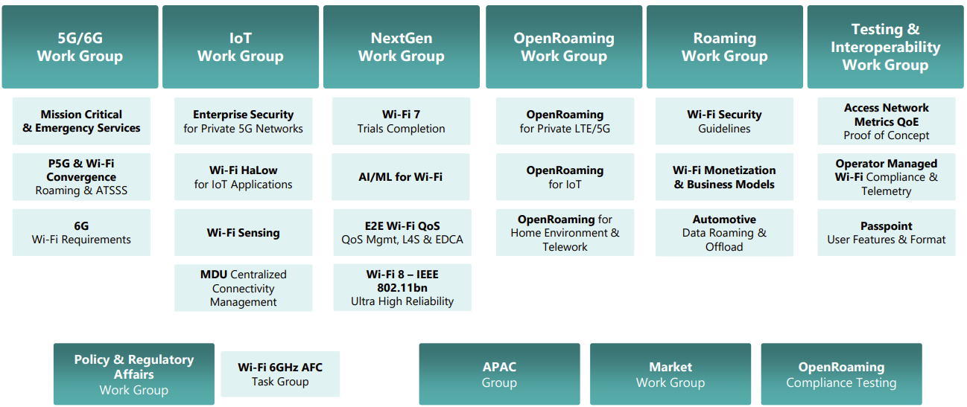
WBA Technical Activities & Roadmap for 2025
https://wballiance.com/wba-program-overview-2025/
https://wballiancec.com/proejcts-details

Slide 4
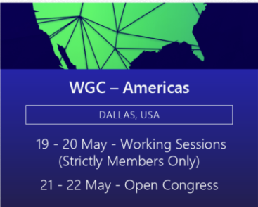
Wireless Global Congress & Members Meetings
https://www.wirelessglobalcongress.com/apac2025/
https://www.wirelessglobalcongress.com/
Presentations

Slide 5
Linux Foundation Broadband & WBA Partners
The partnership aims to foster collaboration between the open source and wireless broadband communities to accelerate the development and adoption of carrier-grade broadband solutions.
WBA and LF Broadband

Slide 6
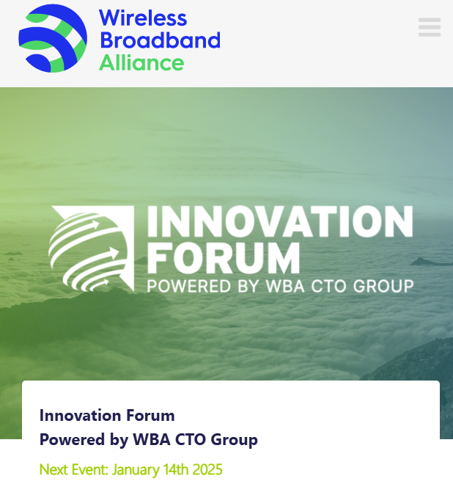
WBA Innovation Forum January
https://wballiance.com/innovation-forum/
Focus on key themes sharing perspectives that will shape the future of connectivity for the next decade and beyond

Slide 7
Enterprise Connectivity Forum
Launching Enterprise Connectivity Forum initiative focused on bringing enterprises together and fostering collaboration in the ecosystem
Open (free) Community
Networking and Collaboration
Pilot Programs and Proof of Concepts
Thought Leadership
https://wballiance.com/ecf/

Slide 8
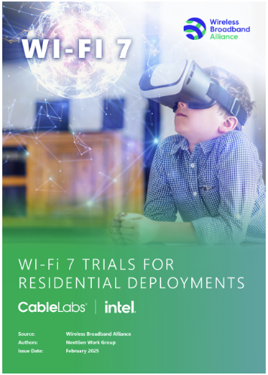
WBA Wi-Fi 7 Field Trials - CableLabs
WBA is conducting Wi-Fi 7 field trials with its participating members to evaluate and validate the key capabilities of Wi-Fi in real-life various deployment scenarios.
As part of this initiative, CableLabs and Intel collaborated to test Wi-Fi 7 in residential settings – focusing on evaluating the performance and coverage of Wi-Fi 7, assessing its benefits over previous generations.
This report presents performance data from testing Wi-Fi 7 and Wi-Fi 6E in a typical home environment, quantifying the improvements. The findings show that Wi-Fi 7 delivered significant enhancements over Wi-Fi 6.
https://wballiance.com/wi-fi-7-cablelabs-intel/

Slide 9
Operator-Managed Smart Home Industry Framework
A reference framework providing a dynamic roadmap for the future of Smart Homes, extending from WBA’s Operator Managed Wi-Fi project.
Evolving Connectivity Hubs: Visualizes smart homes as evolving connectivity hubs that enhance interoperability between established and emerging technologies.
Managed Wi-Fi Reference Architecture: Support residential service providers with a Managed Wi-Fi reference architecture that integrates IoT and Matter components, setting a new standard in interoperability.
https://wballiance.com/smart-home-iot-framework/

Slide 10
L4S Implementation Guidelines
L4S technology, the guidelines cover:
Reducing media access delays in Wi-Fi networks.
Enhancing network configurations.
Complementing QoS Management Stream Classification Services (SCS).
Optimizing Enhanced Distributed Channel Access (EDCA) parameters.
In 2025, the WBA will continue advancing L4S in coordination with QoS Management initiatives, including additional trials, report generation, provider surveys, and evolving L4S testing scenarios.
Download

Slide 11
Further information
WBA information at https://wballiance.com/
Current work areas https://wballiance.com/wba-program-overview-2025/
WBA resource center https://wballiance.com/resource/
WBA events https://wballiance.com/events-awards/
WBA memberships: https://wballiance.com/membership/

Slide 12
Backup

Slide 13
WBA ORGANIZATION
WBA IS A NONPROFIT ASSOCIATION WITH THE VISION TO ACCELERATE THE DEVELOPMENT OF
“SEAMLESS AND INTEROPERABLE WI-FI SERVICES”
Seamless, Secure and Interoperable Wi-Fi
Convergence and Coexistence of Wireless Technologies
Accelerate Next Generation Wi-Fi Networks
Established
in 2003
+200 MEMBERSHIP
COMMUNITY
PROJECTS &
PROGRAMS
3 ANNUAL
EVENTS
PROMOTION AND
GO-TO-MARKET
THOUGHT LEADERSHIP &
MARKET RESEARCH

Slide 14
WBA Focus Areas
WBA MEMBERS SOLVE
REAL BUSINESS ISSUES
Fosters success for its members
WBA’s mission is to enable collaboration between service providers, technology companies and organizations to drive positive change and enable opportunities for growth.
Standards & Specifications - Setting the scene, requirements and creating specifications
Testing & Interoperability - Creating test plans to showcase the technology capabilities
End-to-End Trials - Running field trials/ proof of concept on real-world environment
Guidelines & Best Practices – Accelerate deployments of services and technologies
Certification & Plug Fests - Addressing gaps and helping the industry to maximizing biz opportunities
Think Thank & Advocacy – Industry leaders roundtables and targeted verticals analysis

