Slide 1
Hybrid MLD architecture for Automotive
Date: 2025-03-06
Authors:

Slide 2
Abstract
A proposal for a hybrid network architecture aimed at enhancing Wi-Fi connectivity for moving vehicles.
The primary objective is to facilitate data offloading from cellular networks to Wi-Fi, reducing connectivity costs and addressing scalability concerns.

Slide 3
Key challenges with Wi-Fi in automotive
High-speed scenarios affecting scanning and roaming
  As vehicles quickly move through an AP's coverage area, frequent roaming to new APs is required, disrupting connectivity.
  Slow scanning for outdoor/DFS channels.
Intermittent Wi-Fi coverage
  Continuous Wi-Fi coverage challenging due to high deployment costs in urban areas, involving RF, power, and cabling issues.
  Vehicles often encounter non-contiguous Wi-Fi zones, leading to increased scanning, roaming and authentication overhead.
Need for seamless connectivity
  Disruptions in connectivity can affect data-intensive applications, such as streaming and infotainment services.

Slide 4
Scope of the proposed architecture
Scanning and roaming for high-speed applications
  Optimize the scanning process is essential to maximize the useful connection time within an AP's coverage.
  Leverage the vehicle’s geographical positioning to anticipate and manage Wi-Fi connectivity.
Session and key management
  Establish and maintain sessions even before the vehicle enters a coverage zone using Out-of-Band (OOB) connections to authenticate and manage session keys.
  Allow sessions to persist across non-contiguous Wi-Fi coverage areas, minimizing the need for constant re-authentication and re-association, providing a seamless user experience despite intermittent Wi-Fi availability.
  Allow recovery of session state, without full in-band authentication

Slide 5
Proposed solution overview
Hybrid Network Architecture:
Wi-Fi control plane using Out-of-Band (OOB) connections
  Leverage available connections such as cellular or satellite to handle OOB communication with the Wi-Fi infrastructure.
Integration with location positioning
  Reduced scanning and proactive knowledge of the expected coverage areas using currently known and/or future vehicle’s positions (e.g., via integration with car navigation system).
Leverage Multi-Link Operations (MLO)
  Physical links to each AP to be handled using MLO (add/remove link).

Slide 6
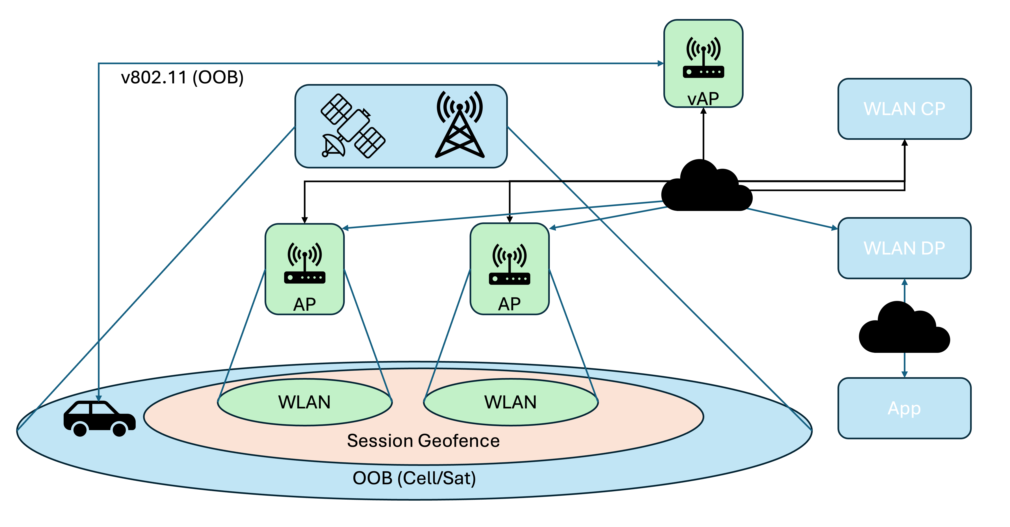
Architecture components

Slide 7
Communication flow overview (1)
OOB connection establishment:
  WLAN service discovery via OOB.
  Geographical WLAN discovery requests/responses.
  Fallback to In-band control plane if OOB is not available
Session establishment when entering a broader served area (e.g., city):
  Session geofence: establish 802.11 assoc/auth via virtual 802.11 interface over OOB.
  Session maintained within the service area, even when Wi-Fi coverage is not available at the specific vehicle’s location.

Slide 8
Communication flow overview (2)
Enhance neighbor reports
  Leverage geographical location information to have highly optimized neighbor reports depending on on each STA’s current (and possibly future) location.
  Improve scalability and allow STAs to optimize scanning (up to an ideal “zero scan” scenario).
Leverage MLO to manage links on physical APs:
  Service geofence: use MLO to add link(s) as well as implementing MBBR roaming

Slide 9
Conclusions
The proposed hybrid architecture aims at enhancing Wi-Fi for automotive use cases on moving vehicles for high volume data offload (e.g., infotainment, upgrades), for efficient opportunistic connections even on non-contiguous coverage on urban areas.
The hybrid architecture leverages Out-of-Band connectivity available on the vehicle to implement the IEEE 802.11 control plane (the data plane details are outside the scope of this proposal).
Scanning and roaming enhancements leverage the availability of the current (and possibly future) vehicle’s location information as well as Multi-Link Operations (MLO).

Slide 10
References
IEEE 802.11-25/70r0 Field Considerations on WiFi for Vehicles

