Slide 1
TGbi – AID-List distribution close to epoch end
Date: 2025-03-04
Authors:
Name | Affiliations | Address | Phone | email
D. Ficara | Cisco |  |  | dficara@cisco.com
J. Contreras | Cisco |  |  | jacontre@cisco.com
U. Campiglio | Cisco |  |  | ucampigl@cisco.com
J. Henry | Cisco |  |  | jhenry@cisco.com
F. Lovison | Cisco |  |  | flovison@cisco.com

Slide 2
Problem
11-24/1714 introduces the AID-List choreography for distributing AIDs to non-AP MLDs.
1st AID present in Association Response
AID-List provided by AP MLD via AID Assignment frame.
What if non-AP MLD associates very close to end of the current epoch? (comment #762)
=> 1st AID exhausted right away.
=> Potential ambiguity for this AID (current/next epoch?)
=> What shall we do? Wait? Send AID assignment response asking for AID?

Slide 3
Problem scenario
Assoc Req
No AID!
AID Assignment
Assoc Resp

Slide 4
Problem scenario
Association request can come at any point in time
From there to reaching state 4 (or when AID Assignment is sent), it might take some time
In the meantime we can go through EDP Epoch completion and transient period
And AID Assignment frame has to reach non-AP MLD to be fully functional
=> need to reduce scenarios/complexity/ambiguity

Slide 5
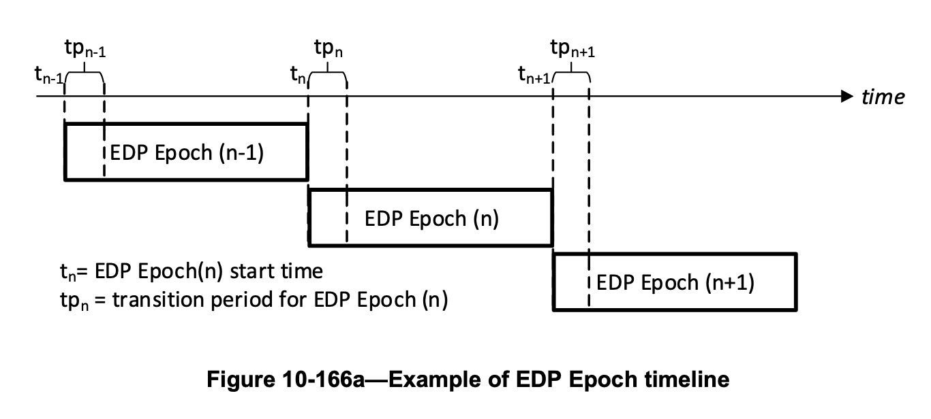
Proposal
Introduce AID-List Element in Association Response
Assoc Req
Assoc Resp with AID-List

Slide 6
Summary
Problem Statement
Proposal of AID-List in Assoc Response

Slide 7
Straw Poll
Do you agree on adding AID-List Element in the Association Response to guarantee AIDs at any moment in the EDP epoch timeline?
Yes
No
Abstain

