Slide 1
Review of EPC Gen2 for Long Range Backscatter
Date: 2025-03-12
Authors:

Slide 2
Abstract
Why is it important to distinguish long-range Backscatter from EPC-inspired close-range Backscatter?
Discuss the gaps in encapsulating EPC Gen2 at the MAC layer for long-range backscatter.

Slide 3
Why long-range Backscatter
There are many use-cases with range >1m presented in the Technical report on support of AMP IoT devices in WLAN [1] and many submissions [2-4]

Slide 4
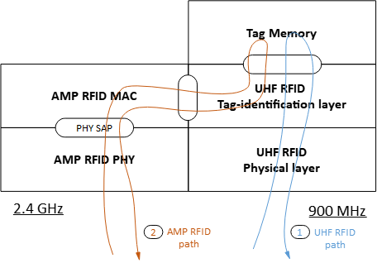
Advantages of EPC Gen2 protocol
There is a wide consensus on using EPC Gen2 for close range backscatter.
Many proposals to encapsulate the UHF RFID Interrogator commands and Tag replies.[5]
Easy to extend to support AMP + UHF RFID operations

Slide 5
EPC Gen2 in 2.4GHz for long-range
Direct extension of EPC Gen2 is not straight forward
We should resolve the following issues:
Presence of multiple independent readers in the range of a tag.
Implementation of Tag Identification protocol in a single TXOP of a 2.4GHz band.
Privacy protection in EPC Gen2 is difficult.
Difficult to implement Slotted Aloha based protocol for a long-range in 2.4GHz band in the presence of competing 802.11 traffic.

Slide 6
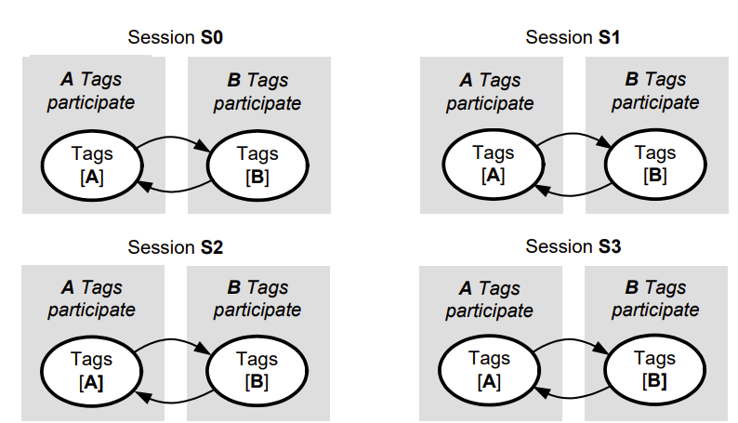
Multiple Independent readers
EPC Gen2 protocol needs coordination between multiple readers working in the near vicinity of each other.
Hard to schedule multiple independent readers in a B2C scenario when the range is not close.
Tag may respond to a non-intended reader with a “Session No”
of high persistence value and moved to ‘B’ state [8].
For example, two different customers in a store with AMP readers on their cell phones. One close to an AMP-Tag, but the other one at a distance reads it first and makes the AMP-Tag go silent.

Slide 7
Tag Identification protocol in a single TXOP
Others like [5] proposed encapsulating the UHF RFID Interrogator commands and tag replies like the following
But it isn’t easy to do this full sequence in a single TXOP in 2.4 GHz, especially in AC_BK access category.
It will be more difficult to achieve this at longer range.
In addition to the challenges of EH mentioned in [6], it will make it more difficult.

Slide 8
Privacy protection in EPC Gen2
In long-range privacy requirements may be different
There are use-cases requiring the infrastructure to address each tag with a unique address without an inventory round.
Provisioning and authorization mechanisms would require more than a simple wrapper of AMP over EPC GEN2.

Slide 9
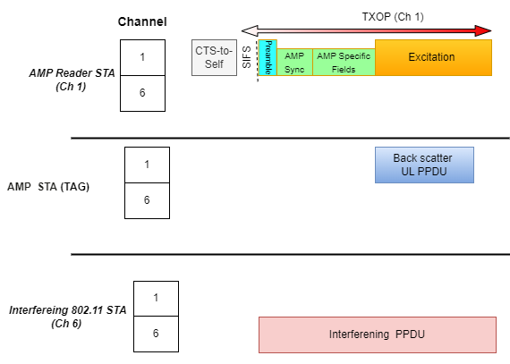
AMP-tags with other STA in the 2.4GHz band
In 2.4GHz devices communicate on different channels.
AMP + UHF RFID tags are supposed to work without a channelized receiver [7].
This makes it difficult to avoid collisions
In the presence of an interfering PPDU
difficult for the tag to decode the AMP fields

Slide 10
Conclusion
We need to redesign some part of the EPC inspired AMP-MAC protocol for long-range.
There are some non-trivial challenges in adapting EPC Gen2 for long-range backscatter.
The combined results of these issues can magnify the problem.

Slide 11
References
[1] Technical Report on support of AMP IoT devices in WLAN, 11-23/2203
[2] Zhisong Zuo et al., Use Cases for AMP IoT Devices, 11-22/0963,
[3] Wei Lin et al., Follow Up on AMP Link Budgets, 11-24/0075
[4] Wei Lin et al., Feasibility study on long range backscatter operation, 11-24/1215
[5] Rojan et al. Thoughts on AMP UHF RFID Tags, 11-24/0836
[6] Dror et al. UL Monostatic and Bistatic Range Extension Considerations, 11-24/0307
[7] Rui et al., Close-range AMP WiFi Reader Feasibility Study Follow up, 11-24/0798
[8] EPC UHF Gen2 Air Interface Protocol | GS1

