Slide 1
Review EPC Gen2 for Long Range Backscatter
Date: 2025-03-11
Authors:

Slide 2
Abstract
Why it is important to distinguish long-range Backscatter from EPC-inspired close-range Backscatter
It is not straightforward to encapsulate EPC Gen2 commands at the MAC layer for long-range backscatter.

Slide 3
Why long-range Backscatter
There are many use-cases with range >1m presented in the Technical report on support of AMP IoT devices in WLAN [1] and many submissions [2-4]

Slide 4
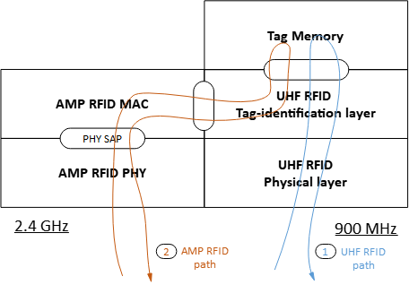
Advantages of EPC Gen2 protocol
There is a wide consensus on using EPC Gen2 for close range backscatter.
Many proposals to encapsulate the UHF RFID Interrogator commands and Tag replies.[5]
Easy to extend to support AMP + UHF RFID operations

Slide 5
EPC Gen2 in 2.4GHz for long-range
Direct extension of EPC Gen2 is not straight forward
We have to resolve the following issues:
Presence of multiple independent readers in the range of a tag
Implementation of Tag Identification protocol in a single TXOP of a 2.4GHz band.
Privacy protection in EPC Gen2 is difficult
Difficult to implement Slotted Aloha based protocol for a long-range in 2.4GHz band

Slide 6
Multiple independent readers
EPC Gen2 protocol needs coordination between multiple readers working in the near vicinity of each other.
Hard to schedule multiple independent readers in a B2C scenario when the range is not close.
Tag may respond to a non-intended reader with a session number with high persistence value and moved to ‘B’ state.

Slide 7
Tag Identification protocol in a single TXOP
Others like [5] proposed encapsulating the UHF RFID Interrogator commands and tag replies like the following
But it isn’t easy to do this full sequence in a single TXOP in 2.4 GHz
It will be more difficult to achieve this at longer range.
With challenges of EH mentioned in [6], it will make it more difficult.

Slide 8
Privacy protection in EPC Gen2
In long-range privacy requirements may be different
There are use-cases requiring the infrastructure to address each tag with a unique address.
Provisioning and authorization mechanisms would require more than a simple wrapper of AMP over EPC GEN2.

Slide 9
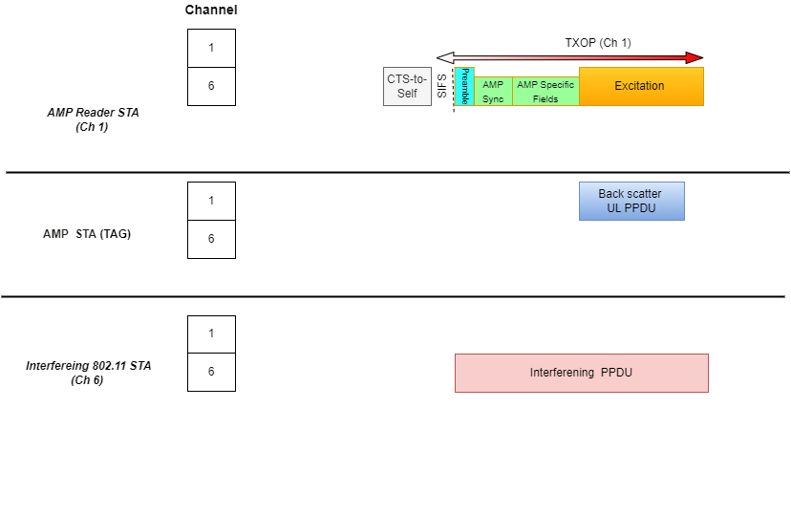
Slotted Aloha based protocol in 2.4GHz band
In 2.4GHz devices communicate on different channels.
AMP + UHF RFID tags are supposed to work without a channelized receiver
This makes it difficult to avoid collisions

Slide 10
Conclusion
We need to redesign some part of the MAC protocol for long-range.
There are some non-trivial challenges in adapting EPC Gen2 for long-range backscatter.

Slide 11
References
[1] Technical Report on support of AMP IoT devices in WLAN, 11-23/2203
[2] Zhisong Zuo et al., Use Cases for AMP IoT Devices, 11-22/0963,
[3] Wei Lin et al., Follow Up on AMP Link Budgets, 11-24/0075
[4] Wei Lin et al., Feasibility study on long range backscatter operation, 11-24/1215
[5] Rojan et al. Thoughts on AMP UHF RFID Tags, 11-24/0836
[6] Dror et al. UL Monostatic and Bistatic Range Extension Considerations, 11-24/0307

