Slide 1
Inter-AP Carrier Synchronization for Coordinated Beamforming (CoBF)
Date: 2025-03-10
Authors:

Slide 2
Inter-AP carrier sync requirements
Carrier frequency difference between the transmission of AP1 and that of AP2 should be smaller than TBD threshold (~350Hz for 90th %-tile)
Carrier frequency during all sounding transmissions* and subsequent PPDU transmission of an AP should be fairly close (<<subcarrier spacing, but no additional requirements on phase noise specified)
*Note: For sequential in-BSS sounding, it seems possible for an AP to post-correct channel feedback instead of pre-correcting its transmission for inter-AP CFO

Slide 3
Solution
At any given time, designate an AP as “sync reference” and the other as “sync follower” [1]—[3]
Each time “sync follower” receives a frame from the other AP, it refines carrier sync (i.e., estimates residual CFO and applies correction to subsequent CoBF-related transmissions)
Do we need negotiation between APs to agree on sync roles? (This is a bad question.)
What normative behaviour does 11bn need to define for an AP?
What is the normative behaviour associated with Sync-Follower?
If one AP is applying Sync-Follower behaviour, does it mean the other AP is Sync-Reference? (NO)
This contribution: Protocols in [1]—[3] can be simplified such that
  Both APs follow exactly the same simple behaviour to acquire and maintain carrier sync
  No inter-AP role negotiation is required (MAC or outside-the-Standards)
Notes:
There is no such thing as “Sync Reference” – there is only “Sync Follower”. “Reference” exits only in the mind of the “Follower”, in the moment when Follower takes an action (of adopting carrier from Reference and applying it to Follower’s own transmissions.)

Slide 4
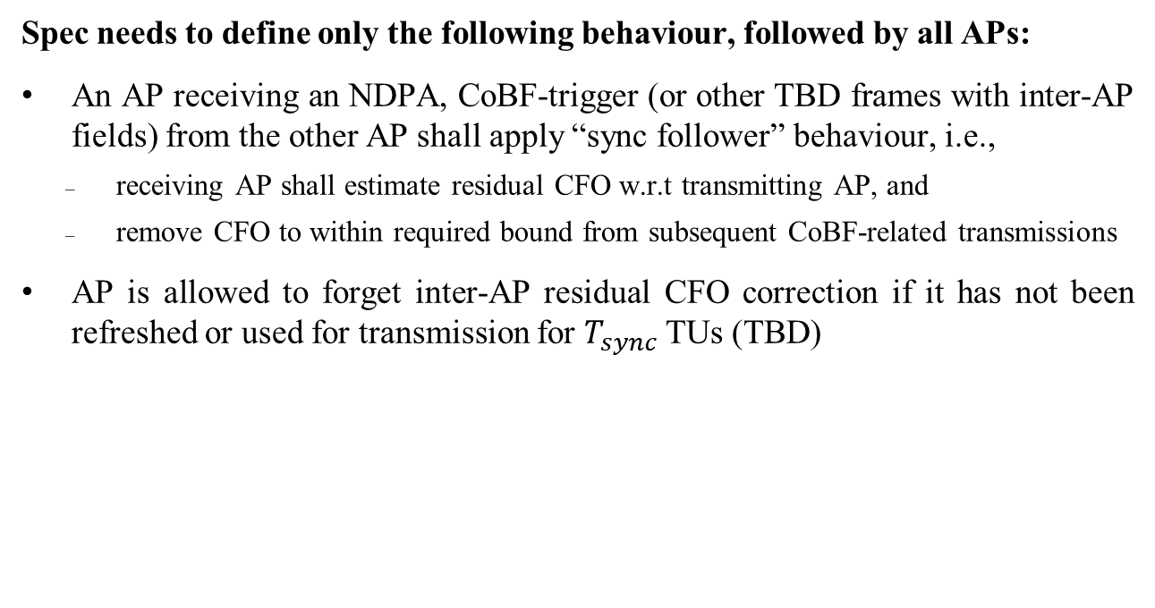
Summary
Spec needs to define only the following behaviour, followed by all APs:
An AP receiving an NDPA, CoBF-trigger (or other TBD frames with inter-AP fields) from the other AP shall apply “sync follower” behaviour, i.e.,
  receiving AP shall estimate residual CFO w.r.t transmitting AP, and
  remove CFO to within required bound from subsequent CoBF-related transmissions
AP is allowed to forget inter-AP residual CFO correction if it has not been refreshed or used for transmission for $T_{sync}$ TUs (TBD)

Slide 5
Summary
Spec needs to define only the following behaviour, followed by all APs:
An AP receiving an NDPA, CoBF-trigger (or other TBD frames with inter-AP fields) from the other AP shall apply “sync follower” behaviour, i.e.,
  receiving AP shall estimate residual CFO w.r.t transmitting AP, and
  remove CFO to within required bound from subsequent CoBF-related transmissions
AP is allowed to forget inter-AP residual CFO correction if it has not been refreshed or used for transmission for $T_{sync}$ TUs (TBD)
Next few slides: Examples of both APs applying this behavior to acquire and maintain carrier sync

Slide 6
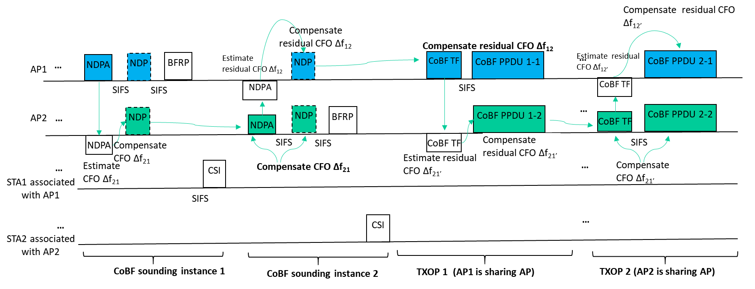
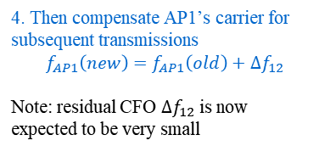

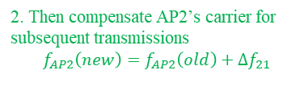

Joint Sounding (1/2)
1. At AP2, update estimated CFO $Δf_{21}$
2. Then compensate AP2’s carrier for subsequent transmissions
$$f_{AP2}\left(new\right)=f_{AP2}\left(old\right)+Δf_{21}$$
Note: In steady state, the updates to estimated residual CFOs at either AP remain fairly small, tracking carrier frequency drift due to phase noise.
3. At AP1, update estimated CFO $Δf_{12}$
4. Then compensate AP1’s carrier for subsequent transmissions
$$f_{AP1}\left(new\right)=f_{AP1}\left(old\right)+Δf_{12}$$
Note: residual CFO $Δf_{12}$ is now expected to be very small

Slide 7
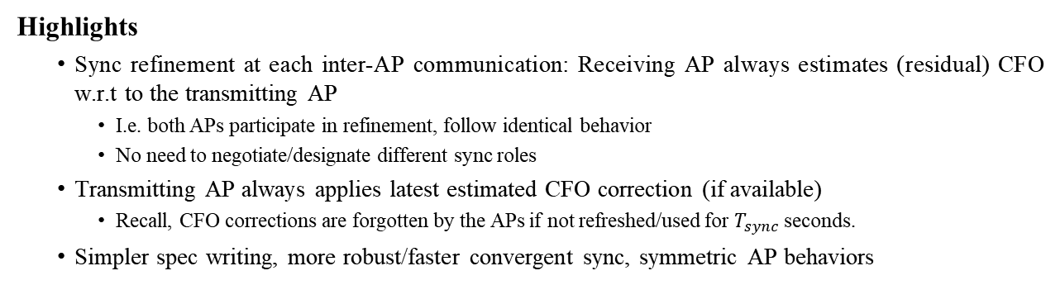
Joint Sounding (2/2)
Highlights
  Sync refinement at each inter-AP communication: Receiving AP always estimates (residual) CFO w.r.t to the transmitting AP
    I.e. both APs participate in refinement, follow identical behavior
    No need to negotiate/designate different sync roles
  Transmitting AP always applies latest estimated CFO correction (if available)
    Recall, CFO corrections are forgotten by the APs if not refreshed/used for $T_{sync}$ seconds.
  Simpler spec writing, more robust/faster convergent sync, symmetric AP behaviors

Slide 8
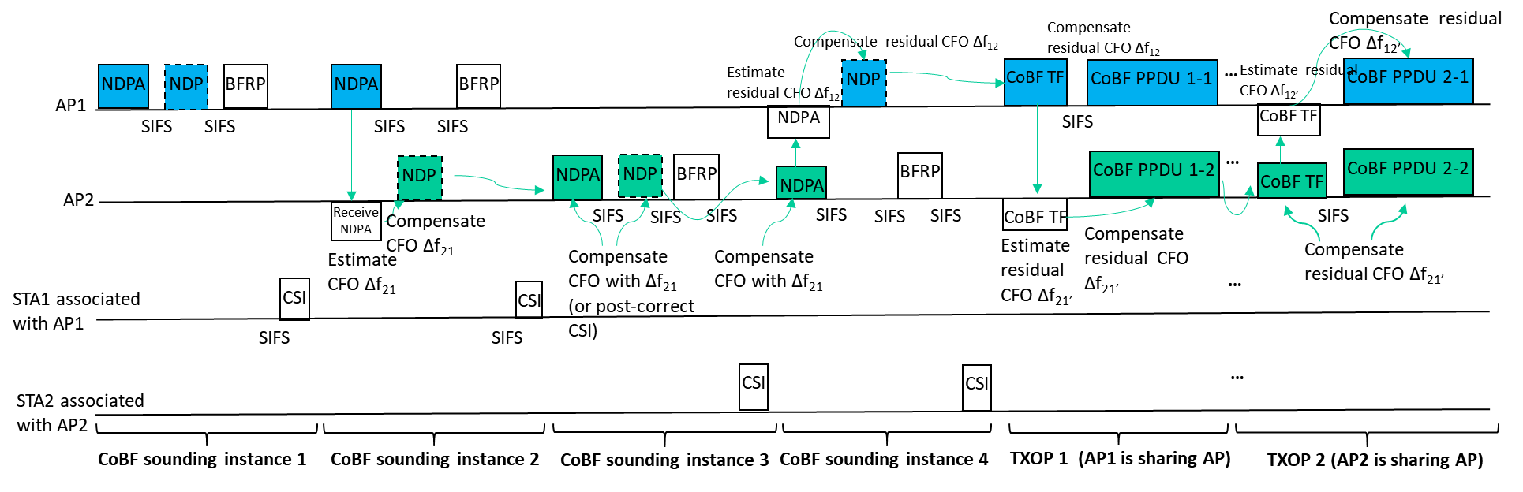




Sequential Sounding (1/2)
1. At AP2, update estimated CFO $Δf_{21}$
2. Then compensate AP2’s carrier for subsequent transmissions
$$f_{AP2}\left(new\right)=f_{AP2}\left(old\right)+Δf_{21}$$
Note: In steady state, the updates to estimated residual CFOs at either AP remain fairly small, tracking carrier frequency drift due to phase noise.
3. At AP1, update estimated CFO $Δf_{12}$
4. Then compensate AP1’s carrier for subsequent transmissions
$$f_{AP1}\left(new\right)=f_{AP1}\left(old\right)+Δf_{12}$$
Note: residual CFO $Δf_{12}$ is now expected to be very small

Slide 9
Sequential Sounding (2/2)
Highlights
  Sync refinement at each inter-AP communication: Receiving AP always estimates (residual) CFO w.r.t to the transmitting AP
    I.e. both APs participate in refinement, follow identical behavior
    No need to negotiate/designate different sync roles
  Transmitting AP always applies latest estimated CFO correction (if available)
    Recall, CFO corrections are forgotten by the APs if not refreshed/used for $T_{sync}$ seconds.
  Simpler spec writing, more robust/faster convergent sync, symmetric AP behaviors

Slide 10
Recap: Both APs can follow identical normative behavior
An AP receiving an NDPA, CoBF-trigger (or other TBD frames with inter-AP fields) from the other AP as part of CoBF operation, shall
  estimate residual CFO w.r.t transmitting AP, and
  if a valid CFO estimate is available,
    remove estimated CFO to within required bound from subsequent CoBF-related transmissions that are required to be carrier synchronized for CoBF operation
What does it mean for an AP to have valid inter-AP CFO estimate?

Slide 11
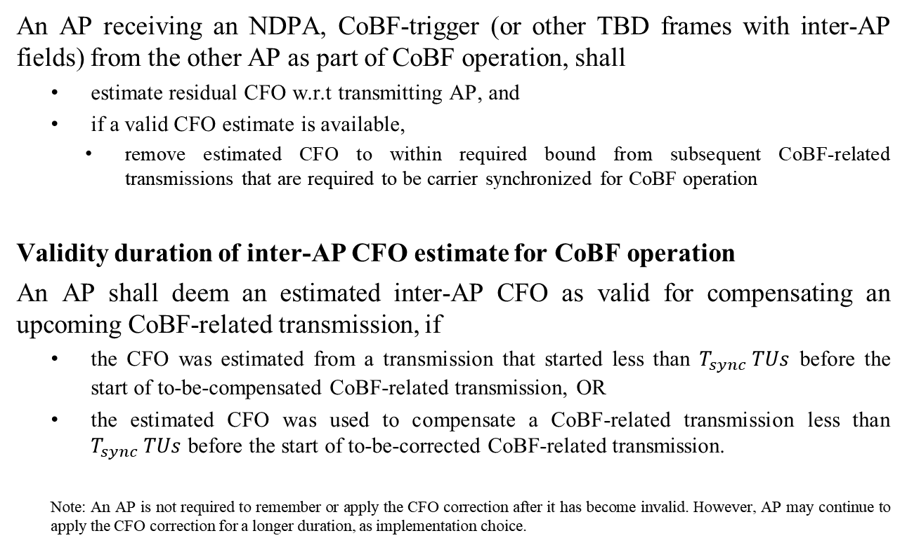
Recap: Both APs can follow identical normative behavior
An AP receiving an NDPA, CoBF-trigger (or other TBD frames with inter-AP fields) from the other AP as part of CoBF operation, shall
  estimate residual CFO w.r.t transmitting AP, and
  if a valid CFO estimate is available,
    remove estimated CFO to within required bound from subsequent CoBF-related transmissions that are required to be carrier synchronized for CoBF operation
Validity duration of inter-AP CFO estimate for CoBF operation
An AP shall deem an estimated inter-AP CFO as valid for compensating an upcoming CoBF-related transmission, if
  the CFO was estimated from a transmission that started less than $T_{sync} TUs$ before the start of to-be-compensated CoBF-related transmission, OR
  the estimated CFO was used to compensate a CoBF-related transmission less than $T_{sync} TUs$ before the start of to-be-corrected CoBF-related transmission.
  Note: An AP is not required to remember or apply the CFO correction after it has become invalid. However, AP may continue to apply the CFO correction for a longer duration, as implementation choice.

Slide 12
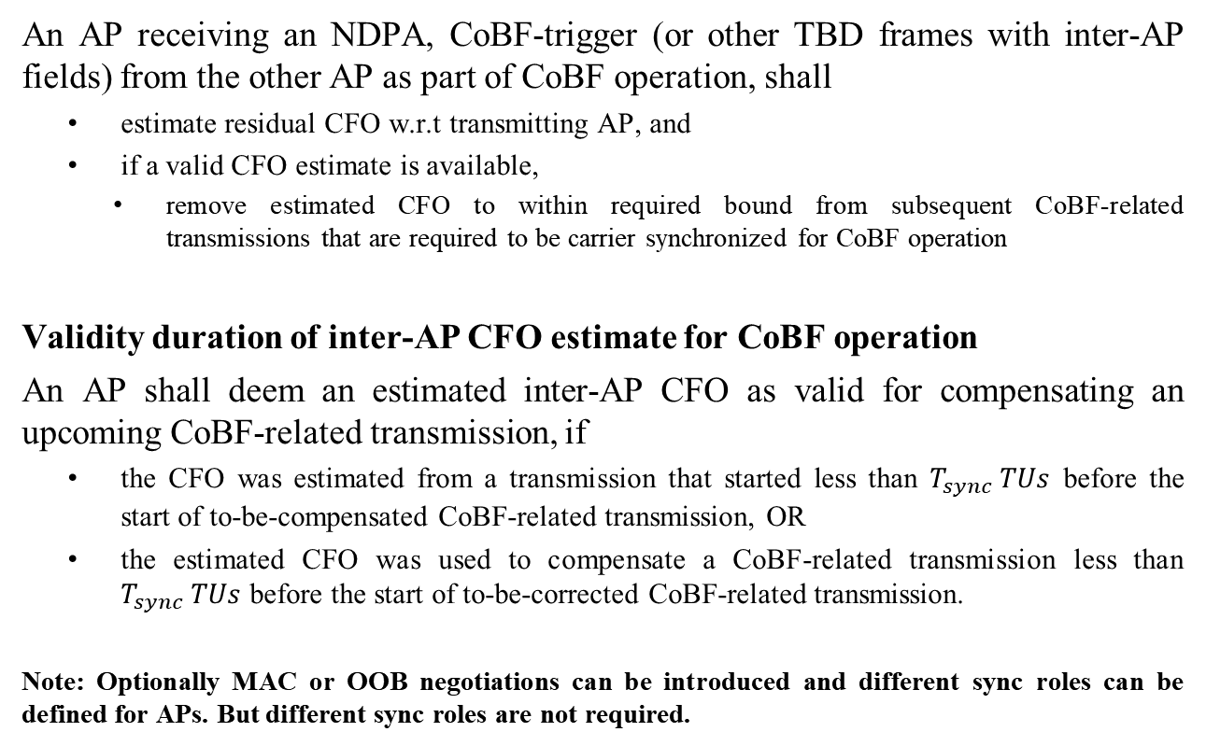
Recap: Both APs can follow identical normative behavior
An AP receiving an NDPA, CoBF-trigger (or other TBD frames with inter-AP fields) from the other AP as part of CoBF operation, shall
  estimate residual CFO w.r.t transmitting AP, and
  if a valid CFO estimate is available,
    remove estimated CFO to within required bound from subsequent CoBF-related transmissions that are required to be carrier synchronized for CoBF operation
Validity duration of inter-AP CFO estimate for CoBF operation
An AP shall deem an estimated inter-AP CFO as valid for compensating an upcoming CoBF-related transmission, if
  the CFO was estimated from a transmission that started less than $T_{sync} TUs$ before the start of to-be-compensated CoBF-related transmission, OR
  the estimated CFO was used to compensate a CoBF-related transmission less than $T_{sync} TUs$ before the start of to-be-corrected CoBF-related transmission.
Note: Optionally MAC or OOB negotiations can be introduced and different sync roles can be defined for APs. But different sync roles are not required.

Slide 13
References
11-24/1542r5, Sounding Schemes for Coordinated Beamforming
11-25/0083r0, CFO Correction for COBF
11-25/0103r0, Simplified Carrier Synchronization for CoBF Transmissions
11-24/2142r0, Multi-AP Sounding Analysis

