Slide 1
IMMW SPs
Date: 2024-11-01
Authors:
Name | Affiliations | Address | Phone | Email
Yue Xu | Huawei | Huawei Nanjing R&D Institute, Nanjing, Jiangsu, China, 210012 |  | xuyue57@Huawei.com
Chenhe Ji
Mengshi Hu
Ross Jian Yu
Chun Pan
Xiaofei Bai
Xiaofei Bai

Slide 2
Introduction
Based on the IMMW SG PAR document[1] and actual requirements in industrial scenarios, we recap our consideration and corresponding SPs.

Slide 3
Recap-1: IMMW SG PAR[1] @fast and integrated
Type | Brief info
AGV / AMR | Including guidance control, process data exchange, video/image, and emergency stop, between robots and a control system,
Robot/drone motion control | Remote operation with haptics communication, programmed robot operation with emergency stop.
IoT Sensors/ WIFI sensing | High-density deployment and Periodical/event-based report of information to the control system.
The ‘fast and integrated’ deployment is:
Reuse/Minimum-adjust current baseband architecture
Reuse/Combine current-technique (e.g., Sounding, MLO, Power saving, TWT…)
Design Appropriate Bandwidth/KPIs
PAR

Slide 4
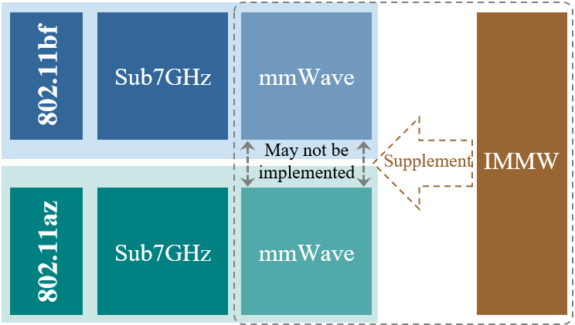
Recap-2：Implements @Multi-streams and bandwidth
Setting: 11ax, 160MHz, 45G Band, 16QAM
802.11bf and 802.11az/bk are main IEEE standard for Sensing and Ranging. So, IMMW can be considered to provide support for these technical standards..
AP
STAs
#SS | throughput
1 | 350 Mbps
2 | 650 Mbps
4 | 1.2 Gbps
In the MIMO, data is divided into multiple independent spatial flows. More spatial flows indicate more paths for independently processing data and a higher rate.
The gain efficiency is decreasing.
Multiple streams
Enhance the throughput
Enhance the stability (link optimization)
cost of hardware devices
gain accelerate is ‘slowing down’.
single flow may not meet the requirements.
Larger bandwidth:
More information
More cost
Lower bandwidth:
Less information
Lower cost
How to balance?
How to choose?

Slide 5
Summary
From the above 2 recaps, we would like to provide our suggestions that:
Main Concern | Suggestion
Bandwidth | A maximum bandwidth is 1280MHz to both meet actual throughput requirements and expand the ecosystem
Spatial Stream | The number of spatial streams are no more than 2SS under SU-MIMO.

Slide 6
References
[1] 11-24-0116-03-immw-immw-draft-proposed-par
[2] 11-23-1570-00-0uhr-latency-consideration-of-industrial-scenarios
[3] 11-24-0723-01-immw-sensing-and-ranging-in-immw
[4] 11-20-1712-02-00bf-wifi-sensing-use-cases
[5] 11-20-1102-01-immw-Thoughts on IMMW For the Industry Use

Slide 7
SP1
Do you agree to add the following into 11bq SFD: “the maximum bandwidth of an IMMW PPDU is 1280 MHz”?
-Yes
-No
-Abstain

Slide 8
SP2
Do you agree to add the following into 11bq SFD: “no more than 2SS under SU-MIMO.”?
-Yes
-No
-Abstain

