Slide 1
Slotted vs Pure Aloha for Active Transmitter AMP Use Cases
Date: 2025-03-10
Authors:

Slide 2
Abstract
In this revision, we consider a modifications to the slotted Aloha as an access procedure – Omitting slot indication.

Slide 3
AMP non AP Active TX STAs (AAMP)
Due to high BW of ED-RX, protocol should be expected to work with high PER of 10%-90% [90% means that 1 in 10 packets is correctly received], even in relative high SNR.
Additionally, every time the Tag-RX is in awake state (SYNC,RX) takes up energy from capacitor (>few uW) and reduces the energy for other tasks, like transmitting back.

Slide 4
Contentions Deferral With 10²-10⁴ Tags
Two main mechanisms:
RFID: Trigger includes a parameter for tag slot-counter random count (Q)
  As described in subsection 6.3.2.6.8 in EPC™ Radio-Frequency Identity Protocols Generation-2 UHF RFID Standard
802.11: Tags use exponential backoff for slot-counter random count (CW)
  As described in subsection 10.3.3 in IEEE Std 802.11™‐2020
Nonetheless, in this contribution we use the variable harvesting-time behavior of the tags within inventory for contention deferral – so no need for above mechanisms, which were thus not included in the simulations.
Further study is required in order to determine the best mechanism for AMP in case no harvesting-time variability can be assumed (did not consider it here).

Slide 5
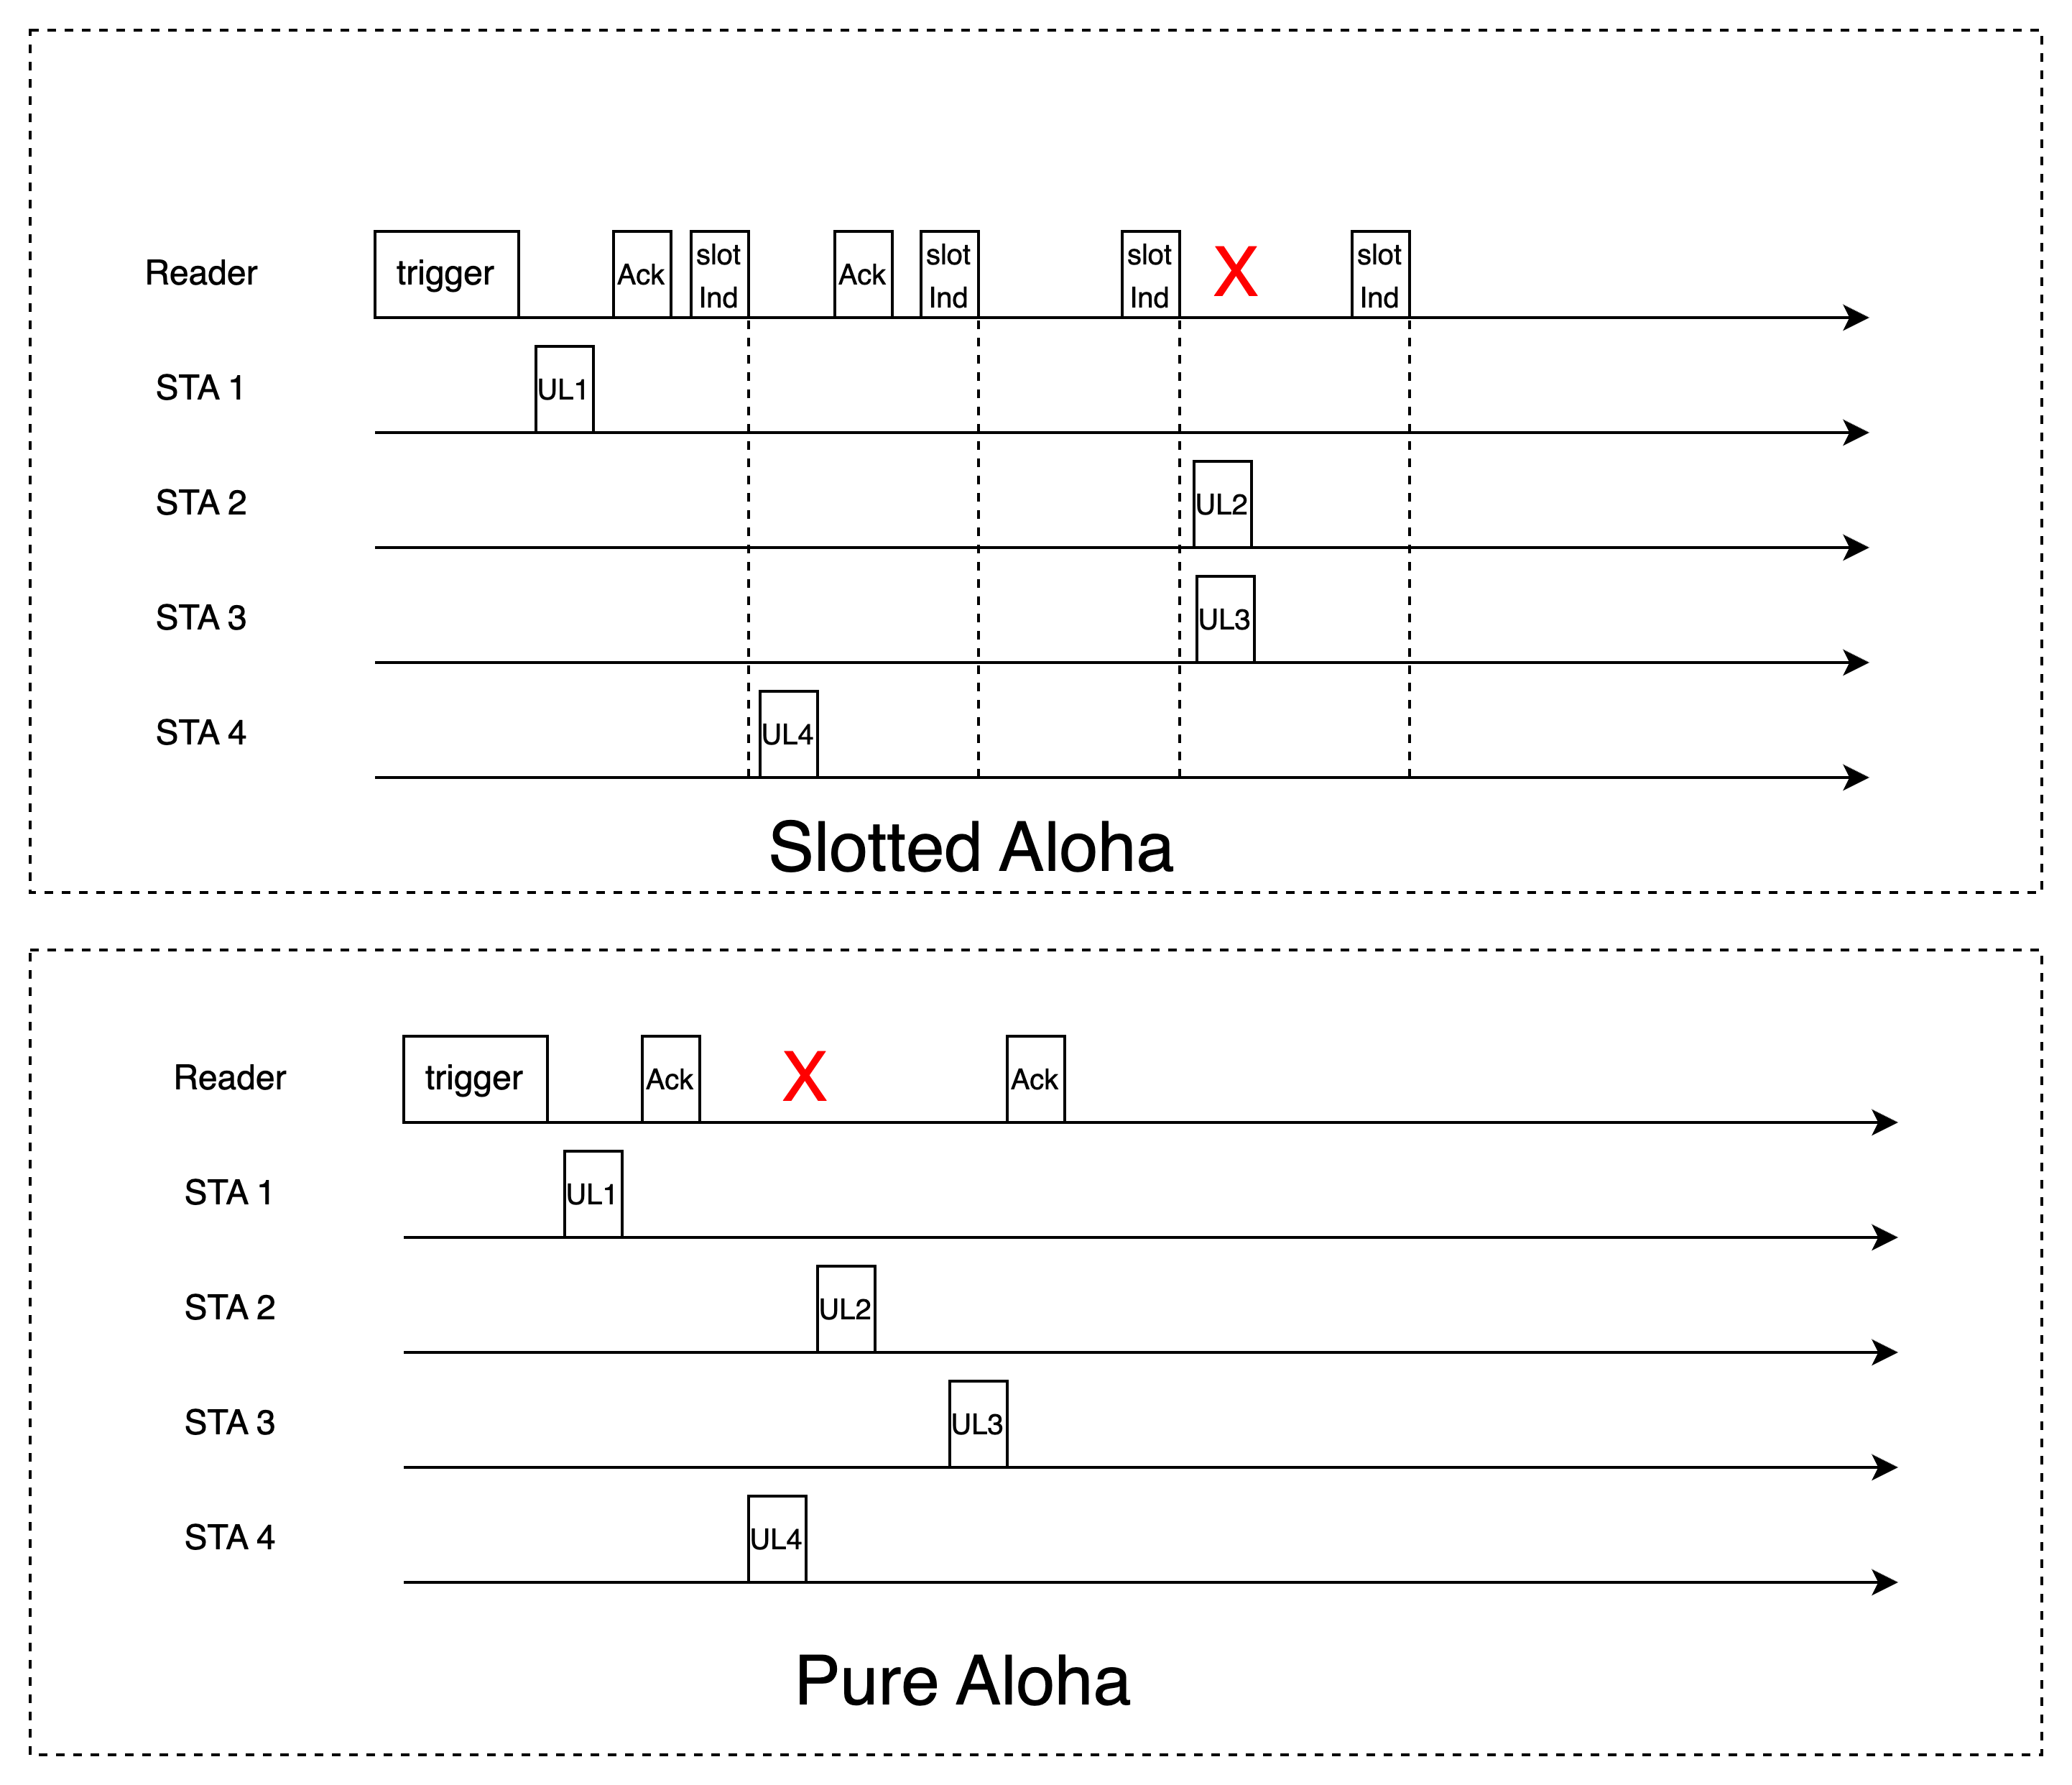
Pure and Slotted Aloha Access
Slotted Aloha
Allows transmission only within slot boundery
Slots are indicated by slot indications as transmitted by reader
TX/RX synchronization between reader and STAs
Each STA randomly selects a slot [# slots from trigger]
STAs can not detect TX from other STAs
Pure Aloha
Trigger frame sets TXOP limit
Each STA transmits with random backoff (with arbitrary time units) during time from trigger to TXOP end
STAs can not detect TX from other STAs

Slide 6
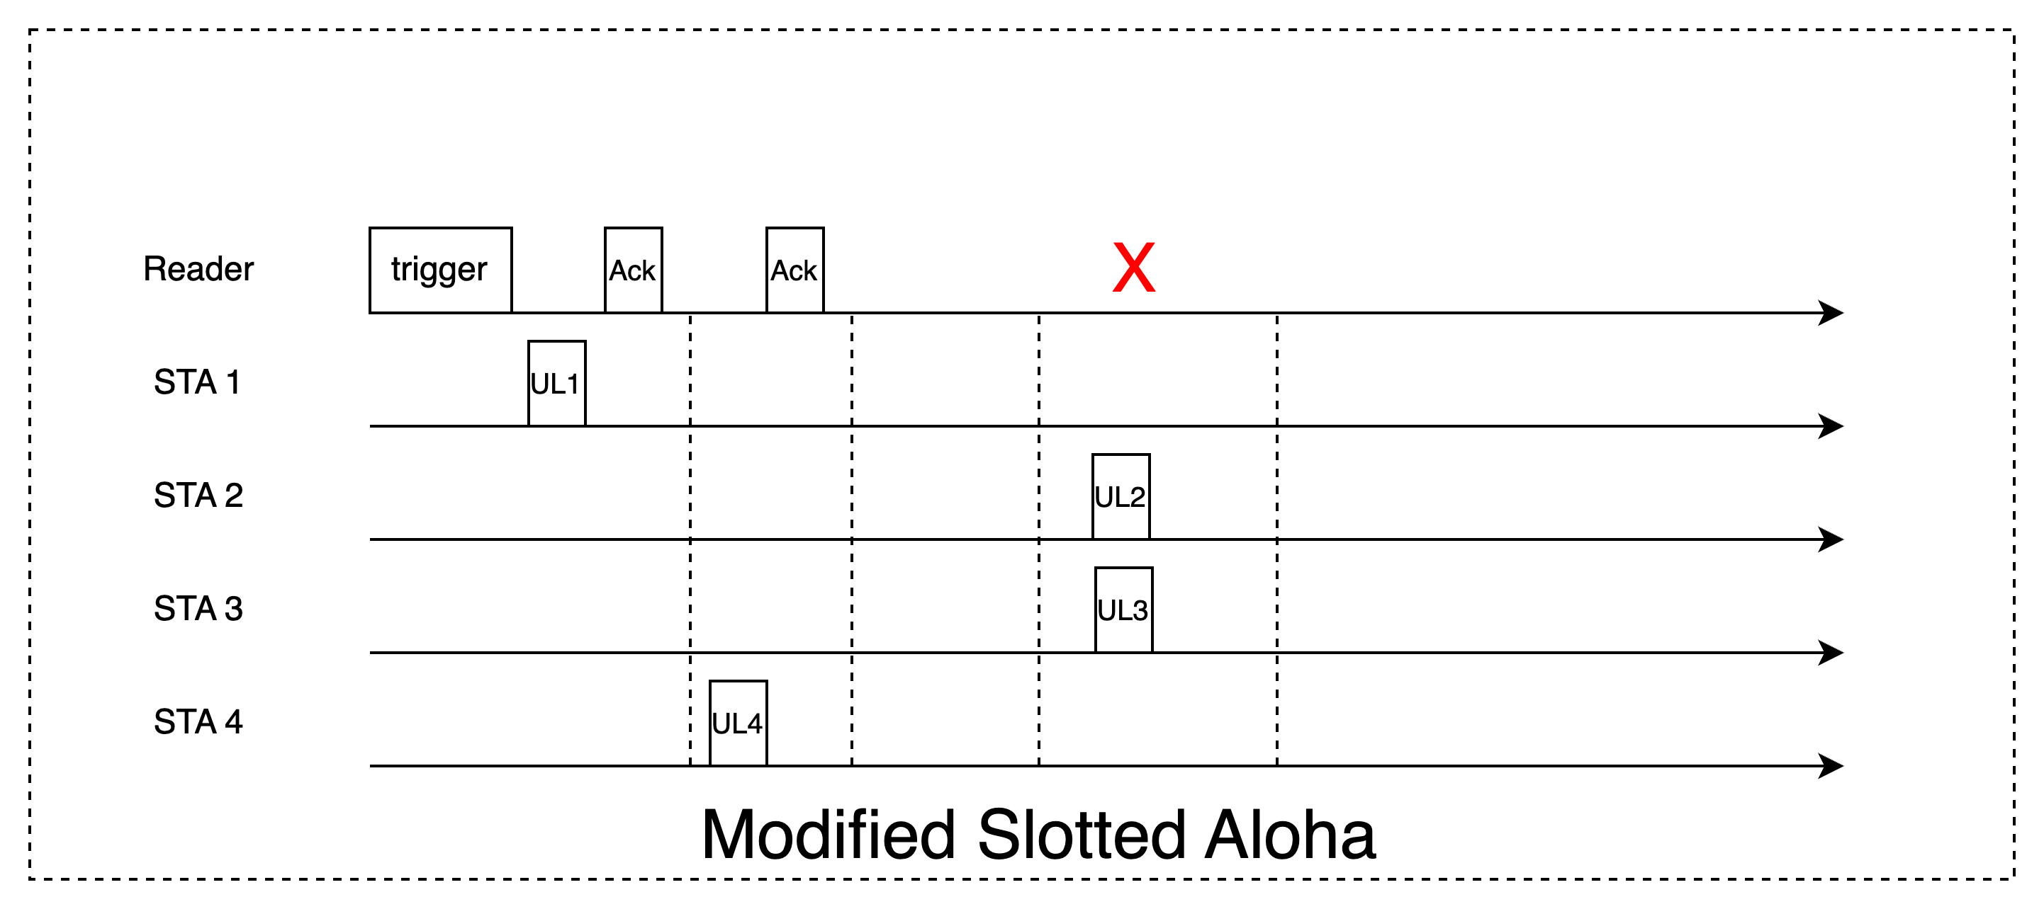
Modification of Slotted Aloha Access
Very similar to Slotted Aloha - only difference
is that no slot indication is transmitted by
Reader
Slots bounderies are maintained using TSF
clock – 10⁴ ppm.
Guard interval between slots is increased by +0.1% per slot. For 4ms, last guard is 40us longer.

Slide 7
DL/UL Rates Impact Example
The agreed rates AAMP for DL were 0.25 and 1Mbps, while the agreed rates for the UL were 0.25,1,4Mbps
For 48 bits inventory command and 112 bits replied payload, we get the following timing parameters (all STAs use the same MCS)
TX/RX switch times=10us
Example 1: UL=1Mbps, DL=0.25Mbps:
  UL Transmission + DL Ack = 284us
  Slot indication + UL Transmission + DL Ack = 448us
  4ms TXOP = 12 net UL+Ack or 7 slots separated by slot indication
Example 2: UL=4Mbps, DL=1Mbps:
  UL Transmission + DL Ack = 95us
  Slot indication + UL Transmission + DL Ack = 160us
  4ms TXOP = 31.7 net non-overlapped transmissions or 20 slots separated by slot indication
 | DL-ack/slot Ind | DL-trigger | UL - data
bits [payload+SIG+SYNC] | 33 | 80 | 120
Rate=0.25Mbps | 164us | 352us | 480us
Rate=1Mbps | 65us | 112us | 120us
Rate=4Mbps |  |  | 30us

Slide 8
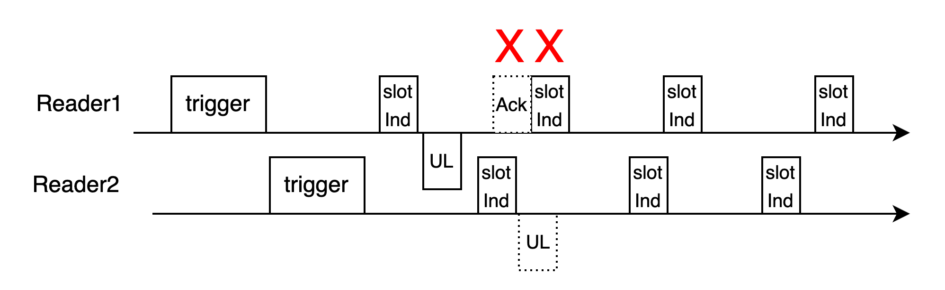
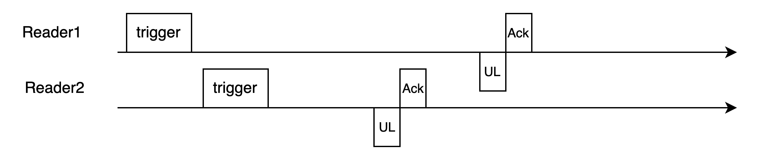
Pure vs Slotted Aloha
  Slotted Aloha
  Tag needs to maintain slot boundary and count slots
  More management @ reader
  At least 3-5 receptions per tag tranmission (Trigger+slotInd+Ack) – higher energy requitement
  Consistent interference between neigboring readers/tags:
  Single reader: No contensions between the reader & tags
  Single reader: No interference from in-band tags – only collisions
  FDM/CDM extendable
Pure Aloha
  No need to maintain slot boundaries or count slots – just TXOP
  No slot management in reader
  Two receptions per tag transmission (Trigger+Ack)
  Non-cosistant interference from Multi-readers:
  Single reader: Contensions from the reader & other tags
  FDM/CDM extendable
Examplary capture

Slide 9
Modified Slotted Aloha
  Modified Slotted Aloha
  Tag needs to maintain slot boundary and count slots
  More management @ reader
  Two receptions per tag transmission (Trigger+Ack)
  Less consistent interference between neigboring readers/tags.
  Single reader: No contensions between the reader & tags
  Single reader: No interference from in-band tags – only collisions
  FDM/CDM extendable

Slide 10
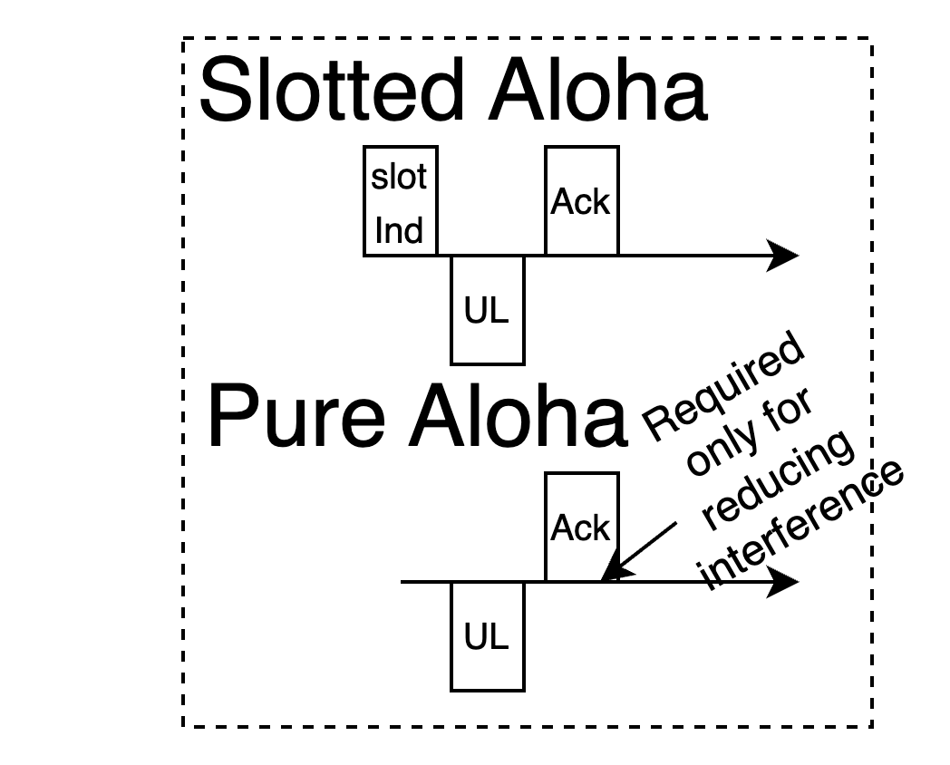
Simulation of Pure vs Slotted Aloha on Examplary Scenarios
Simulation of inventory scenarios over Pure and Slotted Aloha
and Modified Slotted Aloha
Deployed a unified S1G energizer + reader device
Tags distributed on a regular grid
Energizing times and communication protocols are included (incl.
retries, energy per RX/TX, energizing time, RX/TX switch times)
Target tags to be read, others just interference (not required to be read)
DL interferences from hidden/out-of-band: PER=0% or 30%
TX-OP are 4ms each, with short 33dBm energizing in between TXOPs
Tags do not use carrier sense or duty-cycle in this exemplary simulation
Friis channel
Trigger
Ack
Slot Ind
Pure Aloha
Slotted Aloha
Succefully received
Collision with
another tag
Collision with Ack

Slide 11
Simulation of Modified Slotted Aloha
Using two approaches for Modified Slotted Aloha:
Fitting TXOP into exact number of slots, including the guard interval growth over time to account for the AMP-TSF clock drift (10⁴ ppm)
Fitting the provided TXOP with the maximum # slots, leaving out some slack that can not be utilized due to guard interval increase/slot granularity
Exact TXOP
Provided TXOP
Last slot fits exactly
to TXOP end
Slack between last
slot to TXOP end

Slide 12
Results of A Small Scenrio with Interference
250 tags across 50m² region + 400 interfering tags outside region + 30% collisions due to out-of-band interference (DL) + 2% in-band interference (UL):
 | Pure Aloha | Slotted Aloha
Successful reads | 100% | 99.6%
Comm+Energizing duration | 2.54s+0.12s | 3.1s+0.15s
# TXOP | 667 | 818
TXOP duration | 3.8ms | 3.8ms
Average # tag transmissions | 3.98 | 3.7
Collisions with other tags + Acks | 8.4%+7.5% | 5.6%+0%
Interfering tags
Target tags
10% of target
tags succefuly
read
90% of target
tags succefuly
read
100% of target
tags succefuly
read

Slide 13
Slot vs Non-Slot
Slotted vs Non-Slotted (regardless of transmission of slot indication):
  Non-Slotted: A non successful transmission takes only 1 UL time from TXOP
  Slotted: A non-successful transmission takes 1UL and 1 Ack time from TXOP
  To summarize, the slotted is expected to see higher contention rates due to inefficient utilization of the medium for low rate DL transmissions. This is improved when not transmitting the slot indication but not by much.
Success and failure take UL+DL ack time (slot)
Failure takes only UL time
Success takes UL+DL ack time

Slide 14
Results of A Dense Small Scenrio with Interference
1000 tags across 50m² region + 2000 interfering tags outside region + 30% collisions due to out-of-band interference (DL) + 2% in-band interference (UL):
 | Pure Aloha | Modified Slotted Aloha [same TXOP – 9 slots] | Modified Slotted Aloha [optimal TXOP – 9 slots] | Slotted Aloha [6 slots]
Successful reads | 99.9% | 99.8% | 99.7% | 99.6%
Comm+Energizing duration | 7.16s+0.1s | 7.56s+0.1s | 6.8s+0.1s | 10.69s+0.11s
# TXOP | 1791 | 1891 | 1778 | 3055
TXOP duration | 4ms | 4ms | 3.825ms | 3.5ms
Average # tag transmissions | 4.78 | 4.49 | 4.62 | 4.93
Collisions with other tags + Acks | 13.7%+10.13% | 27.75%+0% | 29.78%+0% | 31.2%+0%

Slide 15
Results of Large Scenario With no OOB Interference
10,000 tags across 1260m² region + 20,000 interfering tags outside region but no out-of-band interference:
 | Pure Aloha | Slotted Aloha
Successful reads | 97% | 96.2%
Comm+Energizing duration | 27.1s+2s | 27.8s+2.1s
# TXOP | 7126 | 7311
TXOP duration | 3.8ms | 3.8ms
Average # tag transmissions | 3.56 | 2.95
Collisions with other tags + Acks | 16%+14.5% | 15%+0%

Slide 16
Results of Dense Scenario With no OOB Interference
10,000 tags across 50m² region + 15,000 interfering tags outside region - but no out-of-band interference and using high rates (1Mbps DL, 4Mbps UL)
 | Pure Aloha | Slotted Aloha
Successful reads | 95.1% | 96%
Comm+Energizing duration | 7.7s+0.1s | 8.9s+0.1s
# TXOP | 1888 | 2194
TXOP duration | 4.07ms | 4.07ms
Average # tag transmissions | 4.35 | 2.91
Collisions with other tags + Acks | 12.7%+6.8% | 16.6%+0%

Slide 17
Summary
We presented Pure Aloha and Slotted Aloha and modified Slotted Aloha access approaches
Advantages and disadvantages of each were considered
Simulation results of both approaches over active transmitter AMP devices were presented
From network simulations under current parameters assumptions - it appears Slotted Aloha and modified Slotted Aloha (omitting slot indication) provides marginal advantages over Pure Aloha, while adding requirements and complexities to the tag and reader implementations.
We suggest Pure Aloha or modified Slotted Aloha as access approaches for 802.11bp
Further study is required to determine best approach for contentions deferral

Slide 18
References
[1] 11-25/0031r0 Trigger based multiple access for AMP, OPPO
[2] 11-24/1776r1, multiple access mechanisms for amp, OPPO
[3] 11-24/1806r0, AMP time-based channel access for active tags, Huawei
[4] 11-25-0046r0, Channel access for Active Tx non-AP AMP STAs, Huawei
[5] 11-24/1537r2, Wireless connectivity challenges for AMP only IoT devices under 802.11 specification, Wiliot

Slide 19
SP 1
Do you agree to consider at least one mode of access without the explict transmission of slot indication in 802.11bp for active transmitter AMP non-AP STAs?
Y:
N:
A:

