Slide 1
Slotted vs Pure Aloha for Active Transmitter AMP Use Cases
Date: 2025-02-25
Authors:

Slide 2
Abstract
Several contributions [1-4] have presented TDM with slotted Aloha as the main access procedure for AMP STAs. We would like to consider also pure Aloha option as an access procedure – mainly due to its simplicity and robustness.

Slide 3
AMP non AP Active TX STAs (AAMP)
It was presented [5] that the receiver of the AMP non AP STA is expected to be ultra-low power and ultra-simple.
As such, it is not expected to have a channel filter or sophisticated interference cancelling mechanisms – unlike the AMP reader which is expected to have a good channel filter as well as a good gain control and good low noise amplifiers.
Since this is the case, the receiver in the AAMP is expected to get interfered from all 2.4 channels, as well as from many internal noises.
Thus it should be expected to work with high PER of 10%-90% [90% means that 1 in 10 packets is correctly received], even in relative high SNR.

Slide 4
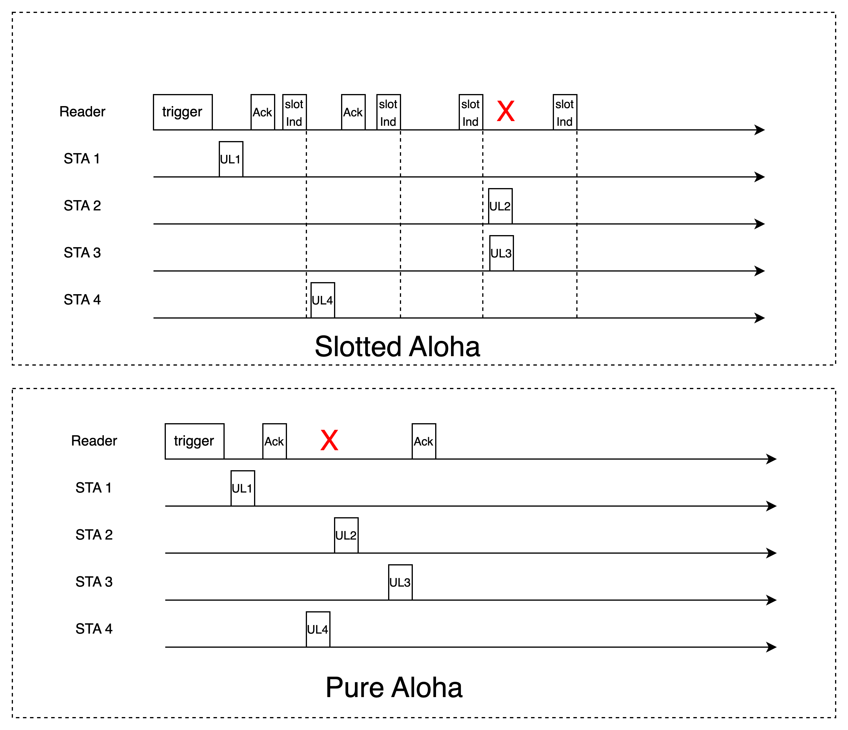
Pure and Slotted Aloha Access
Slotted Aloha
Allows transmission only within slot boundery
Slots are indicated by slot indications as transmitted by reader
TX/RX synchronization between reader and STAs
Each STA randomly selects a slot [# slots from trigger]
STAs can not detect TX from other STAs
Pure Aloha
Trigger frame sets TXOP limit
Each STA transmits with random backoff (with arbitrary time units) during time from trigger to TXOP end
STAs can not detect TX from other STAs

Slide 5
DL/UL Rates Impact Example
The agreed rates AAMP for DL were 0.25 and 1Mbps, while the agreed rates for the UL were 0.25,1,4Mbps
For 48 bits inventory command and 112 bits replied payload, we get the following timing parameters (all STAs use the same MCS)
TX/RX switch times=10us
Example 1: UL=1Mbps, DL=0.25Mbps:
  UL Transmission + DL Ack = 284us
  Slot indication + UL Transmission + DL Ack = 448us
  4ms TXOP = 12 net UL+Ack or 7 slots separated by slot indication
Example 2: UL=4Mbps, DL=1Mbps:
  UL Transmission + DL Ack = 95us
  Slot indication + UL Transmission + DL Ack = 160us
  4ms TXOP = 31.7 net non-overlapped transmissions or 20 slots separated by slot indication
 | DL-ack/slot Ind | DL-trigger | UL - data
bits [payload+SIG+SYNC] | 33 | 80 | 120
Rate=0.25Mbps | 164us | 352us | 480us
Rate=1Mbps | 65us | 112us | 120us
Rate=4Mbps |  |  | 30us

Slide 6
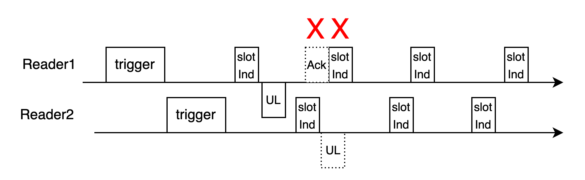
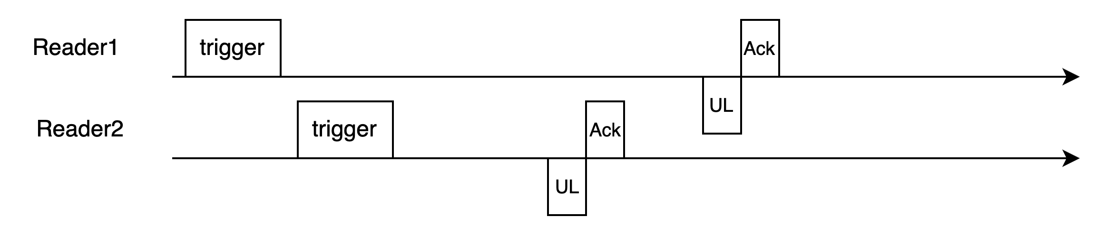
Pure vs Slotted Aloha
  Slotted Aloha
  Tag needs to maintain slot boundary and count slots
  More management @ reader
  At least 3-5 receptions per tag tranmission (Trigger+slotInd+Ack) – higher energy requitement
  Consistent interference between neigboring readers/tags:
  Single reader: No contensions between the reader & tags
  Single reader: No interference from in-band tags – only collisions
  FDM/CDM extendable
Pure Aloha
  No need to maintain slot boundaries or count slots – just TXOP
  No slot management in reader
  Two receptions per tag transmission (Trigger+Ack)
  Non-cosistant interference from Multi-readers:
  Single reader: Contensions from the reader & other tags
  FDM/CDM extendable
Examplary capture

Slide 7
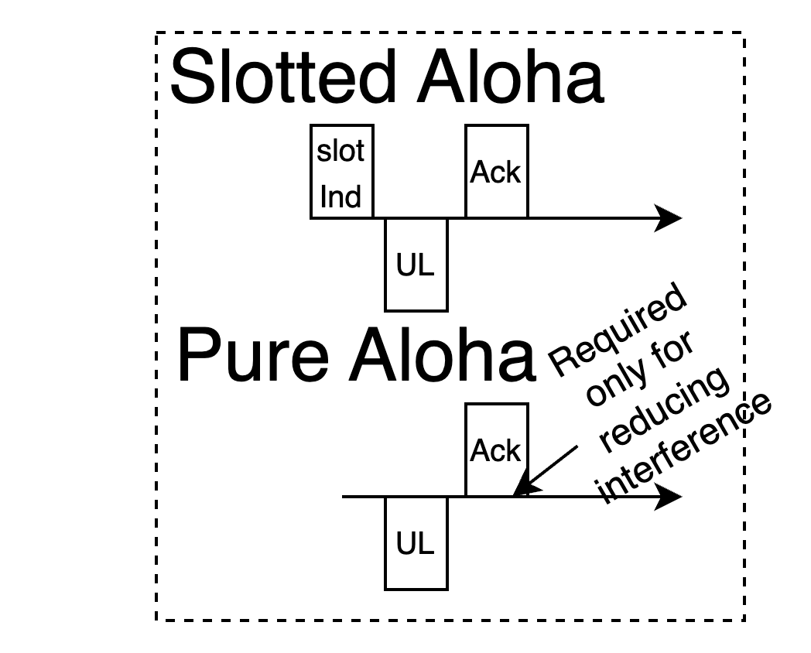
Simulation of Pure vs Slotted Aloha on Examplary Scenarios
Simulation of inventory scenarios over Pure and Slotted Aloha
Deployed a unified S1G energizer + reader device
Tags distributed on a regular grid
Energizing times and communication protocols are included (incl.
retries, energy per RX/TX, energizing time, RX/TX switch times)
Target tags to be read, others just interference (not required to be read)
DL interferences from hidden/out-of-band: PER=0% or 30%
TX-OP are 4ms each, with short 33dBm energizing in between TXOPs
Tags do not use carrier sense or duty-cycle in this exemplary simulation
Friis channel
Trigger
Ack
Slot Ind
Pure Aloha
Slotted Aloha
Succefully received
Collision with
another tag
Collision with Ack

Slide 8
Results of A Small Scenrio with Interference
250 tags across 50m² region + 400 interfering tags outside region + 30% collisions due to out-of-band interference (DL) + 2% in-band interference (UL):
 | Pure Aloha | Slotted Aloha
Successful reads | 100% | 99.6%
Comm+Energizing duration | 2.54s+0.12s | 3.1s+0.15s
# TXOP | 667 | 818
TXOP duration | 3.8ms | 3.8ms
Average # tag transmissions | 3.98 | 3.7
Collisions with other tags + Acks | 8.4%+7.5% | 5.6%+0%
Interfering tags
Target tags
10% of target
tags succefuly
read
90% of target
tags succefuly
read
100% of target
tags succefuly
read

Slide 9
Results of Large Scenario With no OOB Interference
10,000 tags across 1260m² region + 20,000 interfering tags outside region but no out-of-band interference:
 | Pure Aloha | Slotted Aloha
Successful reads | 97% | 96.2%
Comm+Energizing duration | 27.1s+2s | 27.8s+2.1s
# TXOP | 7126 | 7311
TXOP duration | 3.8ms | 3.8ms
Average # tag transmissions | 3.56 | 2.95
Collisions with other tags + Acks | 16%+14.5% | 15%+0%

Slide 10
Results of Dense Scenario With no OOB Interference
10,000 tags across 50m² region + 15,000 interfering tags outside region - but no out-of-band interference and using high rates (1Mbps DL, 4Mbps UL)
 | Pure Aloha | Slotted Aloha
Successful reads | 95.1% | 96%
Comm+Energizing duration | 7.7s+0.1s | 8.9s+0.1s
# TXOP | 1888 | 2194
TXOP duration | 4.07ms | 4.07ms
Average # tag transmissions | 4.35 | 2.91
Collisions with other tags + Acks | 12.7%+6.8% | 16.6%+0%

Slide 11
Summary
We presented Pure Aloha and Slotted Aloha access approaches
Advantages and disadvantages of each were considered
Simulation results of both approaches over active transmitter AMP devices were presented
From network simulations under current parameters assumptions - it appears slotted Aloha provides marginal advantages while adding requirements and complexities to the tag and reader implementations.

Slide 12
References
[1] 11-25/0031r0 Trigger based multiple access for AMP, OPPO
[2] 11-24/1776r1, multiple access mechanisms for amp, OPPO
[3] 11-24/1806r0, AMP time-based channel access for active tags, Huawei
[4] 11-25-0046r0, Channel access for Active Tx non-AP AMP STAs, Huawei
[5] 11-24/1537r2, Wireless connectivity challenges for AMP only IoT devices under 802.11 specification, Wiliot

Slide 13
SP 1
Do you agree to consider Pure Aloha as one of the access approaches in 802.11bp for AMP non-AP STAs?
Y:
N:
A:

