Slide 1
802.11 WG March 2025 Session Report
Date: 2025-03-13
Authors:

Slide 2
Abstract
This document is a digest of the closing reports of all 802.11 sub-groups for presentation at the March 2025 closing plenary meeting. Liaison reports (including liaison reports from the opening plenary) are also included.

Slide 4
Members by affiliation

Slide 5
Telecon attendance (January to March)

Slide 6
Attendance by breakout (March plenary session)

Slide 7
Percentage of attendees: In-person vs Remote

Slide 8
In-person vs Remote by number of sessions attended (voting members only)

Slide 9
802.11 WG Editor’s Meeting (March 2025)
Date: 2025-03-13
Authors:

Slide 10
Volunteer Editor Contacts
WG – Robert Stacey – robert.stacey@intel.com, Emily Qi – emily.h.qi@gmail.com
TGbe – Edward Au – edward.ks.au@gmail.com
TGbh – Carol Ansley – carol@ansley.com
TGbk – Roy Want RoyWant@google.com
TGbf – Claudio da Silva – claudiodasilva@meta.com
TGbi – Po-kai Huang – po-kai.huang@intel.com
TGbn- Ross Jian Yu ross.yujian@huawei.com
TGbq –
REVme – Emily Qi – emily.h.qi@gmail.com, Edward Au – edward.ks.au@gmail.com
REVmf - Po-kai Huang – po-kai.huang@intel.com, Edward Au – edward.ks.au@gmail.com

Slide 11
March meeting roundtable status report (to be updated)
REVme – D7.0, approved by IEEE SASB, will be published as IEEE Std 802.11™-2024
11bh – D6.0, approved by IEEE SASB, will be published as IEEE Std 802.11bh™-2024
11be – D7.0, approved by IEEE SASB, will be published as IEEE Std 802.11be™-2024
11bk 11bk completed the SA1 recirculation ballot based on D4.0, which resulted in 21 comments (8 Editorial, 13 Technical). The TGbk Task Group has been working to resolve these comments and expect to motion all resolutions during the Atlanta meeting, entering recirculation SA2 on D5.0 one week after the meeting.
11bf –SA recirc 2 closed; no comments received. Then waiting for 11bk to move forward. Expect recirc 3 with just baseline update to start at same time as 11bk.
11bi – D1.0 completed initial WG ballot. Approved. Received 1072 comments. Completed initial comment assignment and started resolving comments.
11bn – Completed CC on D0.1. Received 3970 comments. All assigned. Will release D0.2 out of March.
REVmf – Plan to have the initial draft 0.0 from published version. Then have D0.1 with 11bh and D0.2 with 11be. Implement approved changes to date in D1.0 coming out of May session (might be July).

Slide 12
Editor Amendment Ordering
See http://grouper.ieee.org/groups/802/11/Reports/802.11_Timelines.htm
Changes are usually based on MDR readiness.
As discussed in November 2024
Amendment Number | Task Group | Page Count | Projected RevCom Date (submission)
REVme | TGm | 6213 | September 2024 - Approved
802.11-2024 Amendment 1 | TGbh | 34 | September 2024 - Approved
802.11-2024 Amendment 2 | TGbe | 1089 | September 2024 – Approved
802.11-2024 Amendment 3 | TGbk | 111 | May 2025
802.11-2024 Amendment 4 | TGbf | 220 | May 2025
802.11-2024 Amendment 5 | TGbi | 144 | July 2026
802.11-2024 Amendment 6 | TGbn | 240 | May 2028
REVmf | TGm | 6000+ | Feb 2028

Slide 13
Draft Development Snapshot
Changes from last report shown in red.
March 2025
TG | Published or Draft Baseline Document |  |  |  |  |  |  |  | Source | MDR | Editor | Snapshot Date
 | Published | me | bh | be | bk | bf | bi | bn
me | Y | 7.0 |  |  |  |  |  |  | FrameMaker 2020 | Yes | Emily Qi, Edward Au | July 29, 2024
bh | Y | 7.0 | 6.0 |  |  |  |  |  | FrameMaker | Yes | Carol Ansley | July 16, 2024
be | Y | 7.0 | 6.0 | 7.0 |  |  |  |  | FrameMaker (old) | Yes | Edward Au | July 15, 2024
bk | Y | 7.0 | 6.0 | 7.0 | 5.0 |  |  |  | Word | No | Roy Want | March 10, 2025
bf | Y | 7.0 | 6.0 | 7.0 | 3.0 | 7.0 |  |  | FrameMaker 2020 | Yes | Claudio da Silva | January 14, 2025
bi | Y | 7.0 | 6.0 | 7.0 | 1.0 | 3.0 | 1.0 |  | FrameMaker 2020 |  | Po-kai Huang | March 10, 2025
bn | Y | 7.0 | 6.0 | 7.0 | 1.0 | 3.0 | 1.0 | 0.1 | FrameMaker 2020 |  | Ross Jian Yu | March 10, 2025
mf |  |  |  |  |  |  |  |  |  |  | Po-kai Huang, Edward Au

Slide 14
Publication Review Committees
REVme Review Committee
Emily Qi (lead): emily.h.qi@gmail.com
Edward Au: edward.ks.au@gmail.com
Mike Montemurro: montemurro.michael@gmail.com
Robert Stacey: robert.stacey@intel.com
Carol Ansley: carol@ansley.com
Po-kai Huang: po-kai.huang@intel.com
Mark Hamilton: mark.hamilton2152@gmail.com
Joseph Levy: joseph.levy@interdigital.com
11bh Review Committee
Carol Ansley (lead): carol@ansley.com
Mark Hamilton: mark.hamilton2152@gmail.com
Emily Qi: emily.h.qi@gmail.com
Robert Stacey: robert.stacey@intel.com
?
11be Review Committee
Edward Au (lead); edward.ks.au@gmail.com
Alfred Asterjadhi: aasterja@qti.qualcomm.com
Emily Qi: emily.h.qi@gmail.com
Robert Stacey: robert.stacey@intel.com
Carol Ansley: carol@ansley.com
?

Slide 15
802.11-2024 Revision Publication Review
3 Comments – addressed
Michelle will produce a redline pdf
Correct the searchable definitions (revert to draft)
Some of the tables in Clause 6 should not have titles – they are embedded in text with no title
Clause 28 has formatting issues

Slide 16
ANA managed number space
Protocol Version subfield: 9.2.4.1.2
Frame types and subtypes: 9.2.4.1.3, Tables 9-1 and 9-2
Element ID and Element ID extension: Table 9-128
Capability Information field: 9.4.1.4
Extended Capabilities: 9.4.2.25, Table 9-190
Reason codes: 9.4.1.7, Table 9-77
Status codes: 9.4.1.9, Table 9-78
Action frame categories: 9.4.1.11, Table 9-79
Authentication algorithm: 9.4.1.1
RSNE: 9.4.2.23
Cypher suites: Table 9-186
AKM suites: Table 9-188
RSN Capabilities: Figure 9-345
RSNXE Capabilities: 9.4.2.240, Table 9-365
ANQP-element (Info ID): 9.4.5.1, Table 9-412
Neighbor Report subelements: 9.4.2.35, Table 9-210
FTE subelements: 9.4.2.46, Table 9-219
Public Action frames: 9.6.7.1, Table 9-450
WMN-Notification Types: 9.6.13.29, Table 9-516
Mesh Configuration Active Path: 9.4.2.96.2, Table 9-277
TLV encodings: 9.4.4
KDE Selector Data Type: 12.7.2
Operating classes: Annex E
global, USA, Europe, Japan
MIB objects: Annex C
ieee802dot11, dot11smt, dot11phy, dot11mac, dot11StationConfigEntry, dot11OperationEntry, dot11Compliances, dot11Groups

Slide 17
March 2025 AIML SC Closing Report
Date: 2025-03-12
Authors:

Slide 18
Work Completed
1 Meeting Slot
Wednesday AM 2
Agenda: 11-25/188r0
SP and Motion Booklet: 11-24/765r4
Achievements
Two technical presentations
Approved minutes of AIML SC for January 2025 Interim: 11-25/224r0

Slide 19
Plans for May 2025
No teleconference planned
Technical presentations
Additional results, exploration and feasibility for existing use cases
Additional AIML use cases
Technical report drafts

Slide 20
ARC Closing Report
Date: 2025-03-13
Authors:

Slide 21
Abstract
This document is the closing report for ARC SC,
March 2025 Session

Slide 22
Annex G update/replacement
Continued discssion on the proposal for Annex G replacement: 11-23/0880r7, 11-25/0193r4, 11-25/0488r0
This is uncovering mis-alignment among experts on key concepts:
“Frame exchange sequence” (and its relationship to/meaning for other behaviors like power save/doze, off-channel scanning, etc.)
Relation of frame exchange sequence to medium protection (NAV, etc.)
The definition and extent of an occurrence of Wireless Medium
Relation of wireless medium to beamforming, sectorization, MU operation, etc.
Straw Polls didn’t help (much controversy on the questions)
Especially tricky as MLO, and now TGbn concepts are added/considered
Will continue discussion in May. Allocating 2 meeting slots worked well – will do that again, to try to sort out these terms and concepts.

Slide 23
Std 802 update impacts on 802.11
Reviewed 11-25/0150r4 discussion document
Agreed direction, ready for specific text proposals:
EPD and LPD terms are going away – we need to update 802.11 to align
MAC address ordering discussion, and 802.11 assumptions
https://mentor.ieee.org/802.1/dcn/24/1-24-0034-00-Mntg-proposal-to-revise-bit-ordering-material-in-p802revc-d2-0.docx
Review 802.1AC mapping from ISS to 802.11 MAC SAP interface
Any other changes to remove 802.2/LLC terms?
Continue next session:
802.11’s “Portal”, and mapping to/usage of IEEE Std 802 terminology
Access Domains: “802 Access Domains”?
Interconnection of Access Domains?
In 802.11, Access Domain is BSS. Is that still the view, for 802.11be/MLD?
Other 802s? 802.3 Multi-carrier fiber – 1 Access Domain, or many? We think it’s 1. But, there are multiple transmitters, in parallel.
What if we make the DS a bridge (small ‘b’)?
Consider adding something about VLANs (just informational?) into 802.11? Relationship (if we talk about it) to security domains (e.g. Authenticator relationship)? VLAN-aware STAs? What about GLK/non-GLK STAs? (cf 11-08/0114r0)

Slide 24
Other topics
IEEE Std 802 revision (no change since Jan):
Received a report on the P802REV activities
Approvals are completed. Going through publication editing.
WBA L4S (no change since Jan):
No discussion this session.
Per request from proponents, ARC is deferring for discussion in TGbn and perhaps REVmf. ARC will step in with any support needed by those groups.
Still pending:
MLME-RESET, versus MLME-JOIN, MLME-START, MLME-SCAN and MLME-END
Agenda is here: 11-25/0222r5

Slide 25
Plans
Next session/teleconference topics:
Continue EPD/LPD clean-up, other Std 802 alignment
Continue Annex G replacement
MLME clean-up
Teleconferences – None planned (may schedule with 10 days’ notice, depending on progress on reflector discussion on Annex G)
Three meeting slots requested in March

Slide 26
Coex SC Closing Report
Date: 2025-03-12
Authors:

Slide 27
Abstract
Closing report for IEEE 802.11 Coex SC (Coexistence Standing Committee) for March 2025.

Slide 28
Coex SC’s week at a glance
Coex SC met once this week
Technical discussion topics
Bluetooth SIG Update
ETSI BRAN Update
802.15.4ab NB Status Update
802.15.4ab CAD

Slide 29
Update from Bluetooth SIG Work
Work on technical proposal for ETSI BRAN:
Continued input to EN 303 687
Proposed final parameters for LBT for clause 4
Ongoing: work on testing procedures for clause 5
Internal discussion on non-CBT-based channel access scheme
Review of Canada ISED’s upper 6GHz consultation
Further information on both work items to be reported in a subsequent status update

Slide 30
ETSI BRAN Update to 802.11 (1/3)
EN 303 687 (Wireless Access System/Radio Local Area Network (WAS/RLAN) in the license-exempt 6 GHz band)
EN 303 687 only active work item
Coexistence between Narrowband Frequency Hopping (NB FH) and wideband transmissions discussed focusing on Energy Detection Threshold levels, NB FH operation w/o Listen-before-Talk, and NB FH channelization
Discussion of Client-to-Client communication (C2C) at Low Power Indoor (LPI) levels

Slide 31
ETSI BRAN Update to 802.11 (2/3)
EN 303 687 (Wireless Access System/Radio Local Area Network (WAS/RLAN) in the license-exempt 6 GHz band)
Discussion of change in terminology:
Version 1.1.1 defines: Load Based Equipment (LBE) and Frame Based Equipment (FBE).In addition, the HS defines a device category denoted as Narrowband Frequency Hopping Equipment (NBE)
Potential new terminology: Channel access mechanisms to be called Frame Based channel Access (FBA), Load Based channel Access (LBA), and NarrowBand frequency hopping channel Access with Listen Before Talk (NBA-LBT). Term “equipment” to be limited to referring to physical instances that implement LBA, FBA, or NBA-LBT

Slide 32
ETST BRAN Update to 802.11 (3/3)
Official Journal of the EU (OJEU)
Update of OJEU related to Radio Equipment Directive (RED)
Published 2025-01-30
No updates relating to HS developed by TC BRAN
Next update might come as of March/April 2025
It might be that version 1.1.1 of HS EN 303 687 will be listed in the OJEU, then

Slide 33
Technical Discussions
802.15.4ab NB Status Update
Review of 11-25/0349
Recirculation of Draft 2.0 of 802.15.4ab ongoing
All NB channel access comments rejected due to “lack of consensus”.
Additional discussion in May anticipated to discuss main concern, i.e., lack of a mandatory mechanism.
802.15.4ab CAD
Discussion: some work discussed in .11 Coex and joint Coex/802.15.ab not referenced
.19 ballot is open. Closes 2025-03-25

Slide 34
Plans for May
Two dot11 Coex (only) slots
Tuesday PM1
Wednesday PM2
One joint session with 802.15.4ab Tuesday PM3/EVE
Topics:
Update on ETSI BRAN
Update on Bluetooth SIG
Technical submissions (tba)
Note: coexistence-related topics are welcome. Please contact the Chair

Slide 35
Telcos
No telco scheduled.
May be announced with 10-day notice. Member feeling the need for telco and have submissions ready for discussion are asked to approach the Chair.

Slide 36
References for this week
Agenda for this week: 11-24/0208
Snapshot Slide: 11-24/0209
Meeting / Chair’s Slide Deck: 11-24/0210
Closing report: 11-24/0211
Meeting minutes: 11-25/0473

Slide 37
PAR Review SC Jon Rosdahl, Chair
3 PARs and CSDs were considered on 10 March 2025 13:30-15:30
See the list here: https://ieee802.org/PARs.shtml
Comments were posted to the EC reflector doc:
Feedback from WGs was due Tuesday 11 March 2025
Feedback was reviewed on Thursday 13 March 2025 10:30-12:30 PDT
A Final report was sent out prior to the Closing 802 LMSC Plenary Meeting.
Notes:
Monday 13:30-15:30 a
Feedback to be reviewed on Thursday, 10:30-12:30

Slide 38
WNG SC Closing Report
Date: 2025-03-14
Authors:

Slide 39
Abstract
Closing report for WNG SC for
March 2025 mixed-mode meeting

Slide 40
Summary
Final Agenda
https://mentor.ieee.org/802.11/dcn/25/11-25-0212-01-0wng-agenda-for-wng-sc-2025-march.pptx
Presentations at March 2025 meeting
“Intrinsic vulnerabilities of the MIMO channel sounding procedure”, Francesca Meneghello (University of Padova)
https://mentor.ieee.org/802.11/dcn/25/11-25-0460-01-0wng-intrinsic-vulnerabilities-of-the-mimo-channel-sounding-procedure.pptx
“Post-Quantum 802.11”, Dan Harkins (HPE)
https://mentor.ieee.org/802.11/dcn/24/11-24-1103-01-0wng-post-quantum-802-11.pptx
“Post-Quantum Opportunistic Wireless Encryption (OWE)”, Alex Lungu (Samsung)
https://mentor.ieee.org/802.11/dcn/25/11-25-0218-02-0wng-post-quantum-opportunistic-wireless-encryption-owe.pptx
“802.11 Support of VLANs”, Donald Eastlake (Independent)
https://mentor.ieee.org/802.11/dcn/25/11-25-0420-02-0wng-802-11-vlan-support.pptx
Minutes
https://mentor.ieee.org/802.11/dcn/25/11-25-0463-00-0wng-wng-meeting-minutes-2025-march-atlanta-meeting.docx
Plans for May
TBD: call for presentations will be sent out in April
No motions in the SG, two straw polls
Support for ML-KEM for PQC: Y:66 / N:7 / A:8
Support for VLAN TIG: Y:28 / N:10 / A:85

Slide 41
IEEE 802 JTC1 Standing Committee March 2025 (mixed-mode) closing report
Date: 2025-03-14
Author:

Slide 42
The IEEE 802 JTC1 SC reviewed the PSDO process status, including IPR issues holding up 802.11
Agenda - ec-25/0017r01; Minutes – ec-25/0070
WG | Completed | In-process | Stalled
802.1 | 54 | 12 | 0
802.3 | 32 | 8 | 0
802.11 | 13 | 0 | 14
802.15 | 4 | 7 | 0
802.16 | 0 | 0 | 0
802.19 | 0 | 1 | 0
802.21 | 3 | 0 | 0
802.22 | 4 | 0 | 0
All | 110 | 28 | 14
802.11 IPR issue
Situation: IPR holding up adoption of some standards under the PSDO agreement
However, we will begin submitting standards with negative LoAs under IEEE policy to see if different LoAs are submitted under ISO’s policy
Next steps:
Send a letter to IEEE SA President expressing the impacts of ISO/IEC IPR impasse
Observe how IEEE 802.3 fares in the on-going ITU-T SG15 process

Slide 43
The IEEE 802 JTC1 SC will undertake its usual work at its mixed-mode meeting in Warsaw in May ’25
IEEE 802 JTC1 SC plans for May 2025 …
Execute PSDO process, to the extent possible
There are no current ballots open, but the following could go into ballot: IEEE 802.1DC (FDIS), IEEE 802.1ASdm (FDIS), IEEE 802.1ASdn (FDIS), IEEE 802.1Qdj (FDIS), IEEE 802.1Qdx (FDIS), IEEE 802.1Qdy (submitted for 60-day ballot), IEEE 802.3 (FDIS), IEEE 802.15.3 (FDIS), IEEE 802.15.7 (FDIS), and IEEE 802.15.4 (60-day ballot).
Monitor ISO/IEC JTC 1/SC 6 activities
Review response to IEEE 802 LMSC chair’s letter from IEEE SA President, if any

Slide 44
REVmf Closing Report – March 2025
Date: 2025-03-13
Authors:

Slide 45
Work Completed
Considered contributions on modifications REVme D7.0
Accepted two documents with proposed changes
Discussed a contribution on PASN with MLO
Agenda doc: https://mentor.ieee.org/802.11/dcn/25/11-25-0219-03-000m-revmf-agenda-march-2025-session.pptx
Motion doc: https://mentor.ieee.org/802.11/dcn/25/11-25-0486-00-000m-revmf-closing-report-march-2025.pptx

Slide 46
Plans for May
Teleconferences scheduled
Monday April 28 at 10am ET for 2h
May: 3 sessions
Objectives:
Continue to discuss contributions on published REVme D7.0, P802.11bh D6.0, and P802.11be D7.0
Approve the creation of REVmf D1.0 and the initial letter ballot.

Slide 47
TGmf Timeline
Nov 2024 – PAR Approval
Nov 2024 – Initial meeting, contributions on REVme D7.0
Jan - Mar 2025 – Contributions on REVme D7.0/IEEE 802.11-2024
Jan - Mar 2025 – Publication of 802.11-2024 and roll-in of TGbh and TGbe
May 2025 – Initial D1.0 WG Letter ballot
May-Nov 2025 – Roll-in TGbf and TGbk
Jan 2026 – D2.0 Recirculation LB
Jul 2026 – D3.0 Recirculation
Jan 2027 – D4.0 Initial SA Ballot – Roll-in TGbi
Jul 2027 – D5.0 Recirculation SA Ballot
Nov 2027 – D6.0 Recirculation SA Ballot
Jan 2028 – D6.0 Recirculation SA Ballot (clean recirculation)
Feb 2028 – RevCom/SASB Approval

Slide 48
Task Group BF March 2025 Closing Report
Date: 2025-03-13
Authors:
Name | Affiliation | Address | Phone | Email
Tony Xiao Han | Huawei Technologies Co., Ltd. | F3, Huawei Base, Shenzhen, China |  | Tony.hanxiao@huawei.com

Slide 49
TGbf (WLAN Sensing)– March 2025
Progress during March 2025 session
1 slots scheduled for TGbf
P802.11bf report to 802 LMSC on Conditional approval to forward draft to RevCom
Passed TG motions
Motion: P802.11bf fourth recirculation SA ballot
Motion: TGbf CSD Re-affirmation
Motion: P802.11bf Conditional Forward to REVcom
Passed WG motions
Motion: TGbf CSD Re-affirmation
Motion: P802.11bf Conditional Forward to REVcom
Goals for the next two months
Release IEEE802.11bf D8.0
Complete the 4th SA Ballot Recirculation (D8.0)

Slide 50
TGbf Timeline
PAR approved Sep 2020
First TG meeting Oct 2020
Comment Collection (D0.1) Jan 2022→Mar 2022 → April 2022
Initial Letter Ballot (D1.0) Jul 2022→ Sep 2022→ Nov 2022→ Jan 2023
Recirculation LB (D2.0) Jan 2023 → Mar 2023 → July 2023
Recirculation LB (D3.0) May 2023 → Nov 2023
Conditional EC Approval–SA Ballot Mar 2024
Recirculation LB (D4.0) July 2023 à Jan 2024à Apr 2024
SA Ballot pool formation Apr 2024
Initial SA Ballot (D4.0) Sep 2023 à Mar 2024à May 2024
1st SA Ballot Recirculation (D5.0) Sep 2024
2nd SA Ballot Recirculation (D6.0) Jan 2025
3rd SA Ballot Recirculation (D7.0) Mar 2025
Final 802.11 WG approval July 2024à Jan 2025à Mar 2025
802 EC approval July 2024à Jan 2025à Mar 2025
RevCom and SASB approval Sep 2024à Mar 2025à Jun 2025
PAR modification approved by the WG Nov 2023
802EC approval Mar 2024
NesCom/SASB approval Mar 2024

Slide 51
TGbi Closing Report
Date: 2025-03-13
Authors:
Name | Affiliation | Address | Phone | Email
Carol Ansley | Cox Communications |  | +1 404 229 1672 | carol@ansley.com

Slide 52
IEEE 802.11 TGbi
TGbi met 4 times during this plenary session.
We began working through comment resolutions, motioning 88 comment resolutions, with additional comment resolutions reviewed but not yet motioned.
We will weekly teleconferences between now and the May interim meeting.
Wednesday 10:00-12:00EDT
Dates: March 26, April 2, 9, 23, 30

Slide 53
Timeline - Unchanged
TG use case start: March 2021
Use case completion: February 2022
Features identified: September 2022
Comment collection: May 2024
LB initial: January 2025
LB re-circ: July 2025
MDR: July 2025
Ballot Pool: September 2025
SA ballot: January 2026
SA re-circ: March 2026
802.11/LMSC approval: May 2026
RevCom/SASB approval: July 2026

Slide 54
TGbk 320MHz Positioning March Meeting Closing Report
Date: 2025-03-13
Authors:

Slide 55
Abstract
This document is the TGbk 320MHz Positioning closing report for the IEEE 802.11 March 2025 plenary meeting.

Slide 56
March Meeting Progress and Targets Till the May Meeting
Work completed during this meeting:
Reviewed, and resolved 21 CIDs completing response to 1st SA recirculation.
Approved 2nd recirculation SA ballot.
Approved report to EC requesting to forward P802.11bk to RevCom.
Reaffirm CSD.
Work expected towards May meeting:
Publish draft P802.11bk D5.0
Receive EC approval for conditional forwarding to RevCom
Complete response to 2nd SA recirculation of P802.11bk D5.0.
Conduct comment resolution if needed.

Slide 57
Scheduled TGbk telecons
March 18th 10:00 am PT/13:00 ET (2hrs) – previously announced
April 8th 10:00 am PT/13:00 ET (2hrs)
April 15 10:00 am PT/13:00 ET (2hrs)

Slide 58
TGbn March Closing Report
Date: 2025-03-13
Authors:

Slide 59
TGbn (Ultra High Reliability)
TGbn had scheduled 11 sessions during the January interim
Discussed technical submissions covering a variety of topics and proposed draft texts (PDTs)
Approved over 80 motions that added additional concepts to the TGbn SFD, and spec text to the latest TGbn draft
Instructed the TGbn Editor to create TGbn D0.2
Approved a TGbn MAC/PHY ad-hoc (mixed mode) meeting in Europe (location TBD) between 23-25 July 2025
Agenda is available in 11-25/0221r10,
Motions are available in 11-24/0014r13.
Goals for May 2025:
Resolve comments from CC50
Complete inclusion of PDTs to TGbn draft
Target approving delivery of TGbn D1.0

Slide 60
Teleconference Plan
March 17-21 (Monday-Friday) Holiday
March 24 (Monday) – MAC/PHY 19:00-21:00 ET
March 27 (Thursday) – MAC/PHY 10:00-12:00 ET
March 31 (Monday) – MAC/PHY 19:00-21:00 ET
April 03 (Thursday) – MAC/PHY 10:00-12:00 ET
April 07 (Monday) – MAC/PHY 19:00-21:00 ET
April 10 (Thursday) – MAC/PHY 10:00-12:00 ET
April 14 (Monday) – MAC/PHY 19:00-21:00 ET
April 17 (Thursday) – MAC/PHY 10:00-12:00 ET
April 21 (Monday) – MAC/PHY 19:00-21:00 ET
April 24 (Thursday) – MAC/PHY 10:00-12:00 ET
April 28 (Monday) – MAC/PHY 19:00-21:00 ET
May 01 (Thursday) – Joint* 10:00-12:00 ET
May 05-09 (Monday-Friday) Holiday
* TGbn joint session during which there can be motions, subject to WG chair approval and with 10-day advanced notice.

Slide 61
TGbn Timeline And Status
PAR approved July 2023
First TG meeting Nov 2023
D0.1 Jan 2025
D1.0 Letter Ballot May 2025
D2.0 LB May 2026
D3.0 LB Jan 2027
Initial SA ballot (D4.0) May 2027
Final 802.11 WG approval Mar 2028
802 EC approval Mar 2028
RevCom and SASB approval May 2028

Slide 62
IEEE 802.11 Mar 2025 Plenary TGbp Closing Report
Chair: Bo Sun (Sanechips)
Elected Vice Chairs: Steve Shellhammer (Qualcomm)
Rakesh Taori (Infineon)
Secretary : Sebastian Max (Ericsson)
Tech Editor: Yinan Qi (OPPO)

Slide 63
TGbp’s Progress during this week
8 TGbp meetings were planned and held during the March plenary session, with the agenda included in the latest revision of 11-24/0228r7.
TGbp approved the updated SFD documents incorporating approved motions from Jan 2025.
Totally 35 tech contributions were presented and discussed, onPHY/MAC solutions, Wireless Power Transmission and security.
Lots of technical Motions for SFD were approved as captured in last revision of 11-24/0228r7.
Consensus on waveform, coding/modulation, PPDU design, security, channel access, WPT design, etc.
The 11bp timeline was updated with the D0.1 milestone postponed to Jul 2025.
4 teleconferences are planned for after the March plenary session.
Goal of future TGbp work:
Continue developing FRD and SFD based on consensus
PDT development based on approved SFD
Open technical discussion and prepare for PDT development

Slide 64
TGbp Timeline Plan (updated)
PAR approved Mar 2024
First TG meeting May 2024
D0.1 (ready for CC) Mar → Jul, 2025
D1.0 Letter Ballot Feb, 2026
D2.0 LB recirculation Nov, 2026
Form SA Ballot Pool Mar 1 to Mar 31, 2027
Initial SA Ballot (D4.0) Aug, 2027
Final 802.11 WG approval Jan 2028
802 EC approval Mar 2028
RevCom and SASB approval May 2028

Slide 65
TGbp Teleconference Plan
Mar 25th (Tuesday), 10:00am, ET, 2 hours; Webex
Apr 8th (Tuesday), 10:00am, ET, 2 hours; Webex
Apr 22nd (Tuesday), 10:00am, ET, 2 hours; Webex
May 6th (Tuesday), 10:00am, ET, 2 hours; Webex

Slide 66
Task Group BQ March 2025 Closing Report
Date: 2025-03-13
Author:

Slide 67
Work Completed
Completed the Editor appointment and Vice Chair elections
Discussed the proposed task group timeline
Discussed the proposed selection procedure for draft development
Reviewed technical contributions

Slide 68
Plans for May 2025 wireless interim
Teleconferences scheduled for technical contributions
Tuesday, 1 April, 9:30am ET to 11:00am ET
Tuesday, 8 April, 9:30am ET to 11:00am ET
Tuesday, 15 April, 9:30am ET to 11:00am ET
Tuesday, 22 April, 9:30am ET to 11:00am ET
Objectives in May interim
Confirm the task group timeline
Confirm the selection procedure for draft development
Review and discuss technical contributions

Slide 69
Enhanced Light Communications Study Group (ELC) March 2025 Closing Report
Date: 2025-3-12
Authors:

Slide 70
Abstract
This presentation contains the IEEE 802.11 Enhanced Light Communications Study Group closing report for the March 2025 session.

Slide 71
ELC activities at the March 2025 meeting
Content
ELC SG addressed comments on the ELC PAR and CSD received from 802.1, 802.3 and RevCom
The modified PAR (doc. 11-25/0185r1) and CSD (doc. 11-24/1600r5) were also reapproved
Meeting agenda and motions are available in doc. 11-25/0347r2.
Minutes of the meeting are available in doc. 11-25/0461.

Slide 72
ELC SG moving forward
Mar. 2025
802 LMSC approval of the PAR and acceptance of the CSD
Submit to NesCom
May 2025
TG start

Slide 73
Automotive TIG Closing Report
Date: 2025-03-14
Authors:

Slide 74
Abstract
Closing report for AUTO TIG
March 2025 mixed-mode meeting

Slide 75
Summary
Final Agenda
https://mentor.ieee.org/802.11/dcn/25/11-25-0213-00-auto-agenda-for-automotive-tig-2025-march.pptx
Presentation of submissions
“IEEE 802.11ai and IEEE 802.11bc for Automotive Use”, Hitoshi Morioka (SRC Software)
https://mentor.ieee.org/802.11/dcn/25/11-25-0226-00-auto-ieee-802-11ai-and-ieee-802-11bc-for-automotive-use.pptx
“Hybrid MLD for Automotive”, Federico Lovison (Cisco)
https://mentor.ieee.org/802.11/dcn/25/11-25-0308-00-auto-hybrid-mld-for-automotive.pptx
“Automotive-TIG-Thoughts on PHY improvements”, Azin Neishaboori (General Motors)
https://mentor.ieee.org/802.11/dcn/25/11-25-0293-00-auto-automotive-tig-thoughts-on-phy-improvements.potx
“Proposed IEEE802.11 Automotive TIG Technical Report Text on Regional HD Map Updates use case,” Jing Ma (Toyota)
https://mentor.ieee.org/802.11/dcn/25/11-25-0323-00-auto-proposed-ieee802-11-automotive-tig-technical-report-text-on-regional-hd-map-updates-use-case.doc
Minutes
25/0489r0
Plans for May
Presentations on use cases, requirements and KPIs
No motions or teleconferences

Slide 76
802.15.4 Coexistence Feature Update TG 19.3a Contribution
Date: 2025-03-13
Authors:
Name | Affiliations | email
Benjamin Rolfe | BCA, et al | Ben.rolfe @ ieee.org
Notice: This document has been prepared to assist IEEE 802.19. It is offered as a basis for discussion and is not binding on the contributing individual(s) or organization(s). The material in this document is subject to change in form and content after further study. The contributor(s) reserve(s) the right to add, amend or withdraw material contained herein.

Slide 77
Summary
802.15.4 has had several amendments and two revisions since 2019
Some useful features and changes added since 2019 may be useful for coexistence recommendations
This identifies some new or revised features that might be useful to this group

Slide 78
802.15.4 Channel Access: 802.15.4-2024 (Revision E)
Multiple CSMA variations
Multiple Clear Channel Assessment Methods
Multipole Prioritized CSMA schemes
Suspendable CSMA-CA algorithm *new*
Latency bounded random access (SSBD)
Multiple scheduled access methods
Some with, some without CSMA
Some cleanup in Revision E
Some changes to make TSCH more general in draft 15.4ab
Peer-wise coordination (distributed) added in 802.15.4z
Some use channel access with sensing (listen) in conjunction with scheduled access

Slide 79
Multiple CCA methods
Mode 1: Energy above threshold (ED).
Mode 2: Carrier sense only (CS)
CCA Mode 3: Combination of ED and CS
3a ED and CS
3b ED or CS
ED Threshold and Duration variable
Flexibility to meet different operating environments, performance profiles, and regulator requirements

Slide 80
Random Access: multiple CSMA Variations
Simple unslotted CSMA
Slotted CSMA with scheduled access
Multiple superframe types defined
TSCH, DSME and RCC support slotted CSMA
CSMA with Priority (PCA)
CSMA with linear backoff (latency bounding) aka Spectrum Sensing Based Deferral (SSBD)

Slide 81
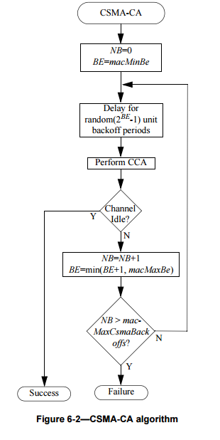
Brief look at CSMA
Simple and flexible
Can reduce to simple LBT without iterative backoff
Can bound backoff growth

Slide 82
Optional backoff suspension in CSMA-CA algorithm
Incorporated into 802.15.4-2024 (Rev E)
Adds capability to sensed channel using the selected CCA mode during the backoff delay period.
Provides improved performance in congested spectrum
Grew out of changing requirements in key applications such as smart energy/grid modernization in Japan and other regions
Expands trade-off space for optimizing and adaptation
More information: https://mentor.ieee.org/802.15/dcn/23/15-23-0234-02-04me-proposed-csma-changes.docx
https://mentor.ieee.org/802.15/dcn/23/15-23-0167-00-0000-the-csma-gap-analysis-between-ieee-802-15-4-and-japanese-standard-jj-300-10.pptx

Slide 83
Added contention-based channel access introduced in (draft) P802.15.4ab: SSBD
Spectrum Sensing Based deferral
CSMA with linear backoff and a few other changes
Iterative sense/backoff/sense as in CSMA
Uses linearly growth in random backoff
Provides for fine resolution bounding of channel access latency
Intended for low-latency use cases
Include optional persistence
Simplified version of 802.11 persistent channel access
Alters channel backoff bounds for retransmission attempts

Slide 84
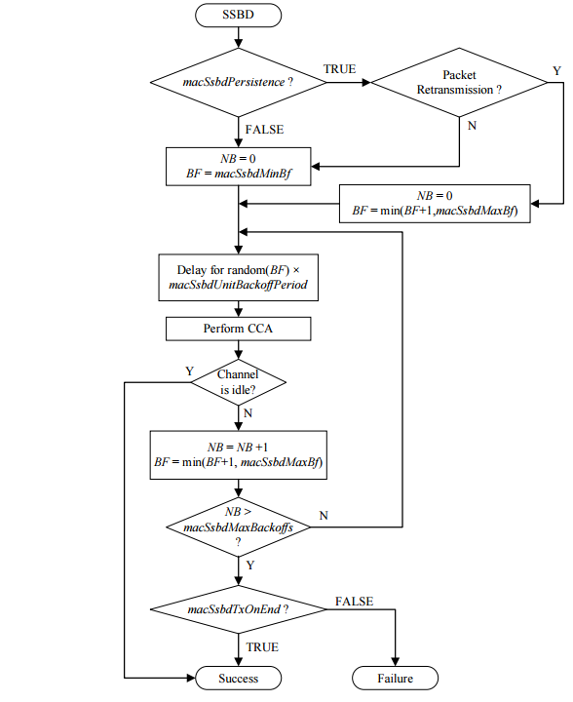
SSBD
Similar to CSMA with
Linear backoff growth
Can reduce to simple LBT
Includes fallback to Aloha option
Optimized for low-latency uses
Includes optional persistence
Reference: https://mentor.ieee.org/802.15/dcn/22/15-22-0485-03-04ab-ssbd-channel-access.pptx

Slide 85
802.15.4s Spectrum resource measurement (SRM) (rolled into 802.15.4-2024)
Provides functionality and data structures to exchange MAC performance and spectrum characterization information
Channel access and retransmission performance
Receiver performance
Channel characterizations
Could be useful for new coexistence recommendations

Slide 86
Other possibly interesting things: 802.15.9
Created to support Key Management Protocol transport over 802.15.4
Includes fragmentation which might be useful for link adaptation

Slide 87
Conclusion
These are just a few of the changes and new features since 2019
Lots of tools we can use
This is only half of the story (802.15.4)
Next step: look into 802.11-2024

Slide 88
802.18 Liaison Report – March 2025
Date: 10 March 2025
Author:
Name | Company | Address | Phone | Email
Edward Au | Huawei Technologies |  |  | edward.ks.au@gmail.com

Slide 89
RR-TAG at a glance
Membership as of 24 January 2025
64 voters (including 10 on LMSC)
3 nearly voters
13 aspirants
Officers
Chair: Edward Au (Huawei Technologies)
Co-Vice Chair: Gaurav Patwardhan (Hewlett Packard Enterprise)
Co-Vice Chair: Al Petrick (Jones-Petrick Associates)
IEEE SA Program Manager: Jodi Haasz (IEEE SA)

Slide 90
Progress since the 2025 January wireless interim
Reviewed the latest ongoing consultations
Approved the following IEEE 802 LMSC submissions:
France ARCEP: Draft decision repealing decision no. 2007-0683 of 24 July 2007 as amended and setting the conditions for use of radio frequencies for equipment operating using ultra-wideband technology
UK Ofcom: Ofcom’s Plan of Work 2025/26
Approved the following liaison statements:
Response to ITU-R Working Party 5C on technical and operational characteristics of their systems operating in the range 450 GHz to 1000 GHz
Information to ITU-R Working Parties 5A and 5C on IEEE Std 802.15.3TM-2023
Discussed the latest topics related to spectrum and regulation in Europe, North America, and Asia Pacific.

Slide 91
Objectives this week (1)
Review and approve draft responses to the following consultations:
UK Ofcom: Updating Wireless Telegraphy Licence Exemptions
UAE TDRA: UAE Spectrum Outlook 2026 – 2031
Australia ACMA: Draft Five-year spectrum outlook 2025-30
Discuss the latest topics related to spectrum and regulation in Europe, North America, and Asia Pacific, including

Slide 92
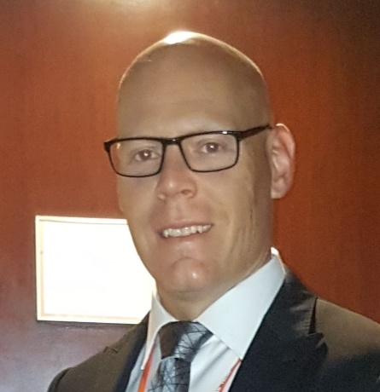
Objectives this week (2)
Invited presentation on Tuesday AM2
Title: Canada Spectrum Outlook
Author: Yan Losier (A/Director, Engineering, Planning and Standards Branch, Department of Innovation, Science and Economic Development Canada / Government of Canada)
Document: 18-25/0007
Source: Yan Losier

Slide 93
802.19 WG January 2025 Liaison Report
Date: 2025-3-12
Authors:

Slide 94
IEEE 802.19 Overview
IEEE 802.19 group reviews coexistence assessment documents (CAD) produced by working groups developing new wireless standards for unlicensed devices.
IEEE 802.19 develops standards for coexistence between wireless standards of unlicensed devices.
Monday PM2 and Thursday PM3 (6:30 PM).
Position | Person
Working Group Chair | Tuncer Baykas (Self)
Working Group Vice Chair | Steve Shellhammer (Qualcomm)
Work Group Secretary | Yukimasa Nagai (Mitsubishi Electric)
Task Group 3a Chair | Ben Rolfe (Blind Creek Associates)
Liaison To/From 802.11 | Tuncer Baykas (Ofinno)

Slide 95
Coexistence Assessment Documents
Letterballot for IEEE P802.15.4ab Coexistence Assessment Document started.
If you are a voter of 802.19 WG, the link for the letterballot is
https://mentor.ieee.org/802.19/polls

Slide 96
FCC Consultation on Sub 1-GHZ Bands
On 6 August 2024, the US FCC Wireless Telecommunications Bureau and Office of Engineering and Technology begins a consultation that seeks public comments on NextNav's petition to reconfigure the 902-928 MHz band and adopt new rules to enable the deployment of a 5G terrestrial positioning, navigation, and timing (PNT) network that “complements and backs up” the U.S. Global Positioning System (GPS).
802.19 WG will provide information to 802.18 WG to be included in IEEE 802 LMSC’s response.

Slide 97
802.19.3a Task Group
Scope of the project: This amendment updates and expands coexistence recommendations to address new market requirements, increasing data traffic, greater device density of devices, and increased potential for congestion based on both IEEE Std 802.11-2020 and IEEE Std 802.15.4 sub-1 GHz standards.
This amendment includes recommendations with respect to new devices, as well as compatibility with deployed legacy devices
‘Follow up on measurement of radio noise over Sub-1 GHz band emitted from mini PC and laptop PC, and its impact on communication performance of IEEE 802.11ah’
Kazuto Yano (ATR) doc:IEEE 802.19-25-0012r0

Slide 98
802.24 Vertical Applications TAG
Liaison Report
March 2025 Plenary Session
Atlanta, GA, USA

Slide 99
802.24 Overview
802.24 Vertical Applications TAG
802.24.1 Smart Grid TG
802.24.2 IoT TG
Officers
TAG Chair: Tim Godfrey
Secretary & TAG Vice Chair: Ben Rolfe
Task Groups
802.24.1 Smart Grid TG Tim Godfrey
802.24.2 IoT TG Chris DiMinico
21 Voting Members
Meeting Plan. Tuesday and Wednesday, PM2 slot

Slide 100
AFV Communications - White Paper
Types of AFV sites: residential, commercial vehicle depot, public transport site, long haul freight transportation, and Public parking facilities
Communications requirements: data volume, resilience, reliability.
Ancillary communication to vehicles (maps, firmware and software updates for vehicles, inventory tracking, logistics, media, etc)
Relate to the use of IEEE 802 technologies as the solution
Output document of combined outline:
24-24-0027-01-0000-proposed-an-extended-outline-for-adding-use-cases-of-integrated-charging-infrastructure-with-distributed-energy-resources-building-and-grid-level-energy-management-systems-in-clause-3—1
AFV Teleconference - 23 April 2025 at 3pm PT 6pm ET, 7am Korea (April 24)

Slide 101
IoT White Paper Discussion
Discussions Notes
Disambiguate the general poor state of available information on IoT, and highlight the IEEE 802 solutions that address them. (done)
Need to distinguish “Internet” public vs private. OT network for highly secure, isolated networks. (Done)
Embedded comments need text contributions
How to incorporate wired IoT – specifically Single Pair Ethernet.
Add section 5 for Connectivity Technologies (needs review from WG experts)
Actions from March 2025
Smart City / Utility section – Ben will seek Wi-Sun text for this.
New section moved to conclusion: “7.Looking back at the Hype, and what has actually been delivered.” (Ben will find a volunteer)
Fill in section on IoT with high reliability (Tim)
Closing statement (Ann)
Draft at end of March 2025: 24-22-0011-08-IoTg-internet-of-things-white-paper
Work on actions above, then we will create clean new version for 2025 after May meeting.

Slide 102
Smart Grid white paper revision
Update of first Smart Grid white paper to address latest amendments of 802.15.4 u, v, w, x, y, Rev-me, and new organization of documents to clarify UWB vs Narrowband
March 2025
Action for Ben w.r.t. spectrum sharing
Action – do we retain or remove OneM2M? Is there any relevance?
Action – Tero to review security section
Action Phil Beecher – update on energy constrained, low power devices
Tim – review and update Companion document - 24-24-0029-00-sgtg-2025-update-package-of-802-smart-grid-standards.docx (looks like equal or greater effort than the white paper)
Output draft from March 2025: 24-24-0014-05-sgtg-802.24

Slide 103
802c status
No report

Slide 104
Wi-Fi Alliance (WFA) Liaison March 2025 Update
Date: 2025-03-12
Authors:

Slide 105
Abstract
This presentation contains the Wi-Fi Alliance (WFA) liaison update for March 2025 IEEE 802.11 meeting

Slide 106
Meetings
The Asia member meeting has been held on Feb. 18-20 in Tokyo.
It was a productive week with excellent guest speakers, networking opportunities, and task group sessions.
Notable keynote speeches
Showcase of the task groups
Discussions on interoperability events’ ability to advance the Wi-Fi ecosystem
Demo of Wi-Fi CERTIFIED HaLoW offerings
Demonstration of EasyConnect interoperability
Documents are available at https://groups.wi-fi.org/wg/Members/document/folder/3941 (available only for members)
The next WFA F2F (Americas) member meeting will take place on June 10th – 12th 2025, in Buenos Aires, Argentina.

Slide 107
Activities
Technical activity at WFA that has recently led to certification
Wi-Fi 7
QoS Management
EasyMesh
WPA3
Wi-Fi proximity ranging
Technical activity at WFA that is expected to lead to certification
Wi-Fi 7 R2
6 GHz standard power
Wi-Fi Direct
XR (Augmented / Virtual / Mixed Reality)
QoS Management
Increased use of interoperability events with commercial products after program launches

Slide 108
Additional Work Areas
Examples of additional WFA technical work
Security
Customer Experience
EasyConnect
Wi-Fi HaLow
Wi-Fi Data Elements
Wi-Fi Aware
Passpoint
Examples of additional WFA activity that may lead to technical work
Sensing
Automotive
Healthcare
Internet of things
Operators
Spectrum regulatory

Slide 109
Recent publications
Press Releases:
Wi-Fi Alliance® applauds UK Ofcom’s proposal to expand 6 GHz Wi-Fi® access
Wi-Fi Alliance® welcomes the nomination of Arielle Roth as NTIA Administrator
Wi-Fi Alliance® statement on the nomination of Olivia Trusty to the FCC
The Beacon Blogs:
Wi-Fi Alliance® pilot trial showcases the transformative power of 6 GHz Wi-Fi for healthcare
Wi-Fi® and AI: Empowering the future of intelligence
Signal Podcasts:
Episode 75: Wi-Fi® is a key ingredient to the AI evolution with Eric McLaughlin of Intel
Episode 74: CEO Insights: Wi-Fi Alliance® and Mike Finley of Boingo
Episode 73: Wi-Fi® enables a new level of security with Marian Kost of Texas Instruments

Slide 110
Further information
For more information on current areas of work, see http://www.wi-fi.org/who-we-are/current-work-areas
If these sound like interesting topics, please plan to sign up and participate
Further general information at http://www.wi-fi.org/

Slide 111
Wireless Broadband Alliance (WBA) Liaison Report – March 2025
Date: 2025-03-12
Authors:
Name | Company | Address | Phone | Email
Necati Canpolat | Intel |  |  | necati.canpolat@intel.com

Slide 112
Wireless Broadband Alliance (WBA)
Drives seamless & interoperable Wi-Fi services
Addresses business and technical issues, as well as opportunities in the industry
IEEE 802.11 (std dev) WFA (cert) WBA (enablement)

Slide 113
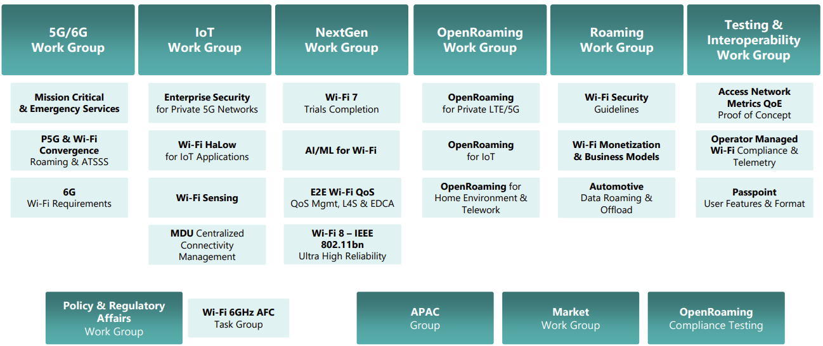
WBA Technical Activities & Roadmap for 2025
https://wballiance.com/wba-program-overview-2025/
https://wballiancec.com/proejcts-details

Slide 114
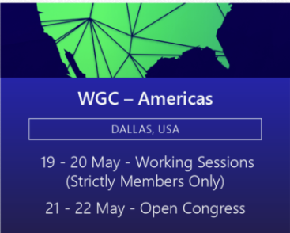
Wireless Global Congress & Members Meetings
https://www.wirelessglobalcongress.com/apac2025/
https://www.wirelessglobalcongress.com/
Presentations

Slide 115
Linux Foundation Broadband & WBA Partners
The partnership aims to foster collaboration between the open source and wireless broadband communities to accelerate the development and adoption of carrier-grade broadband solutions.
WBA and LF Broadband

Slide 116
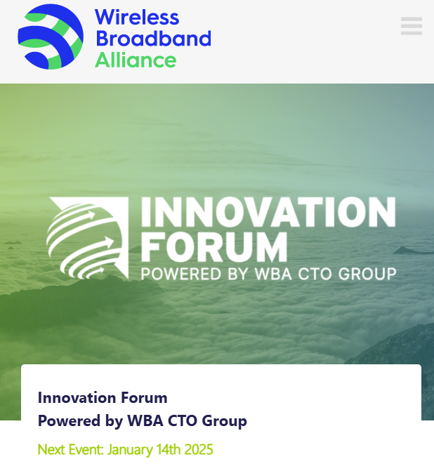
WBA Innovation Forum January
https://wballiance.com/innovation-forum/
Focus on key themes sharing perspectives that will shape the future of connectivity for the next decade and beyond

Slide 117
Enterprise Connectivity Forum
Launching Enterprise Connectivity Forum initiative focused on bringing enterprises together and fostering collaboration in the ecosystem
Open (free) Community
Networking and Collaboration
Pilot Programs and Proof of Concepts
Thought Leadership
https://wballiance.com/ecf/

Slide 118
WBA Wi-Fi 7 Field Trials - CableLabs
WBA is conducting Wi-Fi 7 field trials with its participating members to evaluate and validate the key capabilities of Wi-Fi in real-life various deployment scenarios.
As part of this initiative, CableLabs and Intel collaborated to test Wi-Fi 7 in residential settings – focusing on evaluating the performance and coverage of Wi-Fi 7, assessing its benefits over previous generations.
This report presents performance data from testing Wi-Fi 7 and Wi-Fi 6E in a typical home environment, quantifying the improvements. The findings show that Wi-Fi 7 delivered significant enhancements over Wi-Fi 6.
https://wballiance.com/wi-fi-7-cablelabs-intel/

Slide 119
Operator-Managed Smart Home Industry Framework
A reference framework providing a dynamic roadmap for the future of Smart Homes, extending from WBA’s Operator Managed Wi-Fi project.
Evolving Connectivity Hubs: Visualizes smart homes as evolving connectivity hubs that enhance interoperability between established and emerging technologies.
Managed Wi-Fi Reference Architecture: Support residential service providers with a Managed Wi-Fi reference architecture that integrates IoT and Matter components, setting a new standard in interoperability.
https://wballiance.com/smart-home-iot-framework/

Slide 120
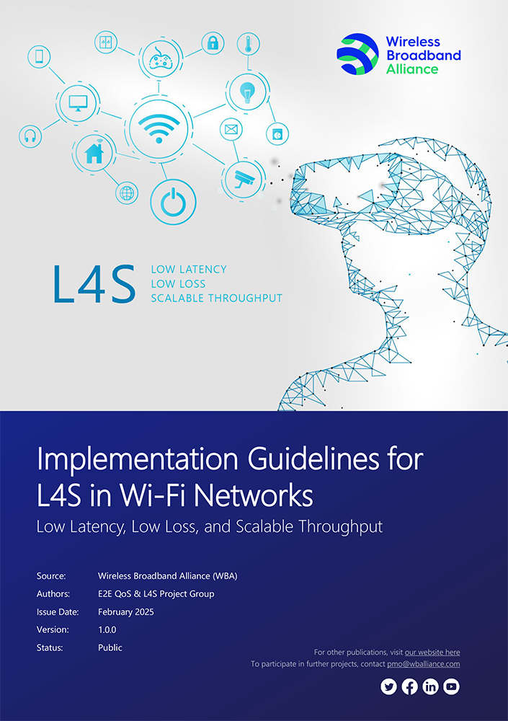
L4S Implementation Guidelines
L4S technology, the guidelines cover:
Reducing media access delays in Wi-Fi networks.
Enhancing network configurations.
Complementing QoS Management Stream Classification Services (SCS).
Optimizing Enhanced Distributed Channel Access (EDCA) parameters.
In 2025, the WBA will continue advancing L4S in coordination with QoS Management initiatives, including additional trials, report generation, provider surveys, and evolving L4S testing scenarios.
Download

Slide 121
Further information
WBA information at https://wballiance.com/
Current work areas https://wballiance.com/wba-program-overview-2025/
WBA resource center https://wballiance.com/resource/
WBA events https://wballiance.com/events-awards/
WBA memberships: https://wballiance.com/membership/

Slide 122
Backup

Slide 123
WBA ORGANIZATION
WBA IS A NONPROFIT ASSOCIATION WITH THE VISION TO ACCELERATE THE DEVELOPMENT OF
“SEAMLESS AND INTEROPERABLE WI-FI SERVICES”
Seamless, Secure and Interoperable Wi-Fi
Convergence and Coexistence of Wireless Technologies
Accelerate Next Generation Wi-Fi Networks
Established
in 2003
+200 MEMBERSHIP
COMMUNITY
PROJECTS &
PROGRAMS
3 ANNUAL
EVENTS
PROMOTION AND
GO-TO-MARKET
THOUGHT LEADERSHIP &
MARKET RESEARCH

Slide 124
WBA Focus Areas
WBA MEMBERS SOLVE
REAL BUSINESS ISSUES
Fosters success for its members
WBA’s mission is to enable collaboration between service providers, technology companies and organizations to drive positive change and enable opportunities for growth.
Standards & Specifications - Setting the scene, requirements and creating specifications
Testing & Interoperability - Creating test plans to showcase the technology capabilities
End-to-End Trials - Running field trials/ proof of concept on real-world environment
Guidelines & Best Practices – Accelerate deployments of services and technologies
Certification & Plug Fests - Addressing gaps and helping the industry to maximizing biz opportunities
Think Thank & Advocacy – Industry leaders roundtables and targeted verticals analysis

Slide 125
IEEE 802.11-IETF Liaison Report
Date: 2025-03-12
Authors:

Slide 126
Abstract
This presentation contains the IEEE 802.11 – IETF liaison report for March 2025.

Slide 127
IETF Meetings
Upcoming Meetings:
March 15-21, 2025 – Bangkok, TH
July 19-25, 2025 – Madrid, ES
IETF meeting fee waivers
http://www.ietf.org
Newcomer training: https://www.ietf.org/about/participate/get-started/
April 2016: Wireless Tutorial (Donald Eastlake), 802.11 & 802.15 tutorials (Dorothy Stanley, Charlie Perkins), see 11-16/500, September 2016: Pat Thaler & Juan Carlos – 802.1E (Privacy Considerations) and 802c (Local MAC address usage) https://datatracker.ietf.org/group/edu/materials/

Slide 128
IETF- IEEE 802 Liaison Activity
Joint meetings, agenda and presentations
http://www.iab.org/activities/joint-activities/iab-ieee-coordination/
Proceedings: https://datatracker.ietf.org/iabasg/ietfieee/meetings/
Coordination topics include: Layer 2/Layer 3 Interaction for Time-Sensitive Traffic, Development of YANG models in the IEEE 802, Capability Discovery, MADINAS
IETF-IEEE 802 coordination teleconferences: February 19, 2025

Slide 129
IETF protocol use with 802.11 technology
RFC 9685 (Listener Subscription for IPv6 Neighbor Discovery Multicast and Anycast Addresses) has been published.

Slide 130
BOFs at IETF 122 March 15-21, 2025
See https://datatracker.ietf.org/wg/bofs/
nasr | Network Attestation for Secure Routing
skex | Symmetric Key Establishment and Exchange

Slide 131
IETF/IRTF groups being (re-)chartered
See https://datatracker.ietf.org/group/chartering/
hrpc | Human Rights Protocol Considerations
ccamp | Common Control and Measurement Plane
diem | Digital Emblems
opsawg | Operations and Management Area Working Group
spring | Source Packet Routing in Networking

Slide 132
YANG Model Catalog
YANG catalog development
A YANG model catalog and registry that allows users to find models relevant to their use cases from the large and growing number of YANG modules being published.
YANG Catalog was developed through a collaboration between the IETF and the Broadband Forum, and contains many data models, including from other Standards Development Organizations (SDOs) such as the IEEE, as well as some vendor-specific data models. Interest and participation from other SDOs, equipment vendors, open-source projects and network operators is encouraged.
See https://www.ietf.org/blog/yang-catalog-latest-developments-ietf-100-hackathon/
See https://yangcatalog.org/ and https://1.ieee802.org/yangsters/

Slide 133
IoT-related work
6LO
Working Group website: https://datatracker.ietf.org/wg/6lo/
Focus: IPv6 over Networks of Resource-constrained Nodes
Updates
Revised: Path-Aware Semantic Addressing (PASA) for Low power and Lossy Networks: https://datatracker.ietf.org/doc/draft-ietf-6lo-path-aware-semantic-addressing/ (March 2025)
Revised: Transmission of SCHC-compressed packets over IEEE 802.15.4 networks: https://datatracker.ietf.org/doc/draft-ietf-6lo-schc-15dot4/ (March 2025)
Revised: Transmission of IPv6 Packets over Short-Range Optical Wireless Communications: https://datatracker.ietf.org/doc/draft-ietf-6lo-owc/ (February 2025) [mentions IEEE802.11bb]
Revised: Generic Address Assignment Option for 6LowPAN Neighbor Discovery: https://datatracker.ietf.org/doc/draft-ietf-6lo-nd-gaao/ (February 2025)

Slide 134
IoT-related work (cont.)
ROLL: Working Group website: https://datatracker.ietf.org/wg/roll/
Focus: Routing over Low Power and Lossy Networks
CORE: (Constrained RESTful Environments) Working Group website: http://datatracker.ietf.org/wg/core/
Focus: framework for resource-oriented applications intended to run on constrained IP networks.
IoT Directorate:
Reviews IETF drafts that are IoT related
See: https://datatracker.ietf.org/group/iotdir/about/

Slide 135
MADINAS WG
See https://datatracker.ietf.org/wg/madinas/
MAC Address Device Identification for Network and Application Services
This is the IETF’s equivalent of IEEE 802.11bh – how to deal with the implications of the deployment of random and changing MAC addresses.
Updates
To be published as RFC 9724: Randomized and Changing MAC Address State of Affairs: https://datatracker.ietf.org/doc/draft-ietf-madinas-mac-address-randomization/ (March 2024)
In RFC Editor’s queue: Randomized and Changing MAC Address Use Cases and Requirements: https://datatracker.ietf.org/doc/draft-ietf-madinas-use-cases/ (December 2024)

Slide 136
EAP Method Update (EMU)
See https://datatracker.ietf.org/wg/emu/
This working group has been chartered to provide updates to some commonly used Extensible Authentication Protocol methods including of EAP-TLS, EAP-AKA, EAP-AKA’ (for 5G), EAP-SIM, etc.
The group should document any recently gained new knowledge on vulnerabilities or the possible implications of pervasive surveillance or other new concerns.
Updates
Revised: Using the Extensible Authentication Protocol (EAP) with Ephemeral Diffie-Hellman over COSE (EDHOC): https://datatracker.ietf.org/doc/draft-ietf-emu-eap-edhoc/ (March 2025)
Revised, waiting for shepherd write-up: Bootstrapped TLS Authentication with Proof of Knowledge (TLS-POK): https://datatracker.ietf.org/doc/draft-ietf-emu-bootstrapped-tls/ (February 2025)
Revised, still in RFC Editor’s queue awaiting other documents, but possibly coming back to the WG: Tunnel Extensible Authentication Protocol (TEAP) Version 1: https://datatracker.ietf.org/doc/draft-ietf-emu-rfc7170bis/ (February 2025)
In AD evaluation: The eap.arpa domain and EAP provisioning: https://datatracker.ietf.org/doc/draft-ietf-emu-eap-arpa/ (January 2025)

Slide 137
Operations Area Working Group
https://datatracker.ietf.org/wg/opsawg/
Updates
Revised: PCAP Capture File Format: https://datatracker.ietf.org/doc/draft-ietf-opsawg-pcap/ (March 2025)
Revised: PCAP Next Generation (pcapng) Capture File Format: https://datatracker.ietf.org/doc/draft-ietf-opsawg-pcapng/ (March 2025)
Background
Of interest: RFC 6632, An Overview of the IETF Network Management Protocols, see https://tools.ietf.org/html/rfc6632
Automated network management, including YANG data models, see https://www.ietf.org/topics/netmgmt/

Slide 138
Internet Area Working Group
https://datatracker.ietf.org/wg/intarea/
Updates
Revised: Communicating Proxy Configurations in Provisioning Domains: https://datatracker.ietf.org/doc/draft-ietf-intarea-proxy-config/ (March 2025)

Slide 139
Transport Layer Security (TLS)
See: https://datatracker.ietf.org/wg/tls/
Updates
Held for formal analysis: TLS 1.3 Extension for Using Certificates with an External Pre-Shared Key: https://datatracker.ietf.org/doc/draft-ietf-tls-8773bis/ (March 2025)
Revised: TLS Encrypted Client Hello: https://datatracker.ietf.org/doc/draft-ietf-tls-esni/ (March 2025)
Revised: Extended Key Update for Transport Layer Security (TLS) 1.3: https://datatracker.ietf.org/doc/draft-ietf-tls-extended-key-update/ (March 2025)
AD Evaluation: Revised I-D needed: The Transport Layer Security (TLS) Protocol Version 1.3: https://datatracker.ietf.org/doc/draft-ietf-tls-rfc8446bis/ (February 2025)
In IESG Evaluation: TLS 1.2 is in Feature Freeze: https://datatracker.ietf.org/doc/draft-ietf-tls-tls12-frozen/ (February 2025)
Adopted: The Datagram Transport Layer Security (DTLS) Protocol Version 1.3: https://datatracker.ietf.org/doc/draft-ietf-tls-rfc9147bis/ (December 2024)

Slide 140
Deterministic Networking (DETNET)
DETNET: https://datatracker.ietf.org/wg/detnet/
The Deterministic Networking (DetNet) Working Group focuses on deterministic data paths that operate over Layer 2 bridged and Layer 3 routed segments, where such paths can provide bounds on latency, loss, and packet delay variation (jitter), and high reliability.
The IEEE 802.11be activities seem like they may fit in with DetNet and there was a joint IEEE-IETF DetNet discussion in Bangkok (November 2018).
Addresses Layer 3 aspects in support of applications requiring deterministic networking.
The Working Group collaborates with IEEE 802.1 Time Sensitive Networking (TSN), which is responsible for Layer 2 operations, to define a common architecture for both Layer 2 and Layer 3.
Example applications for deterministic networks include professional and home audio/video, multimedia in transportation, engine control systems, and other general industrial and vehicular applications being considered by the IEEE 802.1 TSN Task Group.
Updates:
Revised and still in WGLC: Reliable and Available Wireless Architecture: https://datatracker.ietf.org/doc/draft-ietf-raw-architecture/ (February 2025)
Revised and still in IESG evaluation: Reliable and Available Wireless Technologies: https://datatracker.ietf.org/doc/draft-ietf-raw-technologies/ (February 2025)

Slide 141
Autonomic Networking Integrated Model and Approach (ANIMA)
ANIMA: https://datatracker.ietf.org/group/anima/
ANIMA designs protocols to allow network operations (e.g., on-boarding) to be carried out without requiring low-level management of individual devices
Updates:
Waiting for AD go-ahead: BRSKI Cloud Registrar: https://datatracker.ietf.org/doc/draft-ietf-anima-brski-cloud/ (March 2025)
Revised and still in WG Last Call: Constrained Bootstrapping Remote Secure Key Infrastructure (cBRSKI): https://datatracker.ietf.org/doc/draft-ietf-anima-constrained-voucher/ (March 2025)
In IESG Evaluation: BRSKI with Pledge in Responder Mode (BRSKI-PRM): https://datatracker.ietf.org/doc/draft-ietf-anima-brski-prm/ (February 2025)
In WGLC: Join Proxy for Bootstrapping of Constrained Network Elements: https://datatracker.ietf.org/doc/draft-ietf-anima-constrained-join-proxy/ (January 2025)

Slide 142
References
RFC 7241, “The IEEE 802/IETF Relationship” (RFC 4441 update)
https://datatracker.ietf.org/doc/rfc7241/
IEEE 802 Liaisons list is available
http://ieee-sa.centraldesktop.com/802liaisondb/FrontPage

