Slide 1
802.11 WG March 2025 Session Report
Date: 2025-03-12
Authors:

Slide 2
Abstract
This document is a digest of the closing reports of all 802.11 sub-groups for presentation at the March 2025 closing plenary meeting. Liaison reports (including liaison reports from the opening plenary) are also included.

Slide 3
Editors Meeting
No report

Slide 4
ANA
No report

Slide 5
AIML SC (AI and ML)
No report

Slide 6
ARC SC (Architecture)
No report

Slide 7
Coex SC (Coexistence)
No report

Slide 8
PAR Review SC
No report

Slide 9
WNG SC (Wireless Next Generation)
No report

Slide 10
JTC1 802 SC
No report

Slide 11
TGmf (Maintenance)
No report

Slide 12
TGbf (WLAN Sensing)
No report

Slide 13
TGbi (Enhanced Data Privacy)
No report

Slide 14
TGbk (320 MHz Positioning)
No report

Slide 15
TGbn (Ultra High Reliability)
No report

Slide 16
TGbp (Ambient Power)
No report

Slide 17
TGbq (Integrated mmWave)
No report

Slide 18
Enhanced Light Communications Study Group (ELC) March 2025 Closing Report
Date: 2025-3-12
Authors:

Slide 19
Abstract
This presentation contains the IEEE 802.11 Enhanced Light Communications Study Group closing report for the March 2025 session.

Slide 20
ELC activities at the March 2025 meeting
Content
ELC SG addressed comments on the ELC PAR and CSD received from 802.1, 802.3 and RevCom
The modified PAR (doc. 11-25/0185r1) and CSD (doc. 11-24/1600r5) were also reapproved
Meeting agenda and motions are available in doc. 11-25/0347r2.
Minutes of the meeting are available in doc. 11-25/0461.

Slide 21
ELC SG moving forward
Mar. 2025
802 LMSC approval of the PAR and acceptance of the CSD
Submit to NesCom
May 2025
TG start

Slide 22
AUTO TIG (Automotive)
No report

Slide 23
802.15 liaison
No report

Slide 24
802.18 Liaison Report – March 2025
Date: 10 March 2025
Author:
Name | Company | Address | Phone | Email
Edward Au | Huawei Technologies |  |  | edward.ks.au@gmail.com

Slide 25
RR-TAG at a glance
Membership as of 24 January 2025
64 voters (including 10 on LMSC)
3 nearly voters
13 aspirants
Officers
Chair: Edward Au (Huawei Technologies)
Co-Vice Chair: Gaurav Patwardhan (Hewlett Packard Enterprise)
Co-Vice Chair: Al Petrick (Jones-Petrick Associates)
IEEE SA Program Manager: Jodi Haasz (IEEE SA)

Slide 26
Progress since the 2025 January wireless interim
Reviewed the latest ongoing consultations
Approved the following IEEE 802 LMSC submissions:
France ARCEP: Draft decision repealing decision no. 2007-0683 of 24 July 2007 as amended and setting the conditions for use of radio frequencies for equipment operating using ultra-wideband technology
UK Ofcom: Ofcom’s Plan of Work 2025/26
Approved the following liaison statements:
Response to ITU-R Working Party 5C on technical and operational characteristics of their systems operating in the range 450 GHz to 1000 GHz
Information to ITU-R Working Parties 5A and 5C on IEEE Std 802.15.3TM-2023
Discussed the latest topics related to spectrum and regulation in Europe, North America, and Asia Pacific.

Slide 27
Objectives this week (1)
Review and approve draft responses to the following consultations:
UK Ofcom: Updating Wireless Telegraphy Licence Exemptions
UAE TDRA: UAE Spectrum Outlook 2026 – 2031
Australia ACMA: Draft Five-year spectrum outlook 2025-30
Discuss the latest topics related to spectrum and regulation in Europe, North America, and Asia Pacific, including

Slide 28
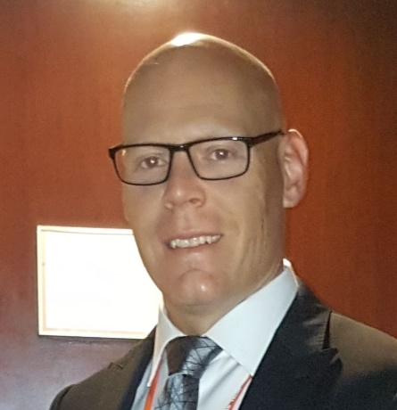
Objectives this week (2)
Invited presentation on Tuesday AM2
Title: Canada Spectrum Outlook
Author: Yan Losier (A/Director, Engineering, Planning and Standards Branch, Department of Innovation, Science and Economic Development Canada / Government of Canada)
Document: 18-25/0007
Source: Yan Losier

Slide 29
802.19 WG January 2025 Liaison Report
Date: 2025-3-12
Authors:

Slide 30
IEEE 802.19 Overview
IEEE 802.19 group reviews coexistence assessment documents (CAD) produced by working groups developing new wireless standards for unlicensed devices.
IEEE 802.19 develops standards for coexistence between wireless standards of unlicensed devices.
Monday PM2 and Thursday PM3 (6:30 PM).
Position | Person
Working Group Chair | Tuncer Baykas (Self)
Working Group Vice Chair | Steve Shellhammer (Qualcomm)
Work Group Secretary | Yukimasa Nagai (Mitsubishi Electric)
Task Group 3a Chair | Ben Rolfe (Blind Creek Associates)
Liaison To/From 802.11 | Tuncer Baykas (Ofinno)

Slide 31
Coexistence Assessment Documents
Letterballot for IEEE P802.15.4ab Coexistence Assessment Document started.
If you are a voter of 802.19 WG, the link for the letterballot is
https://mentor.ieee.org/802.19/polls

Slide 32
FCC Consultation on Sub 1-GHZ Bands
On 6 August 2024, the US FCC Wireless Telecommunications Bureau and Office of Engineering and Technology begins a consultation that seeks public comments on NextNav's petition to reconfigure the 902-928 MHz band and adopt new rules to enable the deployment of a 5G terrestrial positioning, navigation, and timing (PNT) network that “complements and backs up” the U.S. Global Positioning System (GPS).
802.19 WG will provide information to 802.18 WG to be included in IEEE 802 LMSC’s response.

Slide 33
802.19.3a Task Group
Scope of the project: This amendment updates and expands coexistence recommendations to address new market requirements, increasing data traffic, greater device density of devices, and increased potential for congestion based on both IEEE Std 802.11-2020 and IEEE Std 802.15.4 sub-1 GHz standards.
This amendment includes recommendations with respect to new devices, as well as compatibility with deployed legacy devices
‘Follow up on measurement of radio noise over Sub-1 GHz band emitted from mini PC and laptop PC, and its impact on communication performance of IEEE 802.11ah’
Kazuto Yano (ATR) doc:IEEE 802.19-25-0012r0

Slide 34
802c status
No report

Slide 35
Wi-Fi Alliance (WFA) Liaison March 2025 Update
Date: 2025-03-12
Authors:

Slide 36
Abstract
This presentation contains the Wi-Fi Alliance (WFA) liaison update for March 2025 IEEE 802.11 meeting

Slide 37
Meetings
The Asia member meeting has been held on Feb. 18-w0 in Tokyo.
It was a productive week with excellent guest speakers, networking opportunities, and task group sessions.
Notable keynote speeches
Showcase of the task groups
Discussions on interoperability events’ ability to advance the Wi-Fi ecosystem
Demo of Wi-Fi CERTIFIED HaLoW offerings
Documents are available at https://groups.wi-fi.org/wg/Members/document/folder/3941 (available only for members)
The next WFA F2F (Americas) member meeting will take place on June 10th – 12th 2025, in Buenos Aires, Argentina.

Slide 38
Activities
Technical activity at WFA that has recently led to certification
Wi-Fi 7
QoS Management
EasyMesh
WPA3
Wi-Fi proximity ranging
Technical activity at WFA that is expected to lead to certification
Wi-Fi 7 R2
6 GHz standard power
Wi-Fi Direct
XR (Augmented / Virtual / Mixed Reality)
QoS Management
Increased use of interoperability events with commercial products after program launches

Slide 39
Additional Work Areas
Examples of additional WFA technical work
Security
Customer Experience
EasyConnect
Wi-Fi HaLow
Wi-Fi Data Elements
Wi-Fi Aware
Examples of additional WFA activity that may lead to technical work
Sensing
Automotive
Healthcare
Internet of things
Operators
Spectrum regulatory

Slide 40
Recent publications
Press Reelases:
Wi-Fi Alliance® applauds UK Ofcom’s proposal to expand 6 GHz Wi-Fi® access
Wi-Fi Alliance® welcomes the nomination of Arielle Roth as NTIA Administrator
Wi-Fi Alliance® statement on the nomination of Olivia Trusty to the FCC
The Beacon Blogs:
Wi-Fi Alliance® pilot trial showcases the transformative power of 6 GHz Wi-Fi for healthcare
Wi-Fi® and AI: Empowering the future of intelligence
Signal Podcasts:
Episode 75: Wi-Fi® is a key ingredient to the AI evolution with Eric McLaughlin of Intel
Episode 74: CEO Insights: Wi-Fi Alliance® and Mike Finley of Boingo
Episode 73: Wi-Fi® enables a new level of security with Marian Kost of Texas Instruments

Slide 41
Further information
For more information on current areas of work, see http://www.wi-fi.org/who-we-are/current-work-areas
If these sound like interesting topics, please plan to sign up and participate
Further general information at http://www.wi-fi.org/

Slide 42
Wireless Broadband Alliance (WBA) Liaison Report – March 2025
Date: 2025-03-12
Authors:
Name | Company | Address | Phone | Email
Necati Canpolat | Intel |  |  | necati.canpolat@intel.com

Slide 43
Wireless Broadband Alliance (WBA)
Drives seamless & interoperable Wi-Fi services
Addresses business and technical issues, as well as opportunities in the industry
IEEE 802.11 (std dev) WFA (cert) WBA (enablement)

Slide 44
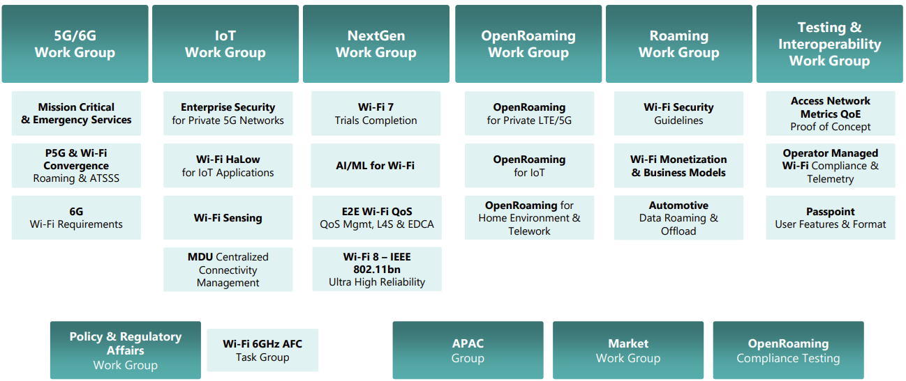
WBA Technical Activities & Roadmap for 2025
https://wballiance.com/wba-program-overview-2025/
https://wballiancec.com/proejcts-details

Slide 45
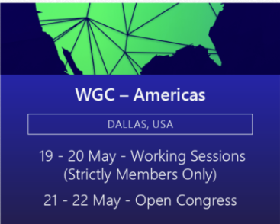
Wireless Global Congress & Members Meetings
https://www.wirelessglobalcongress.com/apac2025/
https://www.wirelessglobalcongress.com/
Presentations

Slide 46
Linux Foundation Broadband & WBA Partners
The partnership aims to foster collaboration between the open source and wireless broadband communities to accelerate the development and adoption of carrier-grade broadband solutions.
WBA and LF Broadband

Slide 47
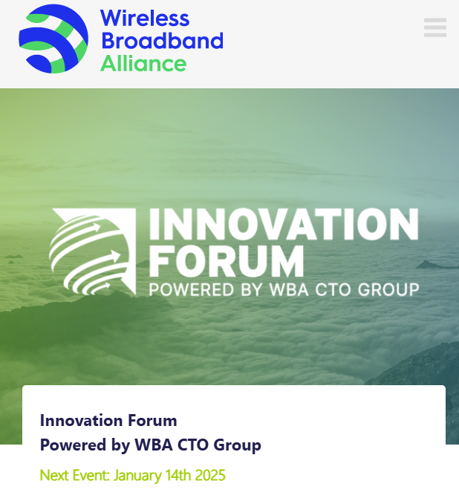
WBA Innovation Forum January
https://wballiance.com/innovation-forum/
Focus on key themes sharing perspectives that will shape the future of connectivity for the next decade and beyond

Slide 48
Enterprise Connectivity Forum
Launching Enterprise Connectivity Forum initiative focused on bringing enterprises together and fostering collaboration in the ecosystem
Open (free) Community
Networking and Collaboration
Pilot Programs and Proof of Concepts
Thought Leadership
https://wballiance.com/ecf/

Slide 49
WBA Wi-Fi 7 Field Trials - CableLabs
WBA is conducting Wi-Fi 7 field trials with its participating members to evaluate and validate the key capabilities of Wi-Fi in real-life various deployment scenarios.
As part of this initiative, CableLabs and Intel collaborated to test Wi-Fi 7 in residential settings – focusing on evaluating the performance and coverage of Wi-Fi 7, assessing its benefits over previous generations.
This report presents performance data from testing Wi-Fi 7 and Wi-Fi 6E in a typical home environment, quantifying the improvements. The findings show that Wi-Fi 7 delivered significant enhancements over Wi-Fi 6.
https://wballiance.com/wi-fi-7-cablelabs-intel/

Slide 50
Operator-Managed Smart Home Industry Framework
A reference framework providing a dynamic roadmap for the future of Smart Homes, extending from WBA’s Operator Managed Wi-Fi project.
Evolving Connectivity Hubs: Visualizes smart homes as evolving connectivity hubs that enhance interoperability between established and emerging technologies.
Managed Wi-Fi Reference Architecture: Support residential service providers with a Managed Wi-Fi reference architecture that integrates IoT and Matter components, setting a new standard in interoperability.
https://wballiance.com/smart-home-iot-framework/

Slide 51
L4S Implementation Guidelines
L4S technology, the guidelines cover:
Reducing media access delays in Wi-Fi networks.
Enhancing network configurations.
Complementing QoS Management Stream Classification Services (SCS).
Optimizing Enhanced Distributed Channel Access (EDCA) parameters.
In 2025, the WBA will continue advancing L4S in coordination with QoS Management initiatives, including additional trials, report generation, provider surveys, and evolving L4S testing scenarios.
Download

Slide 52
Further information
WBA information at https://wballiance.com/
Current work areas https://wballiance.com/wba-program-overview-2025/
WBA resource center https://wballiance.com/resource/
WBA events https://wballiance.com/events-awards/
WBA memberships: https://wballiance.com/membership/

Slide 53
Backup

Slide 54
WBA ORGANIZATION
WBA IS A NONPROFIT ASSOCIATION WITH THE VISION TO ACCELERATE THE DEVELOPMENT OF
“SEAMLESS AND INTEROPERABLE WI-FI SERVICES”
Seamless, Secure and Interoperable Wi-Fi
Convergence and Coexistence of Wireless Technologies
Accelerate Next Generation Wi-Fi Networks
Established
in 2003
+200 MEMBERSHIP
COMMUNITY
PROJECTS &
PROGRAMS
3 ANNUAL
EVENTS
PROMOTION AND
GO-TO-MARKET
THOUGHT LEADERSHIP &
MARKET RESEARCH

Slide 55
WBA Focus Areas
WBA MEMBERS SOLVE
REAL BUSINESS ISSUES
Fosters success for its members
WBA’s mission is to enable collaboration between service providers, technology companies and organizations to drive positive change and enable opportunities for growth.
Standards & Specifications - Setting the scene, requirements and creating specifications
Testing & Interoperability - Creating test plans to showcase the technology capabilities
End-to-End Trials - Running field trials/ proof of concept on real-world environment
Guidelines & Best Practices – Accelerate deployments of services and technologies
Certification & Plug Fests - Addressing gaps and helping the industry to maximizing biz opportunities
Think Thank & Advocacy – Industry leaders roundtables and targeted verticals analysis

Slide 56
IEEE 802.11-IETF Liaison Report
Date: 2025-03-12
Authors:

Slide 57
Abstract
This presentation contains the IEEE 802.11 – IETF liaison report for March 2025.

Slide 58
IETF Meetings
Upcoming Meetings:
March 15-21, 2025 – Bangkok, TH
July 19-25, 2025 – Madrid, ES
IETF meeting fee waivers
http://www.ietf.org
Newcomer training: https://www.ietf.org/about/participate/get-started/
April 2016: Wireless Tutorial (Donald Eastlake), 802.11 & 802.15 tutorials (Dorothy Stanley, Charlie Perkins), see 11-16/500, September 2016: Pat Thaler & Juan Carlos – 802.1E (Privacy Considerations) and 802c (Local MAC address usage) https://datatracker.ietf.org/group/edu/materials/

Slide 59
IETF- IEEE 802 Liaison Activity
Joint meetings, agenda and presentations
http://www.iab.org/activities/joint-activities/iab-ieee-coordination/
Proceedings: https://datatracker.ietf.org/iabasg/ietfieee/meetings/
Coordination topics include: Layer 2/Layer 3 Interaction for Time-Sensitive Traffic, Development of YANG models in the IEEE 802, Capability Discovery, MADINAS
IETF-IEEE 802 coordination teleconferences: February 19, 2025

Slide 60
IETF protocol use with 802.11 technology
RFC 9685 (Listener Subscription for IPv6 Neighbor Discovery Multicast and Anycast Addresses) has been published.

Slide 61
BOFs at IETF 122 March 15-21, 2025
See https://datatracker.ietf.org/wg/bofs/
nasr | Network Attestation for Secure Routing
skex | Symmetric Key Establishment and Exchange

Slide 62
IETF/IRTF groups being (re-)chartered
See https://datatracker.ietf.org/group/chartering/
hrpc | Human Rights Protocol Considerations
ccamp | Common Control and Measurement Plane
diem | Digital Emblems
opsawg | Operations and Management Area Working Group
spring | Source Packet Routing in Networking

Slide 63
YANG Model Catalog
YANG catalog development
A YANG model catalog and registry that allows users to find models relevant to their use cases from the large and growing number of YANG modules being published.
YANG Catalog was developed through a collaboration between the IETF and the Broadband Forum, and contains many data models, including from other Standards Development Organizations (SDOs) such as the IEEE, as well as some vendor-specific data models. Interest and participation from other SDOs, equipment vendors, open-source projects and network operators is encouraged.
See https://www.ietf.org/blog/yang-catalog-latest-developments-ietf-100-hackathon/
See https://yangcatalog.org/ and https://1.ieee802.org/yangsters/

Slide 64
IoT-related work
6LO
Working Group website: https://datatracker.ietf.org/wg/6lo/
Focus: IPv6 over Networks of Resource-constrained Nodes
Updates
Revised: Path-Aware Semantic Addressing (PASA) for Low power and Lossy Networks: https://datatracker.ietf.org/doc/draft-ietf-6lo-path-aware-semantic-addressing/ (March 2025)
Revised: Transmission of SCHC-compressed packets over IEEE 802.15.4 networks: https://datatracker.ietf.org/doc/draft-ietf-6lo-schc-15dot4/ (March 2025)
Revised: Transmission of IPv6 Packets over Short-Range Optical Wireless Communications: https://datatracker.ietf.org/doc/draft-ietf-6lo-owc/ (February 2025) [mentions IEEE802.11bb]
Revised: Generic Address Assignment Option for 6LowPAN Neighbor Discovery: https://datatracker.ietf.org/doc/draft-ietf-6lo-nd-gaao/ (February 2025)

Slide 65
IoT-related work (cont.)
ROLL: Working Group website: https://datatracker.ietf.org/wg/roll/
Focus: Routing over Low Power and Lossy Networks
CORE: (Constrained RESTful Environments) Working Group website: http://datatracker.ietf.org/wg/core/
Focus: framework for resource-oriented applications intended to run on constrained IP networks.
IoT Directorate:
Reviews IETF drafts that are IoT related
See: https://datatracker.ietf.org/group/iotdir/about/

Slide 66
MADINAS WG
See https://datatracker.ietf.org/wg/madinas/
MAC Address Device Identification for Network and Application Services
This is the IETF’s equivalent of IEEE 802.11bh – how to deal with the implications of the deployment of random and changing MAC addresses.
Updates
To be published as RFC 9724: Randomized and Changing MAC Address State of Affairs: https://datatracker.ietf.org/doc/draft-ietf-madinas-mac-address-randomization/ (March 2024)
In RFC Editor’s queue: Randomized and Changing MAC Address Use Cases and Requirements: https://datatracker.ietf.org/doc/draft-ietf-madinas-use-cases/ (December 2024)

Slide 67
EAP Method Update (EMU)
See https://datatracker.ietf.org/wg/emu/
This working group has been chartered to provide updates to some commonly used Extensible Authentication Protocol methods including of EAP-TLS, EAP-AKA, EAP-AKA’ (for 5G), EAP-SIM, etc.
The group should document any recently gained new knowledge on vulnerabilities or the possible implications of pervasive surveillance or other new concerns.
Updates
Revised: Using the Extensible Authentication Protocol (EAP) with Ephemeral Diffie-Hellman over COSE (EDHOC): https://datatracker.ietf.org/doc/draft-ietf-emu-eap-edhoc/ (March 2025)
Revised, waiting for shepherd write-up: Bootstrapped TLS Authentication with Proof of Knowledge (TLS-POK): https://datatracker.ietf.org/doc/draft-ietf-emu-bootstrapped-tls/ (February 2025)
Revised, still in RFC Editor’s queue awaiting other documents, but possibly coming back to the WG: Tunnel Extensible Authentication Protocol (TEAP) Version 1: https://datatracker.ietf.org/doc/draft-ietf-emu-rfc7170bis/ (February 2025)
In AD evaluation: The eap.arpa domain and EAP provisioning: https://datatracker.ietf.org/doc/draft-ietf-emu-eap-arpa/ (January 2025)

Slide 68
Operations Area Working Group
https://datatracker.ietf.org/wg/opsawg/
Updates
Revised: PCAP Capture File Format: https://datatracker.ietf.org/doc/draft-ietf-opsawg-pcap/ (March 2025)
Revised: PCAP Next Generation (pcapng) Capture File Format: https://datatracker.ietf.org/doc/draft-ietf-opsawg-pcapng/ (March 2025)
Background
Of interest: RFC 6632, An Overview of the IETF Network Management Protocols, see https://tools.ietf.org/html/rfc6632
Automated network management, including YANG data models, see https://www.ietf.org/topics/netmgmt/

Slide 69
Internet Area Working Group
https://datatracker.ietf.org/wg/intarea/
Updates
Revised: Communicating Proxy Configurations in Provisioning Domains: https://datatracker.ietf.org/doc/draft-ietf-intarea-proxy-config/ (March 2025)

Slide 70
Transport Layer Security (TLS)
See: https://datatracker.ietf.org/wg/tls/
Updates
Held for formal analysis: TLS 1.3 Extension for Using Certificates with an External Pre-Shared Key: https://datatracker.ietf.org/doc/draft-ietf-tls-8773bis/ (March 2025)
Revised: TLS Encrypted Client Hello: https://datatracker.ietf.org/doc/draft-ietf-tls-esni/ (March 2025)
Revised: Extended Key Update for Transport Layer Security (TLS) 1.3: https://datatracker.ietf.org/doc/draft-ietf-tls-extended-key-update/ (March 2025)
AD Evaluation: Revised I-D needed: The Transport Layer Security (TLS) Protocol Version 1.3: https://datatracker.ietf.org/doc/draft-ietf-tls-rfc8446bis/ (February 2025)
In IESG Evaluation: TLS 1.2 is in Feature Freeze: https://datatracker.ietf.org/doc/draft-ietf-tls-tls12-frozen/ (February 2025)
Adopted: The Datagram Transport Layer Security (DTLS) Protocol Version 1.3: https://datatracker.ietf.org/doc/draft-ietf-tls-rfc9147bis/ (December 2024)

Slide 71
Deterministic Networking (DETNET)
DETNET: https://datatracker.ietf.org/wg/detnet/
The Deterministic Networking (DetNet) Working Group focuses on deterministic data paths that operate over Layer 2 bridged and Layer 3 routed segments, where such paths can provide bounds on latency, loss, and packet delay variation (jitter), and high reliability.
The IEEE 802.11be activities seem like they may fit in with DetNet and there was a joint IEEE-IETF DetNet discussion in Bangkok (November 2018).
Addresses Layer 3 aspects in support of applications requiring deterministic networking.
The Working Group collaborates with IEEE 802.1 Time Sensitive Networking (TSN), which is responsible for Layer 2 operations, to define a common architecture for both Layer 2 and Layer 3.
Example applications for deterministic networks include professional and home audio/video, multimedia in transportation, engine control systems, and other general industrial and vehicular applications being considered by the IEEE 802.1 TSN Task Group.
Updates:
Revised and still in WGLC: Reliable and Available Wireless Architecture: https://datatracker.ietf.org/doc/draft-ietf-raw-architecture/ (February 2025)
Revised and still in IESG evaluation: Reliable and Available Wireless Technologies: https://datatracker.ietf.org/doc/draft-ietf-raw-technologies/ (February 2025)

Slide 72
Autonomic Networking Integrated Model and Approach (ANIMA)
ANIMA: https://datatracker.ietf.org/group/anima/
ANIMA designs protocols to allow network operations (e.g., on-boarding) to be carried out without requiring low-level management of individual devices
Updates:
Waiting for AD go-ahead: BRSKI Cloud Registrar: https://datatracker.ietf.org/doc/draft-ietf-anima-brski-cloud/ (March 2025)
Revised and still in WG Last Call: Constrained Bootstrapping Remote Secure Key Infrastructure (cBRSKI): https://datatracker.ietf.org/doc/draft-ietf-anima-constrained-voucher/ (March 2025)
In IESG Evaluation: BRSKI with Pledge in Responder Mode (BRSKI-PRM): https://datatracker.ietf.org/doc/draft-ietf-anima-brski-prm/ (February 2025)
In WGLC: Join Proxy for Bootstrapping of Constrained Network Elements: https://datatracker.ietf.org/doc/draft-ietf-anima-constrained-join-proxy/ (January 2025)

Slide 73
References
RFC 7241, “The IEEE 802/IETF Relationship” (RFC 4441 update)
https://datatracker.ietf.org/doc/rfc7241/
IEEE 802 Liaisons list is available
http://ieee-sa.centraldesktop.com/802liaisondb/FrontPage

