Slide 1
RU indication to reduce scheduling complexity
Date: Mar. 13, 2025
Authors:
Name | Affiliations | Address | Phone | Email
Jiyang Bai | TCL | Building G1, TCL International-E City, Shenzhen, Guangdong, China. |  | Jiyangbai@gmail.com
 | TCL
Zhanjin Bao

Slide 2
Introduction
The existing contributions are trying to find the balance point by limiting some flexibility in standard level:
A lot of contributions [1-7], passed motions [8] (e.g., Motion #39, #43, #52, #61-63, #65, #66, #87-90) and also the PDT of DRU [9] has related to the concern of scheduling complexity, which leads to increase the limitation the potential patterns of DRU.
Even if we ignore the sacrificed performance and flexibility, the DRU mechanism is still not suitable for massive access in Wi-Fi:
There differences of DRU between DBW 20/40/60/80[10], the potential size of DRU patterns is still significant.
To solve this problem, we provide the other point of view：
Within limited computational resource, we could utilize the feedback Preferred RU sets from STA to reduce the problem complexity.

Slide 3
Recap DRU types
The Different types of DRU are presented in the table below:
DRU Type | Distribution BW20 | Distribution BW40 | Distribution BW60 | Distribution BW80
26-tone DRU | 9 | 18 | N/A | TBD
52-tone DRU | 4 | 8 | 12 | 16
106-tone DRU | 2 | 4 | 6 | 8
242-tone DRU | N/A | 2 | 3 | 4
484-tone DRU | N/A | N/A | N/A | 2
Num. of channel types | DRU types in 40MHz
4 | only 26/52/106/242 tones
1 | 242-tone + 106-tone
1 | 242-tone + 52-tone
1 | 242-tone + 26-tone
3 | 106-tones + 52-tone
3 | 106-tones + 26-tone
8 | 52-tone + 26-tone
2 | 242-tone + 106-tone + 26-tone
1 | 242-tone + 106-tone + 52-tone
4 | 242-tone + 52-tone + 26-tone
12 | 106-tones + 52-tones + 26-tone
2 | 242-tone + 106-tone + 52-tone + 26-tone
Num. of channel types | DRU combinations in 20MHz
One | 9*26-tone
One | 4*52-tone
One | 2*106-tone
Two | 1*106-tone + 5*26-tone | 2*106-tone + 1*26-tone
Three | 1*106-tone + 1*52-tone + 3*26-tone | 1*106-tone + 2*52-tone | 1*106-tone + 2*52-tone + 26-tone
Four | 1*52-tone + 7*26-tone | 2*52-tone + 5*26-tone | 3*52-tone + 3*26-tone | 4*52-tone + 1*26-tone
Notes:
Eg. in 60MHz, using 60DBW
One all 52
One all 106
One all 242
Five 1*106+10*52, 2+8, 3+6，4+4， 5+2
Two 1*242+4*106, 2+2
Two 1*242+8*52, 2+4
Four 1*242+1*106+6*52, 1+2+4, 1+3+2, 2+1+2
16 in total for 60DBW
DBW80=DBW40-7 types with 26-tone= 35 DRU combinations

Slide 4
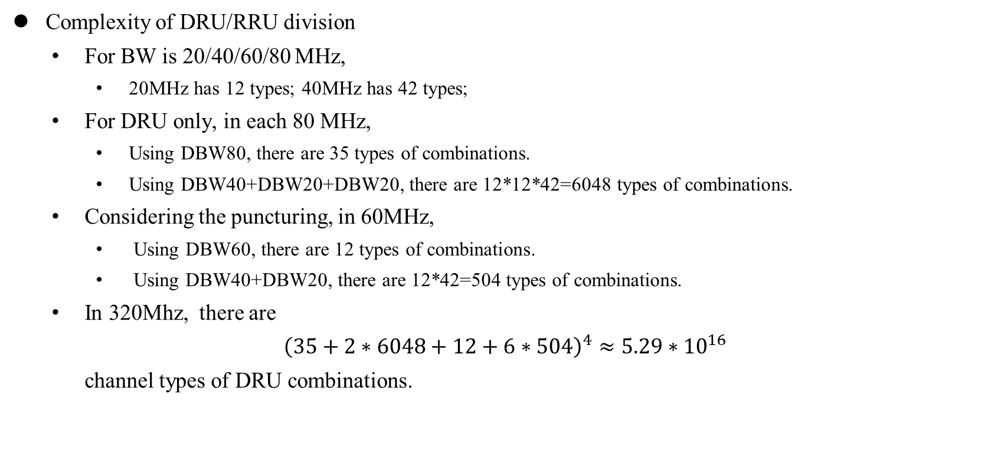
Complexity analysis – Problem Size
Complexity of DRU/RRU division
For BW is 20/40/60/80 MHz,
20MHz has 12 types; 40MHz has 42 types;
For DRU only, in each 80 MHz,
Using DBW80, there are 35 types of combinations.
Using DBW40+DBW20+DBW20, there are 12*12*42=6048 types of combinations.
Considering the puncturing, in 60MHz,
Using DBW60, there are 12 types of combinations.
Using DBW40+DBW20, there are 12*42=504 types of combinations.
In 320Mhz, there are
${\left(35+2∗6048+12+6∗504\right)}^{4}≈5.29∗{10}^{16}$
channel types of DRU combinations.

Slide 5

Complexity analysis – Objective function
For each channel type, AP should also allocate these DRUs to STAs.
The complexity of allocation is depended by the total number of scheduled DRUs N.
If the problem is linear, the time complexity of this problem is $𝒪\left(N^{3}\right)$.
But the problem is non-linear with additional and more complex QoS requirements or functions the problem is NP-hard in general.

Slide 6
Proposed method
If we decompose the original optimization problem into the multiple sub-problem, i.e., the resource allocation problem of each STA.
STAs can optimize their own allocation locally using local computing capacity. The Preferred RU sets are the results.
AP can generate the allocation scheme by gathering the Preferred RU sets.
After resolves all Preferred RU Sets without conflict, AP only need to calculate the RU allocation with conflict, which is much lower than original calculation.
By enabling STA to feedback their preferred (D)RUs, we can utilize the computing resource as well as reduce the complexity of scheduling.

Slide 7
Summary
It is more difficult to schedule the Wi-Fi network after using DRU.
Enable STAs to report their Preferred RU sets could facilitate the scheduling on AP.
With higher management capacity, Wi-Fi network with Preferred RU sets could have better performance than Wi-Fi network without Preferred RU sets
Open Discussions: Detailed Signaling of STA Preferred RU indications

Slide 8
Straw Poll 1
Do you agree to add the following text to the TGbn SFD:
TGbn defines a mechanism that enables a non-AP STA to report its preferred RU sets for following transmission.
Y/N/A

Slide 9
References
[1] 11-23-2020-03-00bn-high-level-perspective-on-distributed-tone-ru-for-11bn
[2] 11-24-1189-01-00bn-dru-transmission-on-frequency-subblocks-of-wide-bandwidth-ppdu
[3] 11-24-1471-03-00bn-signaling-for-dru-in-trigger-frame
[4] 11-24-1472-03-00bn-consideration-on-dru-for-11bn
[5] 11-24-1489-01-00bn-signaling-for-dru-transmission
[6] 11-24-1510-02-00bn-open-issues-on-dru
[7] 11-24-1856-01-00bn-tone-distribution-in-dru-with-puncturing-follow-up
[8] 11-24-0171-26-00bn-tgbn-motions-list-part-1
[9] 11-24-2046-03-00bn-draft-text-on-dru
[10] 11-25-0154-00-00bn-alternative-dru-tone-plan-design-for-60mhz-dbw
[11] J. Bai and X. Wang, "Distributed-Optimization With Centralized-Refining for Efficient Resource Allocation in Future Wireless Networks," in IEEE Transactions on Communications, vol. 72, no. 8, pp. 4829-4843, Aug. 2024.

Slide 10
Appendix: Existing methods and performance
AP can just reschedule the conflicted RRU set
All conflicted RUs are rescheduled. This method only utilized the RU sets without conflict, all processed information in conflicted RUs are wasted.
AP can resolve the conflicted RRU sets, then just schedule the rest of RRU sets.
This method utilizes the carried information in the conflicted RU sets, which is more efficient.
The simulations shows that indicating the Preferred RRU sets has better performance in either linear problem or non-linear problem
Proposed mechanism uses 9.03% processing time but achieves 95.12 % utility performance.
By indicating the preferred RRU sets, network is able to support heavy duty and massive access network.
[11] J. Bai and X. Wang, "Distributed-Optimization With Centralized-Refining for Efficient Resource Allocation in Future Wireless Networks," in IEEE Transactions on Communications, vol. 72, no. 8, pp. 4829-4843, Aug. 2024.
Linear Problem [11]
Non-linear Problem [11]

