Slide 1
I-FCS inclusion in a Trigger frame
Date: 2025-01-04
Authors:
Name | Affiliations | Address | Phone | Email
Sindhu Verma | Broadcom |  |  | sindhu.verma@broadcom.com
Shubhodeep Adhikari |  |  |  | shubhodeep.adhikari@broadcom.com
Hang Su
Notes:
November 2012

Slide 2
Introduction
The following motions regarding intermediate FCS have been agreed in TGbn:
TGbn defines a way in 11bn to include in an initial control frame an intermediate FCS for UHR STA(s) that precedes padding and the FCS field.
If an initial control frame includes an intermediate FCS for UHR STA(s) that precedes padding and the FCS field, the intermediate FCS has the size of 32 bits.
The Intermediate FCS is used to provision various switching delays in UHR that are incurred for features like DPS, DSO, EMLSR, IDC processing, etc
Subsequently, there has been wide consensus that the intermediate FCS in a Trigger frame is inserted as a part of one or more the User Info fields

Slide 3
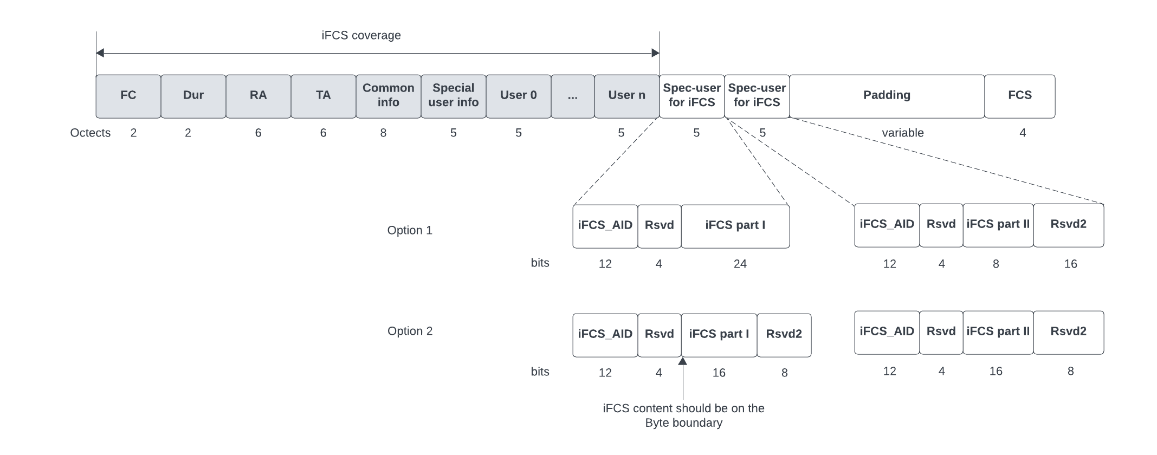
Method of I-FCS inclusion (1)
The diagram below shows our proposal on how I-FCS should be included in a Trigger frame as a part of its User Info fields
The I-FCS is included as a part of 2 contiguous User Info fields known as I-FCS User Info fields
The AID in these 2 I-FCS User Info fields should have the same special AID value (iFCS_AID)

Slide 4
Method of I-FCS inclusion (2)
The 32 bits of the actual I-FCS are distributed between the 2 I-FCS User Info fields as follows
Option 1: Keeping 24 bits in the 1st User Info and 8 bits in the 2nd (Has more support per offline discussions)
Option 2: Keeping 16 bits in each User Info
Hence, it is proposed to split the I-FCS bits keeping 24 bits in the 1st User Info and 8 bits in the 2nd
The I-FCS bits in each I-FCS User Info field should start on the byte boundary i.e. they do not start immediately after the 12-bit AID in the I-FCS user info fields but after leaving a gap of 4 reserved bits.
The 4 reserved bits and other unused bits are set to “Do not care”
The I-FCS should cover all bytes from FC to the last valid user info before the I-FCS, but not including anything in the I-FCS user info fields or later. In other words, none of the bits including AID in the 2 I-FCS User Info fields or later should be included in the I-FCS calculation

Slide 5
Method of I-FCS inclusion (3)
When splitting the I-FCS bits keeping 24 bits in the 1st I-FCS User Info and 8 bits in the 2nd, the ordering of bits also needs to be clarified. It is proposed to have the following ordering/mapping of I-FCS bits in the 2 I-FCS User Info fields:
Representing IFCS value as IFCS[0:31] where IFCS[0] is the LSB, the IFCS bits are ordered in the 2 consecutive “Dedicated IFCS” User Info fields in the trigger frame as follows:
The 24 bits of IFCS (namely IFCS0 subfield) in the 1st “dedicated IFCS” User Info field contain IFCS[0:23] in the same order (bit 16 of the 1st “dedicated IFCS” User Info field is set to IFCS[0])
The 8 bits of IFCS (namely IFCS1 subfield) in the 2nd “dedicated IFCS” User Info field contain IFCS[24:31] in the same order (bit 16 of the 2nd “dedicated IFCS” User Info field is set to IFCS[24])
The I-FCS User Info fields must occur after any User Infos that concern the candidate recipients of the Trigger frame which require inclusion of I-FCS. They can however be before User Info fields of for example, pre-UHR recipients.

Slide 6
Straw Polls (1)
SP1: Do you agree that the I-FCS in a Trigger frame is included as part of 2 contiguous User Info fields known as I-FCS User Info fields?
SP2: Do you agree that the AID in these 2 I-FCS User Info fields have the same special AID12 value of 2011?
SP3: Do you agree that the 32 bits of the actual I-FCS are distributed between the 2 I-FCS User Info fields keeping 24 bits in first User Info and 8 bits in second User Info?
SP4: Do you agree that the I-FCS bits in each I-FCS User Info field start on the byte boundary after leaving a gap of 4 reserved bits after the AID12 field?

Slide 7
Straw Polls (2)
SP5: Do you agree that the input to the I-FCS computation covers all bytes from the Frame Control field up to and including the last User Info that precedes the I-FCS, but not including anything in the I-FCS User Info fields or later?
The input of the I-FCS does not cover any of the fields starting from the first IFCS User Info field
SP6: Do you agree that the I-FCS User Info fields appear after all User Info fields that are addressed to STAs that require the inclusion of I-FCS?
SP7: Do you agree that, representing IFCS value as IFCS[0:31] where IFCS[0] is the LSB, the IFCS bits are ordered in the 2 consecutive “Dedicated IFCS” User Info fields in the trigger frame as follows:
The 24 bits of IFCS (namely IFCS0 subfield) in the 1st “dedicated IFCS” User Info field contain IFCS[0:23] in the same order (bit 16 of the 1st “dedicated IFCS” User Info field is set to IFCS[0])
The 8 bits of IFCS (namely IFCS1 subfield) in the 2nd “dedicated IFCS” User Info field contain IFCS[24:31] in the same order (bit 16 of the 2nd “dedicated IFCS” User Info field is set to IFCS[24])

Slide 8
Reference
[1] IEEE P802.11be™/D7.0
[2] IEEE P802.11bn™/D0.1
[3] 11-24/0209r9 Specification Framework for TGbn
[4] 11-23/1873r0 Post-FCS MAC padding

