Slide 1
Interoperability of NPCA primary channel switching conditions
Date: 2025-03-07
Authors:
Name | Affiliations | Address | Phone | email
Thomas Handte | Sony Group Corporation |  |  | Thomas.Handte@sony.com
Yusuke Tanaka |  |  |  | Yusuke.YT.Tanaka@sony.com
Dana Ciochina
Daniel Verenzuela
Ken Tanaka
Kosuke Aio
Ryuichi Hirata
Qing Xia

Slide 2
Introduction
Non-primary channel access (NPCA) is one important enhancement for 11bn
Several submissions and motions [1] address the operation
The current development state is well captured in a PDT document [2] and D0.1 [3]
The design of the conditions, based on which STAs switch to the NPCA primary channel, is crucial for the performance of NPCA
Certainly, a STA pair which intends to communicate need both to switch to NPCA primary channel
Due to hidden transmissions, STAs may have a different view of the OBSS transmissions
Thus, the likelihood that both STAs switch to the NPCA primary channel is anyway less than 100%
Therefore, we need to design the switching conditions such that, if both STAs of a pair are affected by OBSS transmissions, the switching to NPCA primary channel and related frame exchange is (almost) always successful
This submission addresses an interoperability issue of the current switching conditions and proposes solutions

Slide 3
Issue
Switching to the NPCA primary channel is triggered when any of the following two conditions apply [2]
a inter BSS PPDU and/or a PHY-RXSTART.indication from a inter BSS HE/EHT/UHR PPDU, or
a inter BSS control frame exchange is observed
… and the received frames or PPDUs have certain additional properties [2, 3]
STAs may have a different view of an OBSS frame exchange depending on location
While a first STA applies condition b), a second STA may apply condition a) because condition b) wasn’t fulfilled for the second STA due to a hidden transmission
Thus, a first STA may detect a triggering event earlier than a second STA
Consequently, the first STA may initiate a frame exchange on NPCA primary channel while the second STA is not yet available, or the first STA may have a channel access advantage

Slide 4
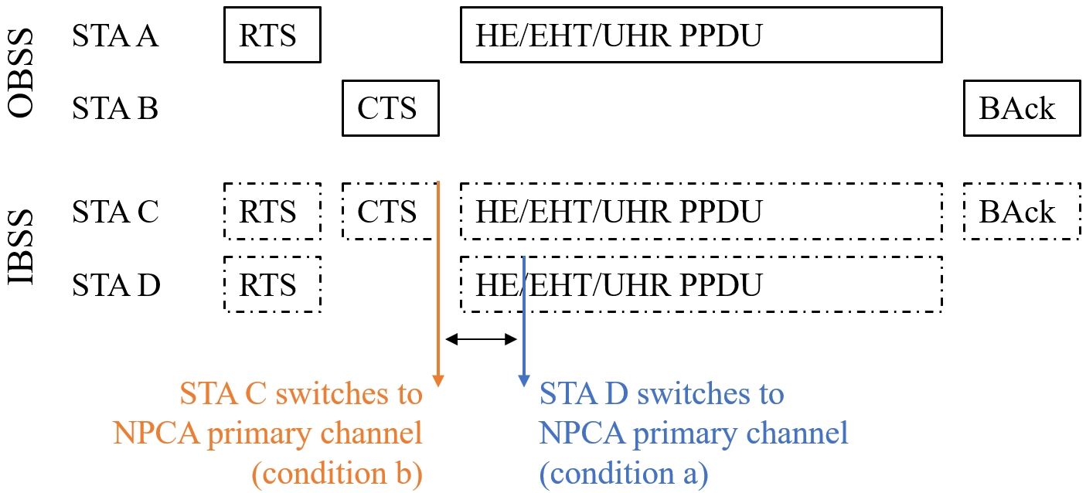
Example
Assumption
OBSS STA A and STA B perform a frame exchange
The frame exchange consist of RTS, CTS, HE/EHT/UHR PPDU, BAck
IBSS STA C may detect all frames
IBSS STA D may detect RTS and the HE/EHT/UHR PPDU only
i.e., STA B’s transmissions are hidden to STA D
Switching to NPCA primary channel
STA C switches after CTS: condition b)
STA D switches after SIG decoding of HE/EHT/UHR PPDU: condition a)
Assuming same switching delay, STA C switches earlier than STA D to NPCA primary channel

Slide 5
Difference in switching times
Switching times as seen from an observing STA
i.e., a decoding delay later than signal on WM
Assumptions
NPCA NHT switch time ($T_{NHT}$) = PHY-RXEND.indication(success) of CTS following RTS
NPCA HE switch time ($T_{HE}$) = PHY-RXTART.indication(RXVECTOR)
Difference is $∆T=T_{HE}−T_{NHT}=\text{aSIFSTime}+T_{endSIG}≥48\text{μs}$
$∆T$can be larger for PPDUs with additional signaling fields such as E(L)R PPDUs
$T_{endSIG}$ is 40µs (HE ER, EHT ER, UHR ELR) or 32µs (all other HE, EHT, UHR PPDU formats)

Slide 6
Implications of different switching times
Availability issue
A STA may initiate a frame exchange on NPCA primary channel while the peer STA is not yet available
A STA can access the medium as early as 34µs (or 25µs) after switching to NPCA primary channel
Fairness issue
The STA that is earlier present on NPCA primary channel has an advantage in gaining channel access by counting down backoff slots earlier
Thus, STAs switching to NPCA primary channel should be available on this channel at (almost) same time

Slide 7
Solutions
Essentially, two options exist
Introduce a waiting time …
Modify the triggering conditions …
… such that regardless of the triggering conditions both STAs are available on NPCA primary channel at (almost) same time

Slide 8
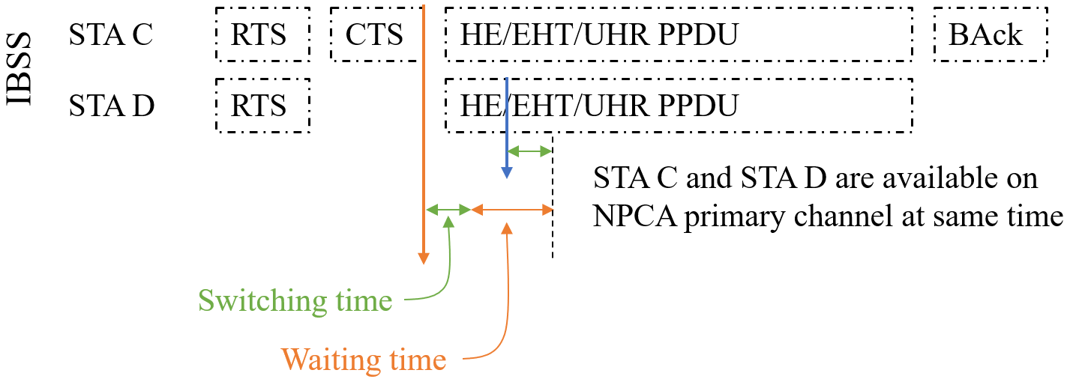
Option 1) waiting time
Currently, there are two conditions triggering the switch to NPCA primary channel
Typically, condition b) (“control frame exchange”) detects a OBSS frame exchange faster than condition a) (“PPDU”)
Thus, a waiting time should be considered whenever condition b) applies
The waiting time is ideally to be considered together with the switching time of a STA
A STA that applies condition b) for switching to the NPCA primary channel at “NPCA NHT switch time” shall initiate a frame exchange on NPCA primary channel not earlier than its peer STA’s switching delay and the waiting time has passed.
The waiting time is $∆T$, i.e., 48µs or 56µs, subject to the assumptions on slide 5

Slide 9
Option 2) modified triggering condition
Add to triggering condition b)
to switch after a PHY-RXEARLYSIG.indication or PHYRXSTART.indication primitive is received on primary channel after the control response frame following the initiating control frame
Such a primitive should be received within aSIFSTime + aRxPHYStartDelay +2x aSlotTime after the PHY-RXEND.indication(success) of control response frame following the initiating control frame
This threshold essentially resembles NAVtimeout on primary channel for NPCA
Implementing this change results in a $∆T$ of 8µs or 16µs which solves the availability issue, but not for the fairness issue
We may add a small waiting time of 8µs or 16µs to remove the fairness issue as well

Slide 10
Conclusion
This submission addresses an interoperability issue of the current conditions under which STAs initiate the switch to the NPCA primary channel
If, due to hidden transmission issues, STAs detect a OBSS transmission with different conditions, a timing mismatch may occur which results in …
… a first STA starting a frame exchange on the NPCA primary channel, while a second STA is not yet available, or
… a first STA having a channel access advantage over the second STA
Two solutions are suggested to ensure that STAs are available on NPCA primary channel at almost same time regardless the applied switching condition
Option 1: Implementation of a waiting time
Option 2: Modification of the triggering condition for inter-BSS control frame exchange

Slide 11
References
[1] 11-24/1762r16 “PDT-MAC-NPCA”
[2] 11-24/0209r7 “Specification Framework for TGbn”
[3] P802.11bn D0.1

Slide 12
Straw Poll #0
(non-SFD, selects subsequent Straw Poll)
Which option do you prefer to address the timing mismatch of NPCA switching conditions
(a) implementation of a waiting time (slide 8)
(b) modification of the triggering condition “inter-BSS control frame exchange” (slide 9)
(c) Abstain

Slide 13
Straw Poll #1
Do you agree to add the following to the TGbn SFD?
The point in time when a STA may initiate a frame exchange on the NPCA primary channel reflects a waiting time such that STAs are available on the NPCA primary channel at same time, regardless the condition that caused the STA to switch to the NPCA primary channel.
- The waiting time is TBD
- Whether the waiting time is a fixed value or can be set by AP is TBD

Slide 14
Straw Poll #2
Do you agree to add the following to the TGbn SFD?
In NPCA operation, when the STA received a PPDU containing a Control frame and a PPDU containing an initial response frame of a Control frame exchange on the BSS primary channel the following condition shall be added:
A PHY-RXEARLYSIG.indication or PHYRXSTART.indication primitive is received after the Control frame exchange on the BSS primary channel within TBD time after the initial response frame of the Control frame exchange

