Slide 1
March 2025
Prioritized EDCA Eligibility Management
Date: 2025-03-10
Authors:
Name | Affiliations | Address | Phone | Email
Mikhail Liubogoshchev | Nokia |  |  | Mikhail.Liubogoshchev@nokia.com
Mika Kasslin
Kerstin Johnsson
Salvatore Talarico
Prabodh Varshney
Behnam Dezfouli
Behnam Dezfouli
Okan Mutgan
Mika Kasslin
Klaus Doppler

Slide 2
Introduction
TGBn agreed to define HIP EDCA in UHR where a STA with Low Latency traffic may be allowed, based on TBD conditions, to send a Defer Signal (it is TBD whether CTS frame or RTS is used) to start a protected short contention for pending LL data
Conditions to be allowed to send a Defer Signal is TBD
STA in HiP EDCA always use RTS/CTS as initial frame exchange and retry.
Duration of protected short contention is TBD.
Access parameters (AIFSN, CW and the expansion rules) used to transmit the Defer Signal are TBD.
The retry count where the Defer Signal is allowed to be sent is TBD
Contention parameters for the protected short contention are TBD. The STAs that transmitted a Defer Signal but did not win the protected short contention will initiate a new retry.
Low Latency traffic is treated as AC_VO traffic. Other cases are TBD.
The solution would provide control on the degree of collisions that may occur while using it and, allows for autonomous randomness or/and controlled by the AP
No new mandatory synchronization requirement on STA side
HIP EDCA is used by the STAs in a BSS only when this feature is enabled by the AP

Slide 3
Open Issues
P-EDCA (HiP-EDCA before Draft 0.1) summary: if AP enables BSS-wide, AC_VO (other cases TBD) STA under TBD conditions sends a DS, starts a protected short contention with TBD contention parameters
Some of the open issues:
Is it flexible enough to consider all AC_VO traffic as Low Latency (LL)?
Should LL property be independent of AC?
L4S adoption is gaining momentum. It aims at bringing low (~1ms queuing) latency to high data rate applications.
L4S applications would benefit a lot from the reduced tail access delays
AC_VO isn’t designed for many STAs with heavy traffic
What eligibility criteria would allow P-EDCA to consistently cut the tail delays?

Slide 4
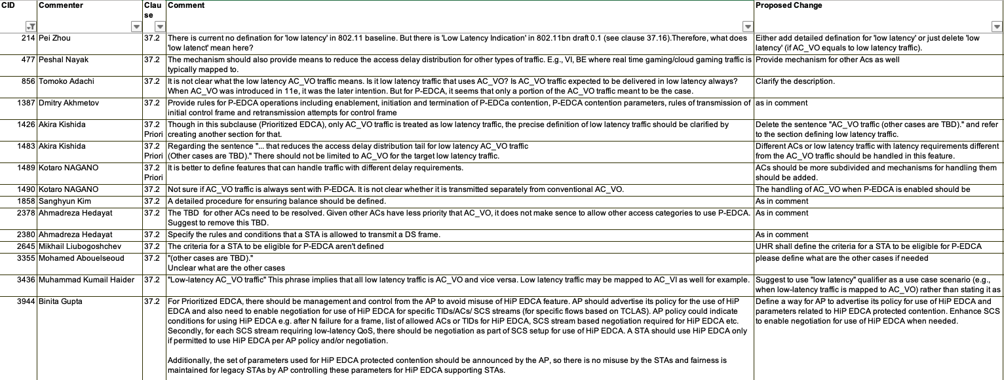
Related Comments on Draft 0.1

Slide 5
What is the Relevant LL Traffic?
Industrial control: 10kbps…1Mbps, UL+DL, many STAs per BSS, periodic (10-1000Hz) => short individual MPDUs, requires OFDMA for high capacity
Real-time online gaming: 100kbps…1Mbps, UL+DL, several STAs per BSS, periodic (1-100Hz) or random + correlated => short individual MPDUs
Audio calls: ~100kbps, UL+DL, few STAs per BSS, ~10Hz => short individual MPDUs
Cloud work (remote desktop, design, photo/video editing, GenAI): DL: (1-1000Hz, 100kbps…10Mbps, bursty), UL: (1-100Hz, 1kbps…1Mbps, bursty)
Audio + Video calls: ~1Mbps, UL+DL, few STAs per BSS, <100Hz => small batches of MPDUs
VR + cloud gaming: DL: (5..100Mbps, 100Hz), UL: (100kbps…5Mbps, ~100Hz), few STAs per BSS => large batches of MPDUs
Controlled environment, high density => distributed EDCA-based solutions are infeasible and inefficient
Is it sensible to map all these traffic types to AC_VO? Is any of this insensitive to tail latencies?

Slide 6
Proposal 1
Extend the SCS/MSCS framework to allow the STA to request, and the AP to manage the P-EDCA eligibility per traffic stream.
SCSIDs of the ACs other than VO (TIDs with a head-of-line MPDU belonging to the SCSID) can become P-EDCA eligible under specific conditions
The differentiation between the ACs can be achieved by differentiating the conditions

Slide 7
Eligibility criteria to consistently cut the tail delays
Real-time online gaming: 100kbps…1Mbps, UL+DL, several STAs per BSS, periodic (1-100Hz) or random + correlated => short individual MPDUs
Audio calls: ~100kbps, UL+DL, few STAs per BSS, ~10Hz => short individual MPDUs
Cloud work (remote desktop, design, photo/video editing, GenAI): DL: (1-1000Hz, 100kbps…10Mbps, bursty), UL: (1-100Hz, 1kbps…1Mbps, bursty)
Audio + Video calls: ~1Mbps, UL+DL, few STAs per BSS, <100Hz => small batches of MPDUs
VR + cloud gaming: DL: (5..100Mbps, 100Hz), UL: (100kbps…5Mbps, ~100Hz), few STAs per BSS => large batches of MPDUs
Even infrequent but long enough BE TxOPs can synchronize several LL STAs and make them contend and collide once the channel becomes idle.
A combination of LL traffic bursts and long BE TxOPs can cause long tail delays due to
delayed channel access and
MCS-selection-induced PER

Slide 8
LL STA Synchronization Problem
Synchronization point for contention of all the LL STAs in the figure
(AC_VO) LL STA_1
(AC_VO) LL STA_2
(AC_VO) LL STA_3
(AC_VO) LL STA_4
AC_BE STA
Frame(s) to Tx from upper layer
LL STA_1 ready for contention
Frame(s) to Tx from upper layer
LL STA_2 ready for contention
Collision between LL STAs because of synchronization
Frame(s) to Tx from upper layer
LL STA_3 ready for contention
Frame(s) to Tx from upper layer
LL STA_4 ready for contention
Long TXOP
t

Slide 9
Proposal 2
Allow the LL-STAs to initiate P-EDCA contention after long TxOPs and TBD periods of unavailable channel (e.g., R-TWT)
The channel unavailability duration threshold is TBD
AP can select and advertise another value
A per-AC or more granular differentiation of the duration is possible
Why?
AC_VO collisions right after a long TxOP are almost inevitable
P-EDCA contention could scale better:
Larger than VO contention window
Non-LL STAs do not participate
Consistently cutting the tail latencies requires considering all the major latency contributors

Slide 10
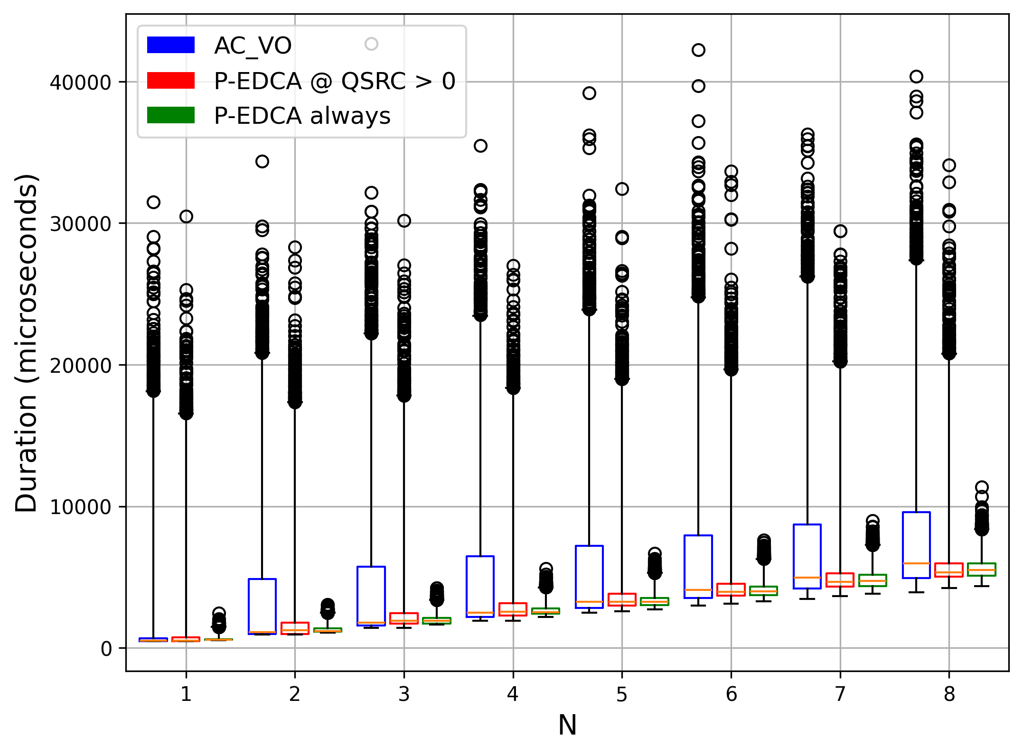
Numerical Example
P-EDCA tail latencies (q99+) are only bit shorter than for the legacy AC_VO
Scenario:
Each of N LL STAs get a new frame to TX during a BE TxOP
LL STAs initiate contention after the TxOP finishes
10 BE STAs also contend and initiate TxOPs for 3 to 5ms
RTS/CTS is enabled
Figure shows the time it takes for all LL STAs to deliver their frames
Solutions:
AC_VO: only legacy AC_VO contention
P_EDCA @ QSRC > 0: LL STAs with QSRC > 0 initiate P-EDCA (implementation according to 24/840r0, no limit on the number of DSs sent in a row)
P-EDCA always: all LL STAs initiate P-EDCA starting from the first attempt, because the BE TxOP was longer than a threshold
Enabling P-EDCA after a long TxOP helps maintaining low tail latency
And it can positively impact the overall BSS capacity by reducing the collision rate

Slide 11
Conclusions
The contribution focused on P-EDCA eligibility criteria
Proposed enabling P-EDCA for other ACs via SCS/MSCS setup
To improve flexibility
To cover a wider range of cases where cutting the tail latencies is important
Proposed optionally enabling P-EDCA after long periods of channel unavailability (such as alien TxOPs, R-TWT, etc.)
To reduce contention when it is the most intensive and avoid excessive collisions for LL STAs

Slide 12
Straw Polls
SP1. Do you agree that TGbn shall enable P-EDCA eligibility management via SCS/MSCS?
SP2. Do you agree that TGbn shall address the issue of increased contention between LL STAs after long periods of channel unavailability to consistently improve tail latencies?
Examples of such periods are long alien TxOPs and R-TWT SPs.
SP3. Do you agree that using the SCS/MSCS framework the AP might enable LL STAs to initiate P-EDCA contention after TBD periods of channel unavailability (e.g., long TxOPs, R-TWT)

Slide 13
References
[1] IEEE 802.11-23/480r3, UHR Proposed PAR
[2] IEEE 802.11-24/840r0, Low latency channel access
[3] IEEE 802.11-24/296r7 IEEE 802.11bn CC50 comments on D0.1

Slide 14
Backup
March 2025

Slide 15
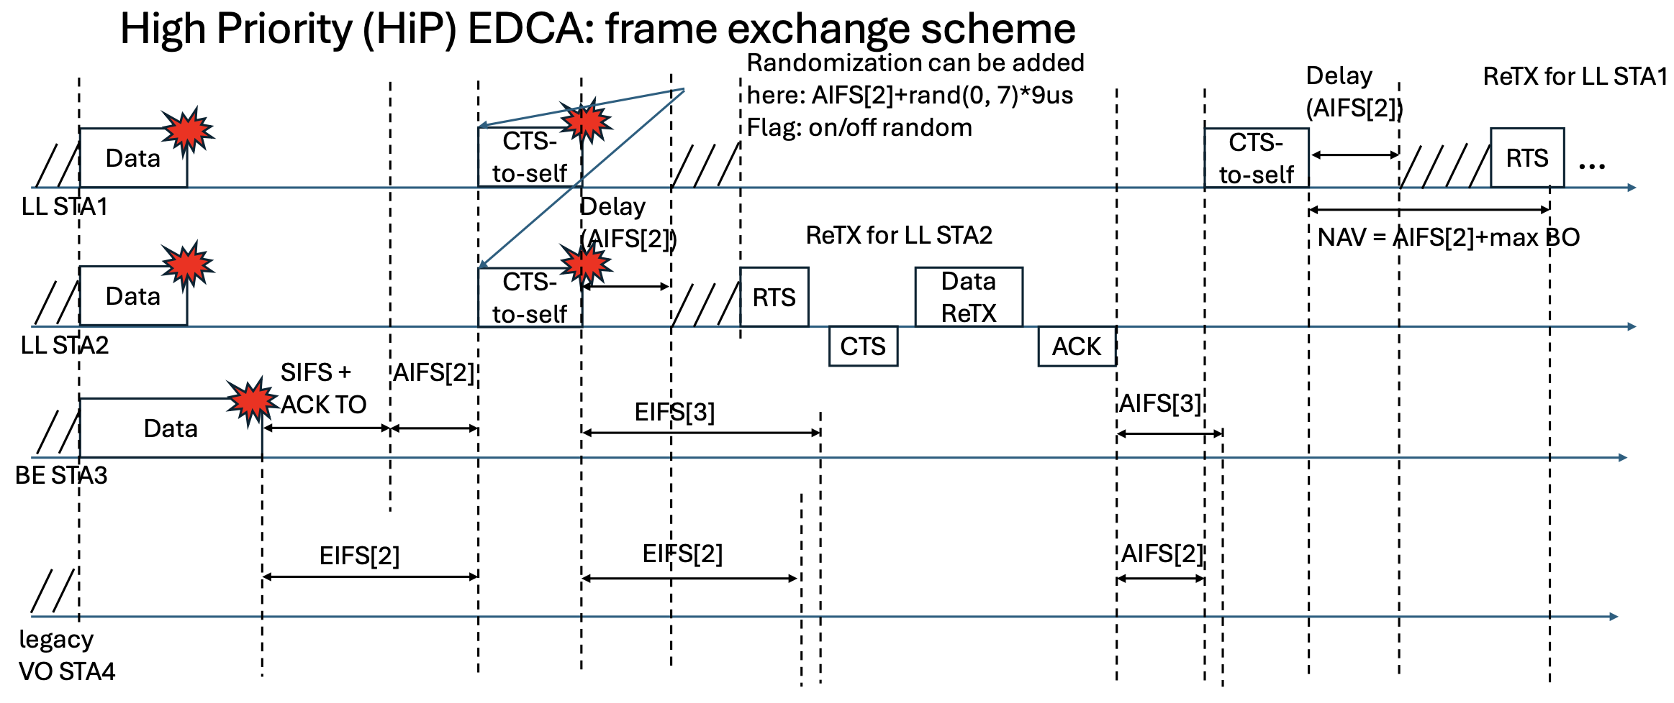
P-EDCA Baseline (24/840r0, etc.)
Idea: Separate LL STA(s) (under some conditions) from the rest of STAs
Such STA(s) send a DS (deferral signal) and announce (P)rioritized-EDCA contention once the medium is IDLE (TBD if with any contention)
Other STA(s) defer based on NAV or EIFS triggered by the DS
Immediately after the DS, LL-STA(s) contend only among themselves
P-EDCA contention parameters: AIFS[2] after the DS, backoff with CW=7, mandatory RTS/CTS
If the LL STA loses the P-EDCA Contention (due to a collision or a large backoff), it repeats the sequence: DS+Contention+RTS+CTS+DATA (TBD on how many times in a row)

