Slide 1
Follow-up of automotive use case study

Slide 2
Abstract
In the July meeting, IEEE 802.11 WG approved the creation of Automotive (AUTO) TIG to investigate:
  Use cases, current and planned mechanisms in 802.11 for vehicle connectivity to external APs
  Gaps between requirements and standards for automotive connectivity to external APs
  Recommendations to address gaps
A use case of regional HD MAP is discussed [1]
More details and numerical examples are discussed in this contribution
Jing Ma (Toyota)

Slide 3



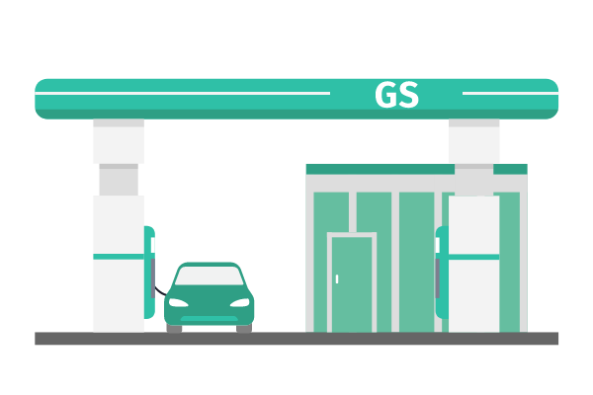


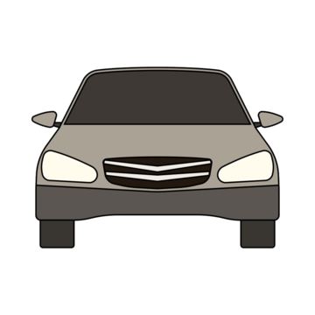



Recap: Regional HD MAP use case
Overview: This use case leverages opportunistic Wi-Fi connectivity for vehicles, either in motion or parked within a specific geographic region.
Functionality: vehicles connect to local WLAN access points (APs) to
  Share data such as sensor data, environmental data.
  Receive updates of the map information.
Benefits:
  Enhances the accuracy of HD maps
  Utilizes local infrastructure for efficient data exchange.
Actors: Vehicle, AP, Edge Cloud
Jing Ma (Toyota)

Slide 4



Recap: Regional HD MAP use case
Example service level requirements
 | Assumed service level requirement
Range | 500m | Urban area
Information requested/ generated [2] | - 100 bytes/ object※, - 50 objects detected in vehicle | assumed uplink
 | 5000 objects updates | Assumed downlink
Look-ahead time | 1s before entering the area of interest
Access network (WLAN)
AP
$$v$$
Upload the detected object info.
Download the updates of map info.
※: Information usually included in HD map are road geometry (e.g. traffic lights, intersection), road furniture (e.g. street lights ), land markers, etc.
Jing Ma (Toyota)

Slide 5

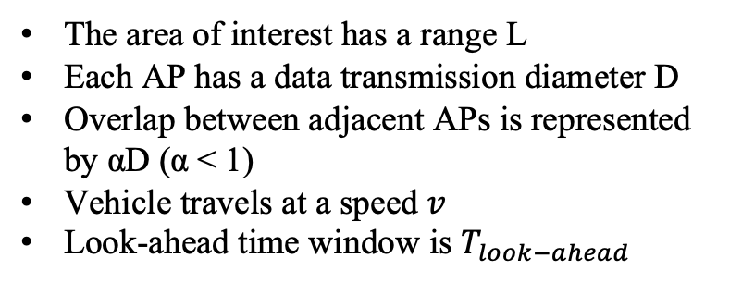
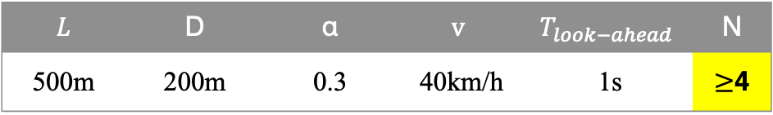


Example WLAN deployment for regional HD MAP use case
Assumptions:
Coverage condition:
The area of interest has a range L
Each AP has a data transmission diameter D
Overlap between adjacent APs is represented by αD (α < 1)
Vehicle travels at a speed $v$
Look-ahead time window is $T_{look−ahead}$
To ensure full coverage of the area, the total deployment must satisfy this condition:
$\left(1−α\right)∙N∙D+{vT}_{look−ahead}≥L$,
Where $N$ represents the required number of APs. Simplified as,
$$N≥ceil(\frac{L−{vT}_{look−ahead}}{\left(1−α\right)D})$$
AP
AP
Look-ahead area
Area of interest
Numerical example:
$$v$$
𝐿 | D | α | $$v$$ | $$T_{look−ahead}$$ | N
500m | 200m | 0.3 | 40km/h | 1s | $≥$4
Upload the detected object info.
Download the updates of map info.
Jing Ma (Toyota)

Slide 6


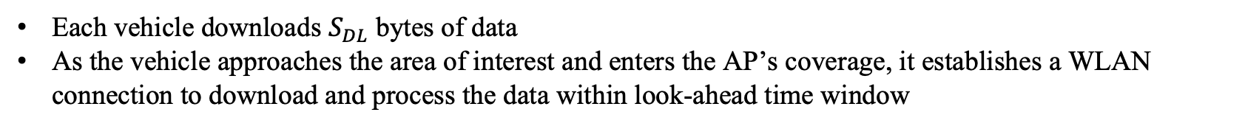
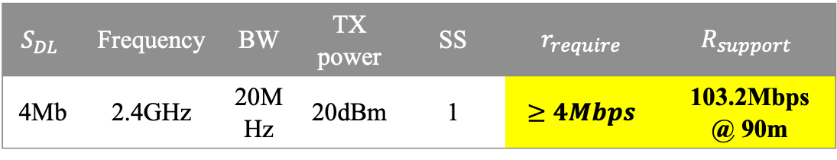


Numerical example for regional HD MAP use case
Case 1: Vehicle downloading map data in light traffic while approaching the area of interest
Scenario:
Each vehicle downloads $S_{DL}$ bytes of data
As the vehicle approaches the area of interest and enters the AP’s coverage, it establishes a WLAN connection to download and process the data within look-ahead time window
Requirement:
The downlink time ($T_{DL}$) should meet the required look-ahead time window,
$T_{DL}=T_{data}+T_{conn.}< T_{look−ahead}$,
The per-vehicle data rate ($r_{require}$) is:
$r_{require}=\frac{S_{DL}}{T_{data}}>\frac{S_{DL}}{T_{look−ahead}}.$
From the pathloss model, the supported throughput at distance d ($R_{support}(d)$) can be estimated [3, 4]
AP
AP
Look-ahead area
Numerical example:
Area of interest
$T_{look−ahead}$=1s, AWGN channel with pathloss model [3]
$$S_{DL}$$ | Frequency | BW | TX power | SS | $$r_{require}$$ | $$R_{support}$$
4Mb | 2.4GHz | 20MHz | 20dBm | 1 | $$≥4Mbps$$ | 103.2Mbps @ 90m
$$v$$
$$T_{data}$$
$$T_{conn}$$
Jing Ma (Toyota)

Slide 7
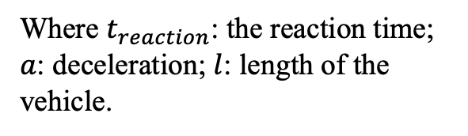




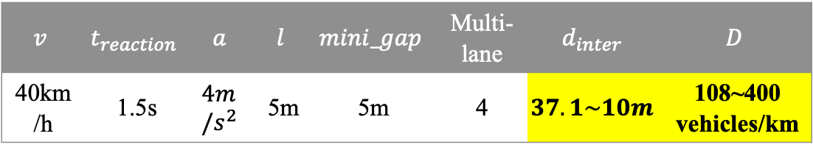
Numerical example for regional HD MAP use case
Case 2: multiple vehicles downloading map data while approaching the area of interest
Vehicle density ($ρ$) should be considered.
$ρ$ (vehicles/km, linear) depends on inter-vehicle distance ($d_{inter}$), calculated using
$$d_{inter}=\left\{\begin{aligned}v・t_{reaction}+\frac{v^{2}}{2a}, Free−flow traffic \\ &l+mini_gap, Congested traffic\end{aligned},\right.$$
Where $t_{reaction}$: the reaction time; $a$: deceleration; $l$: length of the vehicle.
$${ρ=1/d}_{inter}$$
AP
AP
Area of interest
Look-ahead area
Numerical example:
$$v$$
$$v$$ | $$t_{reaction}$$ | $$a$$ | $$l$$ | $$mini_gap$$ | Multi-lane | $$d_{inter}$$ | $$D$$
40km/h | 1.5s | $$4m/s^{2}$$ | 5m | 5m | 4 | $$37.1\sim 10m$$ | 108~400 vehicles/km
$$v$$
The required per-vehicle data rate ($r_{require}$) may not be satisfied when vehicle density becomes high
Jing Ma (Toyota)

Slide 8
Summary
More details related to regional HD MAP use case with WLAN are discussed:
  Data transmitted in local WLAN for the regional HD MAP can generally be supported
    Data size for map updates is assumed relatively small
    In high-density traffic scenarios, the require data rates per vehicle may be achievable but face challenges such as avoiding interference
Opportunities for improvement
  Enhancing MAC layer protocols to handle high-density scenario and prioritize critical updates
  Optimizing channel utilization for better performance
Jing Ma (Toyota)

Slide 9
References
[1] 11-24/1526r1 Automotive WLAN use case study, Sep., 2024
[2] 5gaa-t-200111-tr-c-v2x-use-cases-and-service-level-requirements-vol-i-v3.0
[3] 11-24/1525r2 Use Case Study for Sustained Streaming Services in Moving Vehicles, Sep. 2024
[4] 11-14/0882r1 IEEE 802.11ax Channel Model Document, May, 2014

