Slide 1
Issues on DPS Mode Change Follow Up
Date: 2025-03-12
Authors:

Slide 2
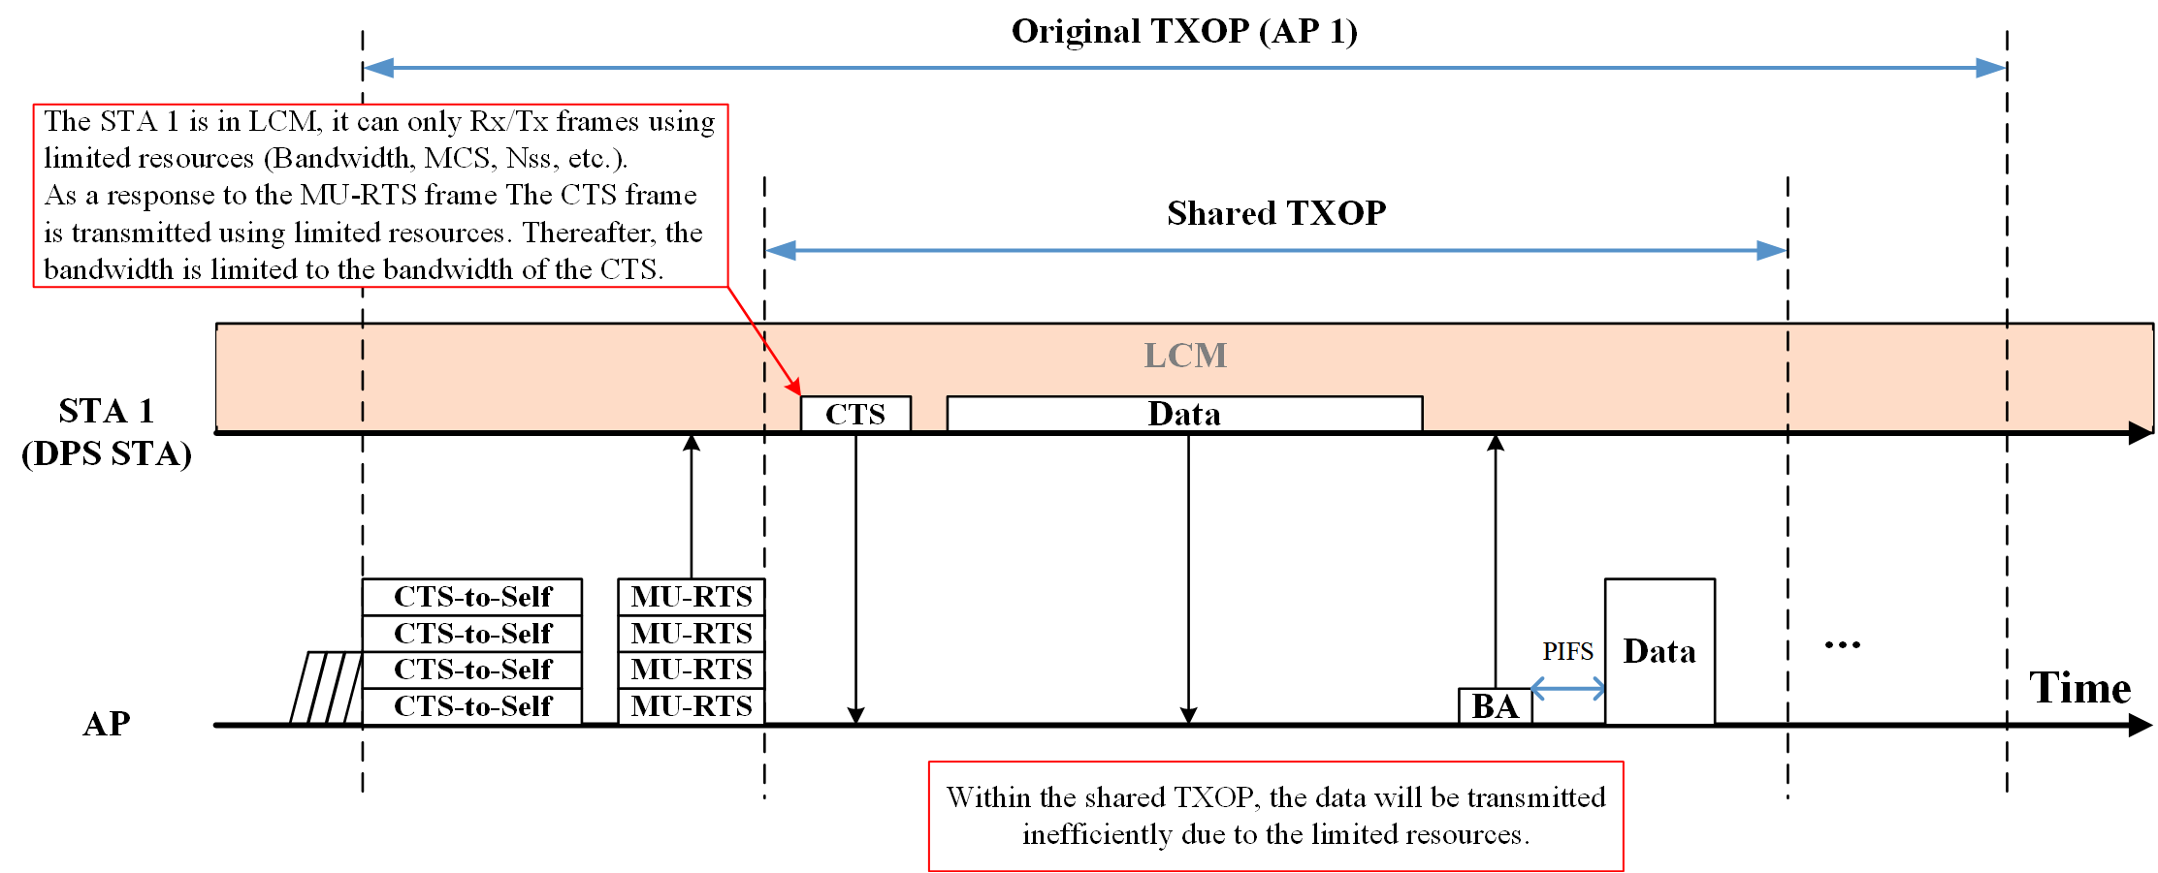
Recap: TXOP Sharing During DPS
In the last contribution, an issue was raised in case TXOP sharing method combined with DPS [1].
When an AP shares its TXOP with a DPS STA in LC mode, the shared TXOP’s resources (e.g., bandwidth, MCS, NSS, etc.) are limited to the DPS STA’s LC mode capabilities.

Slide 3
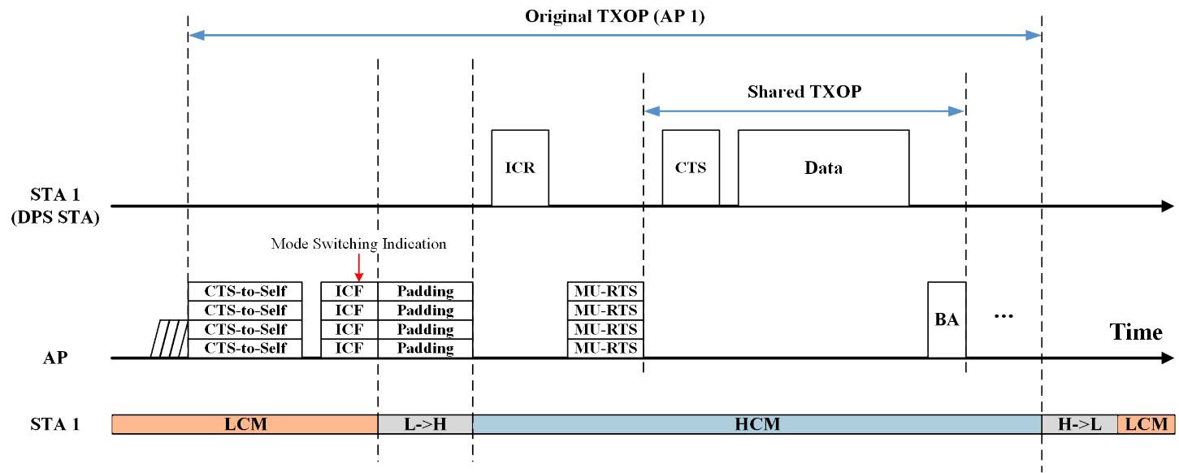
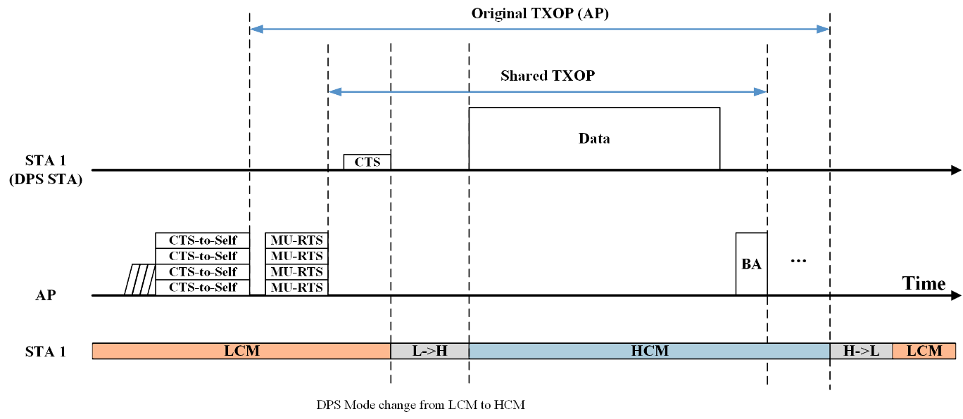
Recap: TXOP Sharing During DPS
To address the issue, two options were proposed.
Option 1) The AP indicates the DPS STA to transition its DPS mode to HC mode when it shares its TXOP with the DPS STA.
Option 2) The AP waits for the DPS STA to attempt to transition its DPS mode to HC mode.
The option 2 is preferred.
In this contribution, further considerations on the option 2 are discussed.

Slide 4
Recap: Option 2
Since the operating mode of Power Save, such as DPS, should be determined by the STA depending on the STA’s power saving status, the AP needs to respect that.
The main concept of the option 2 is that the AP waits for the DPS STA to attempt to transition its DPS mode, and the DPS STA can decide to transition its DPS mode by itself.
With the option 2, the AP can respect the DPS STA’s power save policy.
There are several considerations to enable the option 2.

Slide 5
Consideration 1: Shared TXOP Return Rule
According to the baseline [2], in TXS mode 1, an AP which shared its TXOP to a non-AP STA might reclaim its TXOP when the CS mechanism indicates that the medium is idle at the TxPIFS slot boundary after the end of either the last Tx or Rx during shared TXOP.
With the option 2, the AP needs to wait for the DPS STA to attempt to transition its DPS mode during the shared TXOP, the waiting time might be longer than the TxPIFS slot boundary between the CTS frame reception and the Data frame reception.
To enable the option 2, the TxPIFS slot boundary regulation in the baseline must be relaxed to the DPS Padding Delay value (+ PIFS) indicated by the DPS STA for the waiting time between the CTS frame reception and the Data frame reception.
35.2.1.2.2 AP behavior
…
If the EHT AP determines that its transmission of an MU-RTS TXS Trigger frame to a non-AP EHT STA with the TXS Mode subfield equal to 1 is successful (see 26.2.6.2 (MU-RTS Trigger frame transmission)), then the AP shall not transmit any PPDU within the allocated time specified in the MU-RTS TXS Trigger
frame unless one of the following conditions are true:
- The PPDU carries an immediate response that is solicited by the non-AP STA.
- The CS mechanism indicates that the medium is idle at the TxPIFS slot boundary after the end of either the transmission of an immediate response frame sent to that STA or the reception of a frame from that STA that did not require an immediate response.

Slide 6
Consideration 2: Bandwidth Limitation
According to the baseline [2], in TXS mode 1, the non-AP STA’s bandwidth within the shared TXOP is limited by the bandwidth of the CTS frame that is a response frame of the MU-RTS TXS trigger frame.
The bandwidth limitation rule should be relaxed for the DPS STA to transmit Data frames in HC mode after transition from LC mode.
To enable the option 2, even though, the DPS STA transmits a CTS frame as a response to a MU-RTS TXS Trigger frame, the bandwidth of the PPDU(s) that are transmitted during the shared TXOP need to set to the same or narrower than the MU-RTS TXS Trigger frame, not the CTS frame.
35.2.1.2.3 Non-AP STA behavior
…
A non-AP STA addressed by an MU-RTS TXS Trigger frame shall set the TXVECTOR parameter CH_BANDWIDTH or CH_BANDWIDTH_IN_NON_HT of non-TB PPDUs that it transmits during the time allocated by the MU-RTS TXS Trigger frame to be the same or narrower than the TXVECTOR parameter CH_BANDWIDTH_IN_NON_HT of the CTS frame that it transmitted in response to the MU-RTS TXS Trigger frame.

Slide 7
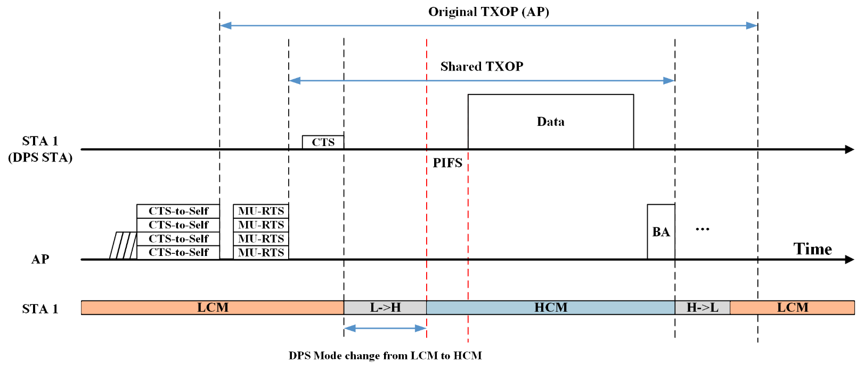
Consideration 3: Wider Channel Access within the Shared TXOP
After the DPS STA transition its DPS mode to HC mode, DPS STA needs to perform wider channel access to transmit PPDU(s) with wider bandwidth than the CTS frame during the shared TXOP.
To enable the option 2, after the DPS STA transition its DPS mode to HC mode, the current TXS rule needs to allow the DPS STA to perform channel access during the shared TXOP.

Slide 8
Conclusion
In this contribution, several considerations and possible solutions for the current TXS rules to support DPS STAs were discussed.
Considerations & Possible Solutions:
1. Shared TXOP Return Rule
After receiving CTS frame, the AP waits for DPS Padding Delay indicated by the DPS STA to transition its DPS mode by itself.
2. Bandwidth Limitation
The bandwidth of the PPDU(s) that are transmitted during the shared TXOP needs to be set to the same or narrower than the MU-RTS TXS Trigger frame, not the CTS frame.
3. Wider Channel Access within the Shared TXOP
After the DPS STA transition its DPS mode to HC mode, the current TXS rule needs to allow the DPS STA to perform channel access during the shared TXOP

Slide 9
References
[1] 25/0019r0, Issues on DPS Mode Change, Gwangho Lee et al.
[2] Draft P802.11be_D7.0

Slide 10
Straw Poll
SP: Do you agree to include the following text into the 11bn SFD?
In triggered TXOP sharing, a DPS STA operating in LC mode is allowed to transmit Data frames either in LC mode or HC mode.
Detailed procedure is TBD.
Y / N / A

