Slide 1
WPT: Protocol, Waveform and PPDU
January 2025
Doc.: IEEE 802.11-25/0029r1
Date: 2025-01-16
Authors:
Name | Affiliation | Address | Phone | Email
 | OPPO

Slide 2
Abstract
Doc.: IEEE 802.11-25/0029r1
In this contribution, we discuss the following issues:
  WPT protocol
    Protocol between AP and energizer
    Protocol between energizer and AMP device
    Association between energizer and AMP device
  WPT waveform
  WPT PPDU

Slide 3



January 2025
Doc.: IEEE 802.11-25/0029r1
WPT Protocol [1]
  Part 1: define the control and signalling between AP and energizer
    Can be OOB at least for some specific topology, e.g., wired interface between AP and energizer
    Key WPT info elements can be defined, e.g., on/off indication, duty cycle related, e.g., on time, period, etc.
  Part 2: define the signalling between AP and AMP devices
AMP STA
Part 2
Part 1
Energizer
AP
Slide 3
Yinan Qi (OPPO)

Slide 4
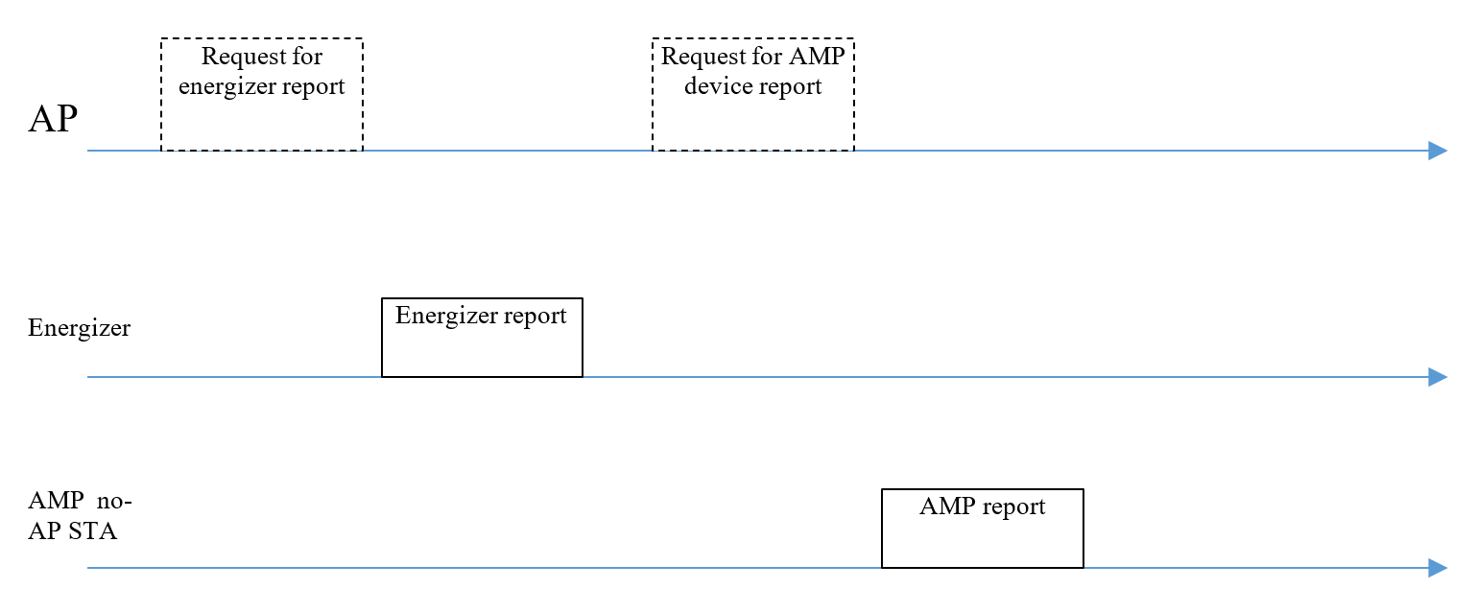
January 2025
Doc.: IEEE 802.11-25/0029r1
General WPT Procedure: Initialization
  WPT can be initialized by requesting for energizer and AMP reporting to initialize the WPT configuration.
  Report procedure can be either AP requested or autonomously done by energizer or AMP devices.
Slide 4
Yinan Qi (OPPO)

Slide 5
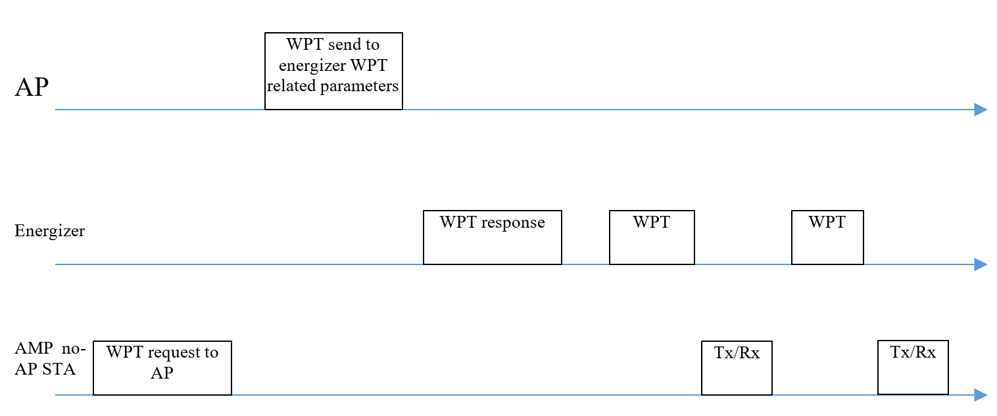
January 2025
Doc.: IEEE 802.11-25/0029r1
General WPT Procedure: Charging Procedure
  AMP requests WPT
  AP send WPT related parameters to energizer
  Energizer acks AP request and initiate WPT
  WPT and Tx/Rx procedures can repeat
Slide 5
Yinan Qi (OPPO)

Slide 6
January 2025
Doc.: IEEE 802.11-25/0029r1
WPT Protocol Part 1: Parameters
  Energizer sleep or active
  WPT frequency related information including central frequency, bandwidth, etc.
  WPT on/off
  WPT on/off duration
    Duty cycle operation related information, e.g., period, on duration, etc., when WPT is on
  Indication the operation frequency: S1G or 2.4GHz
  DL PPDU format for 2.4GHz and/or WPT PPDU format if specified
    DL PPDU or related parameters to define PPDU, e.g., data rate, modulation scheme, etc.
    Charging field related parameters: starting time, BW, waveform and Tx power.
Slide 6
Yinan Qi (OPPO)

Slide 7
January 2025
Doc.: IEEE 802.11-25/0029r1
WPT Protocol Part 2
  Both long-term/non-periodic and short-term/periodic feedback can be supported
    Long-term/non-periodic feedback info
      EH related information
      Energy storage related information
    Short-term/periodic feedback info
      Power status/requirements
    Long-term/non-periodic feedback can be done only one time during activation or based upon the request of AP
    Short-term/periodic feedback can be more frequently, thus should be optionally switched on/off
    Long-term/non-periodic feedback for all users but short-term/periodic feedback only for limited use cases, e.g., sensor
    Joint feedback, e.g., power category should be supported to reduce signalling overhead as well as the power consumpsion.
Slide 7
Yinan Qi (OPPO)

Slide 8
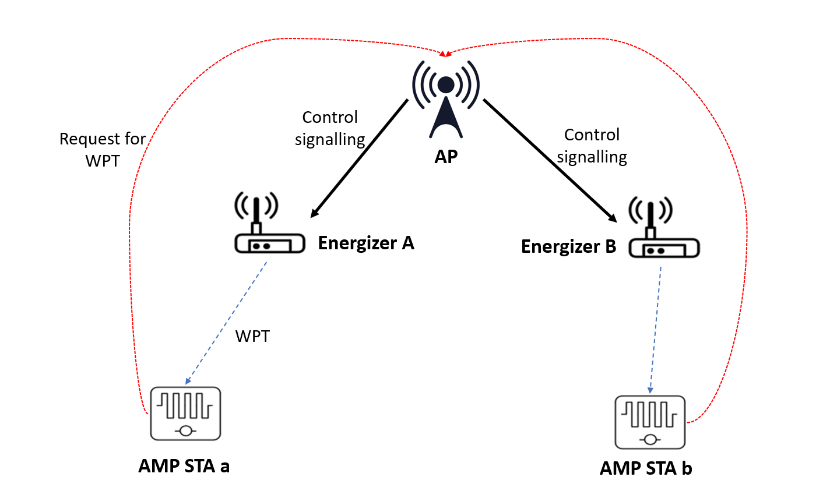
January 2025
Doc.: IEEE 802.11-25/0029r1
Association of Energizer and AMP Devices
  AMP device not only associated with AP but also the energizer
  The association between energizer and AMP devices determines which energizer to activate to charge target AMP
  Such association can be established between energizer and AMP and maintained by the AP
  This association is different from conventional association between AP and non-AP STA, e.g., such association can contain multiple to multiple mapping
  Association can reduce interference and energy consumption of energizers.
  For backscattering and wakeup signal, association is more critical.
Slide 8
Yinan Qi (OPPO)

Slide 9
January 2025
Doc.: IEEE 802.11-25/0029r1
How to Establish the Association?
  Establishment
    Energizer sending its own ID together with WPT signal to the AMP non-AP STAs. AMP non-AP STAs can report the ID back to the AP.
    Sounding between energizer and AMP devices + CSI feedback
    Enquiry by AP by activating energizers one by one and AP receiving AMP non-AP power related feedback
    Position reporting from energizer and AMP devices
  This association may change and can be progressively updated based on AMP reporting
Slide 9
Yinan Qi (OPPO)

Slide 10
January 2025
Doc.: IEEE 802.11-25/0029r1
Without Association
  Without association
    AP broadcasts to activate all energizer
    AP groupcasts to activate energizers group by group
    AP unicasts to activate energizers one by one
  Can be time consuming and cause heavy interference, leading to severe co-existence problem
  No association can be applicable to inventory use case
  For other user case, e.g., sensor, association can be beneficial
Slide 10
Yinan Qi (OPPO)

Slide 11
January 2025
Doc.: IEEE 802.11-25/0029r1
WPT Waveform
  Legacy waveforms are preferred
    Pros: easy to implement, minimal specification/implementation efforts
    Candidates: OFDM, DSSS, single carrier, etc.
    OFDM
      High PAPR → High efficiency
    Single Tone/Carrier
      Subset of OFDM with simple implementation complexity
Slide 11
Yinan Qi (OPPO)

Slide 12
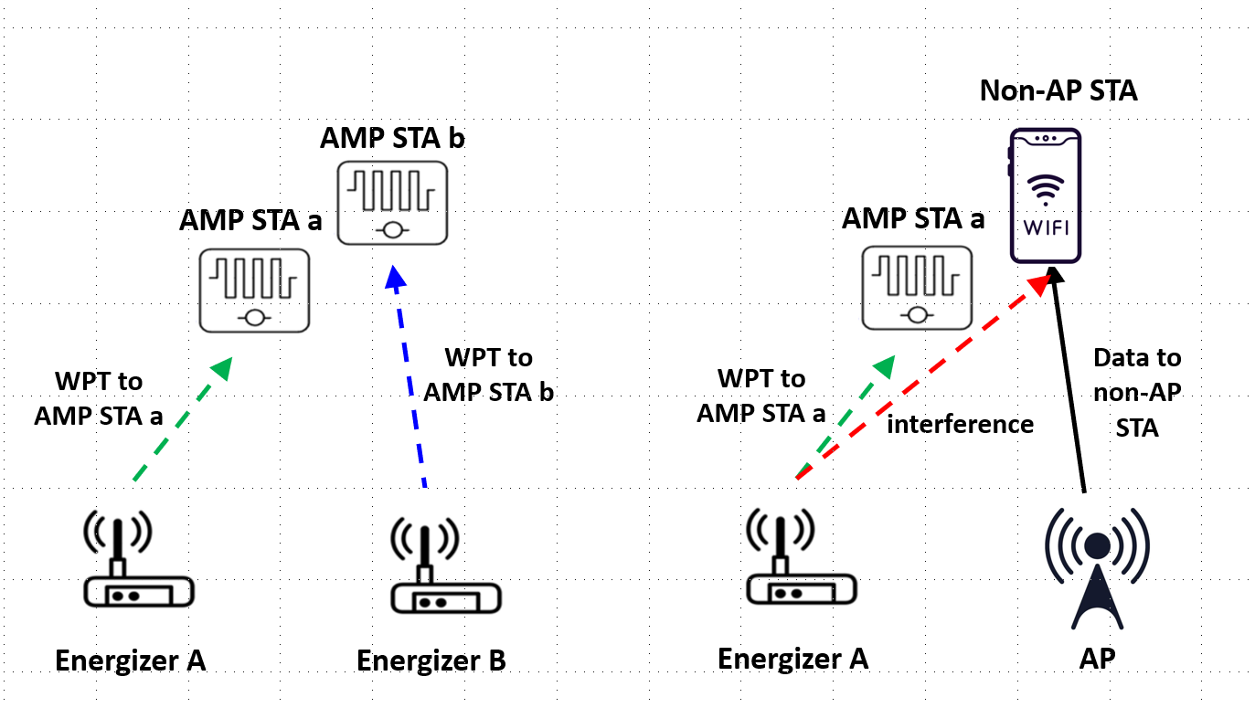
January 2025
Doc.: IEEE 802.11-25/0029r1
WPT PPDU: Co-existence Issue
  Co-existence not only for WiFi systems, e.g., 802.11ah but also for other S1G systems, e.g., Smart Utility Networks, Low Energy, Critical Infrastructure Monitoring, etc.
  WPT PPDU can overlap with each other but will interfere with non-WPT signals
Slide 12
Yinan Qi (OPPO)

Slide 13
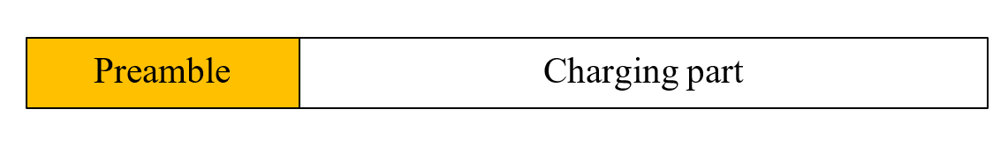
January 2025
Doc.: IEEE 802.11-25/0029r1
WPT PPDU
  Basically, communication signal needs to be avoided by the energizer but WPT signal can co-exist.
  Design WPT signal that can be fully or partially understood by the energizer.
  WPT signal can contain both WPT preamble and charging segment and the WPT preamble can be understandable to energizers.
Slide 13
Yinan Qi (OPPO)

Slide 14
January 2025
Doc.: IEEE 802.11-25/0029r1
LBT for Energizers
  The energizer can do ED first.
  In the case of collision, the energizer needs to keep listening to the channel. If a preamble is detected, the energizer knows the signal is WPT signal and it can transmit its own WPT signal.
  Otherwise, it no preamble is detected, the energizer assumes the signal in the air is communication signal and does backoff.
Energy Detection (ED)
Channel occupied (energy level > threshold_{ED})
Energizer does backoff
N
Y
N
WPT preamble detected?
Y
Transmit WPT signal
Slide 14
Yinan Qi (OPPO)

Slide 15
Reference
January 2025
Doc.: IEEE 802.11-25/0029r1
[1] “Further Consideration of WPT for AMP,” IEEE 802.11-25/0029r1, Nov. 2024

Slide 16
January 2025
Doc.: IEEE 802.11-25/0029r1
SP1
  The following parameters can be considered for AP to control the energizer
    Energizer sleep or active
    WPT frequency related information including central frequency, bandwidth, etc.
    WPT on/off
    WPT on/off duration
      Duty cycle operation related information, e.g., period, on duration, etc., when WPT is on
    Indication the operation frequency: S1G or 2.4GHz
    DL PPDU format for 2.4GHz and/or WPT PPDU format if specified
      DL PPDU or related parameters to define PPDU, e.g., data rate, modulation scheme, etc.
      Charging field related parameters: starting time, BW, waveform and Tx power.
Slide 16
Yinan Qi (OPPO)

Slide 17
January 2025
Doc.: IEEE 802.11-25/0029r1
SP2
  Do you agree to capture the following text to TGbp SFD?
    AMP devices shall report power category to the AP during activation or upon the request of the AP?
      The details on how to define power category are TBD
Slide 17
Yinan Qi (OPPO)

Slide 18
January 2025
Doc.: IEEE 802.11-25/0029r1
SP3
  Do you agree to capture the following text to TGbp SFD?
    The association between energizer and AMP devices that determines which energizer to activate to charge target AMP devices should be supported
Slide 18
Yinan Qi (OPPO)

Slide 19
January 2025
Doc.: IEEE 802.11-25/0029r1
SP4
  Do you agree to capture the following text to TGbp SFD?
    11bp supports OFDM and single carrier as WPT waveforms?
Slide 19
Yinan Qi (OPPO)

Slide 20
January 2025
Doc.: IEEE 802.11-25/0029r1
SP5
  Do you agree to capture the following text to TGbp SFD?
    WPT signals are allowed to overlap with each other.
Slide 20
Yinan Qi (OPPO)

Slide 21
January 2025
Doc.: IEEE 802.11-25/0029r1
SP6
  Do you agree to capture the following text to TGbp SFD?
    11bp specifies, in S1G, WPT PPDU format with at least a preamble and a charging field?
Slide 21
Yinan Qi (OPPO)

