Slide 1
Enable DAPS-like Transmission for Roaming
Dec. 2024
Date: 2024-12-10
Authors:
Notes:
September 2012

Slide 2
Introduction
During the roaming, one important observation is the link qualities with the current AP MLD and the target AP MLD fluctuate in a relatively large range due to the fast channel fading, obstacles or the user walking back and forth.
This will cause the ping-pong roaming and result in a bad roaming performance.
A DAPS (Dual Active Protocol Stack) mechanism has been defined for the roaming in the cellular network. (See next slide)
which is very useful for the high-reliable application.
In this contribution, we will discuss how to realize the DAPS-like transmission for 11bn roaming.

Slide 3
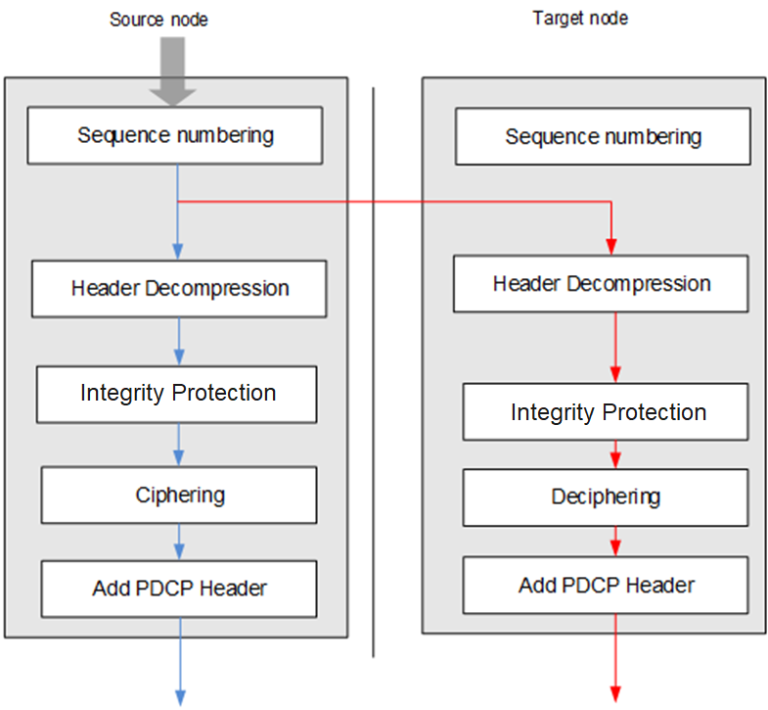
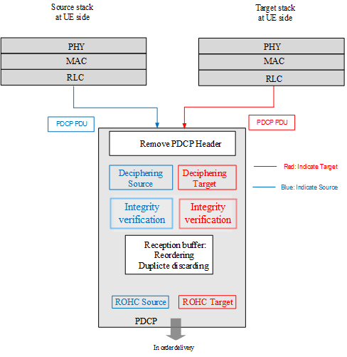
Background DAPS Defined in Cellular network
To improve the roaming reliability, a DAPS transmission mechanism had been defined for the cellular network. It allows a UE can exchange the data with source node, target node, or both of them if the UE has more than one transceiver.
Different keys are used to protect communications between the source node and the target node, respectively.
Both DL and UL are considered.
Figure. DL DAPS processing procedure at the transmitter’s side
Figure. DL DAPS processing procedure at the receiver’s side

Slide 4
DAPS Enable
The non-AP MLD can send a request to enable the DAPS transmission for one or more TIDs.
If the associated AP MLD accepts this DAPS transmission request, it will duplicate each incoming MSDU (or A-MSDU) with an assigned SN and forward them to the target AP MLD.
Before enabling the DAPS transmission, the non-AP MLD shall successfully establish the link(s) with the target AP MLD.
Note for the distributed SMD, since the same PTKSA is used, then a PN is also assigned for each incoming MSDU (or A-MSDU) besides SN.
Since there is no real-time BA sync between current AP MLD and target AP MLD, a duplicated transmission mode is normally adopted. In the following, we will propose a method to improve its transmission efficiency.

Slide 5
Client-assisted Transmission
For the DL DAPS transmission, the non-AP MLD as the receiver can indicate which SNs of MSDUs are needed for transmission for current AP MLD and target AP MLD, respectively. Specifically,
Firstly, the current AP MLD and target AP MLD as transmitters needs to report the info on the transmitter buffer, e.g. Current Max SN within the transmit buffer (labeled it as Info 1)
Info 1 can be included within ICF, a newly defined A-Control field and the Multi-TID BAR frame
Secondly, the non-AP MLD needs to indicate SNs of MSDUs which are requested for transmission, e.g. SSN, Length (labeled it as Info 2)
Info 2 can be included within ICR, a newly defined Poll frame and the Multi-STA BA frame
Benefit.
Reduce unnecessary duplicated transmissions and no requirement on the real-time BA sync between current AP MLD and target AP MLD [1-2].

Slide 6
Client-assisted Transmission (Cont.)
Transmit buffer of current AP
…
Reordering buffer of non-AP MLD
DS
N
2
1
0
Link 1
Current AP assigns a SN for each incoming MSDU, then duplicates and forwards it.
Duplication
Detection
…
…
…
Link 2
N’
2
1
0
Non-ideal
backhaul
Transmit buffer of target AP
Recipient
Originator 1
Originator 2
Reordering Buffer Control
Per TID
(WinStart_B, WinSize_B)
Transmit Buffer Control
Per MLD/TID
(WinStart_O#1, WinSize_O#1)
Transmit Buffer Control
Per MLD/TID
(WinStart_O#2, WinSize_O#2)
Scoreboard Context Control
(WinStart_R, WinSize_R)
Aggregation control
Aggregation control
Deaggregation control
Multi-TID BAR(SSN#2, Max SN#2’)
Multi-STA BA(SSN#2, Bitmap; SSN#2’, Length#2)
Multi-TID BAR(SSN#1, Max SN#1’)
Multi-STA BA(SSN#1, Bitmap; SSN#1’, Length#1)
Which is used for
releasing transmit buffer
Info 2, which is used for submitting
MPDUs for transmission

Slide 7
GSN-based DAPS
Considering the following disadvantages of the proposed method of reusing the current SN, another option is to introduce a new global SN (GSN) on top of the existing MAC processing blocks .
The proposed method may need to change the current chip architecture. For example, may need to add a buffer after the SN is assignment.
This method is not flexible to do the A-MSDU operation, which highly depends on the operating BW and is done per affiliated AP.
Note. GSN is regarded as a part of the frame body, rather than a part of MPDU Header. Because all of related operations are achieved by software and no strict requirement on the processing time.
Figure. MAC Processing Procedure of DL DAPS-like Transmission

Slide 8
GSN-based DAPS(Cont.)
GSN-based Transmit buffer of current AP MLD
GSN assignment, duplication
and forward
…
Reordering buffer of non-AP MLD
DS
N
2
1
0
Link 1
Duplication
Detection
…
…
Non-ideal
backhaul
GSN-based Transmit buffer of target AP MLD
…
Link 2
N’
2
1
0
Originator 1
Originator 2
Recipient
Transmit Buffer Control
Per non-MLD/TID
(WinStart_O#1’, WinSize_O’)
Transmit Buffer Control
Per non-MLD/TID
(WinStart_O#2’, WinSize_O’)
Reordering Buffer Control Per TID
(WinStart_B’,WinSize_B’)
Scoreboard Context Control Per TID
(WinStart_R’,WinSize_R’)
Transmit Buffer Control
Per non-MLD/TID
(WinStart_O#1, WinSize_O#1)
Transmit Buffer Control
Per non-MLD/TID
(WinStart_O#2, WinSize_O#2)
Scoreboard Context Control
(WinStart_R#2,WinSize_R#2)
Scoreboard Context Control
(WinStart_R#1,WinSize_R#1)
Aggregation control
Aggregation control
Deaggregation control
Deaggregation control
Multi-TID BAR(SSN#2, GSSN#2, Max GSN#2’)
Multi-STA BA(SSN#2, Bitmap; GSSN#2, Bitmap; GSSN#2’, Length#2)
Multi-TID BAR(SSN#1, GSSN#1, Max GSN#1’)
Multi-STA BA(SSN#1, Bitmap; GSSN#1, Bitmap; GSSN#1’, Length#1)
Which is used for releasing transmit buffer and submitting MPDUs for transmission
Which is used for releasing GSN-based transmit buffer
Info 2, which is used for submitting
MSDUs for transmission

Slide 9
Comments
The proposed client-assisted transmission method also makes the NC AP MLD (also named centralized SMD) architecture possible.
Because one of previous main concerns is the BA sync delay between the NC AP MLD upper MAC and lower MAC will significantly degrade the transmission efficiency of multiple non-collocated transmitters.
By exploiting the proposed method, each AP MLD maintains a local transmit buffer and no need to further define the BA sync message between the current AP MLD and the target AP MLD [1-2].
DS
NC AP MLD Upper MAC
(e.g. MSDU, TID, GSN/SN)
I/F
AP MLD 0
AP MLD 1
…
AP MLD N

Slide 10
Conclusions
The DAPS-like transmission is very useful to improve the reliability during the roaming.
For the DAPS transmission, a client-assisted transmission method is proposed, which can significantly improve the transmission efficiency.
i.e. the client coordinates transmissions between the current AP MLD and the target AP MLD to reduce unnecessary duplicated transmissions as much as possible .

Slide 11
References
[1] 11-24-0778-00-00bn-nc-mlo-operation-issues
[2] 11-25-0201-00-00bn-frame-processing-enhancements-for-tgbn

Slide 12
SP
Do you support to define a DAPS mechanism which allows a non-AP MLD can simultaneously exchange data frames with the current AP MLD and the target AP MLD?

