Slide 1
Uplink RSSI and AP Transmit Power for Effective Roaming
Date: 2024-12-18
Authors:

Slide 2
Abstract
Highlight the importance of knowledge of uplink RSSI at a client device to make effective roaming decisions
Propose that AP transmit power is included in the Beacon / Probe Response frames to facilitate estimation of uplink RSSI at client

Slide 3
Motivating Scenarios – Importance of Uplink RSSI (1)
Advent of new use-cases like augmented reality and virtual reality has imposed stringent Quality-of-Service (QoS) requirements on the uplink (UL) traffic
Example: 11-22/779r0 indicates that the target e2e delay for AR/VR applications may be as low as 20 ms
UL QoS requirements (throughput, latency) translate to data rate requirements and hence RSSI / SNR target in the uplink
Downlink (DL) RSSI may not be a good proxy for the achieved UL RSSI, i.e., high DL RSSI does not necessarily translate to an equivalently high UL RSSI
This is especially the case in 6 GHz bands in which transmit power of AP and client devices may be different owing to different regulatory limits; AP max PSD is 6 dB higher than client max PSD
Knowledge of the difference in max PSD between AP and client is not sufficient and will lead to inaccurate estimations of uplink RSSI
Desirable to devise a scheme that allows a client device to gauge uplink RSSI to roaming candidate AP(s) to make more informed roaming decisions
Desirable for the scheme to entail low overhead and provide reasonable accuracy of RSSI

Slide 4
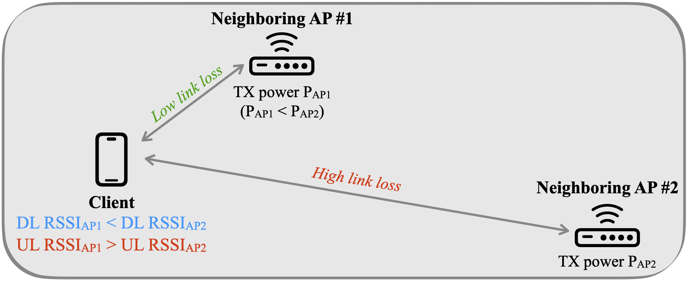
Motivating Scenarios – Importance of Uplink RSSI (2)
Refer to the illustration to the above for an example topology
It is possible that AP #1 operates at a transmit power lower than AP #2 (e.g., Transmit Power Control (TPC) in enterprise environments)
UL RSSI may not follow the same trend as DL RSSI
If STA is aware of the uplink RSSI at AP #1 and AP #2, then it can make educated roaming decisions instead of relying exclusively on DL RSSI measurements

Slide 5
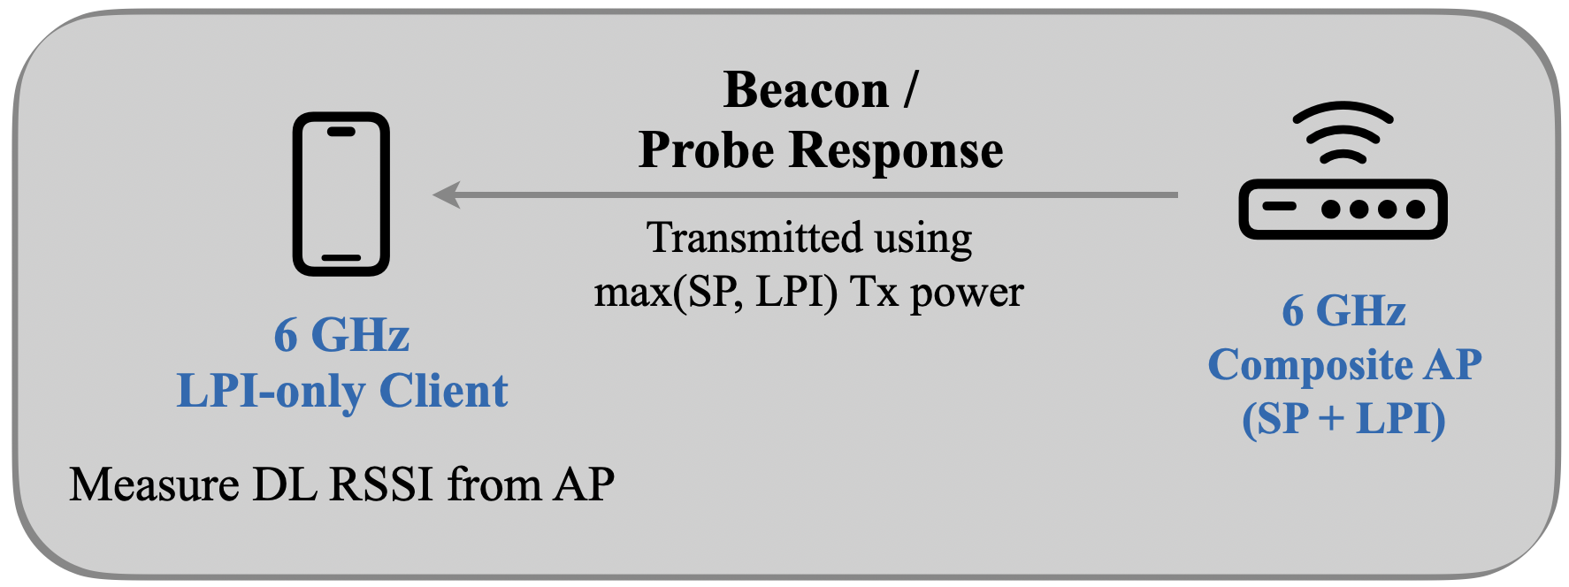
Motivating Scenarios – Importance of Uplink RSSI (3)
A 6 GHz AP may be a composite AP – i.e., it can support standard power (SP) and low-power-indoor (LPI) modes
Such an AP may choose to transmit beacon / probe response frames using max (LPI, SP) Tx power; typically, SP Tx power is higher than LPI Tx power
A 6 GHz LPI-only client may receive such frames and record a high DL RSSI from the AP because high AP Tx power in SP mode
The client may choose to associate with the AP based on DL RSSI only and may run into ramifications like association failures, unsatisfactory UL performance, etc.
Client Tx power in LPI mode << AP Tx power in SP mode ➔ UL RSSI << DL RSSI
Knowledge of uplink RSSI empowers client to make more intelligent AP selection

Slide 6
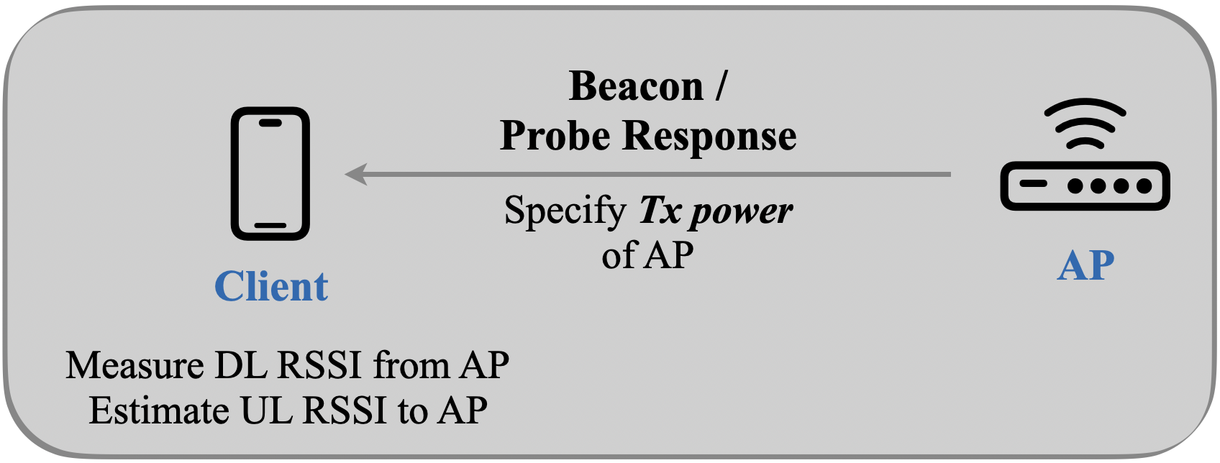
Estimation of Uplink RSSI by Client
Proposal #1 – AP advertises the transmit power (P_{TX, AP}) used to transmit beacon and probe response frames
P_{Tx,AP} is normalized to 20 MHz
Notations:
P_{TX,AP} = TX power of AP (advertised by the AP)
TX power is measured at the output of the antenna connector; aggregated over all antenna connectors in case multiple antennas are used for frame transmission
G_{TX,AP} = G_{RX,AP} = AP antenna gain
P_{TX,STA} = TX power of the STA
G_{TX,STA} = G_{RX,STA} = STA antenna gain
PL = Path loss between AP and STA
DL_{RSSI} = Measured DL RSSI at STA from AP
UL_{RSSI} = Estimated UL RSSI by STA
Math for Estimation
DL_{RSSI} = P_{TX, AP} + G_{TX, AP} – PL + G_{RX, STA}
⇒ PL = P_{TX, AP} + G_{TX, AP} + G_{RX, STA} – DL_{RSSI}
UL_{RSSI} = P_{TX, STA} + G_{TX, STA} – PL + G_{RX, AP}
⇒ UL_{RSSI} ≈ P_{TX, STA} – P_{TX, AP} + DL_{RSSI}

Slide 7
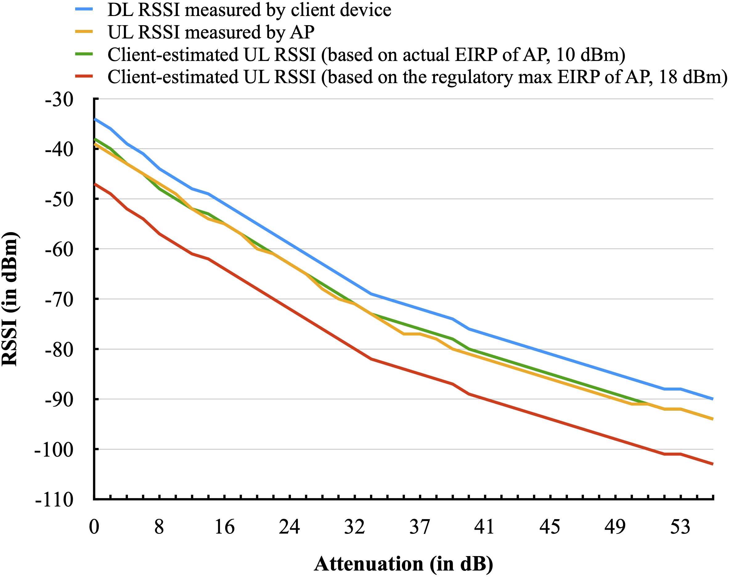
Results from Experiments
Experiment setup:
Channel: 6 GHz, Channel 37 (20 MHz)
One AP, one client device (both are single-link devices)
Attenuation between the two devices was controlled by a programmable attenuator
Experiments were performed in a shield room
Butler channel
Two key upshots:
Knowledge of actual Tx power used by AP greatly improves the accuracy of the estimated UL RSSI
Lightweight estimation of UL RSSI by client matches closely with the actual measured UL RSSI
Notice the gap between red and green curves

Slide 8
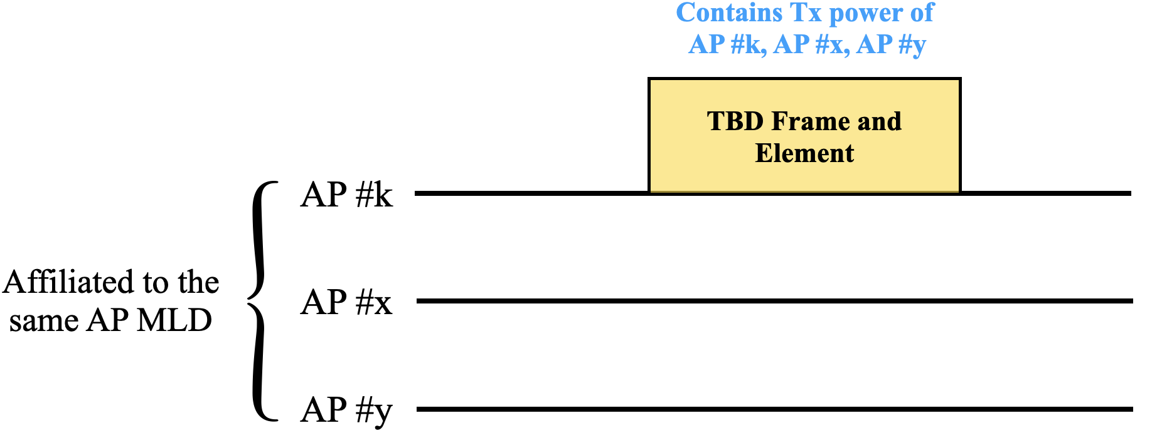
Estimation of RSSI by Client in Other Links
Proposal #2 – AP #k advertises the Tx power of other APs (AP #x, AP #y) affiliated with the same AP MLD
Tx power of AP #x is the transmit power used by AP #x to transmit beacon / probe response frames in Link #x (normalized to 20 MHz)
AP #k may include this information in multi-link (ML) probe response frames, neighbor report, RNR etc.; this is TBD
Motivation:
Based on Rx of ML probe response frame in Link #k, a STA MLD may perform the following operations:
Measure DL RSSI in Link #k
Estimate UL RSSI in Link #k
Estimate DL and UL RSSI in Link #x and Link #y (by translating PL in Link #k to other links by applying a fudge factor dependent on the center frequencies of the links)
Key upshot – STA MLD can estimate RSSI in multiple links with minimal overhead (reduces STA power consumption)

Slide 9
Conclusion
Elucidated the importance of knowledge of uplink RSSI (Client → Roaming candidate AP) at client-side to facilitate effective roaming decisions
Proposed a lightweight scheme that allows local estimation of uplink RSSI at client-side based on reception of beacon / probe response frames from AP
Proposed that AP include the transmit power (measured at the output of the antenna connector) used to transmit beacon / probe response frames
The transmit power is normalized to 20 MHz
Proposed that an AP include the transmit power (normalized to 20 MHz) of other APs affiliated with the same AP MLD
For e.g., AP #k affiliated with an AP MLD may include the information about other APs affiliated with the same AP MLD

Slide 10
SP #1
Do you support the following:
An AP (referred to as the reporting AP) affiliated with an AP MLD includes a TPC Report element in the Per-STA Profile subelement of the Basic Multi-link element in probe response frame for each reported AP affiliated with the same AP MLD?

