Slide 1
802.11 WG January 2025 Session Report
Date: 2025-01-22
Authors:

Slide 2
Abstract
This document is a digest of the closing reports of all 802.11 sub-groups for presentation at the January 2025 closing plenary meeting. Other 802 and external liaison reports are also included.

Slide 3
Executive Summary
TGbi (Enhanced privacy) produced and the working group approved draft P802.11bi/D1.0 for initial working group ballot. Congratulations to the group on achieving this milestone.
TGbn (Ultra High Reliability) produced P802.11bn/D0.1, an early draft incorporating much of the current technical consensus.
TGbp (Ambient Power Communications) continues to make further progress toward an initial draft with consensus building on a number of topics.
TGbq (Integrated mmWave), whose P802.11bq PAR was approved in December, 2024 did not meet at the session, but will hold its first meeting as a teleconference in February. Edward Au was confirmed as the task group chair.
The Enhanced Light Communications (ELC) study group (SG) produced and the working group approved a project authorization request (PAR) and criteria for standards development (CSD). These will be considered by the 802 LMSC at the March session.
The standing committees (SCs) – ARC, Coex, and AI/ML – as well as the AUTO topic interest group (TIG) further advanced their work.

Slide 5
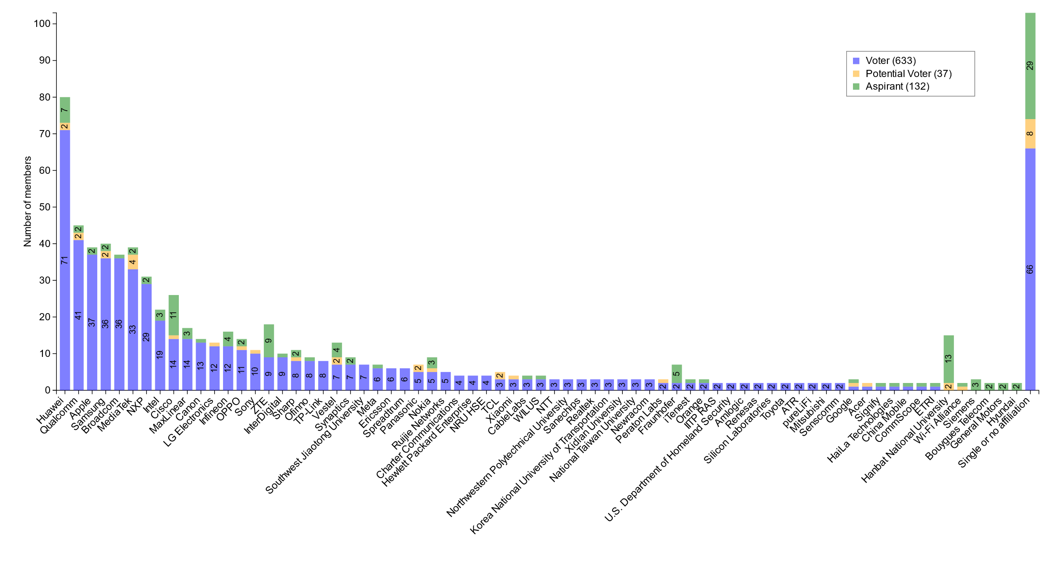
Members by affiliation

Slide 6
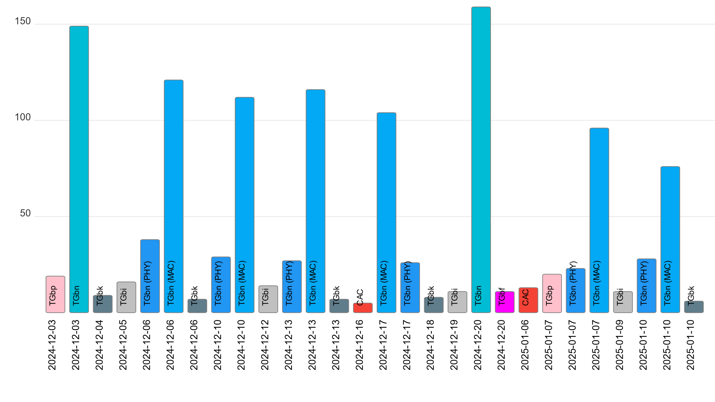
Attendance by subgroup (November to January)

Slide 7
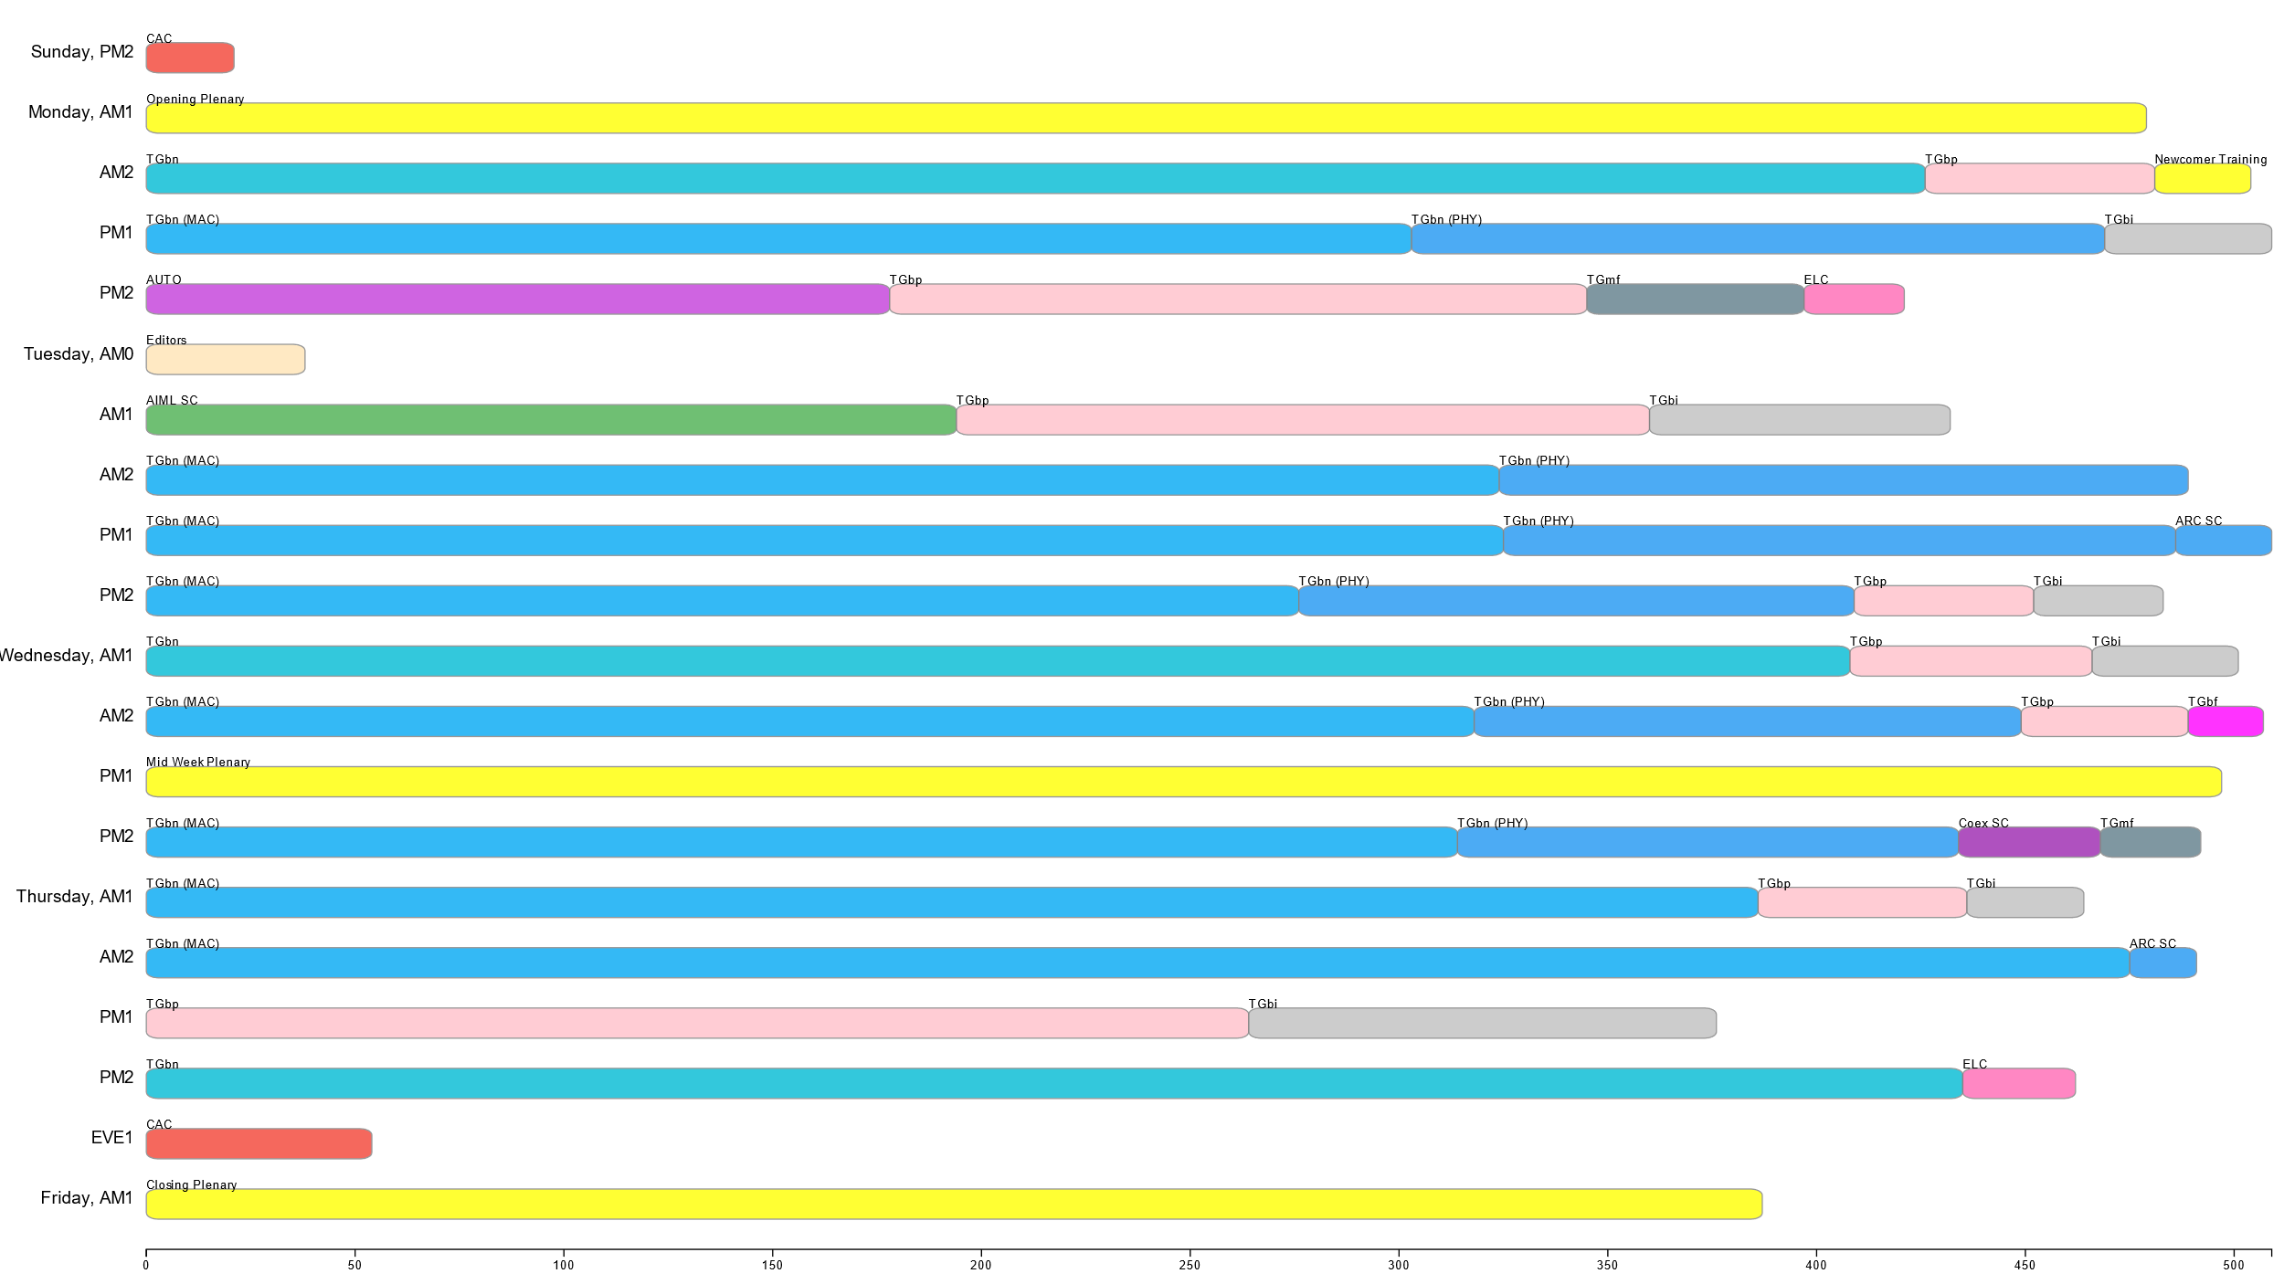
Attendance by breakout (January interim)

Slide 8
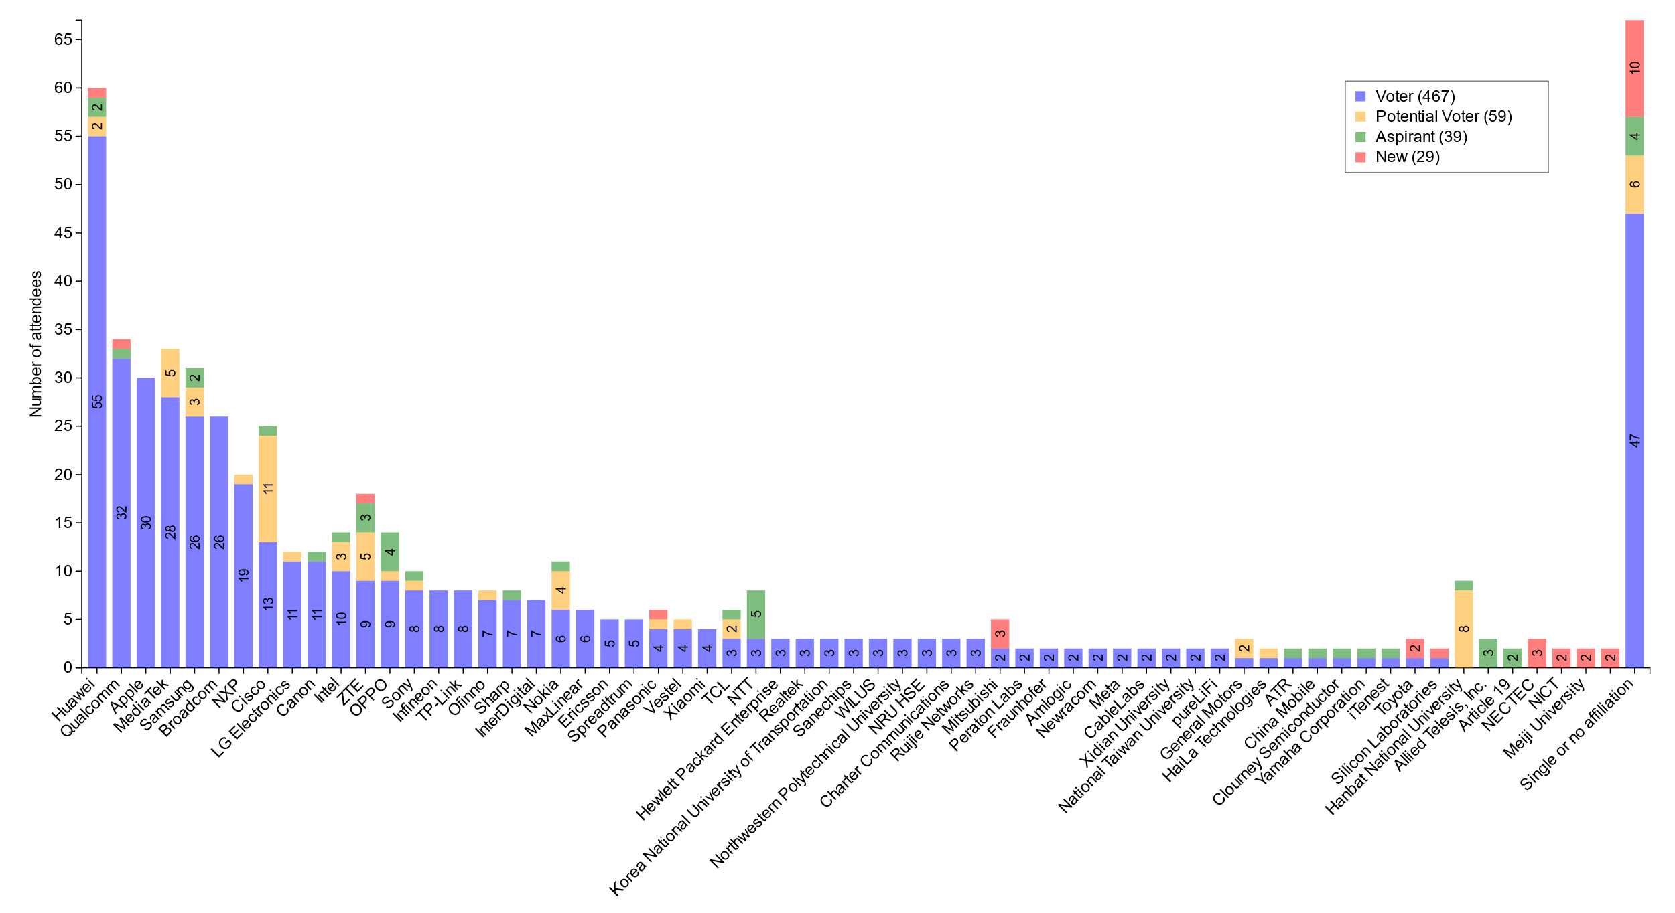
Attendance by Affiliation (January interim)

Slide 9
January 2025 Editors’ Meeting Agenda and Report
Roll Call / Contacts / Reflector
Brief status report
Amendment alignments and draft development snapshot
Review Publication Process
Form the publication review committees
Editorial Style Guide updates and issues for feedback
ANA number spaces

Slide 10
Volunteer Editor Contacts
  WG – Robert Stacey – robert.stacey@intel.com, Emily Qi – emily.h.qi@gmail.com
  TGbe – Edward Au – edward.ks.au@gmail.com
  TGbh – Carol Ansley – carol@ansley.com
  TGbi – Po-kai Huang – po-kai.huang@intel.com
  TGbn- Ross Jian Yu – ross.yujian@huawei.com
TGbk – Roy Want – RoyWant@google.com
TGbf – Claudio da Silva – claudiodasilva@meta.com
  REVme – Emily Qi – emily.h.qi@gmail.com, Edward Au – edward.ks.au@gmail.com
  REVmf - Po-kai Huang – po-kai.huang@intel.com, Edward Au – edward.ks.au@gmail.com

Slide 11
January meeting roundtable status report (to be updated)
REVme – D7.0, approved by IEEE SASB, will be published as IEEE Std 802.11™-2024
11bh – D6.0, approved by IEEE SASB, will be published as IEEE Std 802.11bh™-2024
11be – D7.0, approved by IEEE SASB, will be published as IEEE Std 802.11be™-2024
11bk – Completed initial SA ballot on D3.0. All 78 Comment resolved. D4.0 should be ready end of the week.
11bf – Currently in SA recirc 2; closes Friday on D7.0. Most likely the final recirc. Then waiting for 11bk to move forward.
11bi – D0.7 is available. 58 comments need to be resolved, 24 ready for motion. Still expect D1.0 to go to initial WG ballot out of January.
11bn – Plan to run a motion to approve D0.1 this session. Should be available February.
REVmf – Plan to have the initial draft 0.0 from published version. Then have D0.1 with 11bh and D0.2 with 11be. Implement approved changes to date in D1.0 coming out of May session (might be July).

Slide 12
Editor Amendment Ordering
See http://grouper.ieee.org/groups/802/11/Reports/802.11_Timelines.htm
Changes are usually based on MDR readiness.
As discussed in November 2024
Amendment Number | Task Group | Page Count | Projected RevCom Date (submission)
REVme | TGm | 6213 | September 2024 - Approved
802.11-2024 Amendment 1 | TGbh | 34 | September 2024 - Approved
802.11-2024 Amendment 2 | TGbe | 1089 | September 2024 – Approved
802.11-2024 Amendment 3 | TGbk | 111 | March 2025
802.11-2024 Amendment 4 | TGbf | 220 | March 2025
802.11-2024 Amendment 5 | TGbi | 138 | ?
802.11-2024 Amendment 6 | TGbn | ? | May 2028
REVmf | TGm | 6000+ | Feb 2028

Slide 13
Draft Development Snapshot
Changes from last report shown in red.
January 2025
TG | Published or Draft Baseline Document |  |  |  |  |  |  | Source | MDR | Editor | Snapshot Date
 | Published | me | bh | be | bk | bf | bi
me | Y | 7.0 |  |  |  |  |  | FrameMaker 2020 | Yes | Emily Qi, Edward Au | July 29, 2024
bh | Y | 7.0 | 6.0 |  |  |  |  | FrameMaker | Yes | Carol Ansley | July 16, 2024
be | Y | 7.0 | 6.0 | 7.0 |  |  |  | FrameMaker (old) | Yes | Edward Au | July 15, 2024
bk | Y | 5.0 | 4.0 | 5.01 | 3.0 |  |  | Word | No | Roy Want | January 14, 2025
bf | Y | 7.0 | 6.0 | 7.0 | 3.0 | 7.0 |  | FrameMaker 2020 | Yes | Claudio da Silva | January 14, 2025
bi | Y | 7.0 | 6.0 | 7.0 | 1.0 | 3.0 | 0.7 | FrameMaker 2020 |  | Po-kai Huang | January 14, 2025
bn | Y | 5.0 | 2.0 | 5.0 | 1.0 | 3.0 | 0.1 |  |  | Ross Jian Yu | January 14, 2025
mf

Slide 14
Publication process
Publication editor creates a marked-up PDF with editorial changes highlighted
802.11 WG technical editor forms a review committee, which includes:
- TG editor(s) +WG editor(s) + TG chair + others.
Each member of the committee should review each change proposed by the publication editor
Pay particular attention to
  Reconstructed sentences
  Tables with number changes
  - for example, the order in the Beacon frame body table should not be changed
  ANA assignments
The review process is complete when all publication changes have been reviewed

Slide 15
Publication Review Committees
REVme Review Committee
Emily Qi (lead): emily.h.qi@gmail.com
Edward Au: edward.ks.au@gmail.com
Mike Montemurro: montemurro.michael@gmail.com
Robert Stacey: robert.stacey@intel.com
Carol Ansley: carol@ansley.com
Po-kai Huang: po-kai.huang@intel.com
?
11bh Review Committee
Carol Ansley (lead);
Mark Hamilton: mark.hamilton2152@gmail.com
Emily Qi;
Robert Stacey;
?
11be Review Committee
Edward Au (lead);
Alfred Asterjadhi: aasterja@qti.qualcomm.com
Emily Qi;
Robert Stacey;
Carol Ansley
?

Slide 16
ANA managed number space
Protocol Version subfield: 9.2.4.1.2
Frame types and subtypes: 9.2.4.1.3, Tables 9-1 and 9-2
Element ID and Element ID extension: Table 9-128
Capability Information field: 9.4.1.4
Extended Capabilities: 9.4.2.25, Table 9-190
Reason codes: 9.4.1.7, Table 9-77
Status codes: 9.4.1.9, Table 9-78
Action frame categories: 9.4.1.11, Table 9-79
Authentication algorithm: 9.4.1.1
RSNE: 9.4.2.23
Cypher suites: Table 9-186
AKM suites: Table 9-188
RSN Capabilities: Figure 9-345
RSNXE Capabilities: 9.4.2.240, Table 9-365
ANQP-element (Info ID): 9.4.5.1, Table 9-412
Neighbor Report subelements: 9.4.2.35, Table 9-210
FTE subelements: 9.4.2.46, Table 9-219
Public Action frames: 9.6.7.1, Table 9-450
WMN-Notification Types: 9.6.13.29, Table 9-516
Mesh Configuration Active Path: 9.4.2.96.2, Table 9-277
TLV encodings: 9.4.4
KDE Selector Data Type: 12.7.2
Operating classes: Annex E
global, USA, Europe, Japan
MIB objects: Annex C
ieee802dot11, dot11smt, dot11phy, dot11mac, dot11StationConfigEntry, dot11OperationEntry, dot11Compliances, dot11Groups

Slide 17
AI/ML Standing Committee
  1 Meeting Slot
    Tuesday AM 1
    Agenda: 11-24/2078r0
    SP and Motion Booklet: 11-24/765r3
  Achievements
    Two technical presentations: a lot of discussions
    Approved minutes of AIML SC for November 2024 Plenary: 11-24/2003r0
    Approved the AIML SC 1st Technical Report Draft Outline

Slide 18
Plans for March 2025
No teleconference planned
Technical presentations
  Additional results, exploration and feasibility for existing use cases
  Additional AIML use cases
  Technical report drafts

Slide 19
ARC Standing Committee
Annex G update/replacement
Continued discussion on the proposal for Annex G replacement in 11-23/0880r5.
This is uncovering mis-alignment among experts on concepts:
  “Frame exchange sequence” (and its relationship to/meaning for other behaviors like power save/sleep, off-channel scanning, etc.)
  Relation of frame exchange sequence to medium protection (NAV, etc.)
  The extent definition and extent of an occurrence of Wireless Medium
  Relation of wireless medium to beamforming, sectorization, MU operation, etc.
Especially tricky as MLO, and now TGbn concepts are added/considered
Will continue discussion in March, and allocate 2 meeting slots to try to sort out these terms and concepts.

Slide 20
Std 802 update impacts on 802.11
Reviewed 11-25/0150r3 discussion document
      Reviewed EPD and LPD terms are going away – we need to update 802.11 to align
      Review MAC address ordering discussion, and 802.11 assumptions
        https://mentor.ieee.org/802.1/dcn/24/1-24-0034-00-Mntg-proposal-to-revise-bit-ordering-material-in-p802revc-d2-0.docx
      Review 802.1AC mapping from ISS to 802.11 MAC SAP interface
      Consider any changes to remove 802.2/LLC terms?
      --- Got to here, this session, will continue below next time (after continuing the above)
      802.11’s “Portal”, and mapping to/usage of IEEE Std 802 terminology
Access Domains: “802 Access Domains”?
  Interconnection of Access Domains?
  In 802.11, Access Domain is BSS. Is that still the view, for 802.11be/MLD?
  Other 802s? 802.3 Multi-carrier fiber – 1 Access Domain, or many? We think it’s 1. But, there are multiple transmitters, in parallel.
What if we make the DS a bridge (small ‘b’)?
Consider adding something about VLANs (just informational?) into 802.11? Relationship (if we talk about it) to security domains (e.g. Authenticator relationship)? VLAN-aware STAs? What about GLK/non-GLK STAs? (cf 11-08/0114r0)

Slide 21
Other topics
IEEE Std 802 revision:
  Received a report on the P802REV activities
    Approvals are completed. Going through publication editing.
WBA L4S:
  No discussion this session.
  Per request from proponents, ARC is deferring for discussion in TGbn and perhaps REVmf. ARC will step in with any support needed by those groups.
Still pending:
  MLME-RESET, versus MLME-JOIN, MLME-START, MLME-SCAN and MLME-END
Agenda is here: 11-24/2095r7

Slide 22
Plans
Next session/teleconference topics:
Continue EPD/LPD clean-up, other Std 802 alignment
Continue Annex G replacement
MLME clean-up
Teleconferences – None planned (may schedule with 10 days’ notice, depending on progress on reflector discussion on Annex G)
Three meeting slots requested in March

Slide 23
Coex Standing Committee
Coex SC met once this week
Technical discussion topics
ETSI BRAN Update
Bluetooth SIG Update
Review of NBE with LBT normative text for EN 303.687
Status update on proposed comment resolution for LBT comments against 802.15.4.ab

Slide 24
ETSI BRAN Update to 802.11 (1/3)
EN 303 687 (Wireless Access System/Radio Local Area Network (WAS/RLAN) in the license-exempt 6 GHz band)
Version 1.1.1 has been published; Updates to OJEU expected during first quarter in 2025
Work on next version continued
TC BRAN achieved consensus on Narrowband Frequency Hopping (NB FH) medium access rules (see draft version 1.1.6)
  General concept approved;
  details (e. g., various durations) remain to be defined at future meetings

Slide 25
ETST BRAN Update to 802.11 (2/3)
EN 301 893 (Wireless Access System/Radio Local Area Network (WAS/RLAN) in the license-exempt 5 GHz band)
Final national voting concluded
  No objections
  No comments
ETSI published version 2.2.1
  Offered to European Commission for citation in the Official Journal of the European Union (OJEU)
  Currently, average duration of Harmonised Standards (HSs) exceeds one year

Slide 26
ETST BRAN Update to 802.11 (3/3)
European Commission decision 2021/1067 (and amendments)
updates related to Out-Of-Band Emissions (OOBE) below 5935 MHz for Very Low Power (VLP) devices
Decision to raise OOBE from −45 dBm/MHz to −37 dBm/MHz delayed until end of this year

Slide 27
Update from Bluetooth SIG Work
  Work on technical proposal for ETSI BRAN:
  Draft text for EN 303 687 (Clause 4)
    ACCEPTED in December (BRAN #127)
    A few TBD parameters still need to be finalized in February 2025 (BRAN #128)
  FCC strategy in process
  Change in Leadership
  FCC shifting back to Republican control; timing of NPRM activities uncertain; Net Neutrality the focus again

Slide 28
Technical Discussions (1/2)
Review of BRAN(24)124017r3 (NBE with LBT normative text)
  New alternative type of channel access mechanism:
    “Narrowband Equipment (NBE) with listen before talk (LBT)”
    NBE-LBT shall perform an NB CCA before transmitting on an NB channel,
    Two priority classes: determine how often CCA is repeated in case of busy channels
    EDT = function of TX power. Having upper and lower limits
  Reminder: Local copy of ETSI BRAN documents available in the 802.11 members’ area

Slide 29
Technical Discussions (2/2)
  Review of 15-24/0407r7 (“Proposed Resolution for Comments #988” on LBT for 802.15.4ab)
  Building on BRAN(24)124017r3
  Proposing that LBT-based solution should be the de facto channel access mechanism in 802.15.4ab.
  Ongoing discussion; no consensus so far; expecting deferral of technical comment resolution (withdraw comment or rejection based on non-consensus of the comment resolution committee)

Slide 30
Plans for March
Two dot11 Coex (only) slots
Tuesday AM2
Thursday AM1
One joint session with 802.15.4ab Tuesday PM3/EVE
Topics:
Update on ETSI BRAN
Update on Bluetooth SIG
Technical submissions (tba)
Note: coexistence-related topics are welcome. Please contact the Chair

Slide 31
Telcos
No telco scheduled.
May be announced with 10-day notice. Member feeling the need for telco and have submissions ready for discussion are asked to approach the Chair.

Slide 32
References for this week
Agenda for this week: 11-24/2101
Snapshot Slide: 11-24/2102
Meeting / Chair’s Slide Deck: 11-24/2103
Closing report: 11-24/2104
Meeting minutes: 11-25/0072

Slide 33
IEEE 802 JTC1 Standing Committee
January 2025 (mixed-mode) closing report
Date: 2025-01-17
Author:

Slide 34
The IEEE 802 JTC1 SC reviewed the PSDO process status, including IPR issues holding up 802.11
Agenda - ec-24/0294r00; Minutes – ec-25/0016
WG | Completed | In-process | Stalled
802.1 | 54 | 12 | 0
802.3 | 32 | 8 | 0
802.11 | 13 | 0 | 14
802.15 | 4 | 7 | 0
802.16 | 0 | 0 | 0
802.19 | 0 | 0 | 0
802.21 | 3 | 0 | 0
802.22 | 4 | 0 | 0
All | 110 | 27 | 14
802.11 IPR issue
Situation: IPR holding up PSDO process
  Going forward, 802.11 will not be shown as in-process; some 802.15 and 802.19 standards have also not been advanced in the PSDO process. May want to try submitting these specs to see if they fare better.
Next steps:
  Generate a letter to IEEE SA President expressing the impacts of ISO/IEC IPR impasse
  Observe how IEEE 802.3 fares in the parallel ITU-T SG15 process (still in ballot)

Slide 35
The IEEE 802 JTC1 SC will undertake its usual work at its mixed-mode meeting in Atlanta in March ’25
IEEE 802 JTC1 SC plans for March 2025 …
  Execute PSDO process, to the extent possible
    There are current ballots open for IEEE 802f (FDIS: 12 February), IEEE 802.1Qcw (FDIS: 12 February), IEEE.1Qcj (FDIS: 3 March), IEEE 802.1ASdr (FDIS: 10 March)
  Monitor ISO/IEC JTC 1/SC 6 activities
  Review response from IEEE SA President, if any

Slide 36
TGmf Work Completed
Considered contributions on modifications REVme D7.0
  Accepted two documents with proposed changes
Discussed a contribution on extend multi-link operation to support 802.11 mesh networking
Agenda doc: https://mentor.ieee.org/802.11/dcn/24/11-24-2073-04-000m-revmf-agenda-january-2025.pptx
Motion doc: https://mentor.ieee.org/802.11/dcn/24/11-24-1925-03-000m-revmf-motions.pptx

Slide 37
Plans for March
Teleconferences scheduled
  None planned.
  Will be announced on 10 days notice if one is needed.
March: 2 sessions
Objectives:
  Discuss contributions on changes to REVme D7.0 (in advance of IEEE 802.11-2024 publication)
  Monitor publication status of REVme, 802.11bh, and 802.11be

Slide 38
TGmf Timeline
Nov 2024 – PAR Approval
Nov 2024 – Initial meeting, contributions on REVme D7.0
Jan - Mar 2025 – Contributions on REVme D7.0/IEEE 802.11-2024
Jan - Mar 2025 – Publication of 802.11-2024 and roll-in of TGbh and TGbe
May 2025 – Initial D1.0 WG Letter ballot
May-Nov 2025 – Roll-in TGbf and TGbk
Jan 2026 – D2.0 Recirculation LB
Jul 2026 – D3.0 Recirculation
Jan 2027 – D4.0 Initial SA Ballot – Roll-in TGbi
Jul 2027 – D5.0 Recirculation SA Ballot
Nov 2027 – D6.0 Recirculation SA Ballot
Jan 2028 – D6.0 Recirculation SA Ballot (clean recirculation)
Feb 2028 – RevCom/SASB Approval

Slide 39
TGbf (WLAN Sensing)– January 2025
Progress during January 2025 session
  1 slot scheduled for TGbf
  Approve meeting minutes
  Discuss and confirm the plan for teleconference and March Plenary, for the next round (3rd SA Ballot Recirculation )
Goals for the next two months
  Release IEEE802.11bf D6.0
  Complete the 3rd SA Ballot Recirculation (D7.0)
  Start comment resolution for D7.0
  Requested 2 calls

Slide 40
TGbf Timeline
  PAR approved Sep 2020
  First TG meeting Oct 2020
  Comment Collection (D0.1) Jan 2022→Mar 2022 → April 2022
  Initial Letter Ballot (D1.0) Jul 2022→ Sep 2022→ Nov 2022→ Jan 2023
  Recirculation LB (D2.0) Jan 2023 → Mar 2023 → July 2023
  Recirculation LB (D3.0) May 2023 → Nov 2023
  Conditional EC Approval–SA Ballot Mar 2024
  Recirculation LB (D4.0) July 2023 à Jan 2024à Apr 2024
  SA Ballot pool formation Apr 2024
  Initial SA Ballot (D4.0) Sep 2023 à Mar 2024à May 2024
  1st SA Ballot Recirculation (D5.0) Sep 2024
  2nd SA Ballot Recirculation (D6.0) Jan 2025
  3rd SA Ballot Recirculation (D7.0) Mar 2025
  Final 802.11 WG approval July 2024à Jan 2025à Mar 2025
  802 EC approval July 2024à Jan 2025à Mar 2025
  RevCom and SASB approval Sep 2024à Mar 2025à Jun 2025
PAR modification approved by the WG Nov 2023
802EC approval Mar 2024
NesCom/SASB approval Mar 2024

Slide 41
TGbi
TGbi met 6 times during this interim session.
We completed review of our comment resolution submissions as well as text contributions.
We approved directing our editor to generate a Draft 1.0 to go out in a Working Group ballot.
Please participate in our ballot and provide comments to help us improve our draft.
We will not have any teleconferences between now and March.

Slide 42
Timeline
TG use case start: March 2021
Use case completion: February 2022
Features identified: September 2022
Comment collection: May 2024
LB initial: January 2025 - done
LB re-circ: July 2025
MDR: July 2025
Ballot Pool: September 2025
SA ballot: January 2026
SA re-circ: March 2026
802.11/LMSC approval: May 2026
RevCom/SASB approval: July 2026

Slide 43
TGbn (Ultra High Reliability)
TGbn had scheduled 11 sessions during the January interim
  Discussed technical submissions covering a variety of topics and proposed draft texts (PDTs)
  Approved over 100 motions that added additional concepts to the TGbn SFD, and spec text to the TGbn D0.1
  Instructed the TGbn Editor to create TGbn D0.1
Agenda is available in 11-24/2074r17,
Motions are available in 11-24/0014r7.
Goals for March 2025:
  Discuss technical submissions
  Resolve comments received from the internal CC
    Comment collection (CC) to start after TGbn D0.1 is published
      The duration of the internal CC expected to be ~3 weeks
    Comment assignment to be performed during telcos
  Continue populating the TGbn SFD & preparing PDTs
  Instruct the TGbn Editor to create TGbn D0.2

Slide 44
Teleconference Plan
January 27-February 05 (Monday-Wednesday) Holiday
February 06 (Thursday) – MAC/PHY 10:00-12:00 ET
February 10 (Monday) – MAC/PHY 19:00-21:00 ET
February 13 (Thursday) – MAC/PHY 10:00-12:00 ET
February 17 (Monday) Holiday
February 20 (Thursday) – MAC/PHY 10:00-12:00 ET
February 24 (Monday) – MAC/PHY 19:00-21:00 ET
February 27 (Thursday) – Joint (Motions)* 10:00-12:00 ET
March 03-March 07 (Monday-Friday) Holiday
* TGbn joint session during which there can be motions, subject to WG chair approval and with 10-day advanced notice.

Slide 45
TGbn Timeline And Status
  PAR approved July 2023
  First TG meeting Nov 2023
  D0.1 Jan 2025
  D1.0 Letter Ballot May 2025
  D2.0 LB May 2026
  D3.0 LB Jan 2027
  Initial SA ballot (D4.0) May 2027
  Final 802.11 WG approval Mar 2028
  802 EC approval Mar 2028
  RevCom and SASB approval May 2028

Slide 46
TGbp Closing Report
Chair: Bo Sun (Sanechips)
Elected Vice Chairs: Steve Shellhammer (Qualcomm)
Rakesh Taori (Infineon)
Secretary : Sebastian Max (Ericsson)
Tech Editor: Yinan Qi (OPPO)

Slide 47
TGbp’s Progress during this week
8 TGbp meetings were planned and held during Jan interim session, with the agenda include in the latest revision of 11-24/1997r6.
TGbp approved the updated FRD and SFD documents incorporating approved motions in Nov 2024.
More than 40 tech contributions were presented and discussed, on functional requirements, PHY/MAC solutions, Wireless Power Transmission and security.
Lots of technical Motions for SFD were approved as captured in last revision of 11-24/1322r6.
  Consensus on terms, topology, operation types, transmission mode, some AMP PPDU structure in 2.4 GHz, up-link data rate in 2.4 GHz, AMP-sync in AMP DL PPDU, conception of energizer, energy harvesting and power information report, etc.
The 11bp timeline was revisited without change.
3 teleconferences were planned after Jan interim session.
Goal of future TGbp work:
  Continue developing FRD and SFD based on consensus
  Open technical discussion and prepare for PDT development

Slide 48
TGbp Timeline Plan
(Subject to change based on development progress)
  PAR approved Mar 2024
  First TG meeting May 2024
  D0.1 (ready for CC) Mar, 2025
  D1.0 Letter Ballot Feb, 2026
  D2.0 LB recirculation Nov, 2026
  Form SA Ballot Pool Mar 1 to Mar 31, 2027
  Initial SA Ballot (D4.0) Aug, 2027
  Final 802.11 WG approval Jan 2028
  802 EC approval Mar 2028
  RevCom and SASB approval May 2028

Slide 49
TGbp Teleconference Plan
  Feb 11th (Tuesday), 9:00am, ET, 2 hours; Webex
  Feb 25th (Tuesday), 9:00am, ET, 2 hours; Webex
  Mar 4th (Tuesday), 9:00am, ET, 2 hours; Webex

Slide 50
ELC SG activities at the January 2025 meeting
  Content
  ELC approved the proposed draft Project Authorization Request as well as the Criteria for Standards Development (CSD) documents
  Contributions discussed included:
    ELC scope and features summary (doc. 11-25/0140r1)
    Underwater LiFi Prototype Performance (doc. 11-25/0175r1)
    Ad-hoc mode for ELC (doc. 11-25/0180r1)
  Meeting agenda and motions are available in doc. 11-25/0141r2.
  Minutes of the meeting are available in doc. 11-25/0160.

Slide 51
ELC SG moving forward
Mar. 2025
  802 LMSC approval of the PAR and acceptance of the CSD
  Submit to NesCom
May 2025
  TG start

Slide 52
AUTO TIG
Final Agenda
  https://mentor.ieee.org/802.11/dcn/24/11-24-2082-00-auto-agenda-for-automotive-tig-2025-january.pptx
Presentation of submissions
  “Field Considerations on WiFi for Vehicles,” Javier Contreras (Cisco Systems)
    https://mentor.ieee.org/802.11/dcn/25/11-25-0070-00-auto-field-considerations-on-wifi-for-vehicles-8203.pptx
  “Mobile-Wi-Fi,” Lili Hervieu, Steve Arendt (CableLabs)
    https://mentor.ieee.org/802.11/dcn/25/11-25-0017-00-auto-mobile-wi-fi.pptx
  “Follow-up of Automotive WLAN use case study,” Jing Ma (Toyota)
    https://mentor.ieee.org/802.11/dcn/25/11-25-0069-01-auto-follow-up-of-automotive-wlan-use-case-study.pptx
Minutes
  https://mentor.ieee.org/802.11/dcn/25/11-25-0159-00-auto-january-2025-kobe-auto-tig-meeting-minutes.docx
Plans for March
  Presentations on use cases, requirements and KPIs
No motions or teleconferences, 3 straw polls

Slide 53
802.15 Liaison Report – January 2025
January 2025
Date: 2025-01-16
Authors:

Slide 54
Working Group 15 November Agenda
January 2025
https://mentor.ieee.org/802.15/dcn/24/15-24-0669-06-0000-jan-2025-802-15-agenda.xlsx

Slide 55
802.15 Overview
January 2025
Wireless Specialty Networks Active standards:
802.15.3 - no active projects but a bunch of really cool stuff
802.15.4 - many current projects (see next slide)
802.15.6a Body Area Networks: Revision project, WG ballot comment resolutions
802.15.7a Higher Rate, Longer Range Optical, in publication
802.15.9a KMP Transport, extensions to key management: drafting
802.16t Extension to 802.16 for specific bands: In SA ballot
Interest Group Access: exploring potential new features to support more efficient spectrum usage via new and improved channel access and other purposes
SC THz: discussing future THz communications with Terabit/second data rates

Slide 56
WNG: Super-FUN with THz, mmWave, and sub-1GHz
January 2025
In 802.15 Wireless Next Generation:
Multiple presentations on THz – it’s REAL (almost)
Live demonstrations
  THz communication (802.15.3d)
  60 GHz proximity communications (802.15.3e)
Presentation on Wi-SUN success using 802.15.4 SUN PHYs
  Large scale field area networks (FAN) deployed globally
  Very high density deployments demonstrated (Sub 1GHz bands)

Slide 57
802.15.4 Projects
January 2025
802.15.4ab Next Generation UWB: First WG Ballot complete, in comment resolution
802.15.4ac Enhanced Privacy: pre-ballot comment collection and resolution
802.15.4ad Next Generation SUN PHYs: Pre-draft, technical contributions and proposals
802.15.4ae ASCON light weight encryption extension for 802.15.4: pre-draft.
802.15.4me Revision E of 802.15.4: Completed, IEEE Std 802.15.4-2024 published

Slide 58
802.15.4ab Next generation UWB: Amendment to IEEE Std 802.15.4-2024 (rev E)
January 2025
Initial ballot complete
  1471 comments received on draft – 895 technical, 606 editorial
  47 comments received on CAD
Meeting objectives: Comment resolution
Closing report: https://mentor.ieee.org/802.15/dcn/25/15-25-0072-00-04ab-tg4ab-closing-january-2025.pptx
Comment resolution continues
 | Current Schedule
First letter ballot | June 2024
Initial LB comment resolution | Start: July 2024
First recirculation | Jan Feb or March 2025
Recirculation comment resolution | March 2025 and beyond
Second recirculation | April 2025
Recirculation comment resolution | May 2025
First SA-Ballot | After July 2025…
SA-Ballot comment resolution | After that

Slide 59
802.15.4ac Enhanced Privacy
January 2025
This amendment specifies modifications to the IEEE Std 802.15.4 medium access control (MAC) specification to specify mechanisms that address and improve user privacy. These mechanisms include randomized addresses, and exchanges that support session continuity. This amendment maintains backward compatibility with the base standard.
State: reviewing initial draft
Opening and closing report: https://mentor.ieee.org/802.15/dcn/25/15-25-0029-03-04ac-january-opening-and-closing.pptx

Slide 60
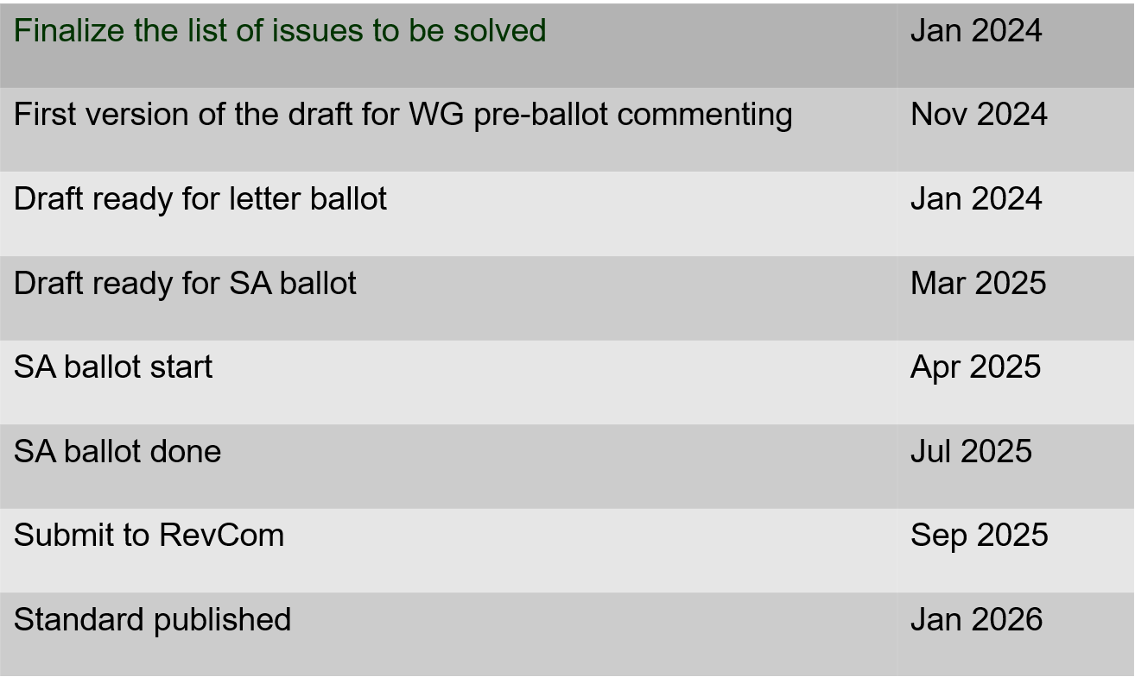
802.15.4ac Enhanced Privacy Timeline
January 2025

Slide 61
802.15.4ad Next Generation SUN PHYs
January 2025
Developing enhancements to the 802.15.4 SUN PHYs (FSK, OFDM)
State: pre-draft development
Meeting goals:
  Considering technical contributions
Objectives completed
Closing report: https://mentor.ieee.org/802.15/dcn/25/15-25-0022-01-04ad-tg4ad-agenda-opening-and-closing-report-january-2025.pptx

Slide 62
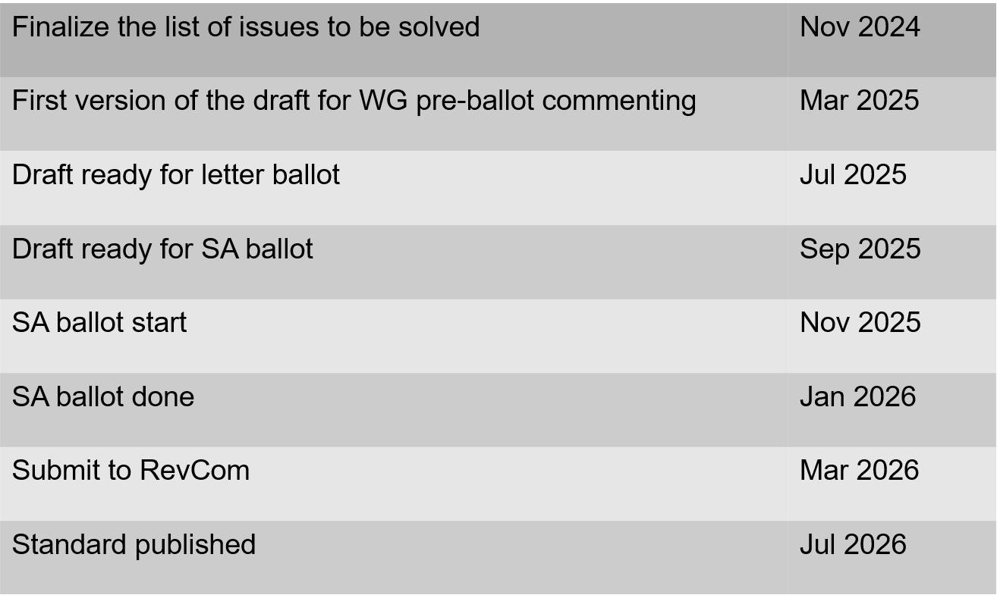
802.15.4ae (ASCON)
ASCON light weight encryption extension for 802.15.4
January 2025
Pre-draft development
Reviewing required changes to 802.15.4 to support ASCON
Drafting
Closing report: https://mentor.ieee.org/802.15/dcn/25/15-25-0031-02-04ae-january-opening-and-closing.pptx

Slide 63
802.15.6a
January 2025
Draft in WG ballot
Session objectives:
  Resolve comments
  Initiate recirculation
Closing report: https://mentor.ieee.org/802.15/dcn/25/15-25-0063-01-006a-tg15-6ma-closing-report-for-january-2025.pptx

Slide 64
January 2025
TG 6ma Timeline(expected)
Tech Req Doc July 2022
Presentation of proposals
May 2023
Comment Resolutionfor LB
Nov. 2024
Comment Resolutionfor LB2
Jan. 2025
EC approval to SA, SA submission
March 2025
SA recirculation
May 2025
WG PreBallot submission for Draft2.5 August 2024
SA recirculation if required
July 2025
Revcom Approve
Sept 2025
^{Draft V1,18 Com}
May. 2024
Recirculation (LB2)
Dec. 2024
RevcomSubmission
August 2025
Comment Resolution fo Draft v2.3 on WG for PreBallot July 2024
1st Letter Ballot(LB)
Sept. 2024
Conditional approval for Standard Association Ballot (SA)
February 2025
TRD,CMD
Call Proposals Sept 2022
Std. Draf V1.9 Proposals
Nov. 2023
Notes: SASB/RevCom scheduled for 2024 a guess

Slide 65
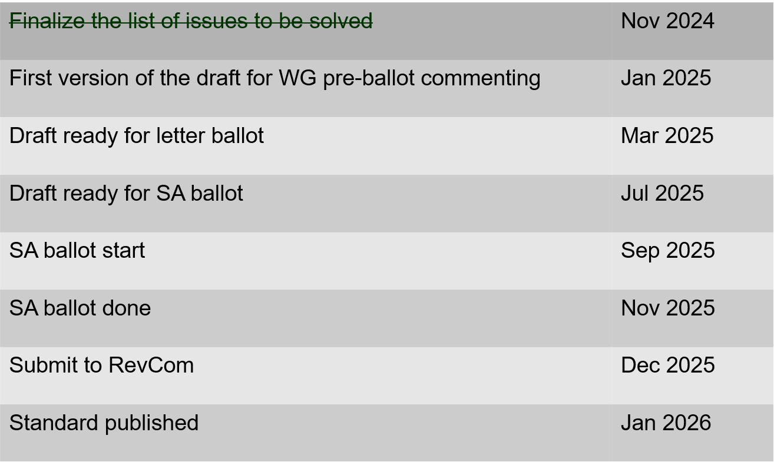
802.15.9a KMP Transport
January 2025
Extensions to key management: extending to support EDHOC
State: draft development
Session objectives
  Update and send out call for participation and call for proposals.
  Update list of changes needed to the IEEE Std 802.15.9 for adding EDHOC KMP
Opening and closing report: https://mentor.ieee.org/802.15/dcn/25/15-25-0030-03-009a-january-opening-and-closing.pptx

Slide 66
IG Access
January 2025
Did not meet in January (no contributions)
Contributions for March on multiple channel access schemes
  Results of simulation studies
  Results of field experience
Purpose: to explore potential enhancements to support better spectrum access
  Topics considered so far include sharing through coexistence, new channel access mechanisms, and reducing interference footprint.
Output: recommendations or information for the Working Group
Short term focus: Bands in which more than one wireless technology may operate
Support (Not preempt or disrupt) efforts in other projects
Some goals:
  Support for a diversity of uses
  Equal access and improved performance for all 802 wireless technologies
Participation encouraged!

Slide 67
Licensed Narrowband Amendment TG16t
January 2025
State: In SA ballot
  Comments from last recirculation: https://mentor.ieee.org/802.15/dcn/25/15-25-0021-00-016t-comments-submitted-for-2nd-sa-recirculation-of-802-16t-d6-0.xlsx

Slide 68
802.18 Liaison Report – January 2025
Date: 15 January 2025
Author:
Name | Company | Address | Phone | Email
Edward Au | Huawei Technologies |  |  | edward.ks.au@gmail.com
Gaurav Patwardhan | Hewlett Packard Enterprise |  |  | gauravpatwardhan1@gmail.com

Slide 69
RR-TAG at a glance
Membership as of 15 November 2024
  68 voters (including 10 on LMSC)
  2 nearly voters
  10 aspirants
Officers
  Chair: Edward Au (Huawei Technologies)
  Co-Vice Chair: Gaurav Patwardhan (Hewlett Packard Enterprise)
  Co-Vice Chair: Al Petrick (Jones-Petrick Associates)
  Secretary (for this interim): Chenhe Ji (Huawei Technologies)
  IEEE SA Program Manager: Jodi Haasz (IEEE SA)

Slide 70
Progress since the 2024 November plenary
Reviewed the latest ongoing consultations
Approved the following IEEE 802 LMSC submissions:
  Japan MIC: Call for opinions on the proposed ministerial ordinance to amend part of the Radio Law Enforcement Regulations: Addition of systems and bands to the special exemption system for non-technical equipment
  Saudi Arabia CST: Light Licensing Regulations Annex for the 6 GHz Frequency Band
  Vietnam MIC: Draft Circular amending and supplementing a number of articles of Circular No. 08/2021/TT-BTTTT dated October 14, 2021 of the Minister of Information and Communications stipulating the List of radio equipment exempted from radio frequency use licenses, technical conditions and accompanying exploitation
Discussed the latest topics related to spectrum and regulation in Europe, North America, and Asia Pacific.

Slide 71
Objectives this week (1)
Review and approve draft responses to the following consultations:
  France ARCEP: Draft decision repealing decision no. 2007-0683 of 24 July 2007 as amended and setting the conditions for use of radio frequencies for equipment operating using ultra-wideband technology
  UK Ofcom: Ofcom’s Plan of Work 2025/26
Review draft responses to the following external liaisons:
  ITU-R Working Party 5C liaison re 450 GHz to 1000 GHz
  ITU-R Working Party 5A and 5C re IEEE Std 802.15.3-2023
Discuss the latest topics related to spectrum and regulation in Europe, North America, and Asia Pacific, including ETSI BRAN update and ETSI ISG THZ liaison

Slide 72
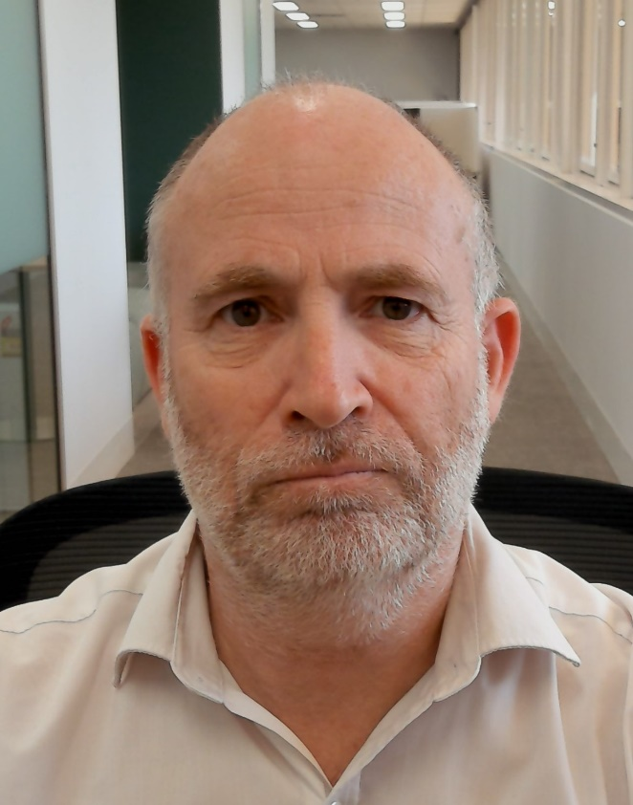
Objectives this week (2)
Invited presentation from Australia ACMA
  Title: ACMA Spectrum planning for Wi-Fi
  Author: Andrew Stewart (Senior Manager, Spectrum Planning Section, Australian Communications and Media Authority)
  Document: 18-25/0001

Slide 73
802.19 WG January 2025 Liaison Report
Date: 2025-1-14
Authors:

Slide 74
IEEE 802.19 Overview
IEEE 802.19 group reviews coexistence assessment documents (CAD) produced by working groups developing new wireless standards for unlicensed devices.
IEEE 802.19 develops standards for coexistence between wireless standards of unlicensed devices.
Meeting times: Monday PM3 and Thursday PM3 (6:30 PM).
Position | Person
Working Group Chair | Tuncer Baykas (Ofinno)
Working Group Vice Chair | Steve Shellhammer (Qualcomm)
Work Group Secretary | Yukimasa Nagai (Mitsubishi Electric)
Task Group 3a Chair | Ben Rolfe (Blind Creek Associates)
Liaison To/From 802.11 | Tuncer Baykas (Ofinno)

Slide 75
Coexistence Assessment Documents
No ballots before November meeting.

Slide 76
802.19.3a Task Group
Scope of the project: This amendment updates and expands coexistence recommendations to address new market requirements, increasing data traffic, greater device density of devices, and increased potential for congestion based on both IEEE Std 802.11-2020 and IEEE Std 802.15.4 sub-1 GHz standards.
Thursday 6:30 PM:
IEEE 802.11ah and IEEE 802.15.4g SUN OFDM PHY Coexistence Simulation, Takenori Sumi

Slide 77
IEICE Conference in Kyoto
Fri, Jan 17 AM Special Session on IEEE 802 Standardization (Maskawa Hall, Kyoto University) 11:00 - 17:30
(1) | 11:00-11:50 | IEEE 802.19 Wireless Coexistence Working Group | Tuncer Baykas (Ofinno)
(2) | 13:00-13:50 | Latest trends in IEEE 802.15 and Wi-SUN Alliance | Phil Beecher (Wi-SUN Alliance)
(3) | 13:55-14:45 | Latest trends in In-Body CA Localization and IEEE 802.15.6ma | Daisuke Anzai (Nagoya Inst. of Tech.)
(4) | 15:00-15:50 | Latest trends of wireless LAN standardization in IEEE 802.11, and development of system-level simulator for evaluating reliability of cybernetic avatar operation | Kazuto Yano (ATR)
(5) | 16:00-17:30 | Discussion session
For more info: https://ken.ieice.org/ken/program/index.php?tgs_regid=58056984cfac617843301b8c7cd5c46dd6c281f7addbd8c4f4245a7de3ec65e9&tgid=IEICE-SRW&lang=eng

Slide 78
802REVc Status January 2025 Update
Date: 2025-01-12
Authors:

Slide 79
IEEE Std 802-REVc Overview
PAR was approved on 24 March 2022 to create:
802-REVc - “Standard for Local and Metropolitan Area Networks: Overview and Architecture”
A maintenance roll up of the outstanding amendments of IEEE std 802-2014 – 802.c, 802d, 802f
  Assigned to 802.1 Maintenance – Mark Hantel Maintenance TG Chair, Glenn Parsons 802.1 Chair
  Status/documents/comments are available: https://1.ieee802.org/maintenance/802-revc/
  Files available: https://www.ieee802.org/1/files/private/802-REVc-drafts/ (members only, .11 members)
  Editor: James Gilb
Draft Status Overview:
  WG ballot phase has completed.
  SA ballot phase has completed.
  RevCom recommended and SASB approved publication December 2024
  Final draft of IEEE Std 802-REVc is available IEEE Std 802-REVc-d2.2
  IEEE Std 802-REVc will be published as IEEE Std 802-2024 in Q1 of 2025

Slide 80
Next Steps
Awaiting IEEE publication of IEEE Std 802-2024
802.11 next steps:
  Align 802.11 to be consistent with the updated IEEE Std 802
  It is anticipated work will be done in 802.11 ARC SC and implemented in 802.11 TGmf.
  802.11 ARC SC has identified the following potential topics to be addressed:
          EPD and LPD terms are going away – we need to update 802.11 to align
          Review MAC address ordering discussion, and 802.11 assumptions (1-24/0034r0)
          Review 802.1AC mapping from ISS to 802.11 MAC SAP interface
          Consider any changes to remove 802.2/LLC terms?
          802.11’s “Portal”, and mapping to/usage of IEEE Std 802 terminology
          Access Domains: “802 Access Domains”?
          What if we make the DS a bridge (small ‘b’)?
          Adding something about VLANs (just informational?) into 802.11?

Slide 81
Wi-Fi Alliance (WFA) Liaison January 2025
Date: 2025-01-15
Authors:

Slide 82
Abstract
This presentation contains the Wi-Fi Alliance (WFA) liaison update for January 2025 IEEE 802.11 meeting

Slide 83
Meetings
This year marks the 25th Anniversary of the WFA
Celebration of W-Fi future at Malaga, Spain in the Europe member meeting, Oct 15-17 after covering future earlier in the year in Singapore and Austin, TX
  Keynote speeches by industry experts
  Panel discussions on expanding enterprise opportunity, innovation, connected healthcare, market segment insights and demos
  Meeting reports available for members
The next WFA F2F (Asia) member meeting will take place on Feb 18th-20th, 2024, in Tokyo, Japan

Slide 84
Activities
Technical activity at WFA that has recently led to certification
  Wi-Fi 7
  QoS Management
  EasyMesh
  WPA3
  Wi-Fi proximity ranging
Technical activity at WFA that is expected to lead to certification
  Wi-Fi 7 R2
  6 GHz standard power
  Wi-Fi Direct
  XR (Augmented / Virtual / Mixed Reality)
  QoS Management
Increased use of interoperability events with commercial products after program launches

Slide 85
Additional Work Areas
Examples of additional WFA technical work
  Security
  Customer Experience
  EasyConnect
  Wi-Fi HaLow
  Wi-Fi Data Elements
  Wi-Fi Aware
Examples of additional WFA activity that may lead to technical work
  Sensing
  Automotive
  Healthcare
  Internet of things
  Operators
Spectrum regulatory

Slide 86
Recent publications
Wi-Fi Alliance® and Faculty of Medicine Ramathibodi Hospital drive 6 GHz Wi-Fi® innovation in Thailand
Propelling innovation: 6 GHz and AFC drive advancements in outdoor Wi-Fi® deployments
Podcasts:
  Episode 72: Wi-Fi® brings connection to communities with Curtis Hill of Open Broadband
  Episode 71: 6 GHz Wi-Fi® and AFC improves connectivity for all with Jussi Kiviniemi of Hamina Wireless

Slide 87
Further information
For more information on current areas of work, see http://www.wi-fi.org/who-we-are/current-work-areas
If these sound like interesting topics, please plan to sign up and participate
Further general information at http://www.wi-fi.org/

Slide 88
Wireless Broadband Alliance (WBA) Liaison Report – January 2025
Date: 2025-01-15
Authors:
Name | Company | Address | Phone | Email
Necati Canpolat | Intel |  |  | necati.canpolat@intel.com

Slide 89
Wireless Broadband Alliance (WBA)
Drives enabling seamless & interoperable Wi-Fi services
Addresses business and technical issues, as well as opportunities in the industry
IEEE 802.11 (std dev) WFA (cert) WBA (enablement)

Slide 90
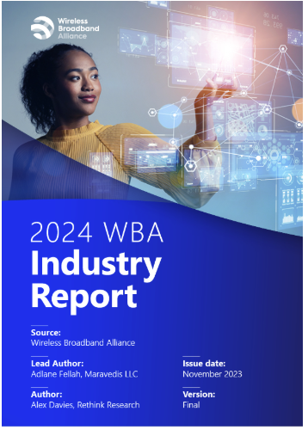
WBA Annual Industry Report 2024
Highlights significant trends and developments in the Wi-Fi and connectivity sector
Based on insights from 200 global industry executives
It is publicly available at: https://wballiance.com/resource/annual-industry-report-2024/

Slide 91
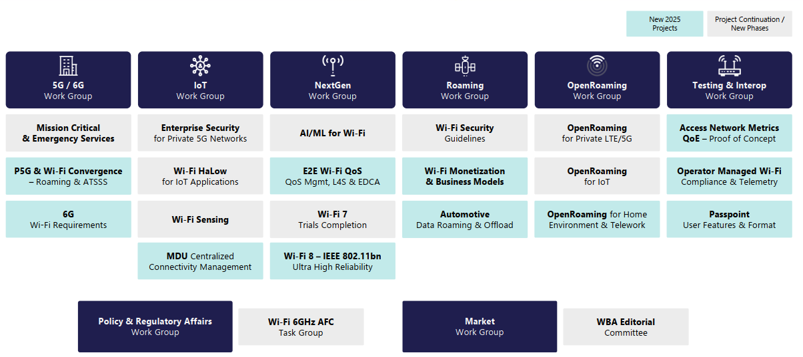
WBA Technical Activities & Roadmap for 2025
https://wballiance.com/wba-program-overview-2025/
https://wballiancec.com/proejcts-details

Slide 92

Wireless Global Congress & Members Meeting
https://www.wirelessglobalcongress.com/apac2025/

Slide 93
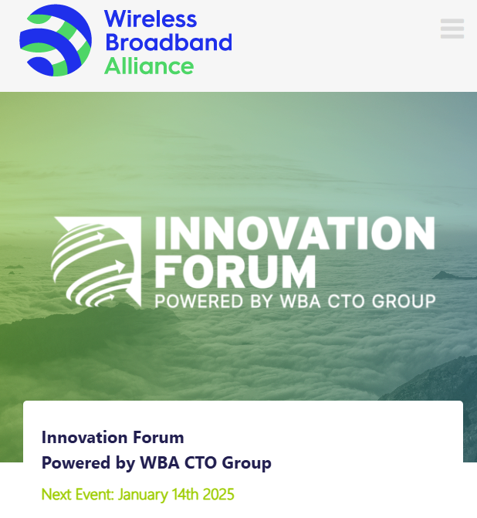
WBA Innovation Forum
https://wballiance.com/innovation-forum/
Focus on key themes sharing perspectives that will shape the future of connectivity for the next decade and beyond

Slide 94
WBA 6G/Wi-Fi Vision Statement
Launched WBA 6G/Wi-Fi Vision Statement on Jan’14
Calls for greater collaboration and among standard bodies all stakeholders for 6G to deliver on its promise
Details five key vision points for 6G, to achieve ubiquitous connectivity that comprises Wi-Fi and cellular

Slide 95
Further information
WBA information at https://wballiance.com/
Current work areas https://wballiance.com/wba-program-overview-2025/
WBA resource center https://wballiance.com/resource/
WBA events https://wballiance.com/events-awards/
WBA memberships: https://wballiance.com/membership/

Slide 96
IEEE 802.11-IETF Liaison Report
Date: 2025-01-15
Authors:

Slide 97
IETF Meetings
Upcoming Meetings:
  March 15-21, 2025 – Bangkok, TH
  July 19-25, 2025 – Madrid, ES
IETF meeting fee waivers
http://www.ietf.org
  Newcomer training: https://www.ietf.org/about/participate/get-started/
  April 2016: Wireless Tutorial (Donald Eastlake), 802.11 & 802.15 tutorials (Dorothy Stanley, Charlie Perkins), see 11-16/500, September 2016: Pat Thaler & Juan Carlos – 802.1E (Privacy Considerations) and 802c (Local MAC address usage) https://datatracker.ietf.org/group/edu/materials/

Slide 98
IETF- IEEE 802 Liaison Activity
Joint meetings, agenda and presentations
  http://www.iab.org/activities/joint-activities/iab-ieee-coordination/
  Proceedings: https://datatracker.ietf.org/iabasg/ietfieee/meetings/
  Coordination topics include: Capability Discovery, Data Center Bridging, use of Local Address in virtualization and IoT, MAC address randomization, DETNET/TSN/RAW, YANG models, pervasive monitoring
  IETF-IEEE 802 coordination teleconferences: October 23, 2024

Slide 99
IETF protocol use with 802.11 technology
RFC 9672 (RFC 8110 to IEEE) has been published.

Slide 100
BOFs at IETF 121 November 2-8, 2024
See https://datatracker.ietf.org/wg/bofs/
alldispatch | IETF-Wide "Dispatch" Session
diem | Digital Emblems
nasr | Network Attestation for Secure Routing
hpwan | High Performance Wide Area Network
rpp | RESTful Provisioning Protocol
deepspace | Deep Space

Slide 101
IETF/IRTF groups being (re-)chartered
See https://datatracker.ietf.org/group/chartering/
ccamp | Common Control and Measurement Plane
diem | Digital Emblems
ianabis | Update to IANA Considerations
ipsecme | IP Security Maintenance and Extensions
opsawg | Operations and Management Area Working Group
roll | Routing Over Low power and Lossy networks
rpp | RESTful Provisioning Protocol
spring | Source Packet Routing in Networking
tiptop | Taking IP To Other Planets

Slide 102
YANG Model Catalog
YANG catalog development
  A YANG model catalog and registry that allows users to find models relevant to their use cases from the large and growing number of YANG modules being published.
  YANG Catalog was developed through a collaboration between the IETF and the Broadband Forum, and contains many data models, including from other Standards Development Organizations (SDOs) such as the IEEE, as well as some vendor-specific data models. Interest and participation from other SDOs, equipment vendors, open-source projects and network operators is encouraged.
See https://www.ietf.org/blog/yang-catalog-latest-developments-ietf-100-hackathon/
See https://yangcatalog.org/ and https://1.ieee802.org/yangsters/

Slide 103
IoT-related work
6LO
  Working Group website: https://datatracker.ietf.org/wg/6lo/
  Focus: IPv6 over Networks of Resource-constrained Nodes
Updates
  Revised: Path-Aware Semantic Addressing (PASA) for Low power and Lossy Networks: https://datatracker.ietf.org/doc/draft-ietf-6lo-path-aware-semantic-addressing/ (November 2024)
  New and revised: Generic Address Assignment Option for 6LowPAN Neighbor Discovery: https://datatracker.ietf.org/doc/draft-ietf-6lo-nd-gaao/ (November 2024)

Slide 104
IoT-related work (cont.)
ROLL: Working Group website: https://datatracker.ietf.org/wg/roll/
  Focus: Routing over Low Power and Lossy Networks
CORE: (Constrained RESTful Environments) Working Group website: http://datatracker.ietf.org/wg/core/
  Focus: framework for resource-oriented applications intended to run on constrained IP networks.
IoT Directorate:
  Reviews IETF drafts that are IoT related
  See: https://datatracker.ietf.org/group/iotdir/about/

Slide 105
MADINAS WG
See https://datatracker.ietf.org/wg/madinas/
MAC Address Device Identification for Network and Application Services
  This is the IETF’s equivalent of IEEE 802.11bh – how to deal with the implications of the deployment of random and changing MAC addresses.
Updates
  In RFC Editor’s queue: Randomized and Changing MAC Address Use Cases and Requirements: https://datatracker.ietf.org/doc/draft-ietf-madinas-use-cases/ (December 2024)

Slide 106
EAP Method Update (EMU)
See https://datatracker.ietf.org/wg/emu/
  This working group has been chartered to provide updates to some commonly used Extensible Authentication Protocol methods including of EAP-TLS, EAP-AKA, EAP-AKA’ (for 5G), EAP-SIM, etc.
  The group should document any recently gained new knowledge on vulnerabilities or the possible implications of pervasive surveillance or other new concerns.
Updates
  Submitted to IESG for publication: The eap.arpa domain and EAP provisioning: https://datatracker.ietf.org/doc/draft-ietf-emu-eap-arpa/ (January 2025)
  Revised and still in RFC Editor’s queue and waiting on other document: Tunnel Extensible Authentication Protocol (TEAP) Version 1: https://datatracker.ietf.org/doc/draft-ietf-emu-rfc7170bis/ (January 2025)

Slide 107
Operations Area Working Group
https://datatracker.ietf.org/wg/opsawg/
Updates
  In IESG Review: A YANG Data Model for Augmenting VPN Service and Network Models with Attachment Circuits: https://datatracker.ietf.org/doc/draft-ietf-opsawg-ac-lxsm-lxnm-glue/ (January 2025) [noted as being one of several related YANG attachment circuit Internet-Drafts in progress]
Background
  Of interest: RFC 6632, An Overview of the IETF Network Management Protocols, see https://tools.ietf.org/html/rfc6632
  Automated network management, including YANG data models, see https://www.ietf.org/topics/netmgmt/

Slide 108
Internet Area Working Group
https://datatracker.ietf.org/wg/intarea/
Updates
  No updates noted over the preceding two months

Slide 109
Transport Layer Security (TLS)
See: https://datatracker.ietf.org/wg/tls/
Updates
  Held for formal analysis: TLS 1.3 Extension for Using Certificates with an External Pre-Shared Key: https://datatracker.ietf.org/doc/draft-ietf-tls-8773bis/ (January 2025)
  Waiting for AD go-ahead: TLS 1.2 is in Feature Freeze: https://datatracker.ietf.org/doc/draft-ietf-tls-tls12-frozen/ (January 2025)
  Adopted: The Datagram Transport Layer Security (DTLS) Protocol Version 1.3: https://datatracker.ietf.org/doc/draft-ietf-tls-rfc9147bis/ (December 2024)

Slide 110
Deterministic Networking (DETNET)
DETNET: https://datatracker.ietf.org/wg/detnet/
  The Deterministic Networking (DetNet) Working Group focuses on deterministic data paths that operate over Layer 2 bridged and Layer 3 routed segments, where such paths can provide bounds on latency, loss, and packet delay variation (jitter), and high reliability.
  The IEEE 802.11be activities seem like they may fit in with DetNet and there was a joint IEEE-IETF DetNet discussion in Bangkok (November 2018).
  Addresses Layer 3 aspects in support of applications requiring deterministic networking.
  The Working Group collaborates with IEEE 802.1 Time Sensitive Networking (TSN), which is responsible for Layer 2 operations, to define a common architecture for both Layer 2 and Layer 3.
  Example applications for deterministic networks include professional and home audio/video, multimedia in transportation, engine control systems, and other general industrial and vehicular applications being considered by the IEEE 802.1 TSN Task Group.
Updates:
  (Still) In WGLC: Reliable and Available Wireless Architecture: https://datatracker.ietf.org/doc/draft-ietf-raw-architecture/ (November 2024)
  In IESG evaluation: Reliable and Available Wireless Technologies: https://datatracker.ietf.org/doc/draft-ietf-raw-technologies/ (October 2024)

Slide 111
Autonomic Networking Integrated Model and Approach (ANIMA)
ANIMA: https://datatracker.ietf.org/group/anima/
  ANIMA designs protocols to allow network operations (e.g., on-boarding) to be carried out without requiring low-level management of individual devices
Updates:
  In WG Last Call: Constrained Bootstrapping Remote Secure Key Infrastructure (cBRSKI): https://datatracker.ietf.org/doc/draft-ietf-anima-constrained-voucher/ (January 2025)
  Submitted to IESG for publication and in AD evaluation: BRSKI with Pledge in Responder Mode (BRSKI-PRM): https://datatracker.ietf.org/doc/draft-ietf-anima-brski-prm/ (January 2025)
  Revision requested by IESG: JWS signed Voucher Artifacts for Bootstrapping Protocols: https://datatracker.ietf.org/doc/draft-ietf-anima-jws-voucher/ (November 2024)

Slide 112
References
RFC 7241, “The IEEE 802/IETF Relationship” (RFC 4441 update)
  https://datatracker.ietf.org/doc/rfc7241/
IEEE 802 Liaisons list is available
  http://ieee-sa.centraldesktop.com/802liaisondb/FrontPage

