Slide 1
Multi-link scheduled Power Save for AP MLD
Date: 2024-09-20
Authors:

Slide 2
Introduction
SFD for TGbn states[1]:
  Define a new mechanism and/or enhance existing mechanism for AP power save
Several AP power save(PS) mechanisms have been developed[2-12]: scheduled PS mode, unscheduled PS mode and dynamic PS mode. In the aspect of power benefit, the unscheduled PS mode is one of the most promising candidate, while encountering some limitations, eg, only being supported well by non-AP MLD.
In this contribution, we extend the unscheduled PS operation to a flexible power management mechanism that provides flexible access services while maintain the high power efficiency in AP MLD

Slide 3
Recap: Unscheduled AP PS mode
Unscheduled AP PS mode: all links operation modes are announced ( )
  After announcement, only one link in active mode and the others in PS mode(doze state is preferred )
  When critical traffic service in need, the cross-link signaling mechanism is adopted
Issues of unscheduled AP MLD PS mode due to the long duration of doze state
  Non-MLD STA may lost connectivity if the associated AP in doze state
  New non-MLD STA cannot get associated to the AP if the AP in doze state
A
AP_MLD
Non-AP
MLD
AP_1
A
Active mode: Awake state
…
AP_1
STA_1
STA_1
Awake
ICF
Awake
Awake
…
AP_2
A
Doze
Awake
Doze
…
AP_2
STA_2
STA_2
Doze
Awake
Doze
…
Critical traffic transmission

Slide 4
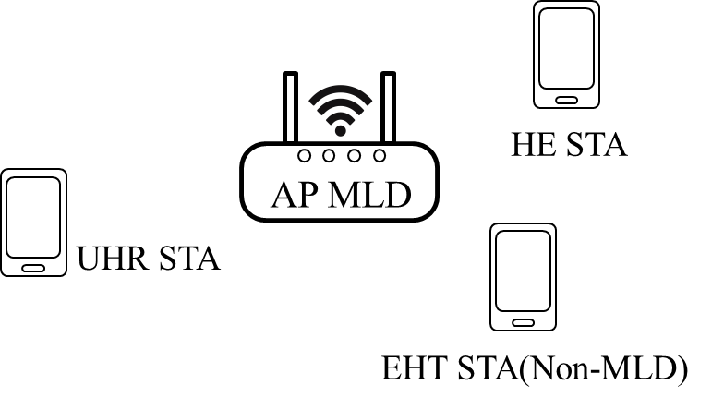
Motivation
In most scenarios, non-MLD and MLD STAs are concurrently deployed. In addition, some contributions predicted that 11ax (HE STA, non-MLD) and after STAs would contribute the majority of the non-AP STAs [6]. As a result, potential association or connectivity issues may arise frequently when a AP MLD operates in unscheduled AP PS mode due to the presence of non-MLD STAs.
It comes to the motivation naturally: can we extend the existing PS operations to support non-MLD STAs (eg. HE STAs) while maintain high power efficiency near to that in unscheduled AP PS mode in AP MLD?

Slide 5
Proposal: Multi-link scheduled AP PS operation
  AP MLD schedule affiliated APs power state in MLD level and announce the schedule information in each link (by a frame, TBD )
    PS Schedule: start time, multi-link service period(MSP) duration, and the power state of each link. MSP is a service period that only one affiliated AP is in awake state in a AP MLD and the MSP duration may be in the units of Beacon interval (BI)
    Cross-link signaling mechanism in unscheduled PS mode is reused to provide critical traffic service for non-AP MLD(as shown in previous slide 3)
    Similar to the MLSR operation in AP side
AP_MLD
MSP_1
MSP_2
MSP_3
MSP_4
AP_1
Link_1
…
A
Awake
A
Doze
A
…
Awake
A
Doze
(2.4GHz)
STA_2.4GHz
STA_2.4GHz
STA_5GHz
STA_5GHz
AP_2
Link_2
…
A
Awake
A
…
A
Doze
Doze
A
Awake
(5GHz)

Slide 6
Case_1: UHR Non-AP STAs
AP MLD operation
  The AP MLD announce the PS schedule information in each link
  If receiving a probe/association request, AP MLD may suspend the PS mode to provide the association service before the timeout
Non-AP STA operation
  The non-AP STA shall schedule its power state according to the announced schedule information
  The frame shall be exchanged in the link when both non-AP STA and AP are in awake state
AP_MLD
MSP_1
MSP_2
Non-AP
MLD
AP_1
A
Awake
A
Doze
…
AP_1
Link_1
STA_1
STA_1
Awake
Doze
…
AP_2
A
Doze
A
Awake
…
AP_2
Link_2
STA_2
STA_2
Doze
Awake
…

Slide 7
Cases_2: Pre-UHR Non-AP STAs
AP MLD operation
  AP MLD shall negotiate TWT agreements with all pre-UHR STAs with Responder PM Mode =1 :
    If the TWT agreement negotiation is finished, the ongoing AP PS mode shall continue
      TWT SP limited in the MSP when the corresponding AP in awake state
    Otherwise, the ongoing AP PS mode shall terminate
Pre-UHR non-AP STA operation
  The non-AP STA only wake and exchange frame in the TWT SP
AP_MLD
MSP_1
MSP_2
MSP_3
AP_1
…
…
AP_1
A
Awake
A
Doze
A
Awake
STA_2.4GHz
…
Doze
TWT
Doze
TWT
Doze
…
(2.4GHz)
AP_2
…
…
A
Doze
A
Awake
A
Doze
AP_2
STA_5GHz
…
Doze
TWT
Doze
…
(5GHz)

Slide 8
Summary
In this contribution, we proposed a AP MLD PS mode that schedules the affiliated APs power state at the MLD level :
  Each affiliated AP power state is scheduled and announced in each link by a frame
  In each MLD service period, only one affiliated AP transition into awake state
Advantages:
  Have a compatibility to legacy non-MLD STAs that supports TWT scheduling
  Can provide more flexible multi-link access service while maintain the high power efficiency near to the unscheduled AP PS mode

Slide 9
References
[1] 11-24-0209-05-00bn specification framework for tgbn
[2] 11-23/2040r1-bn Enabling AP power save – Follow Up
[3] 11-24/0589r0-bn Dynamic TID-To-Link Mapping for AP MLD Power Save
[4] 11-24/0737r0-bn Cross-link Wake-up to Go Deeper in Power Save
[5] 11-24/0352r1-bn Enabling Unscheduled AP PS Follow-up
[6] 11-23/0015r0-uhr AP MLD Power Management
[7] 11-23/0225r1-uhr Considering Unscheduled AP Power Save
[8] 11-23/1936r0-uhr AP MLD Power Save Follow-up
[9] 11-24/0659r1-bn Thoughts on AP Power Save
[10] 11-24/0097r0-bn AP Power Management Follow Up
[11] 11-24/1126r1-bn ICF-ICR Discussion for DPS
[12] 11-24/0503r1-bn Power Save Follow Up

