Slide 1
Secure Transaction Methods with Low Computation Complexity for AMP Devices
Date: 2024-11-26
Authors:

Slide 2
Introduction
A set of secure transaction methods for AMP devices have been presented. They are based on WPA3 SAE, requiring some level of computation power for authentication and encryption key generation.
  11-24/0178, a shared secret-based secure transaction method (suitable for active UL TX AMP, legacy preamp AMP).
  11-24/0526, a server-managed secure transaction method (suitable for active UL TX AMP, legacy preamp AMP).
  11-24/0871, AMP device-initiated secure transaction methods (suitable for legacy preamp AMP).
  11-24/1242, add privacy to above methods using random MAC addresses.
The corresponding secure transaction methods with low computation complexity are introduced in this contribution. They are based on 4-way handshake protocol, only computing hash values in authentication and encryption key generation, applicable for backscattering devices.
  To the extreme: devices can power off after one excitation cycle followed by one backscattering frame.
Notes:
https://unit42.paloaltonetworks.com/iot-threat-report-2020/

Slide 3
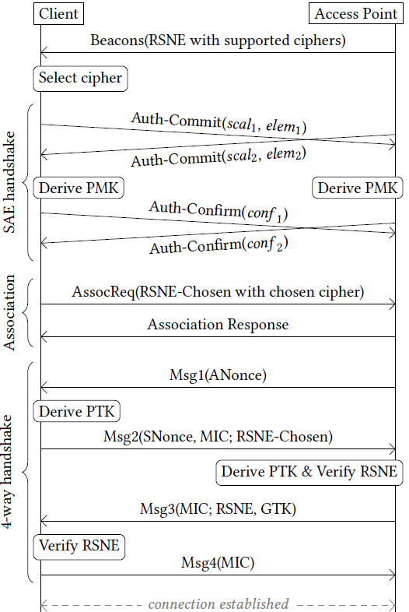
Recap: why transaction methods?
Current 802.11 security protocol such as WPA3 SAE defines 10+ frame exchanges to setup a secure link (security association) between two STAs, requiring the STAs to maintain the secure link, which consumes energy that may not be affordable by power-constrained AMP devices.
Secure links are designed to support multiple applications running on STAs, possibly with large data volume over a long period. AMP devices are most likely designed for single purposes and very likely exchange small amount of data for every communication attempt (called a transaction). A lightweight security protocol that allows AMP devices power off without maintaining security association after a transaction could be a better option.
Notes:
https://unit42.paloaltonetworks.com/iot-threat-report-2020/

Slide 4
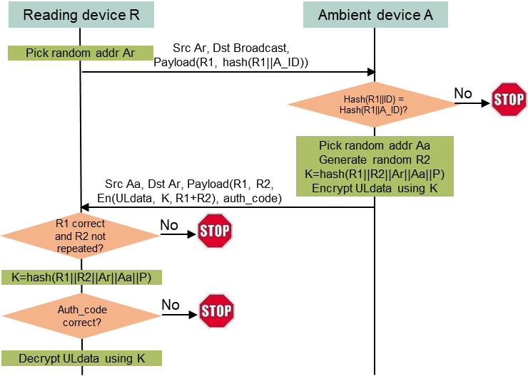
A high-entropy shared secret-based secure transaction method for single-purpose read-only AMP devices
Assumptions
  A reading device R and an ambient device A share a high-entropy secret P.
  A has a secret ID (A_ID) known by R.
  DL data does not need encryption. Its sole purpose is to enable the AMP device to transmit/backscatter the same type of UL data (A is a read-only, single-purpose device).
Protocol highlights
  Privacy (random MAC address for R and A)
  Only one round-trip frame exchange (DL then UL), then A can power off.
  R-to-A authentication not needed as A is single-purpose and read-only.
  A-to-R authentication is assured by A’s capability of generating the same key K and producing an authentication code verifiable by R.
Complexity
  64B DL, 80B UL, ±16B (assuming minimum 16B data).
  2 hash calculations, 5 encryption blocks (16B block size) by A.
  1.4uJ/4.9uJ needed if A runs ASCON/AES, using estimation in 11/24-1584.
  Applicable to all types of 11bp devices.
Notes:
https://unit42.paloaltonetworks.com/iot-threat-report-2020/

Slide 5

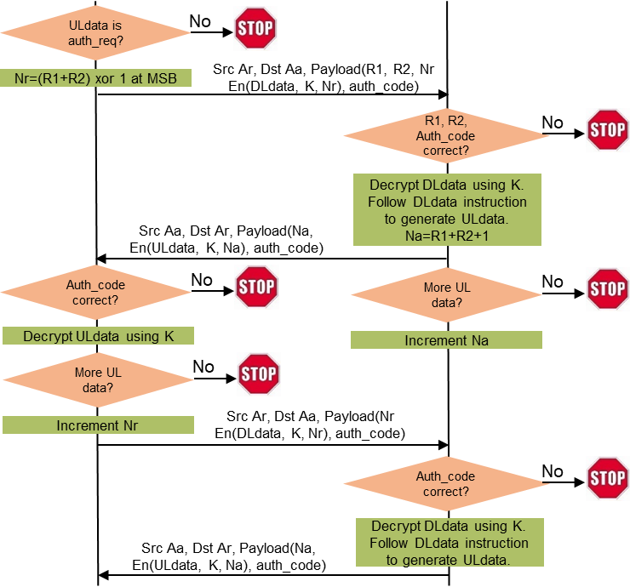
A high-entropy shared secret-based secure transaction method for AMP devices that can keep memory for 2 or more UL transmission/backscattering
Assumptions
  A reading device R and an ambient device A share a high-entropy secret P.
  A has a secret ID (A_ID) known by R.
  A can keep memory alive for 2 or more UL transmission/backscattering.
  A may not be single-purpose, read-only device, so both DL data and UL data need to be encrypted.
Protocol highlights
  Privacy (random MAC address for R and A).
  Mutual authentication.
  A seamless extension of the one-cycle security protocol: A can send UL data in multiple transmission/backscattering (N+1 round-trip frame exchanges if A needs to transmit/backscatter N UL data frames).
Complexity
  64B DL, 80B UL, 80B DL, 64B UL ±16B (assuming minimum 16B data).
  2 hash calculations, 14 encryption blocks (16B block size) by A.
  3.8uJ/13.3uJ needed if A runs ASCON/AES, using estimation in 11/24-1584.
  Applicable to all types of 11bp devices.
Notes:
https://unit42.paloaltonetworks.com/iot-threat-report-2020/

Slide 6
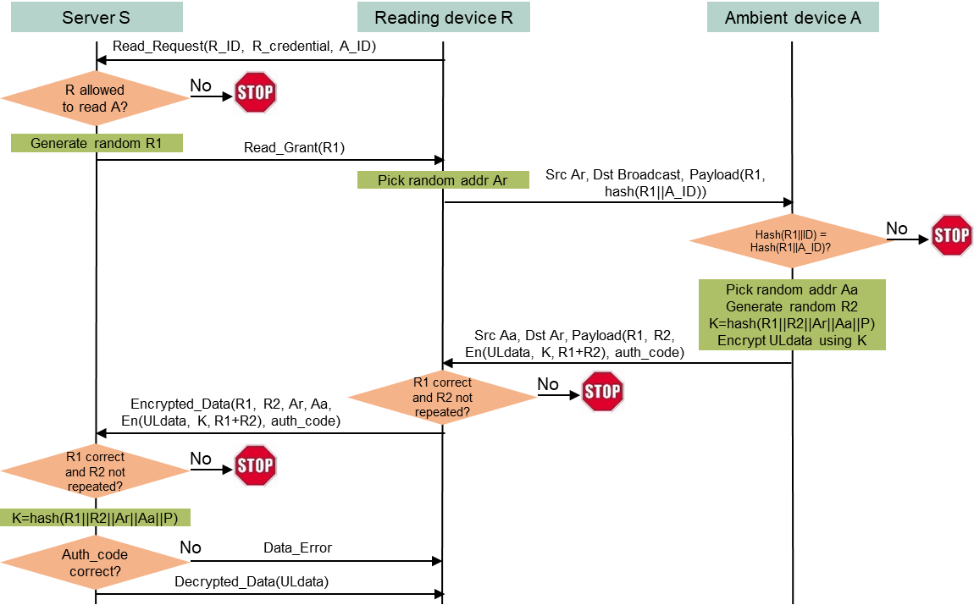
A server-managed secure transaction method for single-purpose read-only AMP devices
Assumptions
  An ambient device A and a server S share a high-entropy secret P.
  S manages whether a reading device R can read data from A based on R_ID and R_credential.
  A has a secret ID (A_ID) known by R. The server’s URL (S_URL) is also known by R.
  DL data does not need encryption. Its sole purpose is to enable the AMP device to transmit/backscatter UL data (A is a read-only, single-purpose device).
Protocol highlights
  Privacy (random MAC address for R and A)
  Only one round-trip frame exchange (DL then UL), then A can power off. No server access delay.
  R-to-A authentication not needed as A is single-purpose and read-only.
  A-to-R authentication is assured by A’s capability of generating the same key K and producing an authentication code verifiable by S.
Complexity
  64B DL, 80B UL, ±16B (assuming minimum 16B data).
  2 hash calculations, 5 encryption blocks (16B block size) by A.
  1.4uJ/4.9uJ needed if A runs ASCON/AES, using estimation in 11/24-1584.
  Applicable to all types of 11bp devices.
Notes:
https://unit42.paloaltonetworks.com/iot-threat-report-2020/

Slide 7


A server-managed secure transaction method for AMP devices that can keep memory for 2 or more UL transmission/backscattering
Assumptions
  An ambient device A and a server S share a high-entropy secret P.
  S manages whether a reading device R can read data from A based on R_ID and R_credential.
  A has a secret ID (A_ID) known by R. The server’s URL (S_URL) is also known by R.
  A can keep memory alive for 2 or more UL transmission/backscattering.
  A may not be single-purpose, read-only device, so both DL data and UL data need to be encrypted.
Protocol highlights
  Privacy (random MAC address for R and A).
  Mutual authentication. Only R-to-A authentication is subject to one-time server access delay.
  A seamless extension of the server-managed one-cycle security protocol: A can send UL data in multiple transmission/backscattering without server access delay (N+1 round-trip frame exchanges if A needs to transmit/backscatter N UL data frames).
Complexity
  64B DL, 80B UL, 80B DL, 64B UL ±16B (assuming minimum 16B data).
  2 hash calculations, 14 encryption blocks (16B block size) by A.
  3.8uJ/13.3uJ needed if A runs ASCON/AES, using estimation in 11/24-1584.
  Applicable to all types of 11bp devices.
Notes:
https://unit42.paloaltonetworks.com/iot-threat-report-2020/

Slide 8
Summary
A set of high-entropy shared secret-based secure transaction methods are proposed. They are low-computation-complexity, applicable to all types of 11bp devices, including backscattering devices.
These secure transaction methods can be considered as a compressed version of 4-way handshake protocol. They can co-exist with current 802.11 security protocol that requires STAs to maintain security associations.
The ballpark numbers of DL data size, UL data size, and energy needed by ambient devices are provided.
Notes:
https://unit42.paloaltonetworks.com/iot-threat-report-2020/

