Slide 1
Enhanced Light Communications (ELC) Underwater Interoperability and Backwards Compatibility
Date: 2024-11-07
Authors:

Slide 2
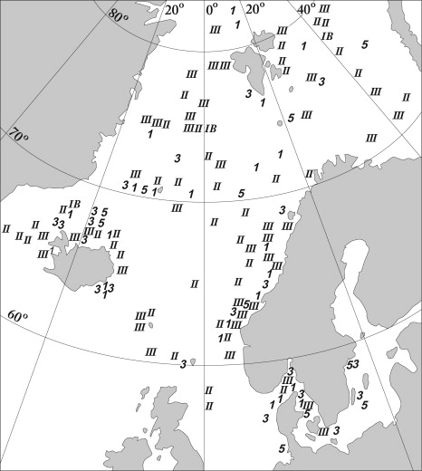
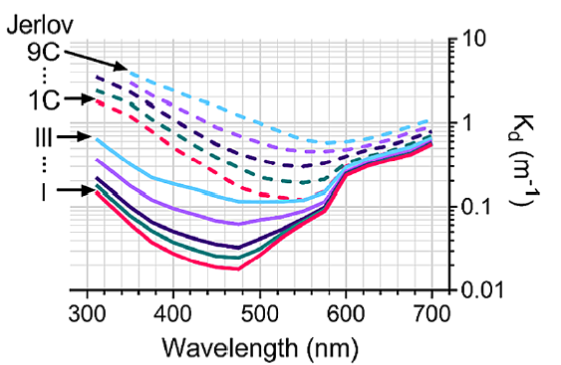
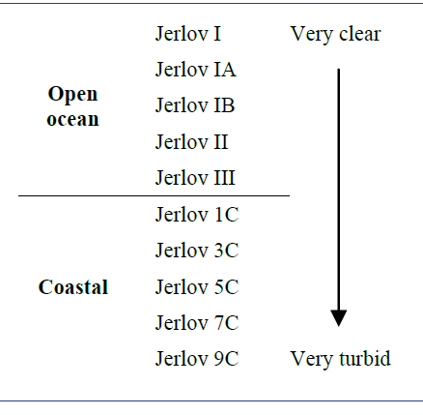
The Underwater Optical Channel
[1]
[1]
[2]
Optimum window that would cover all water types would be approximately 450 nm to 600 nm.

Slide 3
Underwater LiFi Operation
The properties of the underwater optical channel suggest that perhaps systems could be designed with different operational wavelengths depending on where they would typically be deployed. This raises a question of potential interoperability of systems employing different wavelengths for communication.
There is also the open question of backwards compatibility with 802.11bb compliant systems operating in the 800 nm – 1000 nm window.

Slide 4
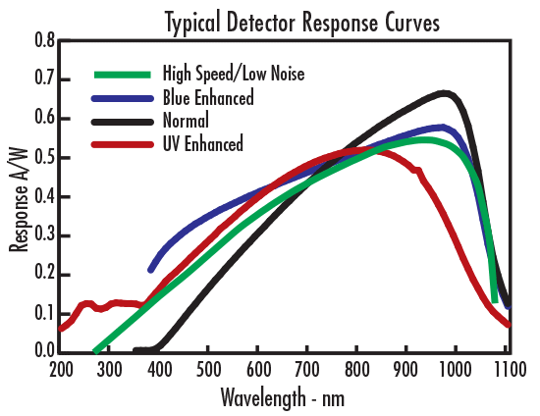
Interoperability
[3]
Single transmit wavelength
Typical Si photodetectors are capable of supporting wavelengths in the desired range both in the 450 nm to 600 nm (and 800 nm to 1000 nm ranges).
A single filter solution covering the entire range of wavelengths to be used in underwater communications should not compromise performance significantly compared to a tighter filter solution but would enable interoperability between systems utilizing different emission wavelengths best suited to their primary deployment conditions.

Slide 5

Backwards Compatibility
Requirement on the new systems to be able to also transmit in the 800 nm to 1000 nm range –this necessitates multiple transmitters i.e. one in each range of operation (minimum of 2)
Requirements on the new systems to detect signals in the 800 nm to 1000 nm range – this necessitates in the very least use of two different filter solutions (or two detector chains; or system implementation without filters at all) which either are end-user replaceable or intelligently operated by the system/modem itself

Slide 6
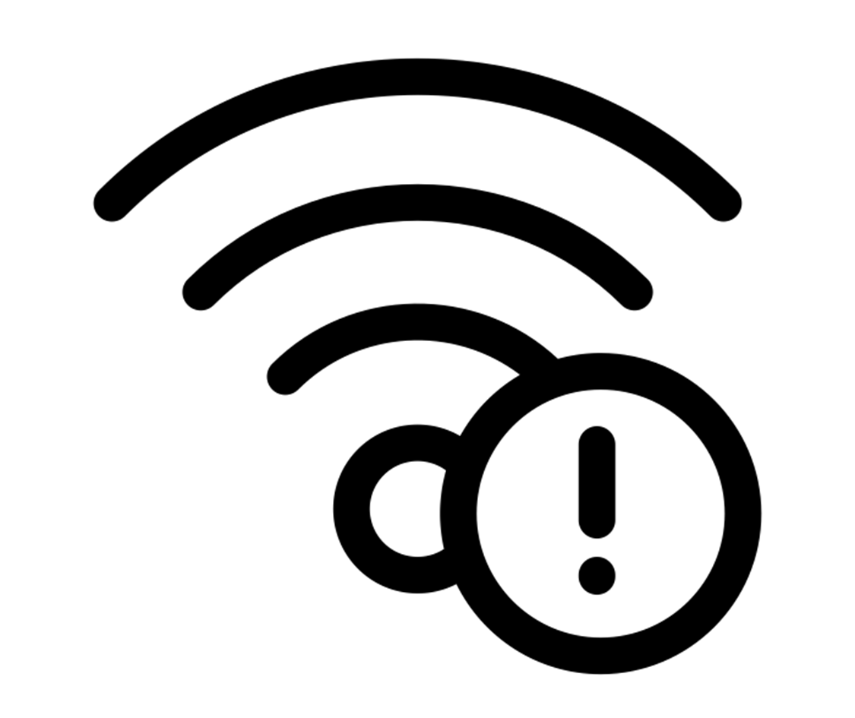
Argument Against Backwards Compatibility
No technical reason why infrared would be used underwater due to the unfavorable absorption properties of water.
As far as we are aware there are no underwater systems in existence that are 802.11bb compliant and therefore operating in the 800 nm to 1000 nm spectrum.
Difficult to envision a use case scenario where backwards compatibility to the 802.11bb 800 nm to 1000nm systems would be required or be advantageous to the end user.
[4]

Slide 7
Summary
Underwater systems can be designed and built such that the receiver portion is compatible across different wavelengths of transmission used underwater; this ensures interoperability
Backwards compatibility does not seem like it would provide any meaningful end user benefit due to lack of infrared based underwater systems as well as a lack of a meaningful use case for infrared use underwater
Technical solutions can be created based on the use of two different wavelength transmitters and at least one receiver with multiple filter solutions or no filter use in the system at all.

Slide 8
References
[1] C. Williamson and R. Hollins, "Measured IOPs of Jerlov water types," Appl. Opt. 61, 9951-9961 (2022).
[2] Eyvind Aas, Niels Kristian Højerslev, Jo Høkedal, Kai Sørensen, Optical water types of the Nordic Seas and adjacent areas, Oceanologia, Volume 55, Issue 2,
2013, Pages 471-482, ISSN 0078-3234, https://doi.org/10.5697/oc.55-2.471. (https://www.sciencedirect.com/science/article/pii/S0078323413500261)
[3] https://www.edmundoptics.com/knowledge-center/application-notes/testing-and-detection/basic-principles-of-silicon-detectors/
[4] Created by amante de icono from Noun Project

