Slide 1
DRU LTF Sequence Design for 40MHz DBW
Date: 2024-11
Authors:
Name | Affiliation | Address | Phone | Email
Chenchen Liu | Huawei Technologies Co., Ltd | Huawei Base, Bantian, Shenzhen |  | liuchenchen1@huawei.com
Jian Yu
Ming Gan

Slide 2
Introduction
Existing LTF sequences are optimized for PAPR (Peak-to-Average Power Ratio) in RRU tones and pilot locations.
Directly using or remapping these RRU LTF sequences to DRU tone locations can lead to significantly higher PAPR.
Design DRU LTF sequences tailored specifically to the DRU tone plan and pilot locations.
Our design includes LTF sequences for 40MHz DBW, considering tone plans in [1] and pilot placements[2].

Slide 3
Introduction
Uniformity Across Sizes: Unlike RRU, all DRUs of varying sizes occupy the same bandwidth in a distributed manner, leading to expectations of low PAPR for all DRUs.
Focus on Worst-Case PAPR: The worst-case PAPR should be the primary consideration in the LTF sequence design.
Power Consideration: The maximum transmitter power for the 26-tone DRU and 52-tone DRU is more than 1 dB lower than other larger DRUs[3], making the PAPR of the 26-tone DRU and 52-tone DRU less critical in the DRU LTF design.
Design Scope: This contribution focuses exclusively on the 4x LTF design.

Slide 4
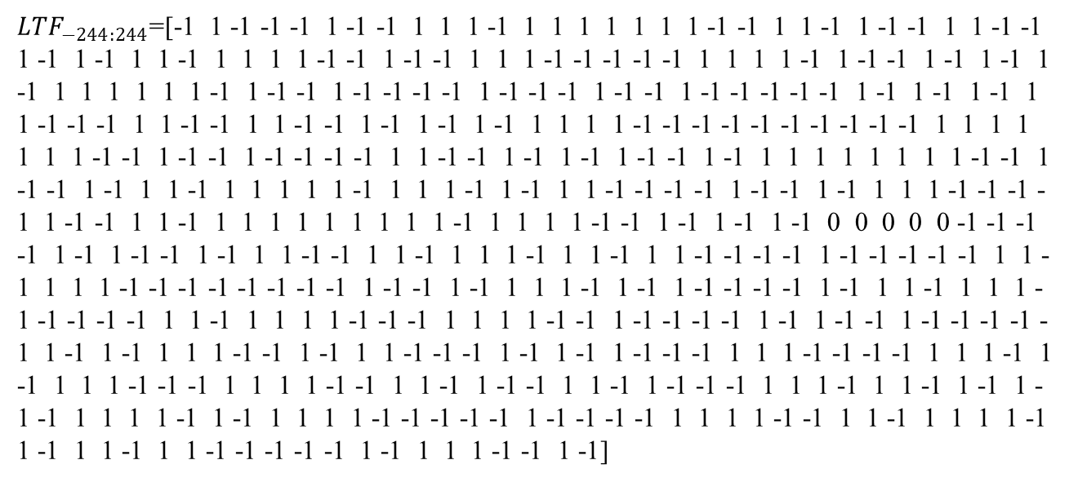
40 MHz DRU 4xLTF Sequence
${LTF}_{−244:244}$=[-1 1 -1 -1 -1 1 -1 -1 1 1 1 -1 1 1 1 1 1 1 1 -1 -1 1 1 -1 1 -1 -1 1 1 -1 -1 1 -1 1 -1 1 1 -1 1 1 1 1 -1 -1 1 -1 -1 1 1 1 -1 -1 -1 -1 -1 1 1 1 1 -1 1 -1 -1 1 -1 1 -1 1 -1 1 1 1 1 1 1 -1 1 -1 -1 1 -1 -1 -1 -1 1 -1 -1 -1 1 -1 -1 1 -1 -1 -1 -1 -1 1 -1 1 -1 1 -1 1 1 -1 -1 -1 1 1 -1 -1 1 1 -1 -1 1 -1 1 -1 1 -1 1 1 1 1 -1 -1 -1 -1 -1 -1 -1 -1 -1 -1 1 1 1 1 1 1 1 -1 -1 1 -1 -1 1 -1 -1 -1 -1 1 1 -1 -1 1 -1 1 -1 1 -1 -1 1 -1 1 1 1 1 1 1 1 1 -1 -1 1 -1 -1 1 -1 1 1 -1 1 1 1 1 1 -1 1 1 1 -1 1 -1 1 1 -1 -1 -1 -1 1 -1 -1 1 -1 1 1 1 -1 -1 -1 -1 1 -1 -1 1 1 -1 1 1 1 1 1 1 1 1 1 -1 1 1 1 1 -1 -1 1 -1 1 -1 1 -1 0 0 0 0 0 -1 -1 -1 -1 1 -1 1 -1 -1 1 -1 1 1 -1 -1 1 1 -1 1 1 1 -1 1 1 -1 1 1 -1 -1 -1 -1 1 -1 -1 -1 -1 -1 1 1 -1 1 1 1 -1 -1 -1 -1 -1 -1 -1 -1 1 -1 -1 1 -1 1 1 1 -1 1 -1 1 -1 -1 -1 -1 1 -1 1 1 -1 1 1 1 -1 -1 -1 -1 -1 1 1 -1 1 1 1 1 -1 -1 -1 1 1 1 1 -1 -1 1 -1 -1 -1 -1 1 -1 1 -1 -1 1 -1 -1 -1 -1 -1 1 -1 1 -1 1 1 1 -1 -1 1 -1 1 1 -1 -1 -1 1 -1 1 -1 1 -1 -1 -1 1 1 1 -1 -1 -1 -1 1 1 1 -1 1 -1 1 1 1 -1 -1 -1 1 1 1 1 -1 -1 1 1 -1 1 -1 -1 1 1 -1 1 -1 -1 -1 1 1 1 -1 1 1 -1 1 -1 1 -1 -1 1 1 1 1 -1 1 -1 1 1 1 1 -1 -1 -1 -1 -1 1 -1 -1 -1 -1 1 1 1 1 -1 -1 1 1 -1 1 1 1 1 -1 1 -1 1 1 -1 1 1 -1 -1 -1 -1 -1 1 -1 1 1 1 -1 -1 1 -1]

Slide 5
40 MHz DRU 4xLTF Sequence Performance Evaluation
Worst case PAPR (dB) for Max Nss=2 of the new proposal
 | 1 | 2 | 3 | 4 | 5 | 6 | 7 | 8 | 9 | 10 | 11 | 12 | 13 | 14 | 15 | 16 | 17 | 18 | max
DRU26 | 3.94 | 3.94 | 3.41 | 3.76 | 4.01 | 3.97 | 3.9 | 3.79 | 3.95 | 3.97 | 3.99 | 3.92 | 3.98 | 3.74 | 3.89 | 3.89 | 3.87 | 3.91 | 4.01
DRU52 | 3.99 |  | 3.98 |  |  | 3.99 |  | 3.93 |  | 3.97 |  | 4.07 |  |  | 3.63 |  | 4.04 |  | 4.07
DRU106 | 4.66 |  |  |  |  | 4.75 |  |  |  | 4.71 |  |  |  |  | 4.74 |  |  |  | 4.75
DRU242 | 5.31 |  |  |  |  |  |  |  |  | 5.31 |  |  |  |  |  |  |  |  | 5.31
Worst case PAPR (dB) for Max Nss=2 with DRU LTF sequence in[4]
 | 1 | 2 | 3 | 4 | 5 | 6 | 7 | 8 | 9 | 10 | 11 | 12 | 13 | 14 | 15 | 16 | 17 | 18 | max
DRU26 | 3.87 | 3.89 | 3.79 | 3.87 | 3.87 | 3.90 | 3.89 | 3.80 | 3.84 | 3.52 | 3.68 | 3.85 | 3.73 | 3.45 | 3.85 | 3.79 | 3.67 | 3.89 | 3.90
DRU52 | 4.13 |  | 4.01 |  |  | 4.07 |  | 4.09 |  | 4.14 |  | 3.88 |  |  | 3.89 |  | 4.03 |  | 4.14
DRU106 | 5.17 |  |  |  |  | 5.19 |  |  |  | 5.19 |  |  |  |  | 5.26 |  |  |  | 5.26
DRU242 | 5.36 |  |  |  |  |  |  |  |  | 5.38 |  |  |  |  |  |  |  |  | 5.38

Slide 6
Conclusion
Our DRU LTF sequences demonstrate improved PAPR performance, effectively reducing potential signal distortions and enhancing transmission quality and channel estimation results.

Slide 7
References
[1] 24/11-24-0468-01-00bn-dru-tone-plan-for-11bn
[2] 24/11-24-1230-01-00bn-pilot-tone-design-in-dru-transmission
[3] 24/11-24-1540-00-00bn-power-imbalance-issue-analysis-for-dru
[4] 24/11-24-1567-00-00bn-ltf-design-for-dru

Slide 8
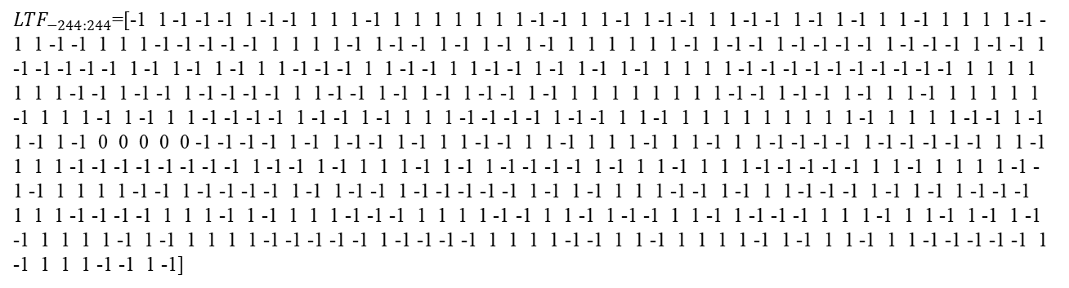
SP1
Do you agree to include the proposed 40MHz DBW 4xLTF sequence design for DRU in the 11bn SFD
${LTF}_{−244:244}$=[-1 1 -1 -1 -1 1 -1 -1 1 1 1 -1 1 1 1 1 1 1 1 -1 -1 1 1 -1 1 -1 -1 1 1 -1 -1 1 -1 1 -1 1 1 -1 1 1 1 1 -1 -1 1 -1 -1 1 1 1 -1 -1 -1 -1 -1 1 1 1 1 -1 1 -1 -1 1 -1 1 -1 1 -1 1 1 1 1 1 1 -1 1 -1 -1 1 -1 -1 -1 -1 1 -1 -1 -1 1 -1 -1 1 -1 -1 -1 -1 -1 1 -1 1 -1 1 -1 1 1 -1 -1 -1 1 1 -1 -1 1 1 -1 -1 1 -1 1 -1 1 -1 1 1 1 1 -1 -1 -1 -1 -1 -1 -1 -1 -1 -1 1 1 1 1 1 1 1 -1 -1 1 -1 -1 1 -1 -1 -1 -1 1 1 -1 -1 1 -1 1 -1 1 -1 -1 1 -1 1 1 1 1 1 1 1 1 -1 -1 1 -1 -1 1 -1 1 1 -1 1 1 1 1 1 -1 1 1 1 -1 1 -1 1 1 -1 -1 -1 -1 1 -1 -1 1 -1 1 1 1 -1 -1 -1 -1 1 -1 -1 1 1 -1 1 1 1 1 1 1 1 1 1 -1 1 1 1 1 -1 -1 1 -1 1 -1 1 -1 0 0 0 0 0 -1 -1 -1 -1 1 -1 1 -1 -1 1 -1 1 1 -1 -1 1 1 -1 1 1 1 -1 1 1 -1 1 1 -1 -1 -1 -1 1 -1 -1 -1 -1 -1 1 1 -1 1 1 1 -1 -1 -1 -1 -1 -1 -1 -1 1 -1 -1 1 -1 1 1 1 -1 1 -1 1 -1 -1 -1 -1 1 -1 1 1 -1 1 1 1 -1 -1 -1 -1 -1 1 1 -1 1 1 1 1 -1 -1 -1 1 1 1 1 -1 -1 1 -1 -1 -1 -1 1 -1 1 -1 -1 1 -1 -1 -1 -1 -1 1 -1 1 -1 1 1 1 -1 -1 1 -1 1 1 -1 -1 -1 1 -1 1 -1 1 -1 -1 -1 1 1 1 -1 -1 -1 -1 1 1 1 -1 1 -1 1 1 1 -1 -1 -1 1 1 1 1 -1 -1 1 1 -1 1 -1 -1 1 1 -1 1 -1 -1 -1 1 1 1 -1 1 1 -1 1 -1 1 -1 -1 1 1 1 1 -1 1 -1 1 1 1 1 -1 -1 -1 -1 -1 1 -1 -1 -1 -1 1 1 1 1 -1 -1 1 1 -1 1 1 1 1 -1 1 -1 1 1 -1 1 1 -1 -1 -1 -1 -1 1 -1 1 1 1 -1 -1 1 -1]

