Slide 1
NPCA Hidden Node Problem
Date: 2024-11-13
Authors:

Slide 2
Introduction
In 11bn, NPCA enables efficient channel utilization by switching to NPCA primary channel when an OBSS occupies a BSS’s Primary 20 MHz channel [1].
In several cases, a Hidden Node problem may occur during NPCA operation [3].
  Especially, an OBSS STA initiates a TXOP with (MU-)RTS/CTS exchange, the CTS has no information about bandwidth/channel on which occupied by the OBSS, the NPCA operation may interrupt the OBSS’s transmission.
In this contribution, the Hidden Node problem during NPCA operation and a possible solution will be discussed.

Slide 3
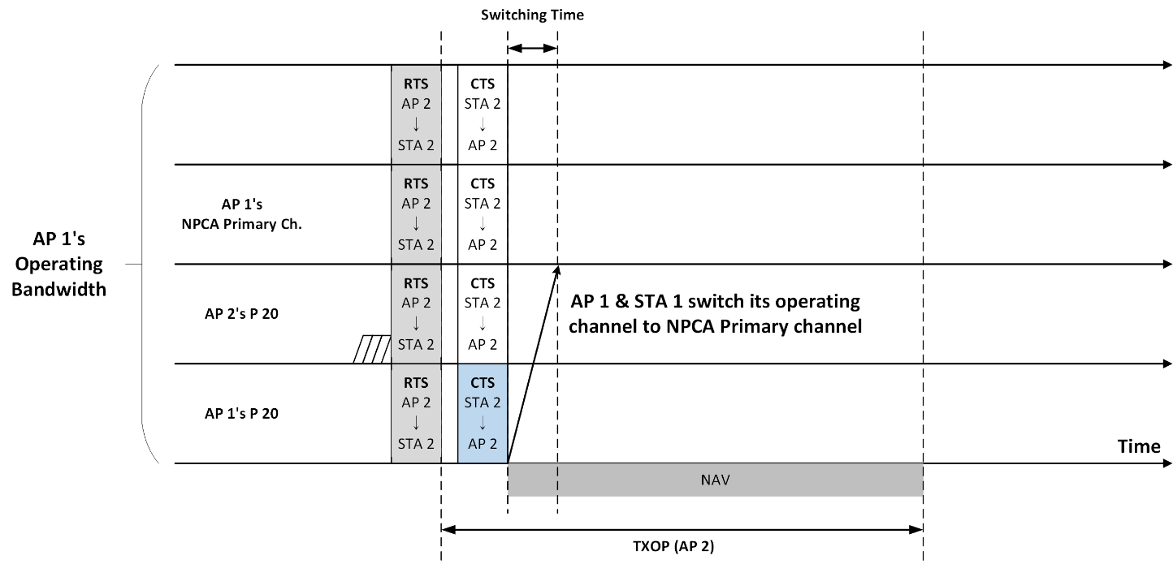
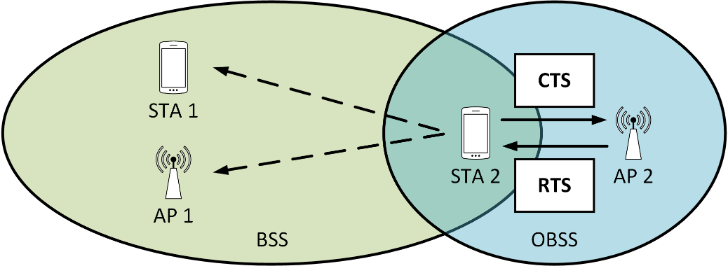
Hidden Node Problem during NPCA
In the figure below, the AP 1 and the STA 1 operate in a BSS, and the AP 2 and the STA 2 operate in an OBSS.
the AP 2 sends RTS to the STA 2 within wider bandwidth including P 20 of BSS 1, P 20 of BSS 2 and NPCA Primary channel of BSS 1.
After the STA 2 receives the RTS, the STA 2 responses with CTS which has same bandwidth/channel with the RTS from the AP 2.
In this case, the AP 1 and the STA 1 can decode the CTS from the STA 2 on the BSS 1’s P 20 and intend to proceed with NPCA operation.

Slide 4
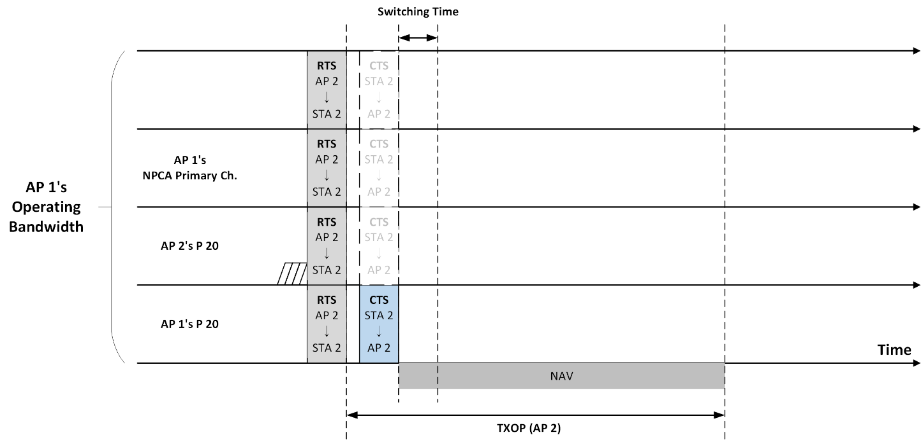
Hidden Node Problem during NPCA (cont’d)
Unfortunately, a CTS frame does not have information about bandwidth/channel which is occupied by the CTS.
In the figure below, the AP 1 and the STA 1 only decoded the CTS from the STA 2 on the BSS 1’s P 20.
So, the AP 1 and the STA 1 may not able to know the bandwidth/channel occupied by the CTS [3].

Slide 5
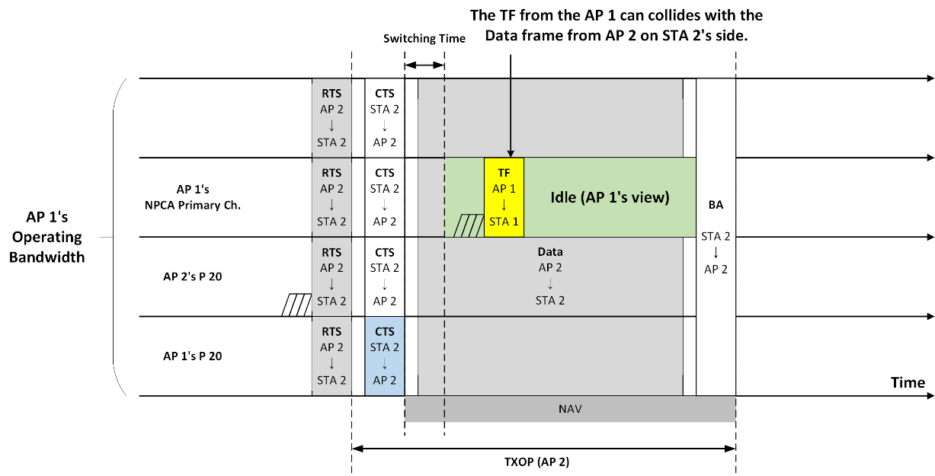
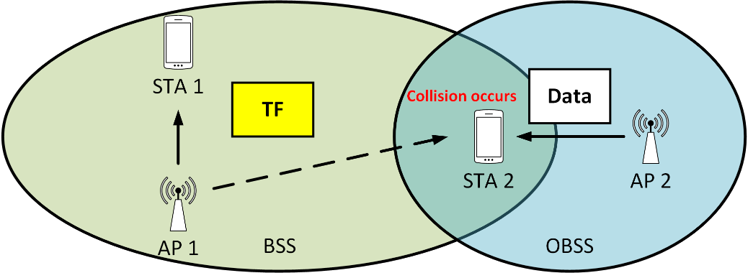
Hidden Node Problem during NPCA (cont’d)
After the AP 1 and the STA 1 switch to the NPCA primary channel and perform channel access, the AP 1 transmits a Trigger Frame (TF) to the STA 1.
However, this TF may collide with the Data frame transmitted by the AP 2 on the STA 2’s side.

Slide 6
Possible Solution
To solve the Hidden Node issue during NPCA, an UHR STA needs to know whether the received OBSS’s frame occupies the NPCA Primary channel or not, prior to switch its operating channel.
This can be achieved by an UHR STA checks the bandwidth/channel on which the OBSS’s frame was transmitted across its operating bandwidth/channel including the NPCA Primary channel.
  E.g., check the CCA results during the CTS transmission time across its operating bandwidth/channel including NPCA Primary channel.
  This is similar with the wider channel access procedure in the baseline.
    Wider channel access procedure also check the CCA result whether the secondary channel was idle during aPIFSTime right before a transmission or not.

Slide 7
Possible Solution (cont’d)
With the solution above, there are several cases according to the received OBSS’s frame.
  Case 1. An UHR STA only received CTS.
  Case 2. An UHR STA received both RTS and CTS.

Slide 8
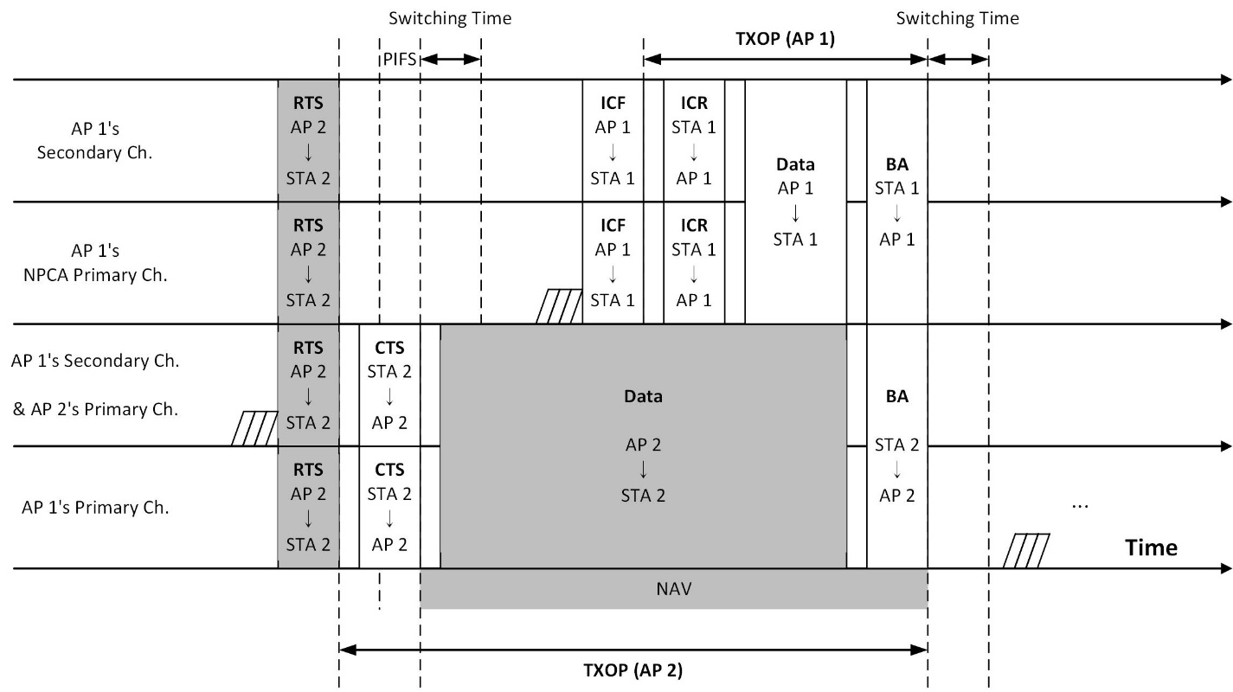
Possible Solution with Case 1
Case 1. An UHR STA only received CTS.
  The AP 1 and the STA 1 check the CCA result during the CTS transmission time across its operating bandwidth/channel including NPCA Primary channel.

Slide 9
Possible Solution with Case 1
Case 1. An UHR STA only received CTS.
  So, the AP 1 and the STA 1 know the bandwidth/channel wherein the CTS was transmitted.
  Then, the AP 1 and the STA 1 switch to the NPCA Primary channel.

Slide 10
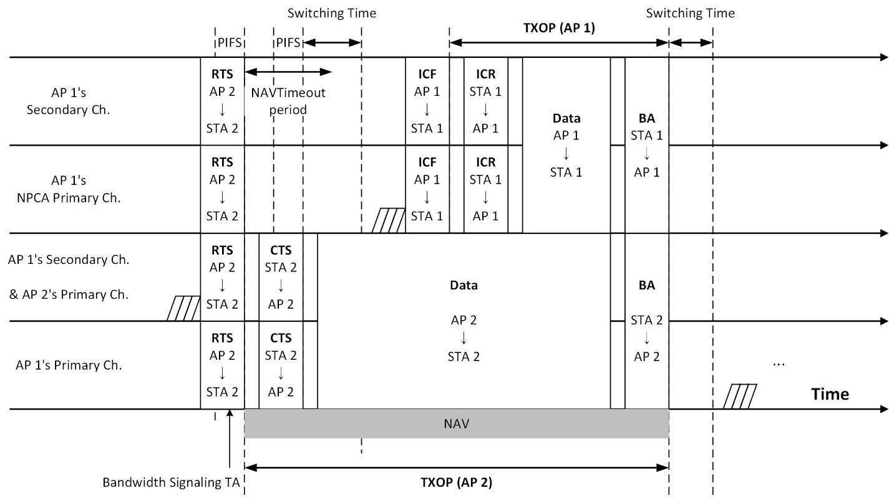
Possible Solution with Case 2
Case 2. An UHR STA received both RTS and CTS.
  After the AP 1 and the STA 1 received RTS, maybe the RTS has Bandwidth Signaling TA, so the AP 1 and STA 1 know the bandwidth/channel wherein the RTS was transmitted.

Slide 11
Possible Solution with Case 2 (cont’d)
Case 2. An UHR STA received both RTS and CTS.
  However, the CTS could be transmitted using narrow bandwidth/channel than the RTS, So, the AP 1 and the STA 1 also need to check the CCA results during the CTS transmission time.

Slide 12
Summary
In this contribution, the Hidden Node problem identified that may occur during NPCA operations.
  If RTS/CTS was received from OBSS, a frame (TF) sent through NPCA Primary channel might collide with a frame transmitted in the OBSS.
To address the Hidden Node issue, a solution to check the bandwidth/channel on which the OBSS’s frame was transmitted was proposed.

Slide 13
Straw Poll
Do you agree that TGbn supports a procedure to check the channel status of NPCA Primary channel before switching to NPCA Primary channel?
Y / N / A

Slide 14
References
[1] 11-24-0209-05-00bn-specification-framework-for-tgbn
[2] 11-24-0427-00-00bn-enabling-non-primary-channel-access
[3] 11-24-1093-01-00bn-special-scenarios-in-non-primary-channel-access

