Slide 1
Proposals for AP Discovery and Evaluation for Initial Association and Roaming
Date: 2024-12-02
Authors:

Slide 2
Abstract
Discuss some considerations and proposals to facilitate effective and expedited discovery of neighborhood APs by a client device (Non-AP STA) for initial association and roaming.

Slide 3
Motivation
Discovery and evaluation of neighbor APs / AP MLDs by a Non-AP device is a crucial component in choosing target APs for initial association / roaming
Conventionally, a Non-AP device performs autonomous OTA channel scans (active / passive) to discover neighbor APs / AP MLDs
OTA channel scans are expensive in time and power consumption; executing channel scans in 2.4/5/6 GHz bands may take a few seconds to complete
OTA scanning disrupts low latency transmission → Adds delays to low latency transmissions
Complete Beacon or Probe Response content is available to evaluate whether a discovered AP is suitable as a roaming target AP. The Beacon / Probe Response contains many unnecessary parameters
Hence, it is desirable to devise schemes to efficiently discover neighbor APs / AP MLDs by a Non-AP:
Data radio is available all the time for data transmissions, no additional delays caused by OTA scanning
non-AP STA power consumption is minimized
Key idea – An associated AP (referred to as Reporting AP) provides necessary information of (non-co-located) neighbor APs / AP MLDs to a Requesting Non-AP STA
Non-associated STAs request neighbor AP parameters by sending a probe request requesting neighbor parameters to the Reporting AP

Slide 4
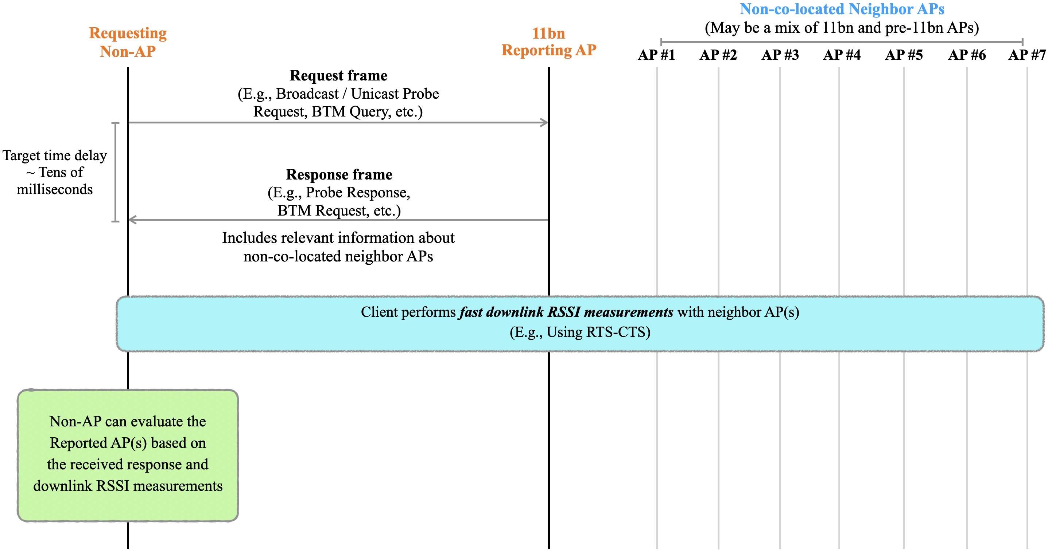
Overarching Goal
Key takeaway — A Non-AP can discover multiple neighbor APs, obtain relevant information about the APs, and create / maintain candidate AP(s) with a single frame exchange with Reporting AP

Slide 5
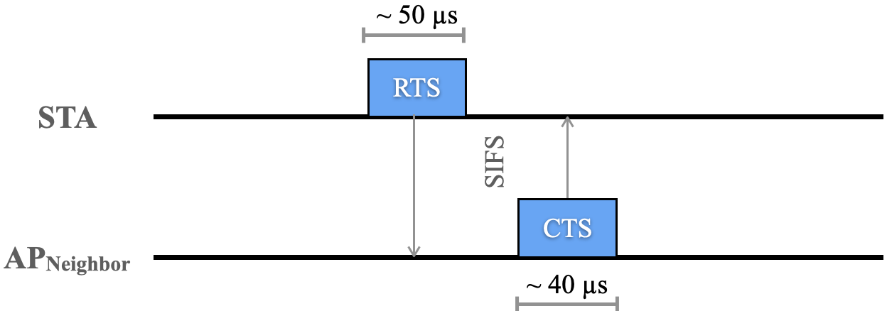
Fast OTA Scanning
A STA obtains all required AP parameters from serving AP
STA does not perform OTA scanning for the AP, only OTA DL RSSI measurement is needed
STA minimizes the OTA operation duration at the neighbor AP channel
Proposal: STA uses RTS-CTS frames to measure DL RSSI from Reported APs
RTS-CTS are Class-1 control frames that can be exchanged between a STA and an unassociated (and unauthenticated) AP
STA sends RTS to AP_{Neighbor}; STA measures RSSI _{APNeighbor → STA} from the CTS response
Benefits:
Simple framework, supported in current standards
Overhead of RSSI measurement is minimal; ~100s of microseconds per neighbor AP; maximized availability for the associated AP
Similar RSSI measurement accuracy as beacon / probe response frames;
RSSI measured over the preamble (L-LTF field) of the frames (in the PHY header) and all these frames are transmitted with robust rates

Slide 6
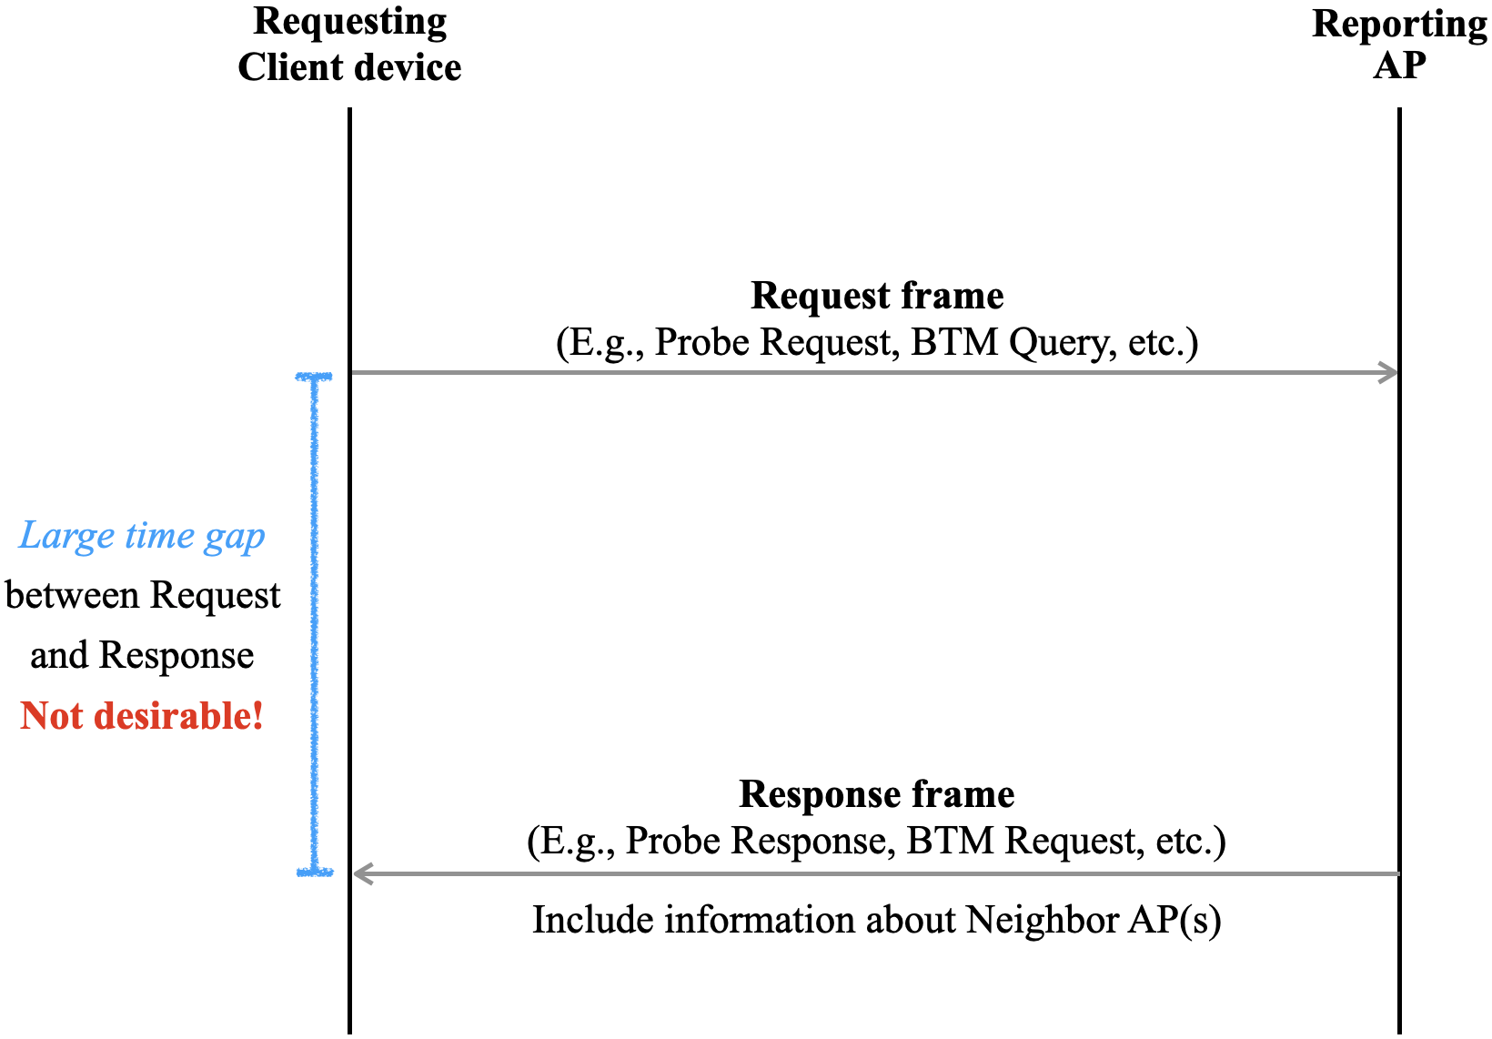
Time Delay Between Request and Response (1)
Goal of the proposed framework — STA receives information about neighbor non-co-located APs through the Reporting AP without incurring a significant delay
Time delay between a request from Client device and a response from Reporting AP should not be inordinately high
As the delay grows higher, the benefits of getting parameters through associated AP are diluted since STA will perform legacy OTA active scans
For example, we have observed time delay in the order of hundreds of milliseconds between when a Client device issues a BTM Query and when Reporting AP responds with a BTM Request

Slide 7
Time Delay Between Request and Response (2)
Proposal: The Reporting AP has an upper bound on the time delay between Request for Neighbor AP information and the corresponding Response
The upper bound on this delay may be in the order of tens of milliseconds (exact value is TBD)
This delay is specified in 802.11 spec and tested in Wi-Fi Alliance
If the delay is stringent, the Reporting AP may provide cached information about Neighbor AP(s) to meet the delay bound
This may be acceptable since static information about Neighbor AP(s) is useful and likely not change over time
Fast response should the primary goal
If the dynamic information about Neighbor AP(s) is indeed old, it can be reflected in a metric that quantifies the age of such information
Client may perform appropriate actions based on the age; for example, perform directed scans for those Neighbor AP(s) for which the information is old, etc.

Slide 8
Motivation – Content of Discovery Information
Some mechanisms already exist in baseline spec that somewhat address our goal:
Reduced Neighbor Report (RNR)
Neighbor Report in BSS Transition Management
Multi-link Probe Request / Response
However, a few key limitations exist for the existing schemes, as described below:
Information contained is either too little (forcing Non-AP to perform additional OTA channel scans) or too much (resulting in wastage of precious medium airtime)
Reporting AP includes information about only those APs that are co-located with the same AP MLD as the Reporting AP (a behavior that we have observed in the field, even though spec does not impose such a limitation)
Objectives and Targets of the discovery information content:
Communicate information about non-co-located neighboring APs / AP MLDs in response to a Request received from a Requesting Non-AP STA
Identify a minimum set of attributes that are relevant for initial link setup / roaming and communicate only that set to the Requesting Non-AP to minimize overhead
The minimum set will serve associated and non-associated STAs
Due to non-AP STA privacy reasons, non-associated STAs cannot request parameters clear OTA
It is better to get complete set of parameters, if the desired minimum set of parameters is not available

Slide 9
Key Considerations
The Reporting AP provides the information about neighbor APs / AP MLDs only in response to a request received from a Non-AP
We do not envision this information to be carried always in Beacons, etc., of the Reporting AP, which may otherwise result in gratuitous bloating of such frames
The response from the Reporting AP contains only those attributes about neighboring APs / AP MLDs that are necessary for a Non-AP to perform candidate AP selection for initial link setup, roaming, etc.
A client device likely does not need the full information about neighbor APs / AP MLDs (present in Beacons / Probe Response frames) to perform selection of candidate AP(s) for initial association / roaming
The content of the response from the Reporting AP should be applicable to both unassociated and associated client devices
The information may be carried in any frame – Probe Response, (unsolicited) BTM Request, etc. sent by the Reporting AP
The attributes of interest to a Non-AP for evaluation of neighbor APs / AP MLDs are listed in the next slide
The response from the Reporting AP may include information about legacy (pre-11bn) neighbor APs / AP MLDs, in addition to 11bn AP MLDs
Providing such information is useful for a Non-AP, especially in the context of initial association

Slide 10
Modified RNR Format (Example)
Example of how Reduced Neighbor Report (RNR) can be updated to carry relevant information about neighbor APs / AP MLDs
TBTT Information Field Type = 0, Length subfield = 23 (currently reserved in 11be)
TBTT Offset (1 byte)
BSSID (6 bytes)
Short SSID (4 bytes)
Neighbor AP Static Attributes (5 bytes)
Co-located
PHY Type
Security Protocol Support Bitmap
IP Address Continuity
Highest NSS
UPR Active
20 MHz PSD
Neighbor AP Dynamic Attributes (4 bytes)
BSS Operating BW
Channel Utilization + Station Count
Association Disallowed
Timestamp of Information Collection
AP MLD ID (1 byte)
SMD ID (1 byte) or Same SMD ID (1 bit)
Proposed new fields to be added to the existing RNR element

Slide 11
Security Protocol Support of Neighbor APs
Goal: Communicate the security protocol (WPA3, WPA2, etc.) supported by each Neighbor / Reported AP
WPA2, WPA3, etc., are terms used by the Wi-Fi Alliance; need to indicate the corresponding AKM Suite Selector(s) for each Reported AP
A Client device typically uses security protocol supported by discovered APs / networks to evaluate them for favorability for initial association and roaming
Example order of preference: Enterprise > PSK > Open, WPA3 > WPA2 > WPA > WEP
An AP may indicate support for several AKM Suites in RSN element; each AKM Suite is represented using 4 octets (see figure below) → Signaling all supported AKM suites (N) entails a high overhead (4*N octets)
To rank/evaluate/select candidate APs, knowledge of security protocols / AKM Suites supported by Neighbor AP(s) should suffice
Problem Statement: Efficiently communicate the list of AKM Suites supported by each neighbor AP
RSNE format

Slide 12
Proposal: Security Protocol Support Bitmap
Security Protocol ID | Wi-Fi Security Protocol | AKM Suite ID (Table 9-190 in REVme_D7.0)
1 | WPA-Enterprise / WPA2-Enterprise (802.1X) | 00-0f-ac-01
2 | WPA-Personal / WPA2-Personal (PSK) | 00-0f-ac-02
3 | WPA2-Enterprise with FT (802.1X + FT) | 00-0f-ac-03
4 | WPA2-Personal with FT (PSK + FT) | 00-0f-ac-04
5 | WPA3-Personal (SAE) | 00-0f-ac-08
6 | WPA3-Enterprise (SAE) | 00-0f-ac-12
7 | WPA3-Personal with FT (SAE + FT) | 00-0f-ac-09
8 | WPA3-Enterprise with FT | 00-0f-ac-13
9 | WPA3-Enterprise Suite-B (192 bit) | 00-0f-ac-14
10 | WPA3-Enterprise Suite-B (192 bit) with FT | 00-0f-ac-24
11 | Opportunistic Wireless Encryption (OWE) | 00-0f-ac-25
Assign a unique ID (named Security Protocol ID) that identifies an AKM Suite supported by the Reported AP
Reporting AP includes a bitmap (3 octets) named Security Protocol Support Bitmap for each Reported AP
Set 1 for each bit position (starting from LSB) corresponding to the Security Protocol ID(s) supported by the Reported AP
Example: Security Protocol Support Bitmap set as 0x8 0x8 01010101 → Reported AP supports WPA2-Enterprise (with and without FT), WPA3-Personal (with and without FT)
Set Security Protocol Support Bitmap as all 0s if the Reported AP does not support any of the listed security protocols
Client device can deduce the AKM Suite(s) supported by the Reported AP by inspecting the bitmap

Slide 13
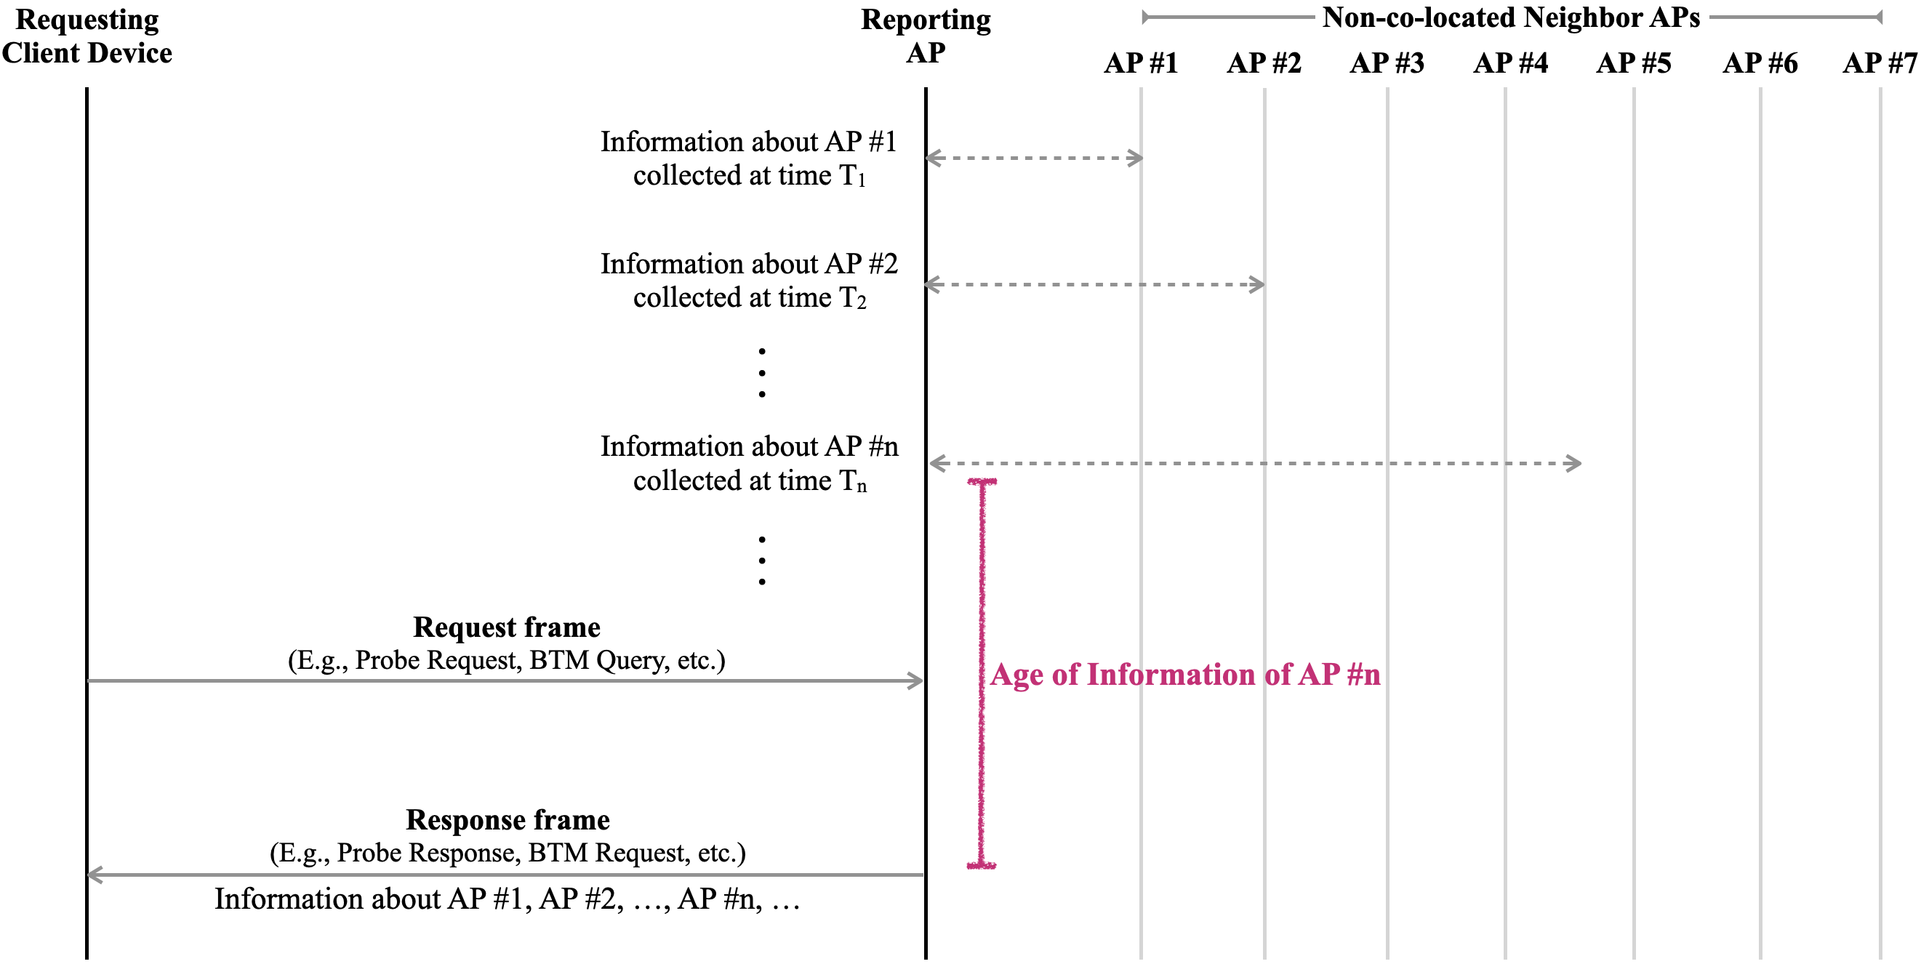
Freshness of Information About Reported AP(s)
Desirable for Non-AP STA to know when information about AP #n was collected, along with the relevant attributes

Slide 14
Proposal: Timestamp of Information Collection and Updated Attributes Bitmap
Add an attribute named “Age of Information Collection” for each Reported AP
Age of Information Collection is the number of TBTTs since one or more of the Dynamic Attributes of the Reported AP were obtained from the reported AP:
Channel Utilization + STA Count (as in BSS Load element)
Association Disallowed
BSS Parameters Change Count
Timestamp value may be in units of 5 Beacon intervals to allow relaxed information updates for the APs

Slide 15
Conclusion
The purpose of this contribution is many-fold:
Highlight the benefits of obtaining non-co-located neighbor APs / AP MLDs information through the serving AP
Minimized OTA scanning time with fast RSSI measurements between Non-AP and the Reported APs
Lower delays for low-latency traffic
Reduced non-AP STA power consumption
Clearly spell out requirements to make the scheme relevant for non-AP STAs
Fast responses
No need for additional OTA scanning
Indicate the age of information collection for each Reported AP
Identify a set of attributes that are relevant to Non-AP to choose target AP(s) for initial association / roaming and include only those attributes in the response from Reporting AP
Such information aids client devices in making educated decisions during initial-link-setup, roaming, etc., while entailing minimal overhead

Slide 16
Straw Poll
Do you support that an AP (referred to as Reporting AP) communicates information it has about non-co-located neighbor APs / AP MLDs (referred to as Reported APs) in response to a request received from a Non-AP device to help the Non-AP device in discovery and evaluation of the Reported APs as targets for initial association / roaming?
Note: The Non-AP device requesting such information may or may not be associated with the Reporting AP
Y:
N:
A:

Slide 17
APPENDIX: Relevant Attributes of Neighbor APs / AP MLDs
Assumption – Reporting AP may be aware of Legacy AP(s) in its neighborhood, not just 11bn AP MLD(s)
Roaming Phase | Attributes of interest | Notes
Discovery | TBTT Offset | Client may receive Beacon from Reported AP, if needed
 | BSSID | Identity of the Reported AP
 | Short SSID
 | Co-located AP | Reported AP is co-located (or not) with the Reporting AP
 | IP Address Continuity | Client can maintain the same IP address when moving from Reporting AP to Reported AP
 | UPR Active | Client may receive UPR from Reported AP in 6 GHz, if needed
 | 20 MHz PSD | Governs the transmit power of the Non-AP when transmitting frames to the Reported AP prior to association
 | AP MLD ID | Identity of AP MLD with which the Reported 11be AP is affiliated
 | SMD ID | Identity of the Seamless Mobility Domain (SMD) to which the Reported 11bn AP is affiliated
Evaluation | PHY Type (11bn, 11be, 11ax, …) | Estimate achievable DL throughput from Reported AP
 | BSS Operating BW
 | Highest NSS
 | BSS Load + STA Count
 | Association Disallowed | Eliminate Reported AP as a candidate if association is disallowed
 | Security Protocol Support (Support of AKM Suites) | Indicate the security protocols / AKM suites supported by the Reported AP

