Slide 1
OBSS Bandwidth Ambiguity in NPCA
Date: 2024-11-09
Authors:

Slide 2
Recap
Non-Primary Channel Access (NPCA) feature in UHR enables an AP and a non-AP STA to communicate on a nonprimary channel when the primary channel is busy due to OBSS traffic
TGbn has agreed to the following:
  TGbn defines a mode of operation that enables a STA to access the secondary channel while the primary channel is known to be busy due to OBSS traffic or other TBD conditions.
    The mode of operation shall not assume that the STA is capable to detect or decode a frame and obtain NAV information of the secondary channel concurrently with the primary channel.
    A BSS shall only have a single NPCA primary channel (name TBD) on which the STA contends while the primary channel of the BSS is known to be busy due to OBSS traffic or other TBD conditions.

Slide 3
Determining the bandwidth of RTS/CTS frames
When an OBSS transmission preceded with an RTS/CTS frame is received, before switching to NPCA Primary, an NPCA STA must perform the following:
  Classify the PPDU carrying the RTS/CTS frame as an inter-BSS or intra-BSS PPDU, and
  Determine bandwidth of OBSS PPDU and whether the OBSS transmission overlaps with the NPCA primary
If the OBSS RTS frame does not include a bandwidth signaling TA, NPCA STAs cannot determine the bandwidth of the OBSS TXOP
  And, therefore, the NPCA STA cannot determine whether the OBSS transmission overlaps with the NPCA primary
  Thus, we propose that if the received OBSS RTS frame does not include a bandwidth signaling TA, NPCA switch to the NPCA primary channel must not be allowed
A CTS frame does not include the Transmitter Address
  Thus, upon receiving a CTS frame an NPCA STA cannot determine
    Whether the SERVICE field carries the bandwidth or not
    In some cases, whether the frame is intra-BSS or inter-BSS
  Thus, we propose that if a CTS frame is received without receiving the soliciting (MU)RTS frame, NPCA switch to the NPCA primary channel must not be allowed

Slide 4
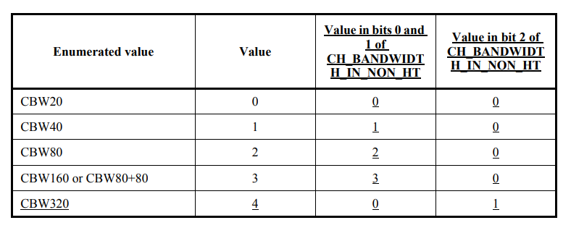
Ambiguity in 320 MHz signaling
When an NPCA STA classifies a PPDU as inter-BSS PPDU and acquires the bandwidth information from that PPDU
  If the PPDU bandwidth is 160 MHz or less, the NPCA STA can unambiguously determine whether the OBSS PPDU overlaps with NPCA Primary or not
  The same applies if the PPDU bandwidth is 320 MHz and the exact bandwidth configuration (320 MHz-1 or 320 MHz-2) is signaled
  However, when a 320 MHz PPDU is non-HT duplicate and carries an RTS frame, it does not carry the bandwidth configuration
    Which causes ambiguity at the NPCA STA as to whether the NPCA Primary channel is occupied
    For example, for the configuration shown in the adjacent figure, an NPCA STA that receives an RTS frame from an OBSS STA on its BSS Primary and receives the 320 MHz signaling, the NPCA STA cannot distinguish between Case-A and Case-B
Thus, the occupancy of NPCA Primary is ambiguous when a 320 MHz OBSS non-HT dup PPDU carries an RTS frame
  Thus, we propose that if an NPCA STA receives an OBSS RTS frame in a non-HT dup PPDU that indicates a 320 MHz bandwidth, NPCA switch to the NPCA primary channel must not be allowed
BW signaling for RTS

Slide 5
Summary
In this contribution, we highlight the cases where an NPCA STA cannot unambiguously determine whether the OBSS transmission overlaps with the NPCA primary channel
  These cases are:
    When an RTS frame carried in a non-HT duplicate PPDU does not include the bandwidth signaling TA, or
    The RTS frame includes the bandwidth signaling TA and the signaled bandwidth is 320 MHz
    When a CTS frame carried in a non-HT duplicate PPDU is received without receiving the soliciting RTS/MU-RTS frame
We propose that in these cases, a switch to the NPCA primary channel must not be allowed

Slide 6
Straw Poll
Do you agree that:
  if an NPCA STA receives an OBSS RTS frame in a non-HT duplicate PPDU that does not include the bandwidth signaling TA, the NPCA STA shall not switch to the NPCA Primary channel?
  if an NPCA STA receives an OBSS RTS frame in a non-HT duplicate PPDU that includes the bandwidth signaling TA and the signaled PPDU bandwidth is 320 MHz, the NPCA STA shall not switch to the NPCA Primary channel?
  if an NPCA STA receives a CTS frame in a non-HT duplicate PPDU without receiving the soliciting OBSS RTS or OBSS MU-RTS frame, the NPCA STA shall not switch to the NPCA Primary channel?

