Slide 1
Some Details on NPCA Operation
Date: 2025-01-10
Authors:

Slide 2
Introduction
According to the NPCA operation, two main steps are as follows.
  Switching to the NPCA PCH: NPCA AP and NPCA STAs switch from the PCH to the NPCA PCH on detecting an inter-BSS PPDU on the PCH.
  Switching back to the PCH: NPCA AP and NPCA STAs switch back from the NPCA PCH to the PCH before the end of the inter-BSS activity and contend for the PCH.
In this contribution, we point out to some issues when switching to the NPCA PCH and switching back to the PCH, and provide some solutions.

Slide 3
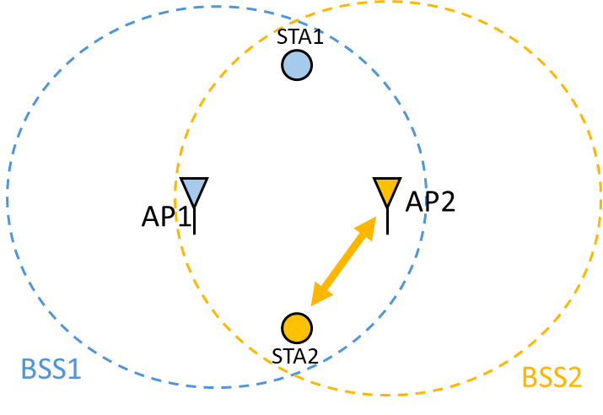
Switching to the NPCA PCH
According to the NPCA baseline operation, if AP-1 and STA-1 in BSS-1 detect an inter-BSS PPDU (e.g., communication in the BSS-2), AP-1 and STA-1 switch from the PCH to the NPCA PCH.
AP-1 and STA-1 may then communicate on the NPCA PCH.
NPCA PCH
ICR
BA
PCH
STA-1
Switch to NPCA PCH
NPCA PCH
ICF
PPDU
PCH
AP-1
Switch to NPCA PCH
NPCA PCH
PCH
BSS-2
Frame exchanges in BSS-2

Slide 4
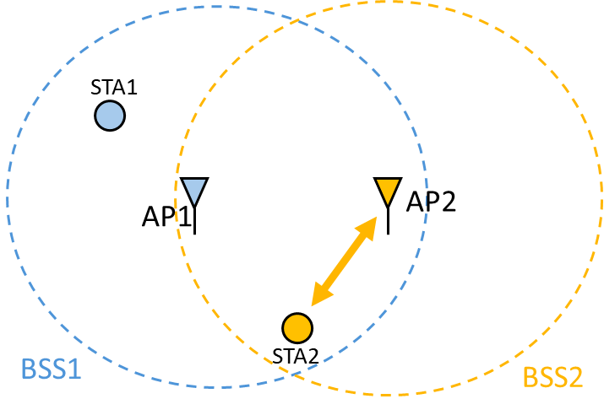
Problem While Switching to the NPCA PCH
If AP-1 detects an inter-BSS PPDU, it switches from the PCH to the NPCA PCH. On the other hand, if STA-1 is outside the communication range of BSS-2, it may not hear the inter-BSS PPDU and stays on the PCH.
AP-1 and STA-1 may not communicate on the NPCA PCH. This results in inefficient use of available resources.
NPCA PCH
PCH
STA-1
Cannot switch to NPCA PCH
NPCA PCH
ICF
PCH
AP-1
Switch to NPCA PCH
NPCA PCH
PCH
BSS-2
Frame exchanges in BSS-2

Slide 5
Some of the Earlier Proposals
According to one approach [1], if there is a control link, the transmitter (e.g., AP1) can indicate on it that it has detected OBSS/or other busy activity and is moving on to the next set of channels.
  → There may not be a control link available between the AP and the STAs
According to another approach [2], each STA/AP keeps a list of OBSS APs that they can hear. If STA1 hears OBSS PPDU of another AP (e.g., AP3, not AP2 that the AP1 can hear), it does not move to NPCA PCH.
→ This approach does not help STA-1 switch to the NPCA PCH when the AP switches
According to another approach [3], OBSS AP (e.g., AP2) queries AP1 of an upcoming OBSS transmission. AP1 responds to this query, and notifies STAs to switch to the NPCA PCH. After that, AP2 starts OBSS transmission.
→ OBSS PPDU transmission may be delayed

Slide 6
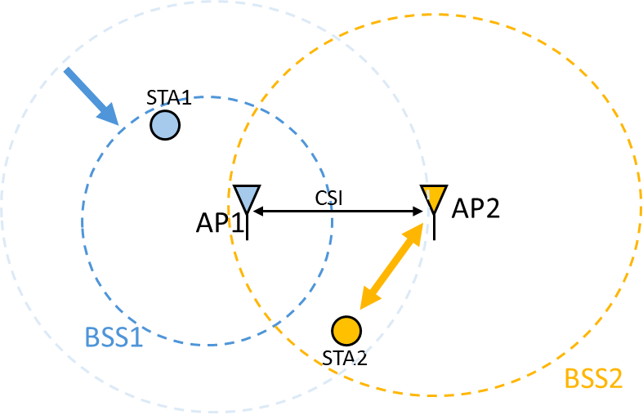
Proposed Approach for Switching to the NPCA PCH
After detecting an inter-BSS PPDU, AP-1 transmits an indication to STA-1 (or to all STAs) on the PCH using spatial reuse (or with lower transmit power) to request STA-1 to switch from the PCH to the NPCA PCH. AP-1 may adjust its transmit power based on prior information of whether each STA is hearing AP-2 or not.
After transmitting the indication, AP-1 switches to the NPCA PCH.
After receiving the indication, STA-1 switches to the NPCA PCH.
NPCA PCH
ICR
BA
PCH
STA-1
Switch to NPCA PCH
NPCA PCH
ICF
PPDU
PCH
AP-1
Ind.
Switch to NPCA PCH
NPCA PCH
PCH
BSS-2
Frame exchanges in BSS-2

Slide 7
Evaluation of the Proposed Approach
Pros:
  STAs that may not hear BSS-2 activity may switch to the NPCA PCH together with AP-1.
  Scenarios such as AP-1 switching to the NPCA PCH and not being able to transmit buffered data can be prevented.
Cons:
  STAs that hear BSS-2 and switch immediately to the NPCA PCH may win channel access before AP-1 (can be addressed with disabling untriggered uplink transmissions).

Slide 8
Switching Back to the PCH
In a different scenario, there may be a STA not switching to NPCA PCH (STA may not support/enable NPCA operation). This STA stays on the PCH while NCPA AP/STAs may switch to the NPCA PCH.
On detecting an inter-BSS PPDU (e.g., transmitted by OBSS AP/STA) and obtaining the NAV duration from the PPDU, UHR AP and STA may set their basic NAVs. While the STA stays on the PCH, UHR AP switches to the NPCA PCH and exchanges frames with its associated STAs that switched to the NPCA PCH.
Before the end of NAV duration, UHR AP may switch back to PCH and may contend for the channel after the basic NAV expires. STA may also contend for the channel after the basic NAV expires.
NPCA PCH
PCH
STA stays on PCH
NAV
STA
NPCA PCH
Frame exchanges between UHR AP and its associated STAs
Switch to PCH
PCH
NAV
UHR AP
Frame
Switch to NPCA PCH
NPCA PCH
PCH
OBSS AP
Frame exchanges between OBSS AP and its associated STAs

Slide 9
Problems due to TXOP Truncation on the PCH
If OBSS AP terminates the communication before the end of the NAV duration, UHR STA being on the NPCA PCH may not switch to the PCH before the end of the NAV duration (since it does not know about the TXOP truncation) and may not contend for the PCH.
STA (e.g., associated with UHR AP) may reset the basic NAV and may win the channel access. STA transmits a frame to UHR AP. STA may not receive a response from the UHR AP.
When UHR AP switches back to the PCH by the end of the NAV duration and contends for the channel, it may not obtain the PCH access (e.g., another STA may already have the channel access).
NPCA PCH
Basic NAV reset
PCH
STA stays on PCH
STA
NAV
Frame
NPCA PCH
Frame exch. between UHR AP and its assoc. STAs
PCH
NAV
Switch to PCH
Cannot obtain the PCH access
UHR AP
Switch to NPCA PCH
NPCA PCH
TXOP truncation
PCH
OBSS AP
Frame exchanges between OBSS AP and its associated STAs

Slide 10
Proposed Solutions for TXOP Truncation on the PCH
OBSS AP does not perform TXOP truncation on the PCH while there is a UHR AP on the NPCA PCH.
  UHR AP may inform OBSS AP in advance that it has enabled NPCA operation.
  UHR AP does not become disadvantageous when it contends for the PCH after switching back.
OBSS AP may inform UHR AP of TXOP truncation on the PCH.
  Informing may be before or after truncation of the TXOP.
  Informing may be via the NPCA PCH (if the NPCA PCH is idle) or via a reserved channel.
  Informing whether before or after truncation of TXOP has its own challenges including transmission by the OBSS AP over the NPCA PCH or unavailability of a reserved channel.
Notes:
Assuming in the same NPCA PCH
PIFS/SIFS operation

Slide 11
Conclusion
In this contribution, we pointed out to some issues when switching to the NPCA PCH and switching back to the PCH, and provided some solutions.
During an OBSS communication, some STAs may not hear the inter-BSS PPDU on the PCH and cannot switch to the NPCA PCH.
  As a solution, NPCA AP may request its associated NPCA STA(s) to switch from the PCH to the NPCA PCH after determining that a PPDU received via the PCH is an inter-BSS PPDU.
If an OBSS AP truncates TXOP on the PCH before the end of the TXOP duration, UHR AP/STAs may not gain channel access after they switch back to the PCH by the end of NAV duration.
  As one solution, OBSS AP may not truncate the TXOP on the PCH if there is an active NPCA operation.
  Alternatively, OBSS AP may inform the UHR AP of TXOP truncation on the PCH.

Slide 12
References
[1] 23/0034r1, Non-primary Channel Utilization
[2] 23/2005r1, Non-primary Channel Access
[3] 24/0318r0, Robust Secondary Channel Access

Slide 13
Straw Poll – 1
Do you agree to add the following text to the TGbn SFD?
TGbn defines a mechanism for an NPCA AP to request its associated NPCA non-AP STAs to switch from the PCH to the NPCA PCH after determining that a PPDU received via the PCH is an inter-BSS PPDU.
  Whether this mechanism is mandatory/optional is TBD.
  Details are TBD.
  Yes
  No
  Abstain
  Y/N/A:

Slide 14
Straw Poll – 2
Do you agree to add the following text to the TGbn SFD?
TGbn defines a mechanism for an NPCA AP to negotiate with an OBSS AP (UHR AP) for the OBSS AP not to truncate TXOP on the PCH if the NPCA AP has enabled NPCA operation.
  Whether this mechanism is mandatory/optional is TBD.
  Details are TBD.
  Yes
  No
  Abstain
  Y/N/A:

Slide 15
Straw Poll – 3
Do you agree to add the following text to the TGbn SFD?
TGbn defines a mechanism for an OBSS AP (a UHR AP) to inform an NPCA AP of TXOP truncation on the PCH.
  Whether this mechanism is mandatory/optional is TBD.
  Details are TBD.
  Yes
  No
  Abstain
  Y/N/A:

