Slide 1
Considerations on Coordinated NPCA
Date: 2024-11-12
Authors:
Name | Affiliations | Address | Phone | Email
Mahmoud Hasabelnaby | Huawei |  |  | Mahmoud.Hasabelnaby@huawei.com
Osama Aboul-Magd
Junghoon Suh
Yan Xin
Sara Norouzi
Notes:
September 2012

Slide 2
Background: NPCA Primary Channel
To meet throughput and latency requirements and further utilize the channel and manage OBSS interference, non-primary channel access (NPCA) was proposed as a potential method [1].
NPCA was proposed in several contributions [2-15] with different problem statement, design principles, high-level concepts, and several options.
Although there are differences in the details of the proposals, there is an alignment on a high-level concept to enable non-primary channel access while the primary channel is busy.
According to Motion #144 [1], the event that triggers switching to the NPCA primary channel shall be
OBSS Control frame exchange (e.g., (MU-)RTS/CTS);
OBSS HE/EHT/UHR PPDU;
Note: Other conditions TBD

Slide 3
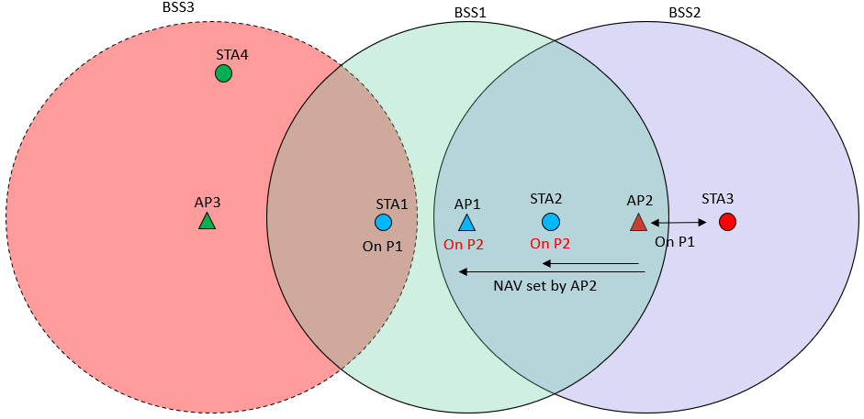
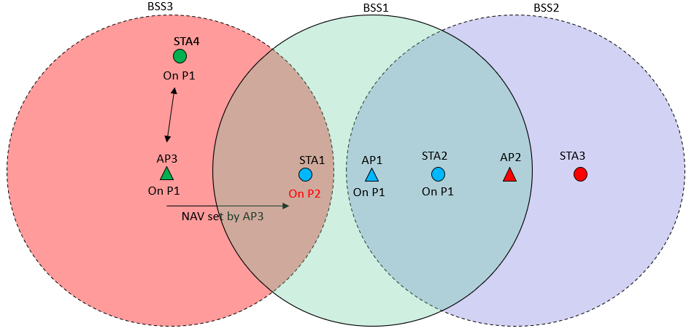
NPCA Identified Issues (1/2)
The lack of coordination between AP and its associated non-AP STA renders NPCA unreliable and inefficient in many scenarios [3-5].
Not all NPCA-enabled STAs in the BSS will transit to the NPCA primary channel, e.g. hidden AP/non-AP STAs are unable to detect interference from neighboring OBSSs.
Case 1: AP1 on the NPCA primary channel while STA1 is still on primary channel.
Case 2: STA1 on the NPCA primary channel while AP1 is still on primary channel.
Case 1
Case 2

Slide 4
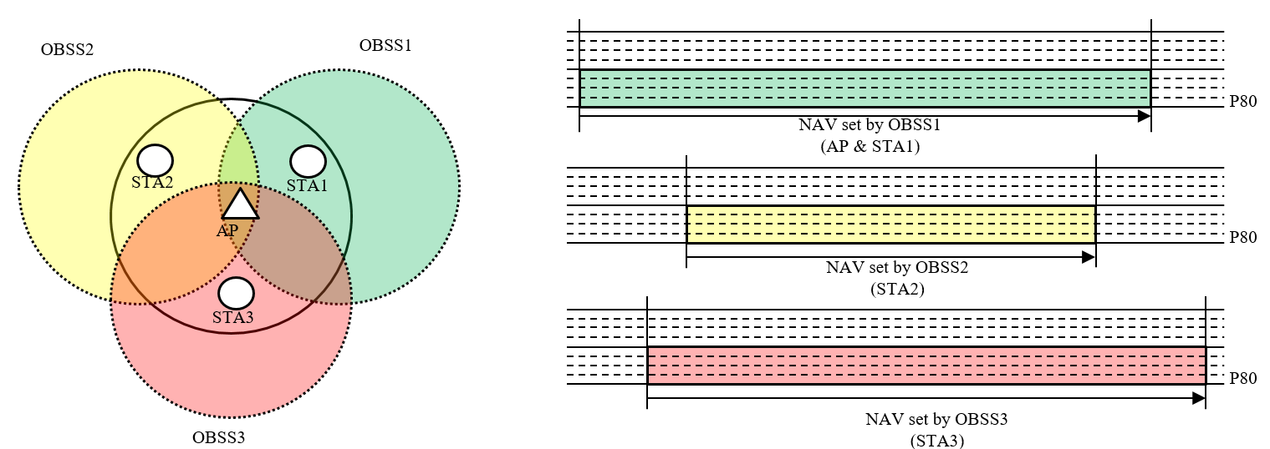
NPCA Identified Issues (2/2)
Different view of OBSS TXOP length [10]
AP and its associated non-AP STAs may be triggered to switch to the NPCA primary channel by different OBSS TXOP, leading to different NPCA duration.
Non-AP STAs with NPCA-enabled capability may switch to the NPCA primary channel and remain there, regardless of their immediate communication needs, then switch back to their primary channel at the end of the OBSS TXOP duration [7].
Unnecessary channel switching may lead to unnecessary power consumption.
While an OBSS transmission is being detected on the primary channel, another OBSS transmission takes place on the NPCA primary channel at the same time [5].
This can happen when multiple OBSSs have overlapping NPCA primary channel locations.

Slide 5
Proposal: Coordinated NPCA
In this contribution, we propose a coordinated NPCA mechanism that enable efficient OBSS interference management.
Inter-BSS coordination between APs within OBSSs and Intra-BSS coordination between APs and their associated non-AP STAs can help resolve various NPCA challenges.
In this contribution, we propose a coordinated NPCA scheme, as discussed next.
Inter-BSS NPCA Coordination
Intra-BSS NPCA Coordination
Co-NPCA Transmission

Slide 6
Inter-BSS NPCA Coordination
During this phase, an NPCA coordination group is established between OBSS APs.
Neighboring APs that enable NPCA operation in their BSSs coordinate selection of their NPCA parameters.
Each AP shares its respective NPCA parameters (e.g., NPCA primary channel location and bandwidth, BSS operating bandwidth, …, etc.) with neighboring APs.
If the NPCA parameters of one AP overlap with those of a neighboring AP, they coordinate to adjust their parameters accordingly, avoiding any OBSS interference—particularly when switching to their respective NPCA primary channels simultaneously.
This coordination guarantees that each AP in the NPCA coordination group operates on a distinct NPCA primary channel, preventing overlap with neighboring APs.

Slide 7
Intra-BSS NPCA Coordination
The associating AP has to (re)announce the location and bandwidth of the NPCA primary channel (if updated) to its NPCA non-AP STAs within its BSS.
Since the BSS is part of NPCA coordination group, the associating AP announces to its associated non-AP STAs that the event triggering STAs switching to the NPCA primary channel is upon being triggered by their associating AP.

Slide 8
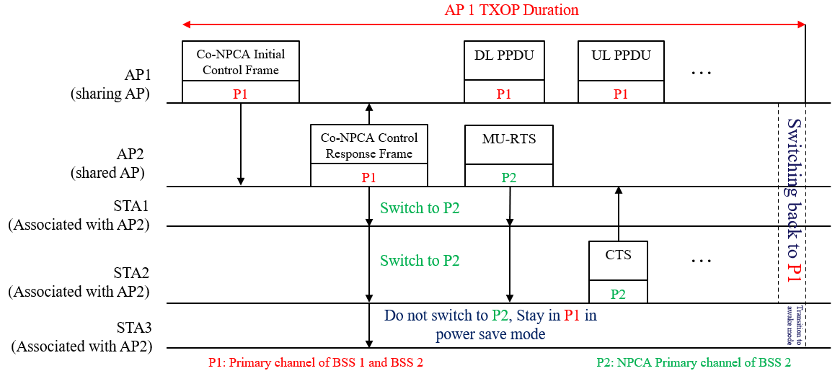
Co-NPCA Transmission (1/2)
When AP1 in the NPCA coordination group obtains a TXOP, it sends a Co-NPCA ICF to other APs in the NPCA coordination group to trigger them to switch to their respective NPCA primary channels.
The duration field of the Co-NPCA ICF frame is set to allow other triggered-APs to trigger their associated NPCA non-AP STAs to switch to the NPCA primary channel.
This solves the hidden node problem.

Slide 9
Co-NPCA Transmission (2/2)
Through the Co-NPCA ICR, AP2 can trigger some or all of its associated NPCA non-AP STAs to transit to the NPCA primary channel based on the immediate communications needs and NPCA duration.
This saves unnecessary power consumption by avoiding unnecessary channel switching.
Within the Co-NPCA ICR, AP2 can determine to its associated non-AP STAs, the NPCA switching time, NPCA duration, and other necessary NPCA parameters.

Slide 10
Summary
The lack of coordination among APs and their associated STAs in OBSSs makes NPCA unreliable and inefficient.
Not all NPCA-enabled STAs will switch to the NPCA primary channel, especially hidden STAs that can't detect interference from neighboring OBSSs.
There is a possibility to have multiple OBSSs with overlapping NPCA primary channels, causing interference when they switch to their NPCA primary channel simultaneously.
Additionally, unnecessary NPCA primary channel switching, resulting in unnecessary power consumption.
Coordination among APs in the OBSSs and AP and its associated STAs can address the aforementioned NPCA challenges.
We proposed a Coordinated NPCA mechanism, in which:
A group of APs in OBSSs forms an NPCA coordination group, in which they agree on the NPCA parameters for each OBSS.
Once one of APs obtains a TXOP, it shares it with other APs included in the NPCA coordination group by sending a Co-NPCA control frame to trigger them to switch to their respective NPCA primary channels.
The shared AP will respond with a Co-NPCA response frame which can be used also as a trigger for its associated STAs to switch to the NPCA primary channel, which solves the hidden node problem.
The design of the response frame will trigger some or all UHR STAs to transit to the NPCA primary channel based on the immediate communications needs, saving unnecessary power consumption by avoiding unnecessary channel switching.

Slide 11
References
11-24/0209r9, “Specification Framework for TGbn,” Ross Jian Yu
11-24/0495r0, “Non-Primary Channel Access (NPCA) – Follow Up,” Minyoung Park
11-23/0495r0, “Non-Primary Channel Access (NPCA),” Minyoung Park
11-24/0318r0, “Robust Secondary Channel Access,” Yanchun Li
11-24/1093r0, “Special scenarios in Non-Primary Channel Access,” Sindhu Verma
11-24/1155r0, “Further discussions on NPCA,” Sanghyun Kim
11-24/1077r0, “Discussions on Non-Primary Channel Access,” Jason Yuchen Guo
11-24/0070r2, “Some details about non-primary channel access,” Yunbo Li
11-24/0486r1, “Some considerations on non-primary channel access,” Ming Gan
11-24/1155r0, “Further discussions on NPCA,” Sanghyun Kim
11-24/0458r1, “Considerations on Non-Primary Channel Access,” Salvatore Talarico
11-23/2023r1, “Further discussion on Non-Primary Channel Access,” Sindhu Verma
11-23/1891r0, “Nonprimary channel access – follow up,” Gaurang Naik
11-24/0042r0, “Flexible Control Frames,” George Cherian
11-24/1256r1, “The Padding After Intermediate FCS”, Yunbo Li

Slide 12
Straw Poll 1
Do you agree to define a mechanism in the 11bn SFD that allows neighboring APs that enable NPCA operation in their BSS to coordinate selection of their NPCA parameters (e.g., NPCA primary channel and bandwidth) when their NPCA primary channels overlap?"
Mechanism’s signaling is TBD.

Slide 13
Straw Poll 2
Do you agree to define a mechanism in the 11bn SFD that enables an AP to trigger a set of OBSS APs to switch to their respective NPCA primary channels when it obtains the TXOP over the primary channel?

Slide 14
Straw Poll 3
Do you agree to include in the 11bn SFD the following in the NPCA operation? – In 802.11bn, the associating AP can trigger its associated non-AP STAs to switch to the NPCA primary channel as one of the triggering events for switching to the NPCA primary channel.

