Slide 1
UHR NDPA Signaling
Date: 2024-11-11
Authors:
Name | Affiliations | Address | Phone | Email
Mahmoud Hasabelnaby | Huawei |  |  | Mahmoud.Hasabelnaby@huawei.com
Junghoon Suh
Osama Aboul-Magd
Yan Xin
Sara Norouzi
Notes:
September 2012

Slide 2
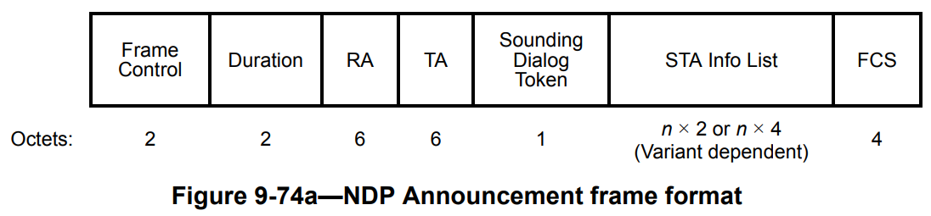
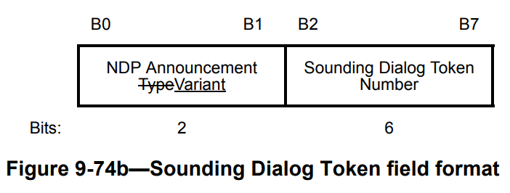
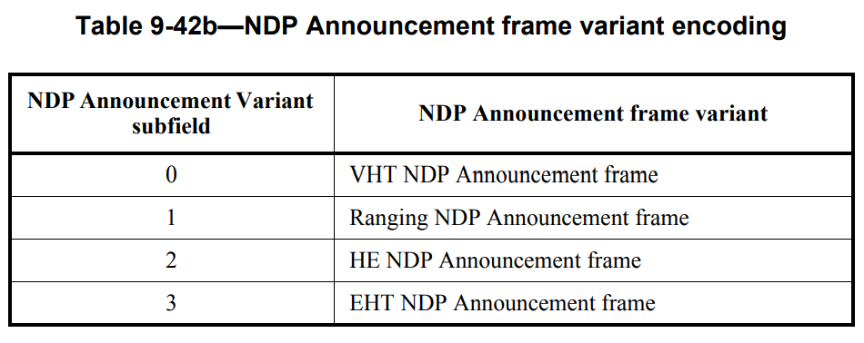
Background: NDPA Signaling Design
The NDP Announcement frame in the current 802.11 baseline is shown as follows.
The first two bits in the Sounding Dialog Token field have been used to indicate the NDP Announcement Variant of the NDPA frame
  The first two bits are already consumed to indicate 4 variants, VHT, Ranging, HE and EHT.
[Challenge]: There is no remaining space in the NDPA Announcement frame to indicate new variants like UHR and future NDPA frame versions.

Slide 3
Background: Co-BF Sounding Parameters
The sharing AP may share with the shared AP some info about how to transmit the NDP, such as:
  BW and punctured channel information.
  NLTF in NDP (P-matrix size).
  Starting stream index and number of spatial streams for shared AP in NDP.
  GI and UHR LTF Type.
  TXOP duration.
  …..
In this contribution, we extend the NDP Announcement frame to accommodate the UHR and beyond variants, as well as considering the Co-BF sounding parameters, as discussed next.

Slide 4
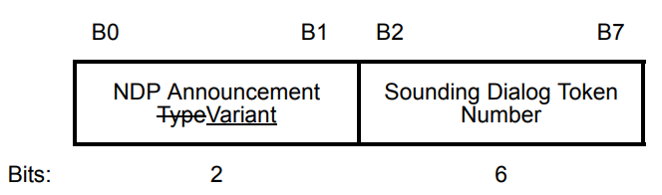
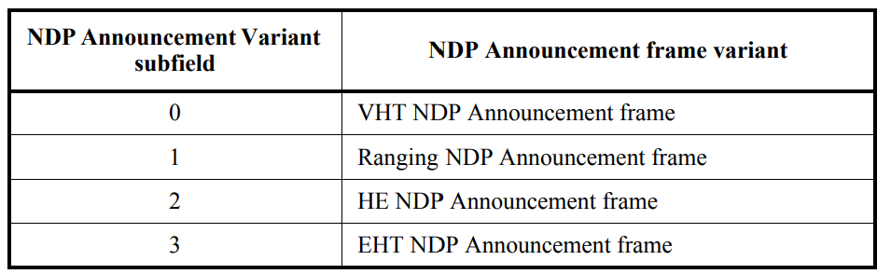


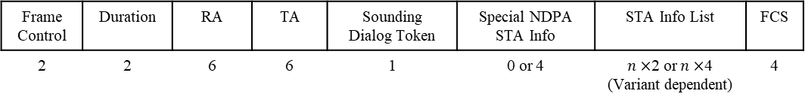

Proposed UHR NDPA Signaling Indication
Frame Control | Duration | RA | TA | Sounding Dialog Token | Special NDPA STA Info | STA Info List | FCS
2 | 2 | 6 | 6 | 1 | 0 or 4 | $n×$2 or $n×$4 (Variant dependent) | 4
Octets
or $UHR$
If the Sounding Dialog Token, with NDP Announcement Variant subfield equals zero, is followed by a STA Info field containing an AID between 1 and 2007, this NDPA frame corresponds to the VHT.
If the Sounding Dialog Token, with NDP Announcement Variant subfield equals zero, is followed by a STA Info field containing a “Special AID” greater than 2007 (e.g., a fixed value in the range of 2008 and 2047), the UHR STA will detect that this is a UHR NDPA frame.

Slide 5
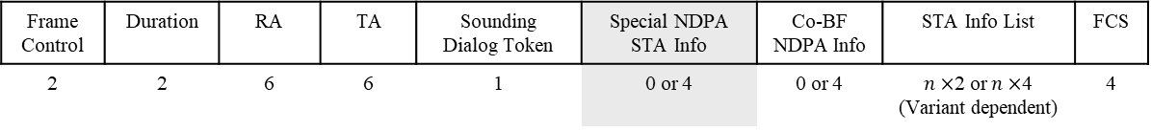
Option 1: Proposed UHR NDPA Signaling Design
Frame Control | Duration | RA | TA | Sounding Dialog Token | Special NDPA STA Info | Co-BF NDPA Info | STA Info List | FCS
2 | 2 | 6 | 6 | 1 | 0 or 4 | 0 or 4 | $n×$2 or $n×$4 (Variant dependent) | 4
Octets
B0 B11 | B12 B14 | B15 | B16 B26 | B27 | B28 B31
Special AID | NDPA Extended Variant Types | Co-BF NDPA Info Flag | Reserved or other TBD Info | Disambiguation | Reserved or other TBD Info
12 | 3 | 1 | 11 | 1 | 4
Bits
Indicate the presence of the Co-BF Info field
Value | NDPA Extended Variant
0 | UHR NDP Announcement Frame
1-7 | Reserved for future generations

Slide 6
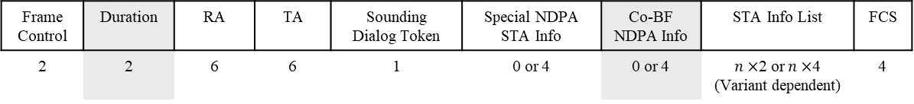
Option 1: Proposed UHR NDPA Signaling Design
Frame Control | Duration | RA | TA | Sounding Dialog Token | Special NDPA STA Info | Co-BF NDPA Info | STA Info List | FCS
2 | 2 | 6 | 6 | 1 | 0 or 4 | 0 or 4 | $n×$2 or $n×$4 (Variant dependent) | 4
Octets
TXOP Info may be interpreted from the Duration field
B0 B5 | B6 B10 | B11 | B12 B14 | B15 B17 | B18 | B19 B25 | B26 | B27 | B28 B30 | B31
Shared AP BSS Color | Punctured Channel Info | Disambiguation | Starting of SS | NSS | GI AND UHR-LTF Type | Tx EVM or other TBD Info | N_LTF | Disambiguation | BW | Sounding Type
6 | 5 | 1 | 3 | 3 | 1 | 7 | 1 | 1 | 3 | 1
Bits
Avoid the wrong detection of AID
Avoid the wrong detection of AID
Space made available
The Shared AP BSS Color (6 bits) is utilized to distinguish Co-BF NDPA Info across different shared APs, if applicable.
Other shorter AP identifiers may be used, allowing for additional bit savings.
  This frees up more space for incorporating more control information parameters (if needed) to be shared with the Shared AP within “one STA Info field”.

Slide 7
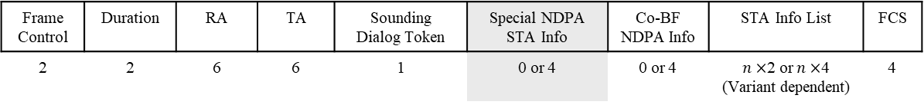
Option 2: Proposed UHR NDPA Signaling Design
Frame Control | Duration | RA | TA | Sounding Dialog Token | Special NDPA STA Info | Co-BF NDPA Info | STA Info List | FCS
2 | 2 | 6 | 6 | 1 | 0 or 4 | 0 or 4 | $n×$2 or $n×$4 (Variant dependent) | 4
Octets
TXOP Info may be interpreted from the Duration field
B0 B11 | B12 B14 | B15 | B16 B18 | B19 B21 | B22 B26 | B27 | B28 | B29 B31
Special AID | NDPA Extended Variant Types | Co-BF NDPA Info Flag | Reserved | BW | Punctured Channel Info | Disambiguation | Sounding Type | Reserved
12 | 3 | 1 | 3 | 3 | 5 | 1 | 1 | 3
Bits
In option 2, some Co-BF Info parameters can be included in the Special NDPA STA Info field.
This saves more space at the Co-BF NDPA Info field to accommodate additional control information, if needed.

Slide 8
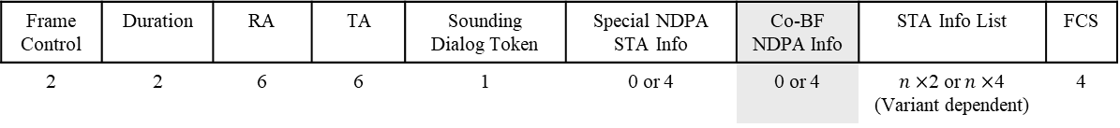
Option 2: Proposed UHR NDPA Signaling Design
Frame Control | Duration | RA | TA | Sounding Dialog Token | Special NDPA STA Info | Co-BF NDPA Info | STA Info List | FCS
2 | 2 | 6 | 6 | 1 | 0 or 4 | 0 or 4 | $n×$2 or $n×$4 (Variant dependent) | 4
Octets
TXOP Info may be interpreted from the Duration field
B0 B5 | B6 B8 | B9 B10 | B11 | B12 B14 | B15 B21 | B22 B24 | B25 B26 | B27 | B28 B31
Shared AP BSS Color | Starting of SS | GI AND UHR-LTF Type | Disambiguation | NSS | Tx EVM or other TBD Info | Reserved or other TBD Info | N_LTF | Disambiguation | Reserved or other TBD Info
6 | 3 | 2 | 1 | 3 | 7 | 3 | 2 | 1 | 4
Bits

Slide 9
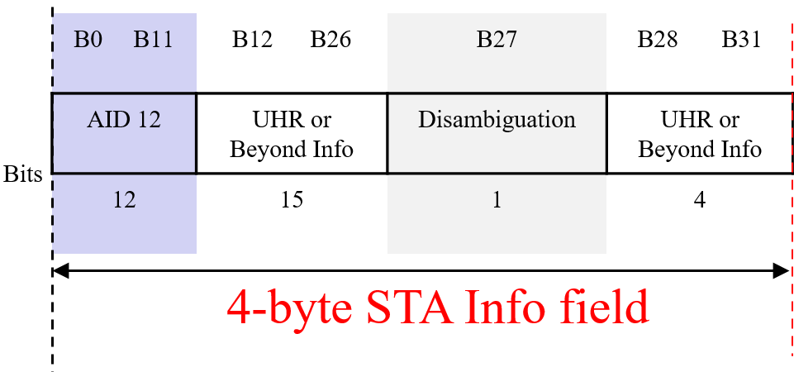
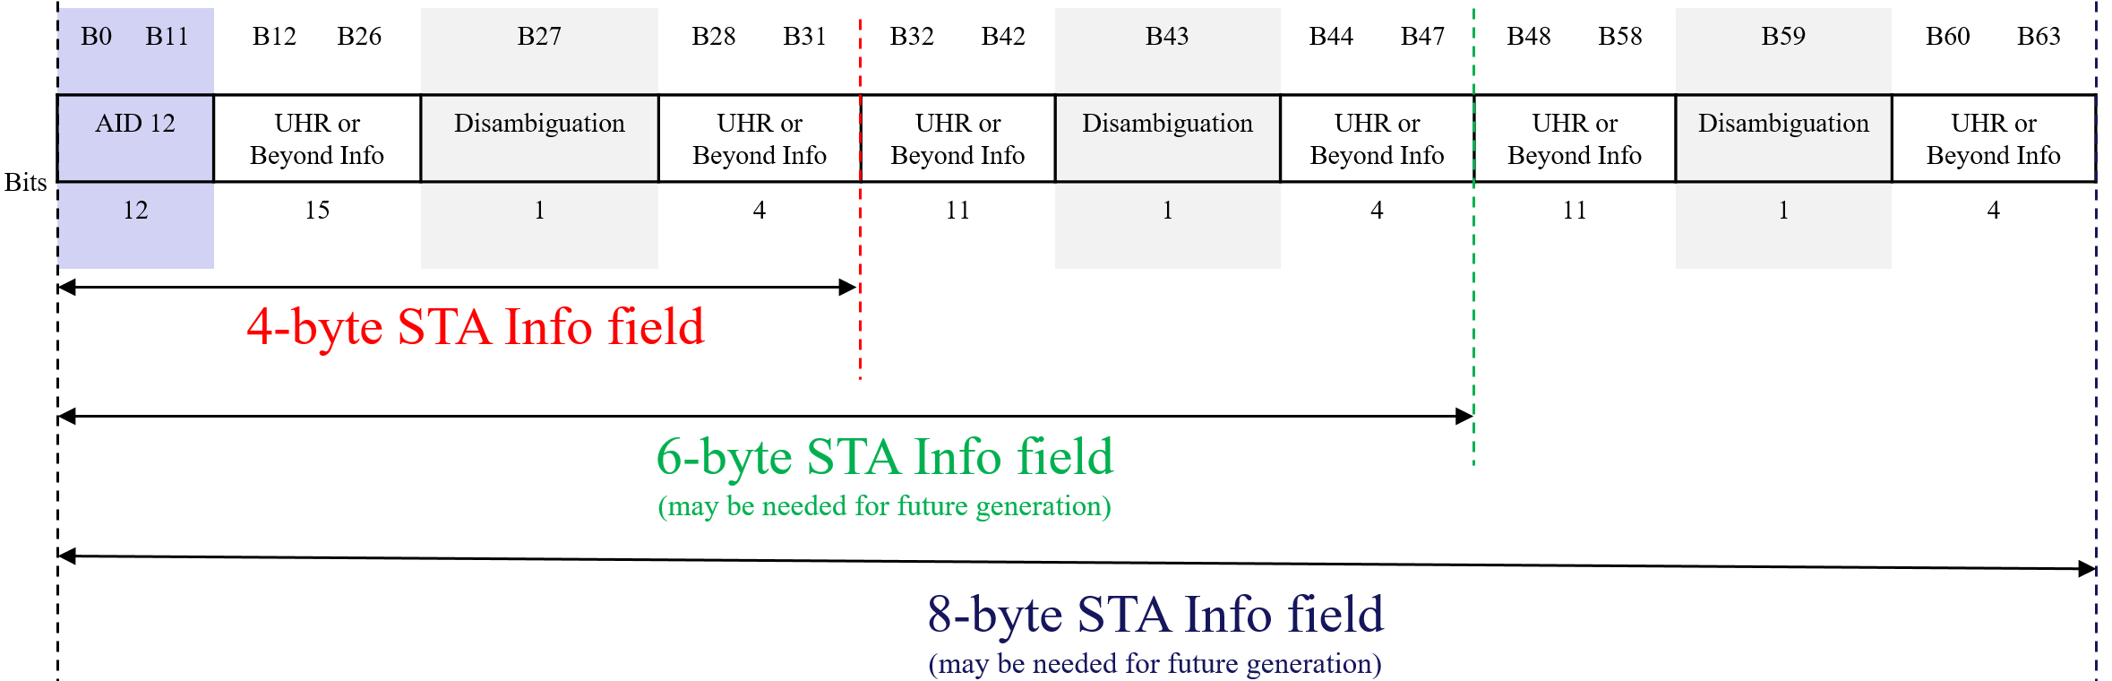
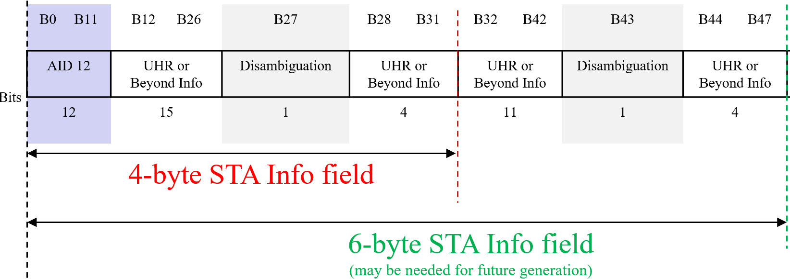
STA Info field Size (1/2)
An advantage of accommodating the UHR and future NDPA variants indication alongside the VHT variant is:
  it allows for easy extension of the STA Info field size to 2×K bytes (with K = 2, 3, 4, …) if needed, especially for future generations.
    This only requires setting each Disambiguation bit to 1 to avoid wrong AID detection by VHT devices.

Slide 10
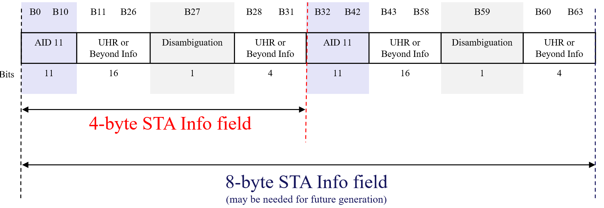
STA Info field Size (2/2)
Accommodating the UHR and future NDPA variants indication with HE or EHT variants presents challenges for expanding the STA Info field, if needed to meet future generational needs, as these variants use AID 11.
Specifically, STA Info field size could only expand in multiples of 4×K bytes (where K = 2, 3, 4, …).
Additionally, after every 4 bytes, the first 11 bits must repeat the same AID found in the initial 11 bits of the STA Info field to prevent misinterpretation by legacy HE/EHT STAs, leading to significant bit wastage.
  For example, expanding the STA Info field to 8 bytes for future needs would result in 13 bits of the 64-bit field being used to avoid AID detection issues, compared to only 3 bits required for disambiguation with VHT STAs in our preferred design.
Avoid wrong AID detection by HE/EHT STAs
Avoid wrong AID detection by VHT
STAs

Slide 11
Summary
In this contribution, we extended the NDP Announcement frame to accommodate the UHR and beyond variants, as well as considering the Co-BF sounding parameters.
Particularly, we propose indicating UHR and Beyond NDPA variants alongside the VHT variant by setting the value of NDPA Variant subfield in the Sounding Dialog Token field to 0.
If the Sounding Dialog Token (with NDPA Variant = 0) is followed by a STA Info field containing:
  an AID12 in the range 1-2007, the NDPA frame corresponds to VHT.
  a “Special AID” (e.g., fixed value between 2008-2047), the UHR STA recognizes this as a UHR NDPA frame.
Benefits of VHT Variant Usage for UHR and Beyond NDPA Variants Indication:
  This simplifies STA Info field expansion to 2×K bytes (where K = 3, 4, …), if needed, enabling future scalability by simply setting every disambiguation bit to 1.
  Shared AP BSS Color (6 bits) or other “shorter” AP IDs can be used to distinguish the Co-BF NDPA Info field across different APs, freeing space for more control info, instead of using the first 11 or 12 bits for the shared AP ID.

Slide 12
References
Junghoon Suh, et. al., “11-21/1977r0 NDPA for Future Amendments”.
Sameer Vermani, et. al., “11-24/1542r3 Sounding Schemes for Coordinated Beamforming”.
IEEE P802.11-REVme/D5.0
IEEE P802.11be/ D5.0

